Slide 1
California
Interactive Quiz
for 8-11 Forms
Автор:
Ольга Михайловна Степанова
учитель английского языка
МБОУ «Цивильская СОШ №2»
города Цивильск
Чувашской Республики
2015

Slide 2
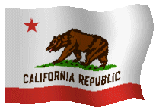
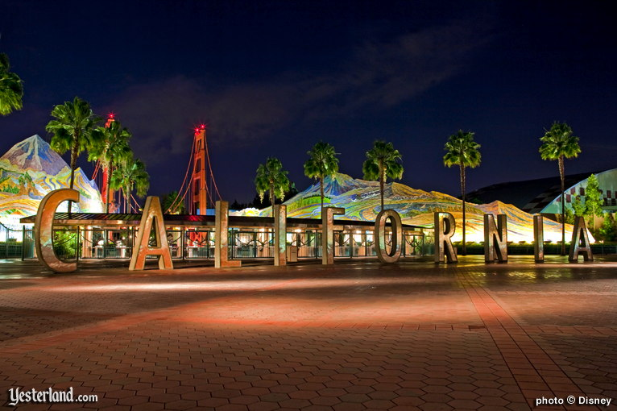
Welcome
to California!
How well do you think you know Alabama state? This quiz will help you to know some facts about one of the beautiful states of the USA!

Slide 3
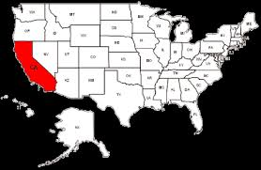
Ready? Steady? Go!

Slide 4
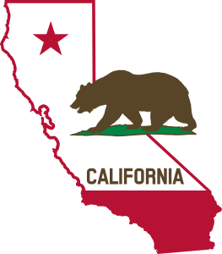
The … State is the nickname of California.
sunny, golden, silver
Golden

Slide 5
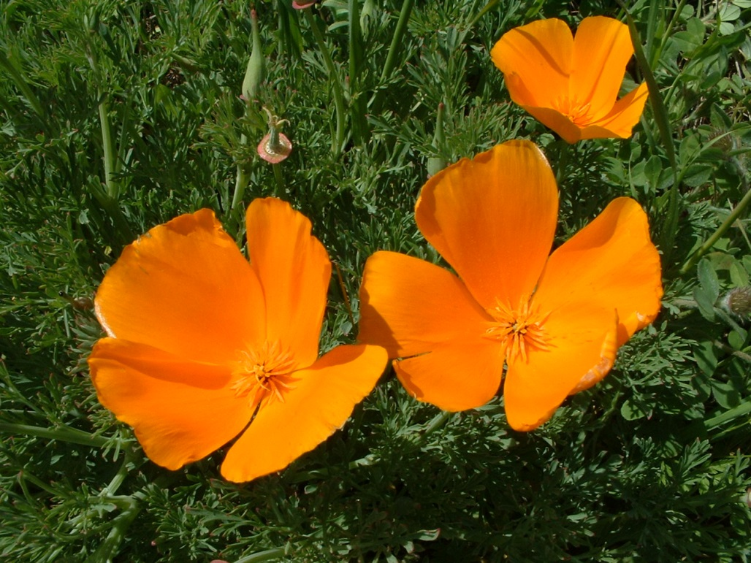
California celebrates its official flower day every year, April 6 when it is California … Day
poppy, rose, peony
Poppy

Slide 6
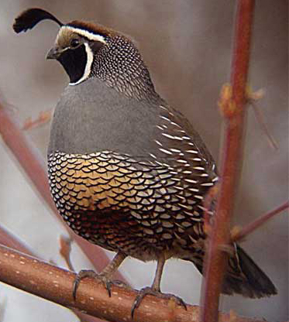
The California valley …,
the official state bird, is known for its hardiness and adaptability, and being a plump bird, smaller than a pigeon, with a distinctive black plume on its head.
flamingo, quail, pegeon
quail

Slide 7
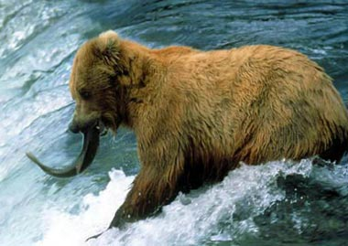
The California grizzly … was designated as the official state animal of California in 1953
monkey, bear, tiger
bear

Slide 8
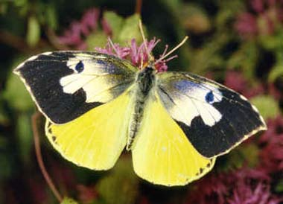
The California … butterfly is found only in California since 1929.
dogface, dogeye, dogears
dogface

Slide 9
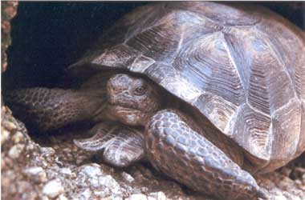
California recognized the desert … as the official state reptile in 1972.
tortoise
chameleon
crocodile
tortoise

Slide 10
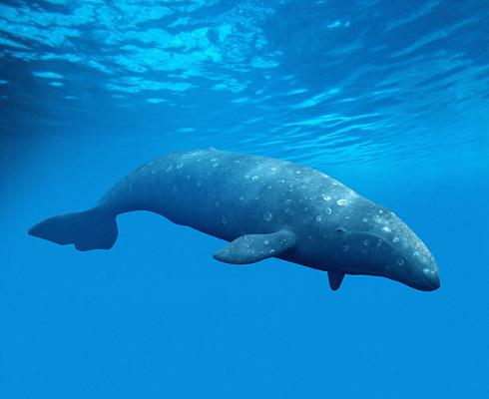
The California state marine mammal gray … measures 35 to 50 feet in length and 20 to 40 tons in weight.
shark, dolphin, whale
whale

Slide 11
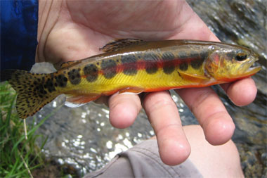
The official state fish of California the golden … is native to California, originally found only in a few icy streams of the headwaters of the Kern River.
tusk, redfish, trout
trout

Slide 12
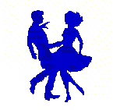
The … dance is the official dance of California
Foxtrot
Flamenco
Square
Square

Slide 13
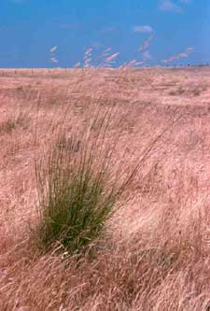
A widespread, native perennial bunchgrass - Purple … - was designated the official state grass of California in 2004.
timothy
clover
needlegrass
needlegrass

Slide 14
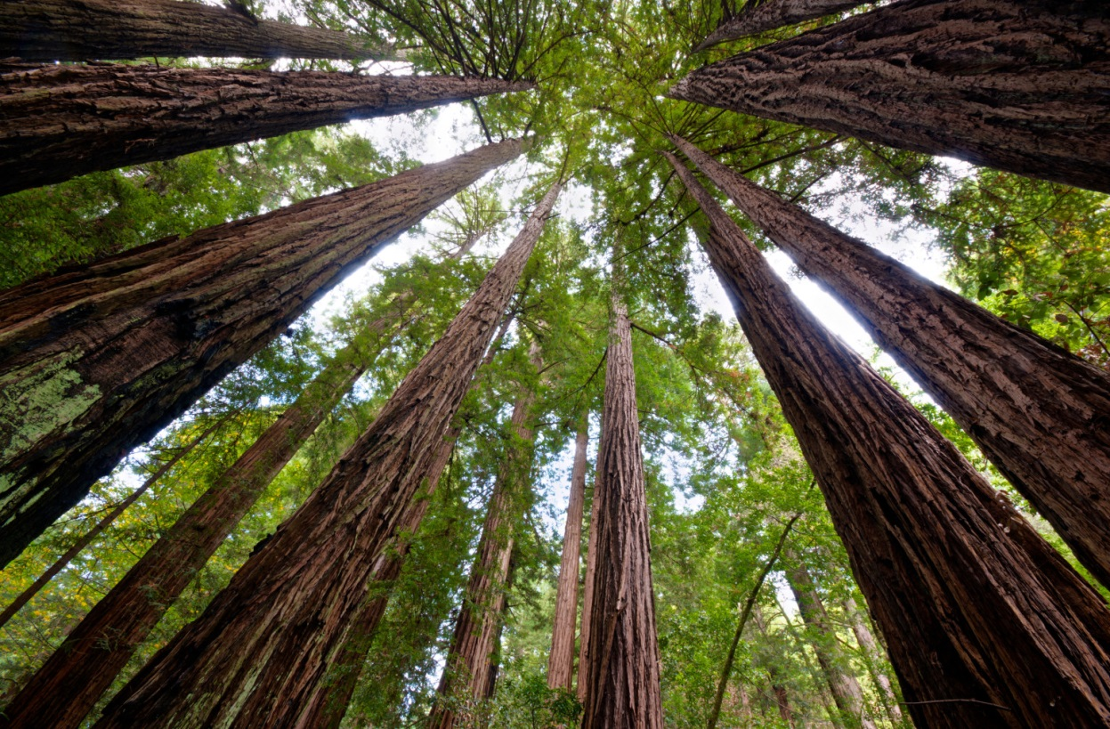
California designated … as the official state tree in 1937
redwood
birch
rowan-tree
redwood

Slide 15
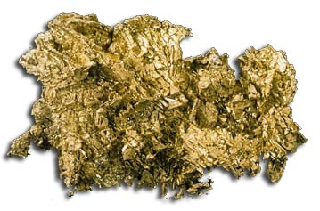
… is an element with the chemical symbol Au (from the Latin word aurum - "shining dawn") and is the official mineral of California.
calcite, copper, gold
Gold

Slide 16
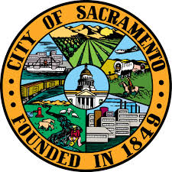
The capital of California is … .
Sacrameno
Los Angeles
San Francisco
Sacramento

Slide 17
Great Job!
California Now Welcomes You!

Slide 18
The End

Slide 19
Sources
http://www.statesymbolsusa.org/California/mineral_gold.html

