Slide 1
Colorado
Interactive Quiz
for 8-11 Forms
Автор:
Ольга Михайловна Степанова
учитель английского языка
МБОУ «Цивильская СОШ №2»
города Цивильск
Чувашской Республики
2015

Slide 2
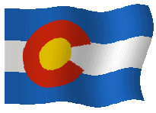
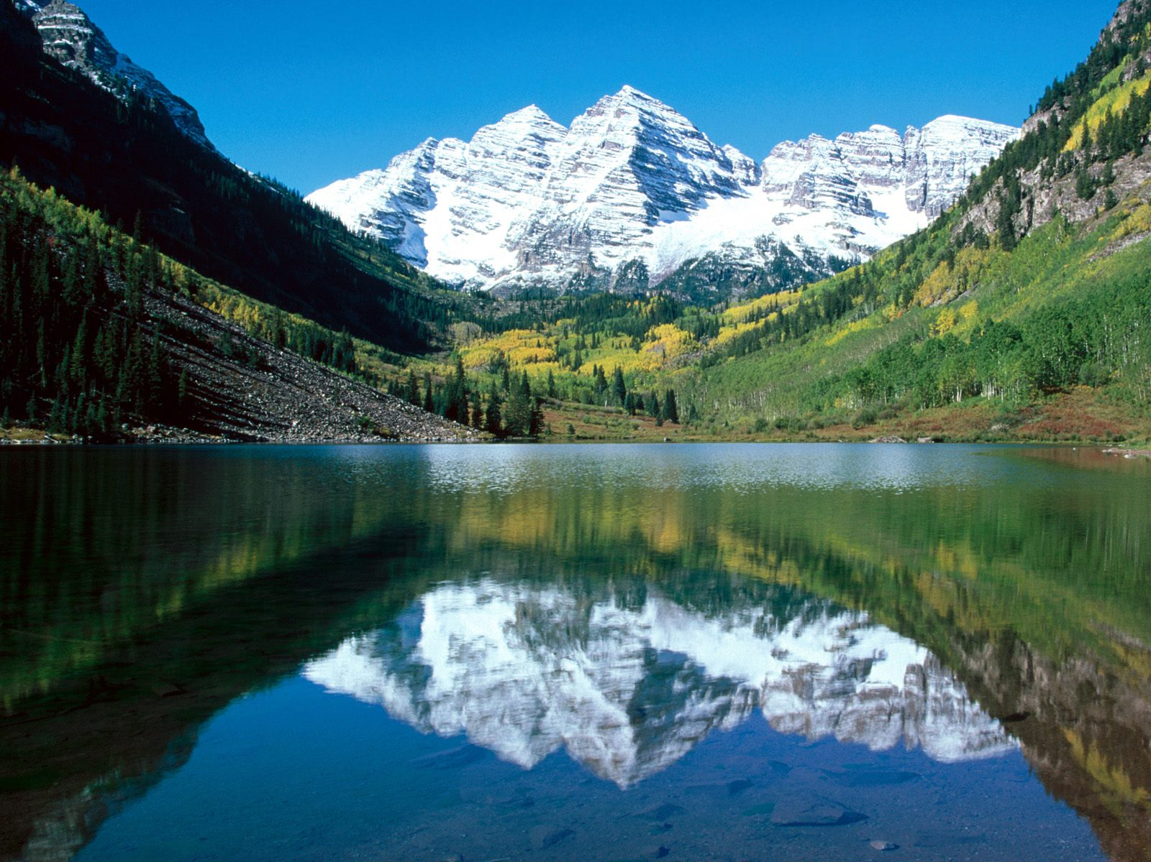
Welcome to Colorado!
How well do you think you know Colorado state? This quiz will help you to know some facts about one of the beautiful states of the USA!

Slide 3
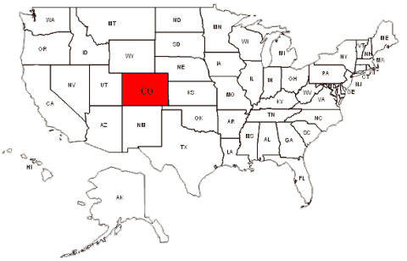
Ready? Steady? Go!

Slide 4
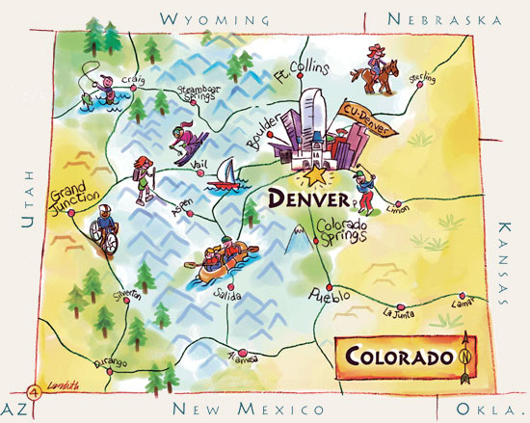
Colorado became the 38th state of the United States in 1876 - one hundred years after the signing of the Declaration of Independence and its nickname is … State.
centennial, bright, strange
centennial

Slide 5
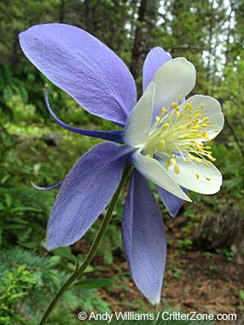
The official state flower of Colorado since 1899, the Rocky Mountain … is a lovely flower with a rich aroma to attract bees, hummingbirds and butterflies to it's nectar. .
columbine, iris, tulip
columbine

Slide 6
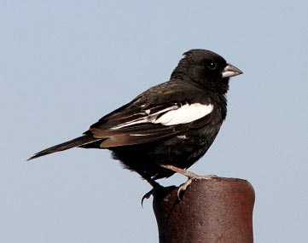
Colorado State Bird is the migratory … bunting since 1931.
lark, sparrow, dove
lark

Slide 7
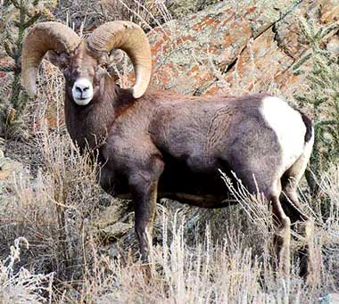
The magnificent Rocky Mountain bighorn … named for their massive, curling horns, is the official state animal of Colorado since 1961..
goat, sheep, bull
sheep

Slide 8
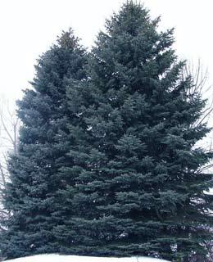
Known for its stately, majestic, symmetrical form and its beautiful silver-blue color, the Colorado blue … is the official state tree of Colorado since 1939 .
spruce, palm, cypress
spruce

Slide 9
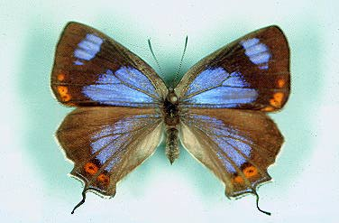
The Colorado hairstreak … was designated the official state insect of Colorado in 1996.
beetle, butterfly, cricket
butterfly

Slide 10
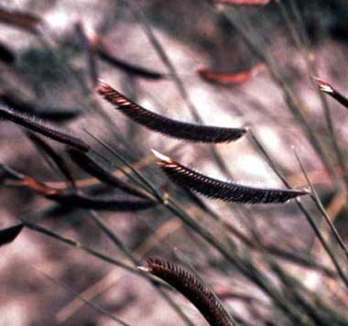
… Grama grass was designated the official state grass of Colorado in 1987 .
red, yellow, blue
Blue

Slide 11
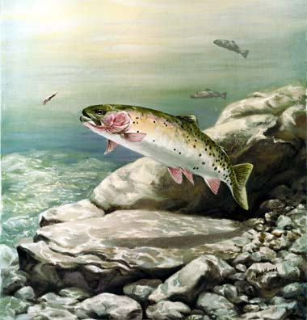
The greenback cutthroat … was designated the official state fish of Colorado in 1994.
scat, snook, trout
trout

Slide 12
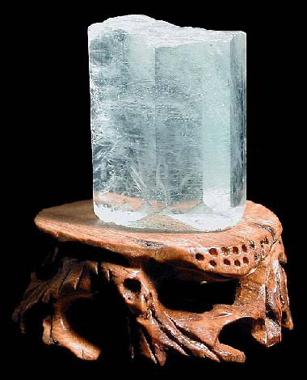
… was recognized officially as the state gemstone of Colorado in 1971.
Aquamarine
Opal
Diamond
aquamarine

Slide 13
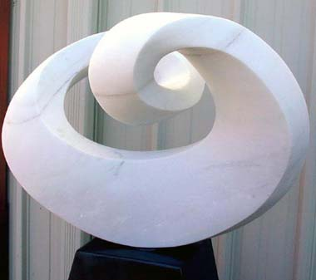
The exterior of Lincoln Memorial is yule… , the official rock of Colorado.
dolomite
marble
quartzite
marble

Slide 14
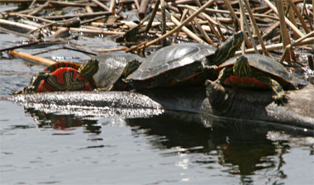
The western painted … is the official state reptile of Colorado since 2008
turtle, snake, lizard
turtle

Slide 15
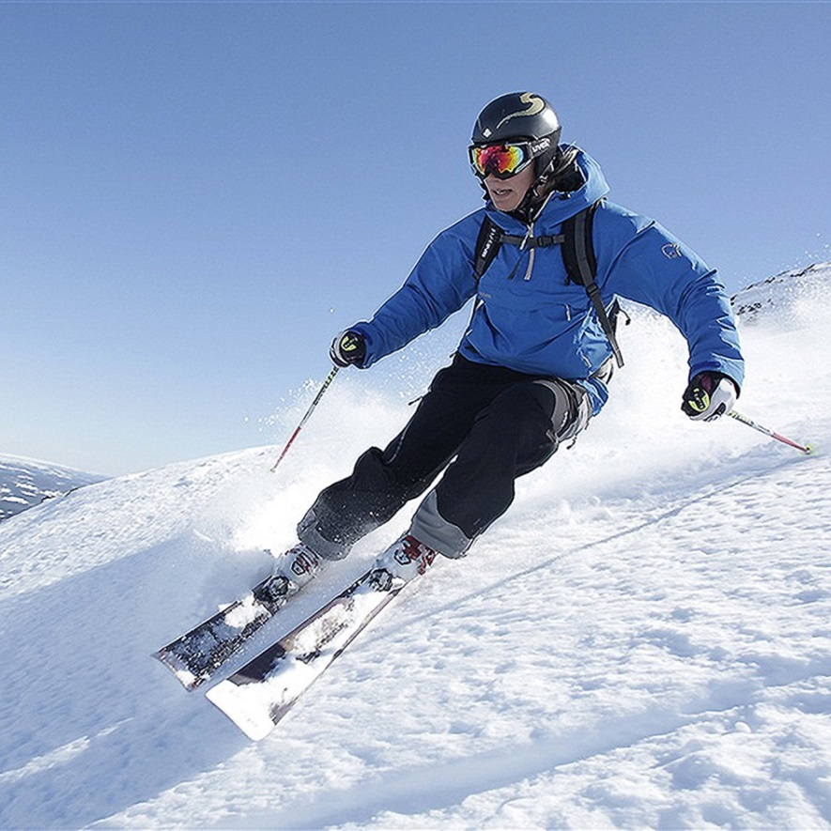
The official recreational sports of Colorado are snowboarding and … since 2008.
skiing
skating
ice hockey
skiing

Slide 16
The capital of Colorado is … .
Aurora
Lakewood
Denver
Denver

Slide 17
Great Job!
Colorado Now Welcomes You!

Slide 18
The End

Slide 19
Sources
http://www.statesymbolsusa.org/Colorado/statesymbols.html

