Slide 1
Сочинение по английскому языку
Сказка
The Prince and a Nice Girl
Работу выполнил
Зыкин Иван
4М класс
ГБОУ «Школа №106»
Учитель английского языка
Шайдурова Валентина Федоровна
Санкт-Петебург
2015

Slide 2
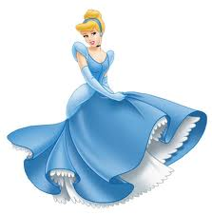
The Prince and a Nice Girl

Slide 3
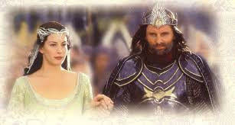
Once upon the there lived
a king and a queen.

Slide 4
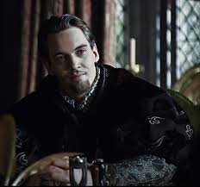
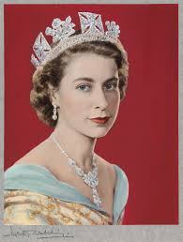
The king \The king was angry and stupid but
the queen was good and smart.
The had two daughters.
s angry and stupid but The king was angry and stupid

Slide 5
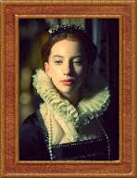
The first daughter
was smart and nice.
the second daughter
was very angry as the king.
but

Slide 6
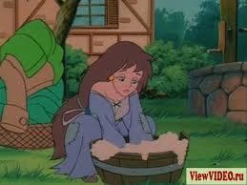
One day the queen died.
The king loved only his first daughter
and hated the second daughter.
He always made her to do hard work.

Slide 7
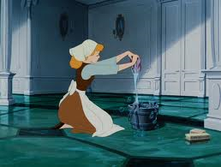
But the girl wasn’t angry with her dad
and she was still good and nice.

Slide 8
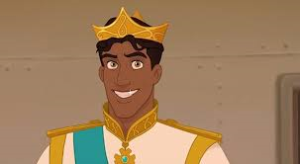
One day she walked in the wood and
she met a beautiful prince and fell in love.

Slide 9
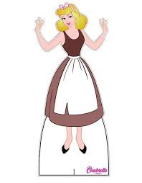
One day the prince had the ball and
the second daughter came to that ball.
The Prince saw her and fell in love too.

Slide 10
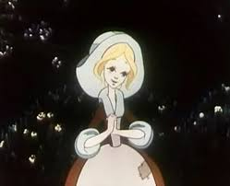
And he didn’t see her dirty dress and tired hands.

Slide 11
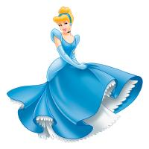
He saw a beautiful girl and married her.

