Slide 1
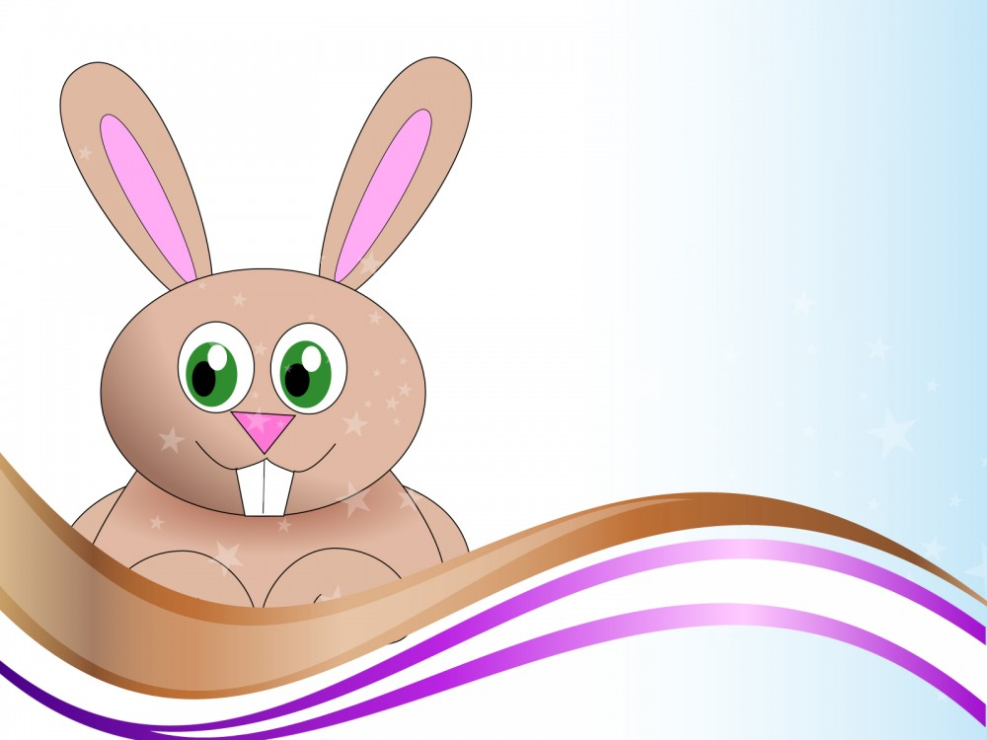
Pets, pets, pets…
Reading Test
English 3
Made by
Olga Stepanova
Tsivilskaya Secondary School #2
Tsivilsk
Chuvashia, Russia
2015

Slide 2
Fill in the table with the appropriate words
1
2
3
4
5
6
7
8
9
10

Slide 3
1. Tim and Jack …
a rabbit at school.
look
keep
love

Slide 4
2. They keep the rabbit in a … .
bag
box
cage

Slide 5
3. The rabbit sometimes plays on the … .
grass
bench
table

Slide 6
4. Rabbits like … green food.
drinking
eating
cooking

Slide 7
5. Children give … to the rabbit.
water
milk
juice

Slide 8
6. Nick and Bill keep a hamster at … .
farm
home
school

Slide 9
7. Hamsters sometimes … away.
skip
run
jump

Slide 10
8. But their hamster … got a very good cage .
have
has
hasn’t

Slide 11
9. The hamster runs and … in the cage.
falls
cries
jumps

Slide 12
10. The hamster likes sleeping all … long .
morning
night
day

Slide 13
1 | keep
2 | cage
3 | grass
4 | eating
5 | water
6 | school
7 | run
8 | has
9 | jumps
10 | day
Keys
Ключи

Slide 14
Тест составлен по УМК «Английский язык» для 3 класса.
Авторы - В.П. Кузовлев, Н.М. Лапа, И.П. Костина, Е.В. Кузнецова .
Учебник , Часть 2, стр 41: Раздел 7, Урок 4.

