Slide 1
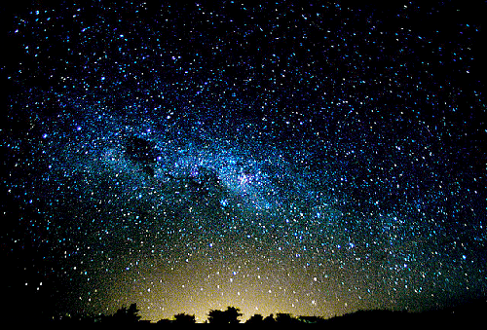
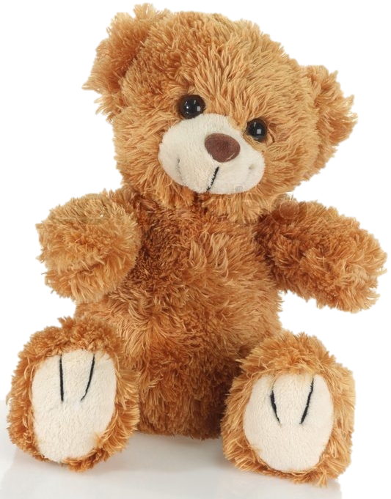
This Lovely Teddy Bear
Познавательная лекция
про самую любимую мягкую игрушку всех детей
на английском языке
для учащихся 7-10 классов
Автор:
Ольга Михайловна Степанова
Учитель английского языка
МБОУ «Цивильская СОШ №2
Чувашской Республики
2015

Slide 2
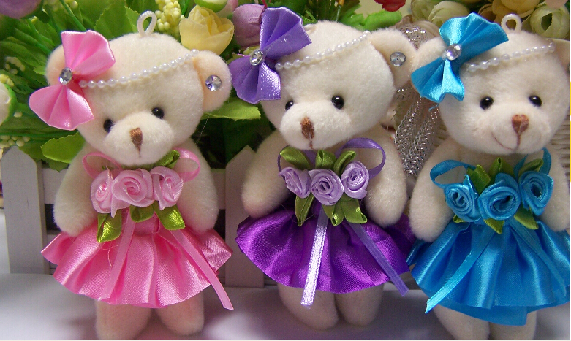
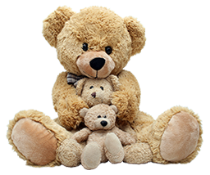
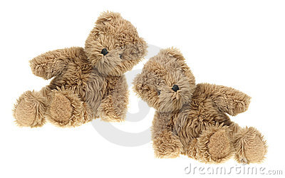
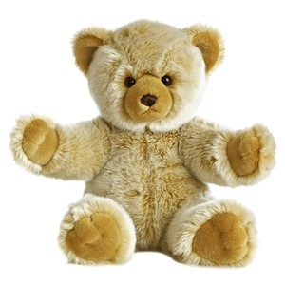
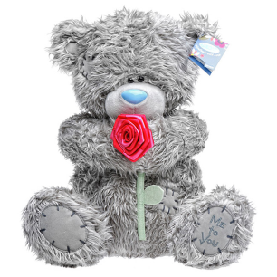
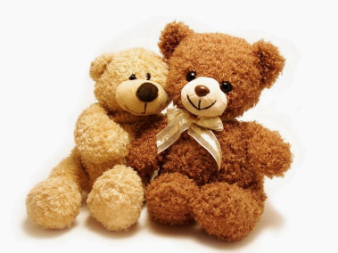
The most favorite toy of all times

Slide 3
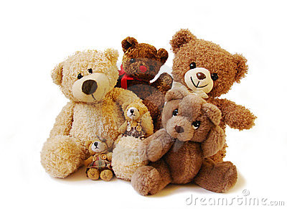
Teddy bears are among the most popular gifts for children around all over the world.

Slide 4
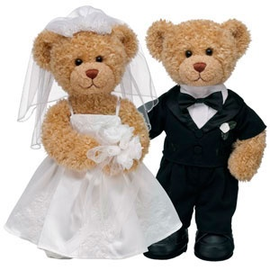
Teddy Bears are often given to adults to signify love, congratulations, or sympathy.

Slide 5
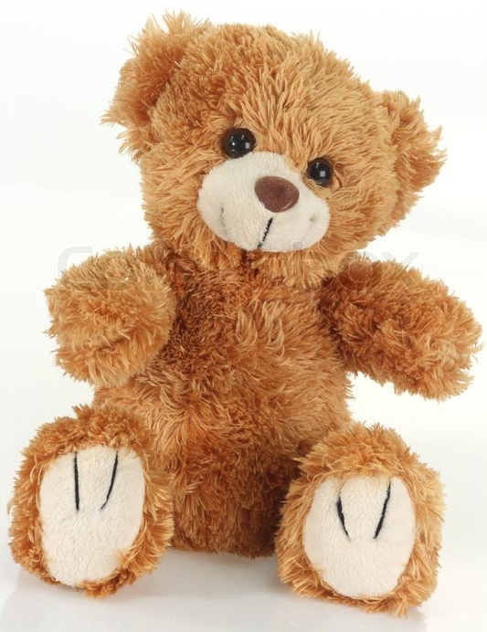
The teddy bear is a soft toy in the form of a bear. Stuffed toys can be made from a variety of materials. Most common is cotton, which usually makes the bulk of the toy if not all of it. Polyester may be mixed in with the cotton, or the whole toy may be made of it. There are bears made of silk, and even real animal fur. Fiber fill or plastic beads can make the filling.

Slide 6
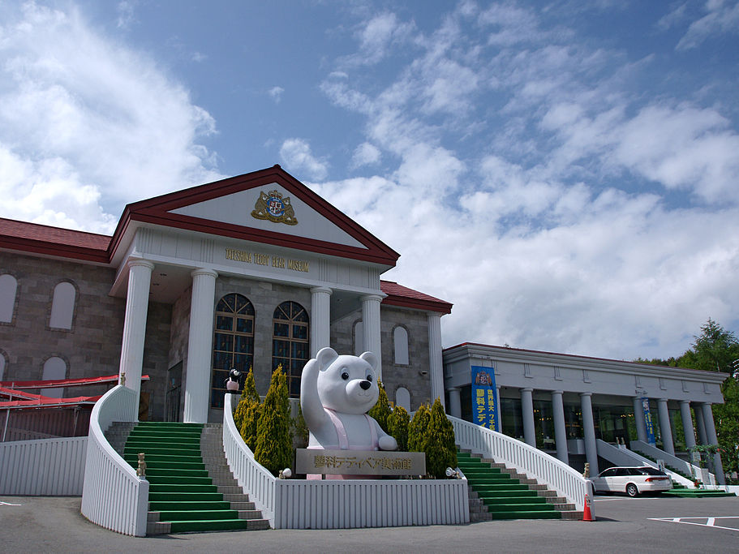
A teddy bear museum is a museum about teddy bears. There are many teddy bear museums around the world. This one is Tateshina Teddy Bear Museum, Tateshina, Nagano, Japan
You can view more than 5,000 teddy bears collection from around the world.

Slide 7
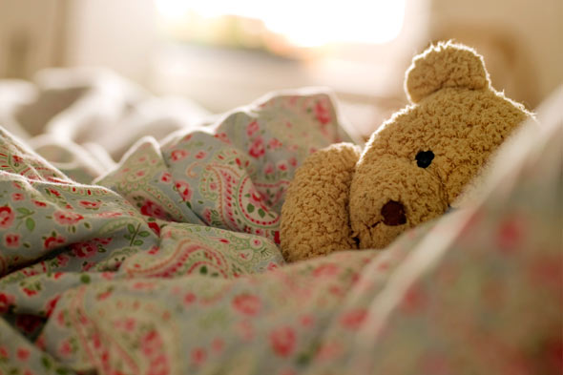
The world's first Teddy Bear Museum was based in Petersfield, Hampshire, England, It was founded by Judy Sparrow in 1984, and housed a collection of antique teddy bears and related items. It was closed in 2006.

Slide 8
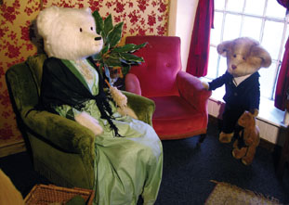
The Dorset Teddy Bear Museum is a teddy bear museum in Dorchester, Dorset, southern England.
The museum includes Teddy Bear House and displays antique and other teddy bears. Bears on display include Paddington Bear, Rupert Bear, and Winnie the Pooh.[3] The earliest bear dates from 1906 and there are also life-sized bears.
The Dorset Teddy Bear Museum admission charges: Adults £5.99, Children £3.99, Family (2ad+2ch) £17.99, Children under three - free.

Slide 9
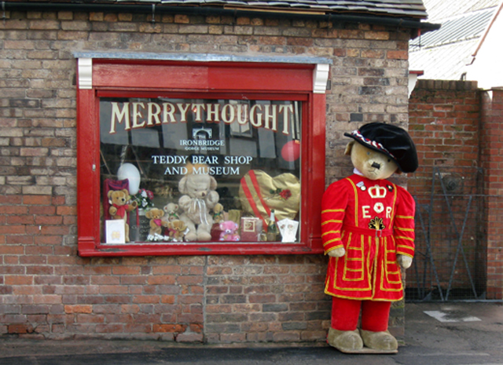
Merrythought is a toy manufacturing company established in 1930 in the United Kingdom. The company specialises in soft toys, especially teddy bears.
It is the last remaining British teddy bear factory to still make its products in Britain and is located at Ironbridge in Shropshire.

Slide 10
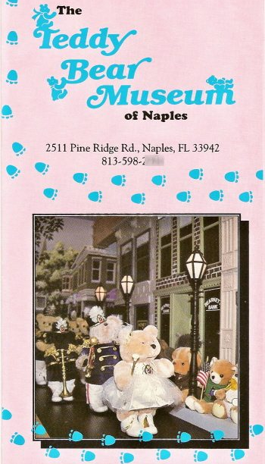
The Teddy Bear Museum of Naples began with a Christmas present: a stuffed M&M'S teddy bear given to Frances Pew Hayes by one of her grandchildren in 1984. Hayes liked the M&M'S Bear so much she began to collect more bears…
Hayes died on May 15th, 2004, at the age of 85. As happens with many museums founded in the passion of a single collector, the Teddy Bear Museum of Naples did not long survive its benefactor; it closed in 2005 and the collection was sold off.

Slide 11
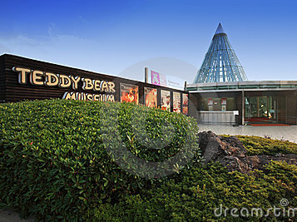
The Jeju Teddy Bear Museum (South Korea) opened on April 24, 2001. Here you can find everything you want to know about Teddy Bears! It contains two galleries, a museum gift shop, and a museum cafe.

Slide 12
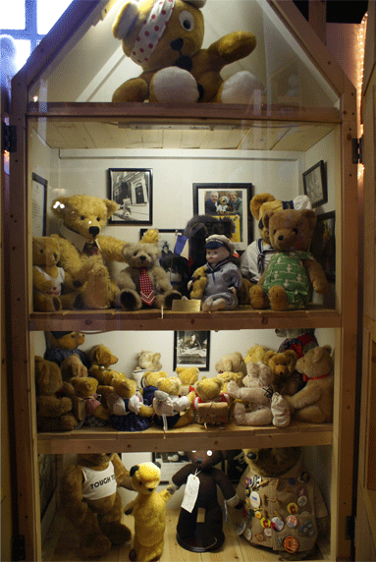
After 18 years in Stratford-upon-Avon, a small selection from the award-winning Teddy Bear Museum has moved to…. 240 The Broadway, Wimbledon, London
...Polka is the perfect home in which to display a few of the stars of the Teddy Bear Museum's unique collection.
Each year Polka introduces 100,000 children and their families to the magic of theatre. Polka is a place where the whole family comes together in a fantastic child-friendly environment – watching plays, reading in the book corner, having fun in the playground, and now meeting some of the teddy bears from the Teddy Bear Museum.

Slide 13
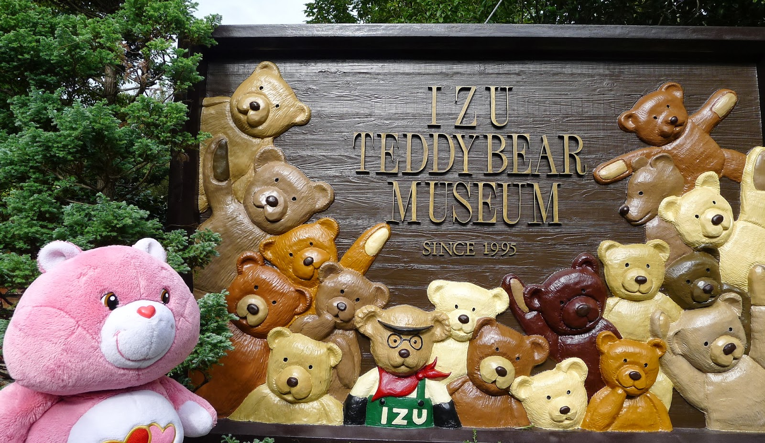
The Izu Teddy bear museum (Japan) collects and displays Teddy bears from all over the world. Many antique bears and beautiful artist bears await you in our old English style museum.
Our star bear is a Guiness world records holder, the Teddy Girl. We also have fantastic animated dioramas, "Teddy bears' factory," "Teddy bear express," and "Bears' amusement park in the wood."
A Fantastic Place!

Slide 14
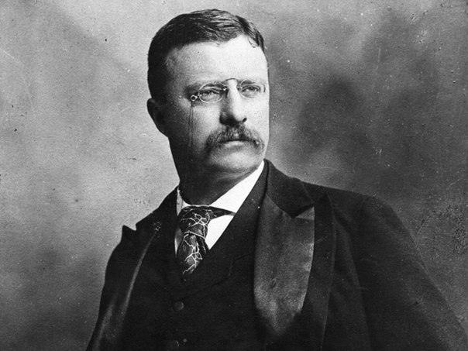
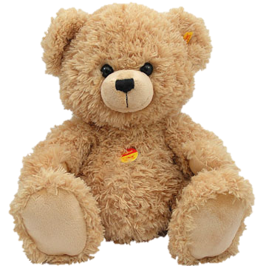
One of the world’s most beloved toys was named in honor of the 26th President Theodore Roosevelt

Slide 15
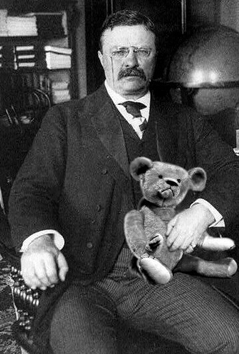
How did toy bears come to be named after President Theodore Roosevelt?

Slide 16
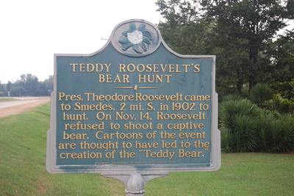
The history of the teddy bear date back to 1902. President Theodore Roosevelt was on a hunting trip in Mississippi but had been unable to shoot a bear.
Guides clubbed a bear and tied it to a tree then invited the president to shoot it; instead, Roosevelt, an avid outdoorsman and hunter, declined, saying it would be unsportsmanlike to kill a defenseless animal that way.
This act gained
a lot of love and respect
from Americans.

Slide 17
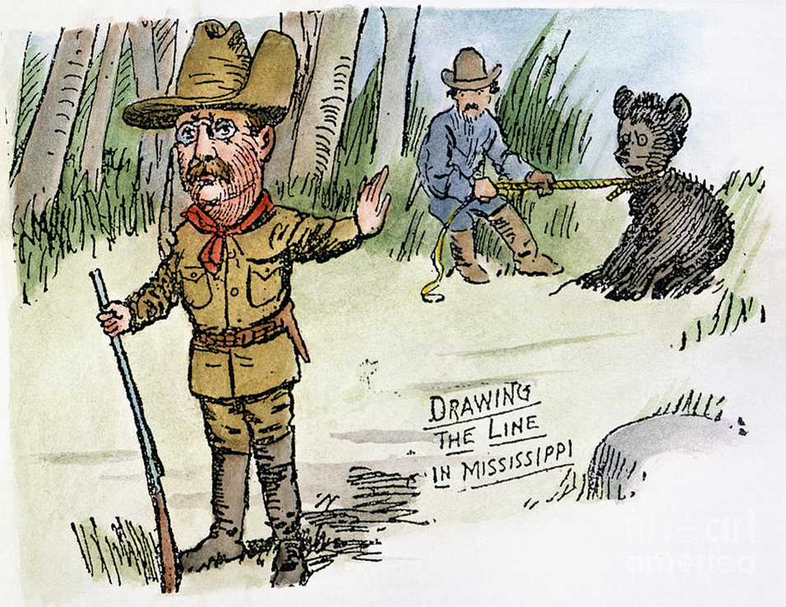
The incident was immortalized in the Washington Post with a cartoon by Clifford Berryman showing Roosevelt, his gun in front of him with the butt resting on the ground and his back to the animal, gesturing his refusal to make the shot.
To shoot it?
It’s unsportsmanlike!

Slide 18
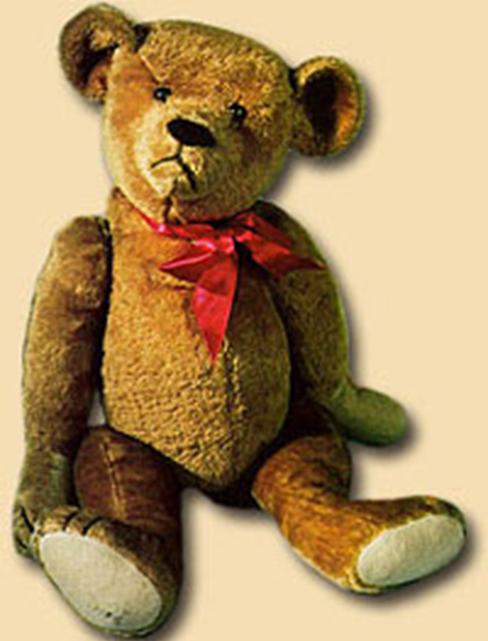
A Brooklyn, New York, candy maker named Morris Michtom decided to do something to commemorate the event and honor the President. He asked his wife Rose to create a stuffed bear, and she made one from extra pieces of plush mohair material, with shoe button eyes and embroidered detail for the mouth. Snout, ears, moveable arms and legs, all were a part of this original version/prototype. On November 21st, 1902, after his wife had put the finishing touches on the animal, he took it to his candy store and, in his store’s front window, placed the bear on top of a mountain of wrapped chocolate candies. Next to the display he placed a hand printed card with the words “Teddy Bear” on it.

Slide 19
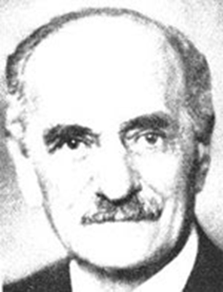
Customers and passersby loved the display and people came from great distances to see the new and unique item in the candy store window. Legend has it that Mr. Michtom asked his wife Rose to produce copies of the original bear to sell to customers in his candy store who had offered to buy the bear from him. But, he wondered, would not the President be offended at the use of his name, without permission, on a commercial product? So Michtom took the bear out of the store’s window, packed it into an old candy box along with a letter to President Roosevelt and mailed it to the White House. Michtom wrote, “Dear Mr. President: I do not wish to seem disrespectful, but I would like to call my toy ‘Teddy’s Bear.’” The President was charmed by the cuddly stuffed animal and responded to Michtom by writing, “I don’t think my name is worth much to the toy bear cub business, but you are welcome to use it.”
Morris Michtom, the owner of a candy store in 1902.

Slide 20
Nowadays, everyone knows these toys as Teddy Bears, but few people know that they were named after President Theodore “"Teddy"” Roosevelt.

Slide 21
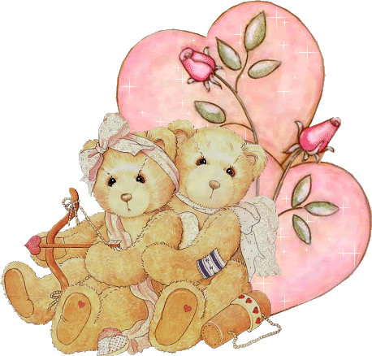
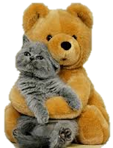
Enjoy teddy bears!

Slide 22
Источники:
http://s1.hubimg.com/u/782196_f520.jpg
http://images.fineartamerica.com/images-medium-large/t-roosevelt-teddy-bear-granger.jpg
http://en.wikipedia.org/wiki/Merrythought
http://www.lostparks.com/teddybear.html
http://www.lifeinkorea.com/travel2/cheju/407
http://www.theteddybearmuseum.com/
http://www.dreamstime.com/royalty-free-stock-photos-jeju-teddy-bear-museum-image16303938
http://www.sun-arrow.com/eng_itm.html
http://en.wikipedia.org/wiki/Teddy_bear_museum
http://img21.dreamies.de/img/82/b/x3gjx1ublc2.gif
http://www.rjohnwright.com/images/newreleases/mississippi.jpg
http://www.history.com/news/ask-history/who-invented-the-teddy-bear
http://historyspaces.blogspot.ru/2012/01/short-history-of-teddy-bear-how.html

