Slide 1
Rose, My Sister
Reading Test
Enjoy English 3
Unit 3 Lesson 49
Made by
Olga Stepanova
Tsivilskaya Secondary School #2
Tsivilsk
Chuvashia
2015

Slide 2
Andrew has got … sister.
a
-
the

Slide 3
2. Her name … Rose.
are
is
am

Slide 4
3. Rose is nice … kind.
or
but
and

Slide 5
4. Rose … a lot of toys.
have got
has got
haven’t got

Slide 6
5. She has got one … .
bike
ball
doll

Slide 7
6. She likes to draw and play … her toys.
without
for
with

Slide 8
7. Rose is a … girl.
bad
sad
smart

Slide 9
8. She likes to … a lot of questions.
answer
ask
read

Slide 10
9. Rose asks mum, dad, and Andrew her questions every … .
week
day
month

Slide 11
10. Many of her questions are … .
funny
sunny
tiny

Slide 12
11. Rose asks questions in the morning and in the … .
January
evening
afternoon

Slide 13
12. Her question is:
… are the flowers
beautiful?
When
Where
Why

Slide 14
13. Her question is:
… elephants go to school?
Do
Does
Don’t

Slide 15
14. Her question is:
… does Santa Claus live?
When
Where
Why

Slide 16
15. Her question is:
… is Tiny’s birthday?
When
Where
Why

Slide 17
16. Her question is:
… is a teddy bear’s
name?
When
Where
What

Slide 18
17. Her question is:
… sweets can you eat?
How
How many
How much

Slide 19
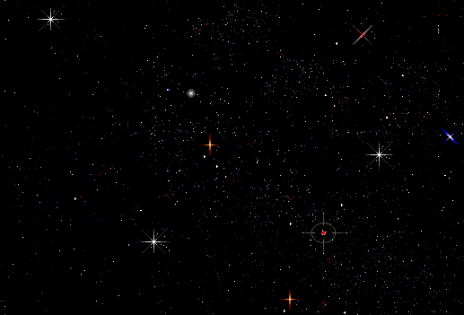
The End
Good Job!
Well Done!

Slide 20
Answers
№ | Answers
1 | a
2 | is
3 | and
4 | has got
5 | bike
6 | with
7 | smart
8 | ask
9 | day
10 | funny
11 | evening
12 | why
13 | Do
14 | Where
15 | When
16 | What
17 | How many

