Slide 1
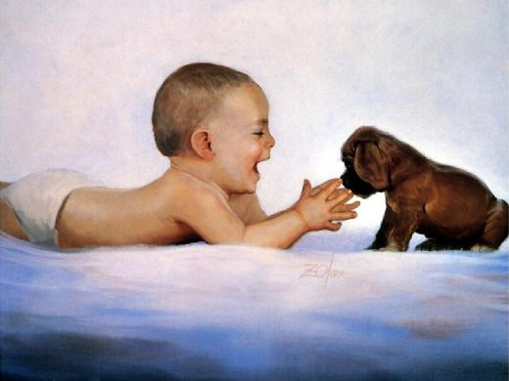
Meet Donald Zolan
Art Gallery
Made
by O.M. Stepanova
English Teacher
Of Tsivilskaya Secondary School #2
Tsivilsk, Chuvash Republic
2015

Slide 2
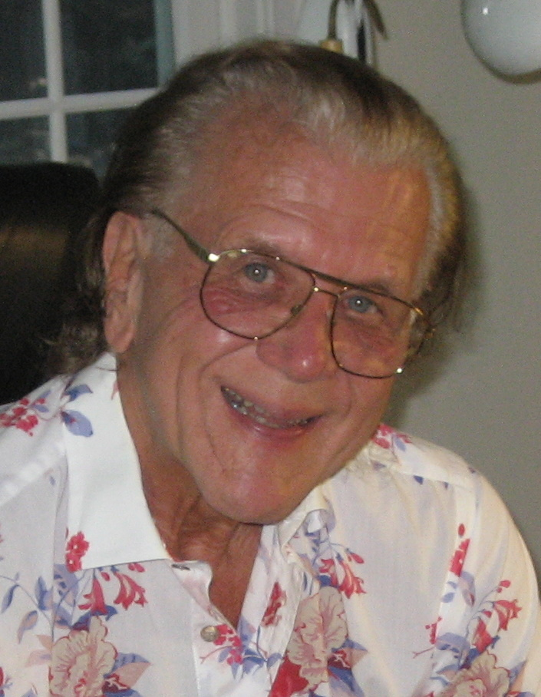
magical moments of childhood are brought to life by America's premier children's artist, Donald Zolan.
Donald Zolan
(1937 - 2009)

Slide 3
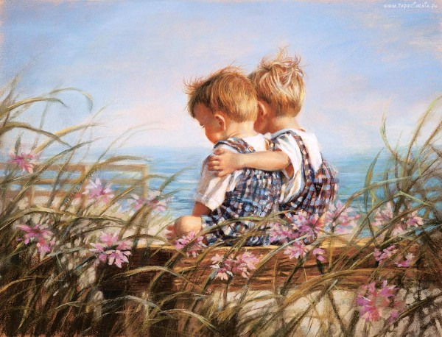
Enjoy the sun-kissed days of childhood summers with these heartwarming
Childhood Dreams .

Slide 4
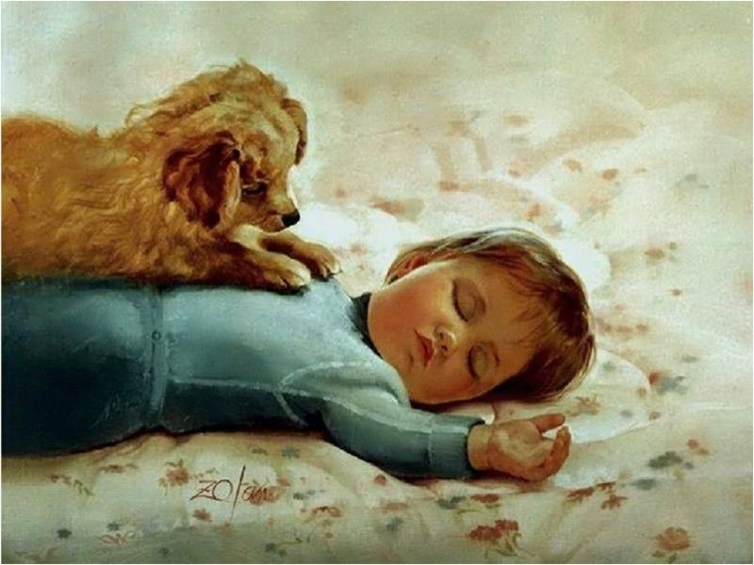
His work celebrates
the joy of childhood, with all its wonders, innocence, and love.

Slide 5
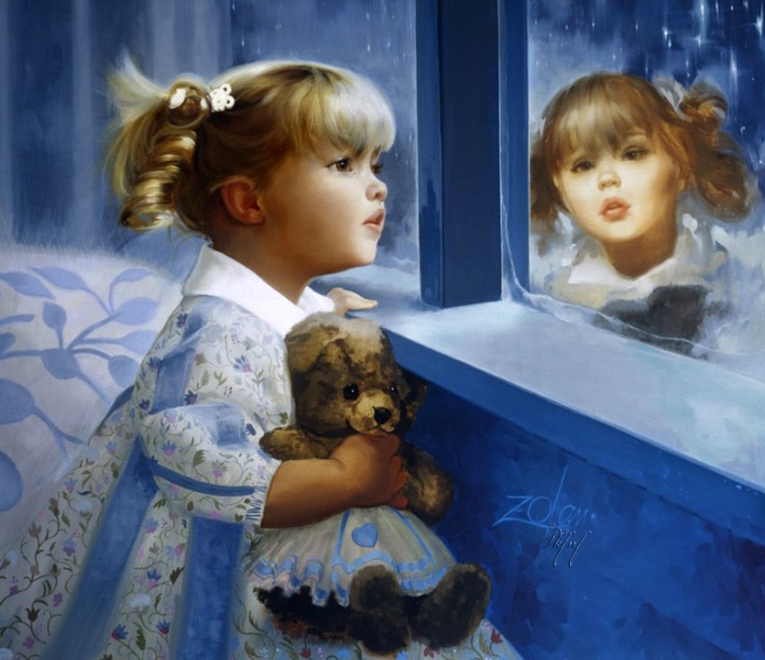
As a child prodigy, Donald Zolan began studying at the prestigious Chicago Art Institute at the age of ten and is now recognized as a gifted children's artist.

Slide 6
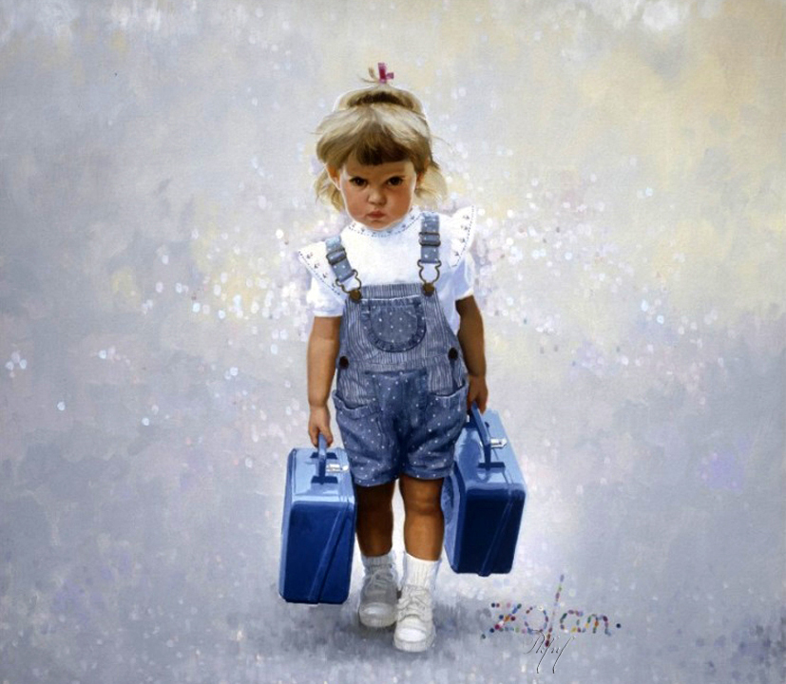
Born on August 11, Brookfield, Illinois, 1937 and a fifth generation artist, Zolan began drawing at the age of 3, completing his first oil painting by age 8.

Slide 7
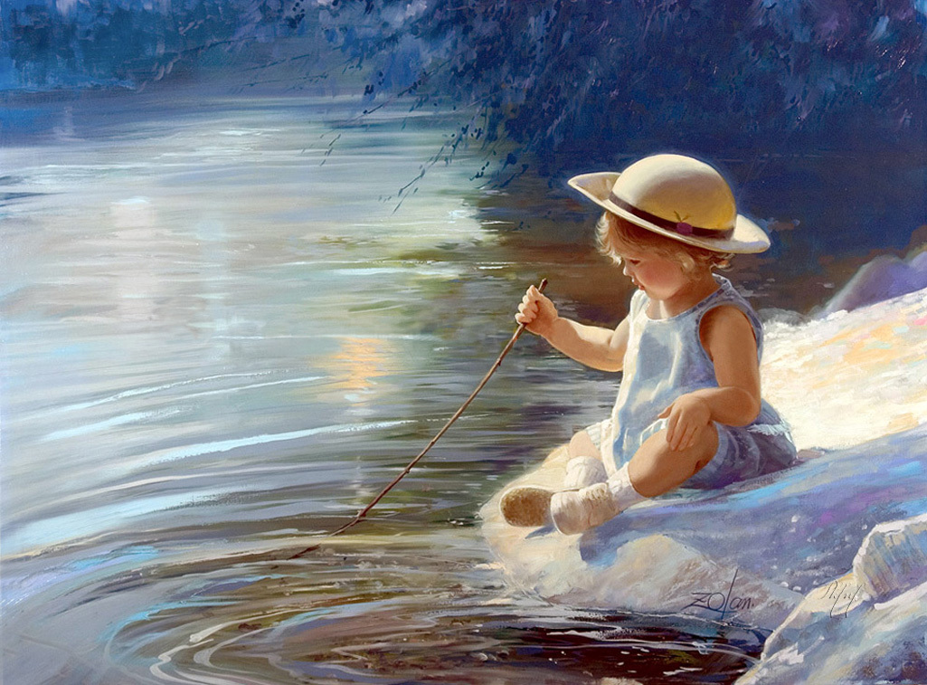
Zolan's artwork is featured in ANGELS AMONG THE ROSES and MY FAVORITE FARM ANIMAL FRIENDS, and on numerous limited edition collectibles, as well as greeting cards, puzzles, ornaments, and calendars.

Slide 8
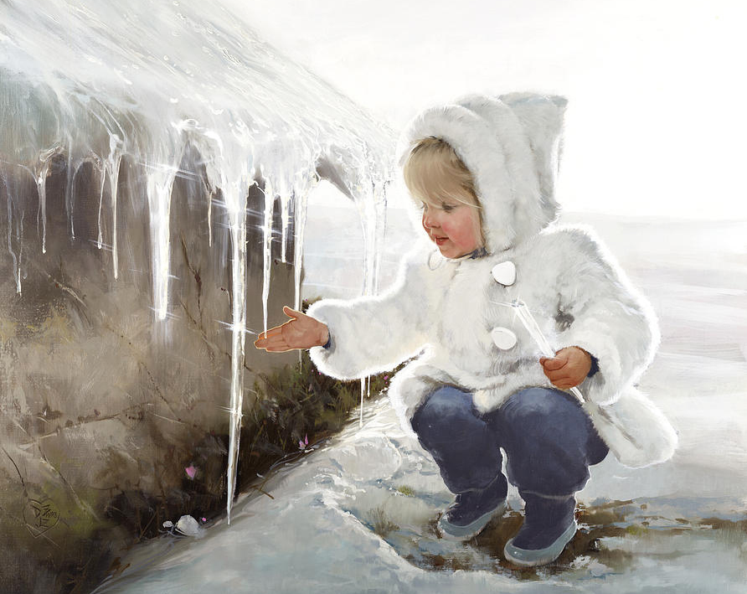
"I love little children", says Zolan, "the way their eyes light up with excitement as they awaken to the world around them.

Slide 9
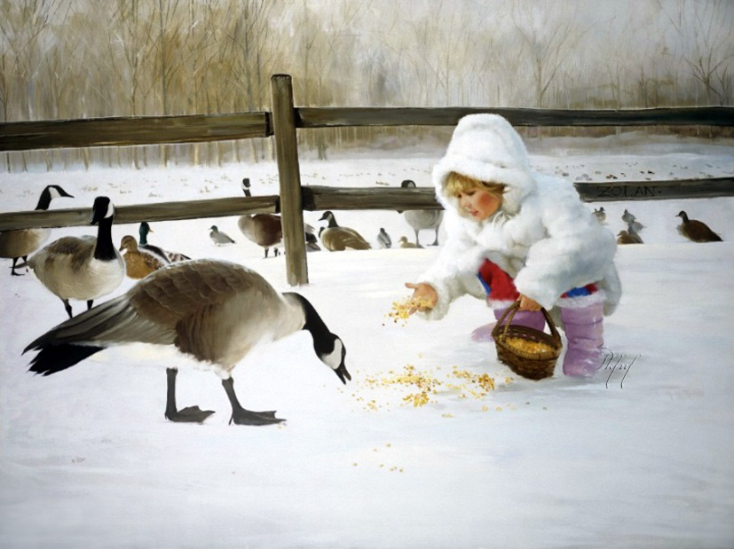
Donald's work had become a familiar feature in Parade magazine, the nation's most popular Sunday newspaper supplement.

Slide 10
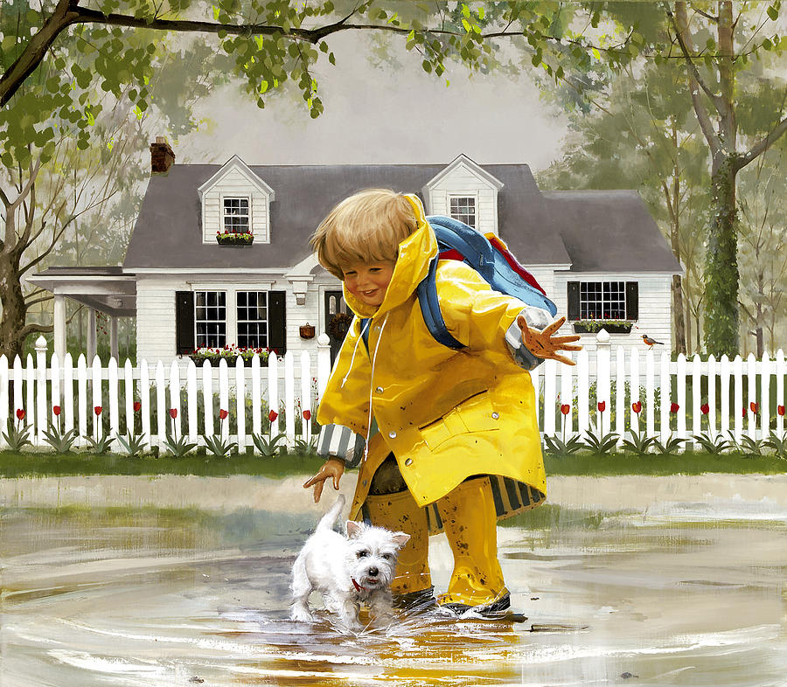
As Donald's reputation grew as a distinguished portrait artist, his precious paintings of children earned him global fame.

Slide 11
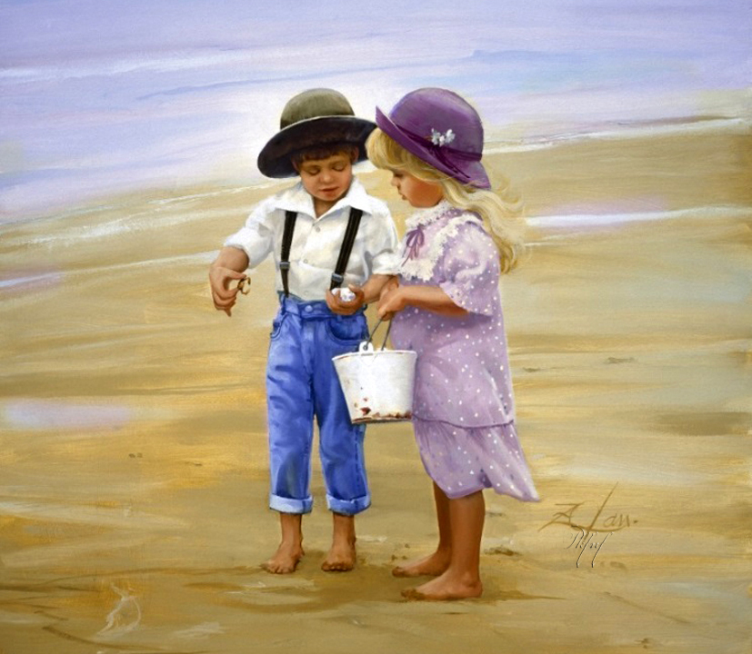
He is a six-time winner of America's Favorite Plate Artist and 12-time winner of the Collector Editions Awards of Excellence.

Slide 12
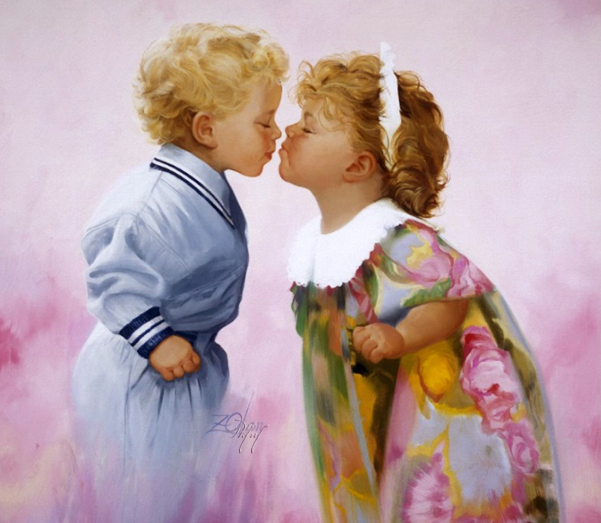
“It's a marvelous time of life filled with wonderment, a time when each new discovery is another magical moment,“ he said.

Slide 13
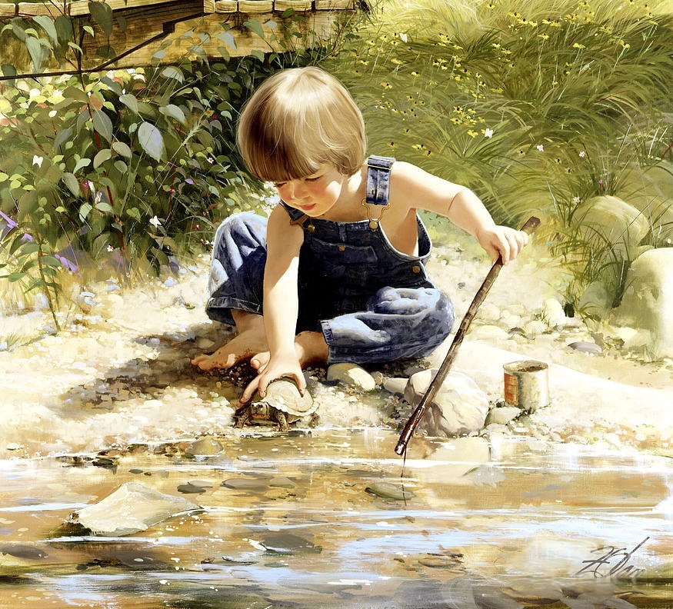
Donald's paintings draw from his own happy childhood and are continually inspired by farm life and Midwestern culture.

Slide 14
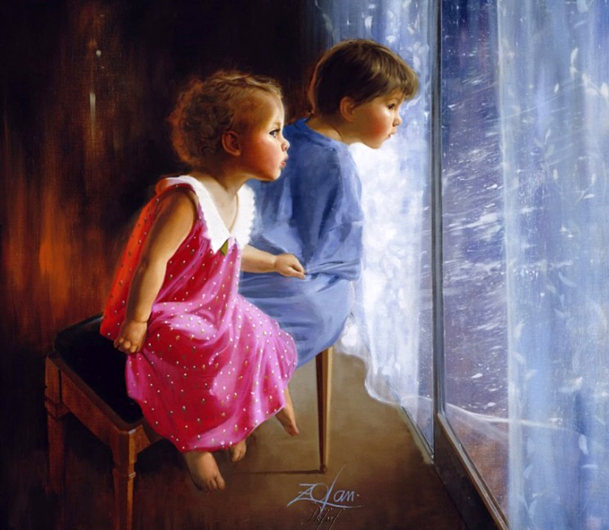
Donald was “the people's artist”, a true gentleman of great humility, a happy and positive thinking man, and a man who cherished and loved his wife.

Slide 15
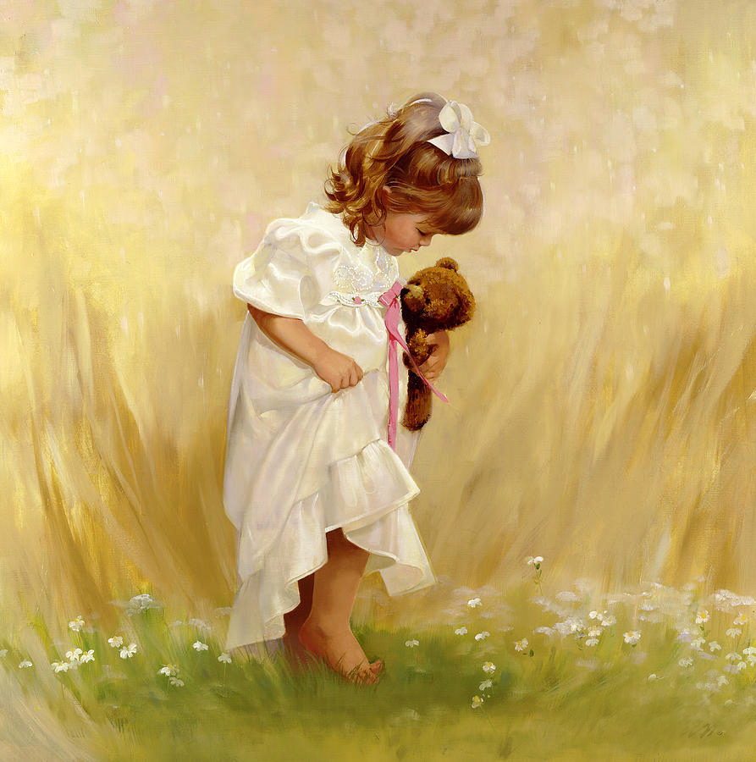
The love and joy one sees in his paintings are a sincere expression of himself and each painting rekindles a spark of nostalgia in each of us as the warmth and richness of his work touches the heart and enlivens the soul.

Slide 16
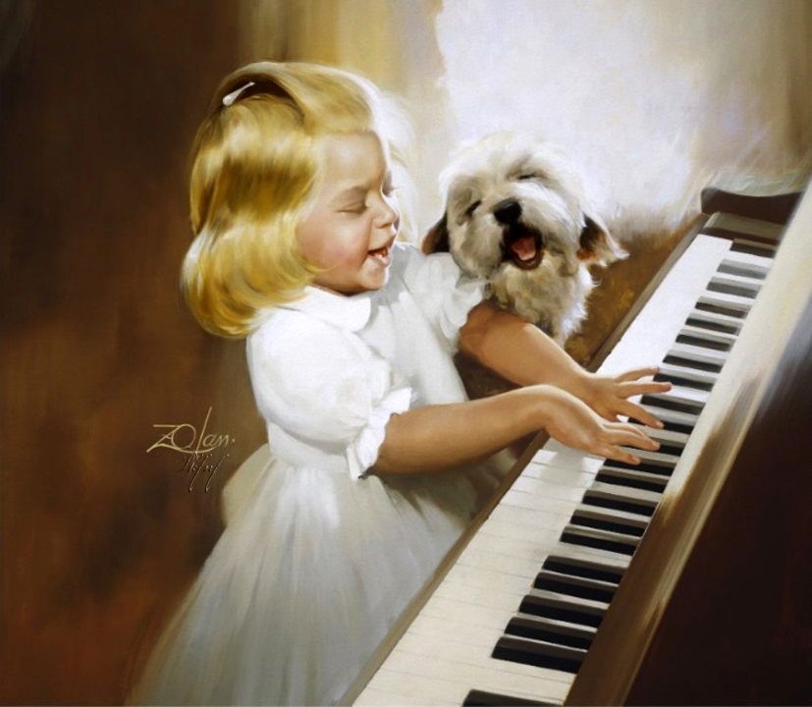
His true love, however, was his fine art prints and posters which were shown in leading galleries and museums around the world.

Slide 17
America's beloved painter of children,
Donald Zolan,
passed away on Monday,
July 20, 2009, at the side of his wife Jennifer R. Zolan
in Scottsdale, Ariz.

Slide 18
Sources
http://wiedemanfuneralhome.com/Obituaries/2009%20Obituaries/Zolan,%20Donald.html
http://www.prints.com/art.php/Donald_Zolan/?artist_id=3294&type=6
https://iamachild.wordpress.com/2013/02/14/donald-zolan-1937-2009-american-6/
https://www.pinterest.com/dianezink/art-my-style-donald-zolan/

