Slide 1

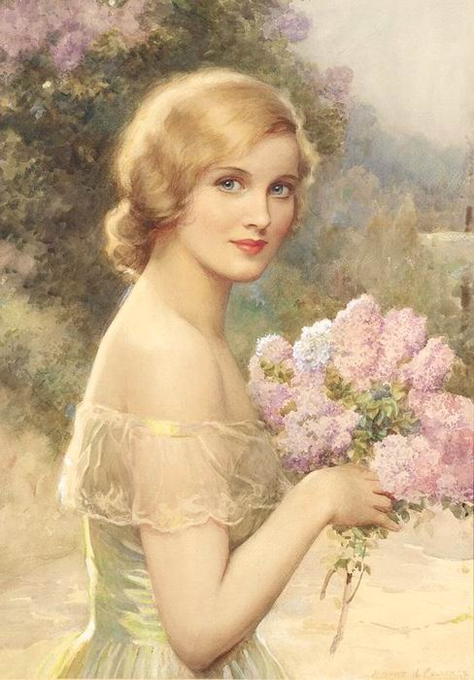
Albert Henry Collings and his Girl with Lilac
Lecture and Quiz
Made
by O.M. Stepanova
English Teacher
Of Tsivilskaya
Secondary School #2
Tsivilsk
Chuvash Republic
2015

Slide 2
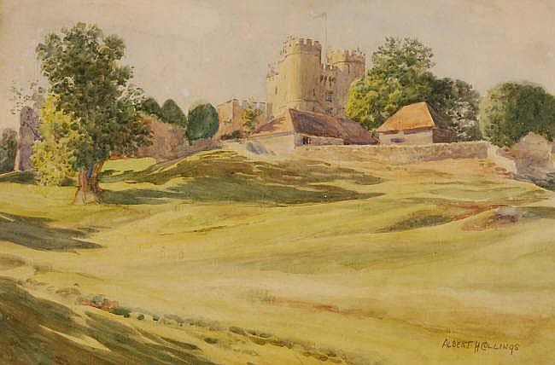
ALBERT HENRY COLLINGS
(1868-1947)
was an English artist
most notable for his portraiture .
Collings was born, trained, and lived all his life in London.
A rare watercolour landscape by Albert Henry Collings.

Slide 3
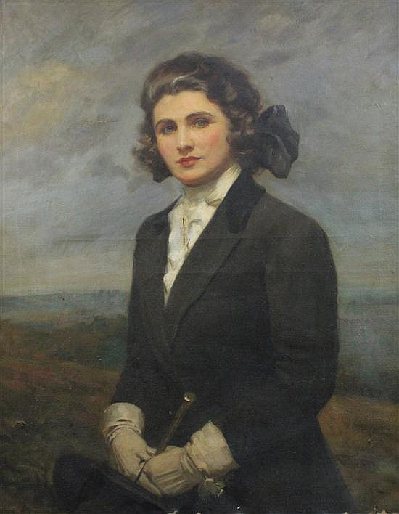
Portrait painter Albert Henry Collings was born in 1869 to decorative writer (calligrapher) John Richard Collings and his wife Eliza Eliza was the eldest daughter of animal painter James Clark. Albert had two older brothers and a younger sister.
Portrait of Miss Melhursh

Slide 4
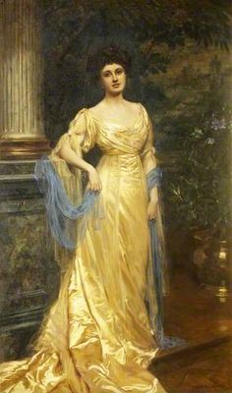
Working in oils, water-colour, and pastel, he specialised in figure subjects and portraits, for which he received a number of official commissions. He exhibited for many years at the Royal Society of British Artists, showing a total of 98 works and being elected a member in 1897.

Slide 5
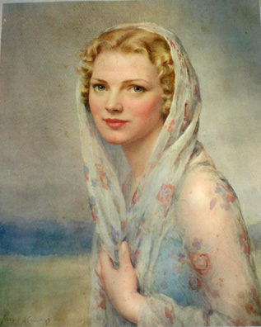
He also supported the Royal Academy (29 works, 1896–1938) and the Royal Institute of Painters in Water Colours, and showed at the Paris Salon, where he was awarded a gold medal for a portrait in 1907.

Slide 6
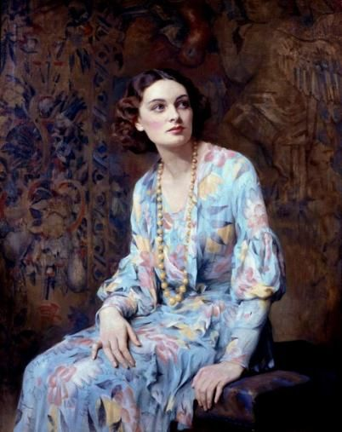
Albert Henry Collings is listed in the 1934 edition of Who's Who in Art, where his biography states that his leisure interests include golf and music. He died 6 May 1947 at St John's Nursing Home in Buxton, Derbyshire, aged 79.
Portrait of a Lady

Slide 7
Girl with Lilac
by Albert Henry Collings
The Painting
loved by everyone

Slide 8
Quiz!
Fill in the Table
№№ | abc | answers
1
2
3
4
5
6
7

Slide 9
Answers Keys
1 | a | portraiture
2 | a | London
3 | c | two
4 | c | gold
5 | b | golf
6 | c | music
7 | b | lilac

Slide 10
Meet Girl with Lilac
by Albert Henry Collings
The Painting
loved by everyone
How
can
you describe the
Girl?

Slide 11
The Plan
to describe the picture
Her appearance: I see a pretty (beautiful, attractive, nice ) girl. She is slim.
Her face: Her face and her look is clear. Her eyes are blue and tender . Her hair is golden (blond).
She is wearing a light nice dress.
On the background I can see some lilac bushes. They are blooming.
She holds lilac bunches in her hands. The flowers are purple and light blue..
I think the lilac is for her … (Mom, sister, friend).
I like the painting. It makes my mood good and happy (merry and positive).

Slide 12
Dear friend, you have trained how to describe the painting, enjoying the Art Work.
Now, it is time to listen to your story!
The contest!
Who is the best speaker, the best describer, the best story teller?

Slide 13
Thank you for being with the ‘Girl with Lilac!’
Good Luck!

Slide 14
Sources
http://io.ua/3035524
https://sites.google.com/site/clarkfamilyofartists/home/albert-henry-collings
http://en.wikipedia.org/wiki/Albert_Henry_Collings#Life_and_work
http://www.palladiumfineart.com/wp-content/uploads/2012/11/COLLINGS-CAT.pdf

