Slide 1
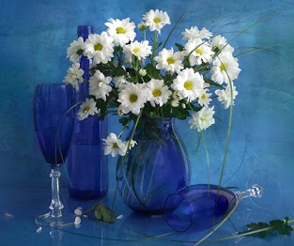
Photo Still Life by Luiza Gelts
Art Gallery
8-11 Grades
Made with Love
by Olga Stepanova
Tsivilskaya Secondary School №2
Chuvash Republic
2015

Slide 2
Meet Luiza Gelts,
a fashionable and outstanding digital artist, master in still-life, landscape and other types of photo art.

Slide 3
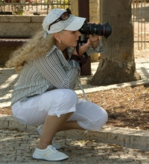
Born in Germany, Chemnitz. Lives in Russia, Dubna.
She graduated
from art school studio
in Dubna,
in 1079.
Education:
Russian State University of Physical Culture
and Sports.
Artistic
photography : 10 years

Slide 4
​​Luiza Gelts is a very fashionable and outstanding digital artist, master in still-life, landscape and other types of photo art.

Slide 5
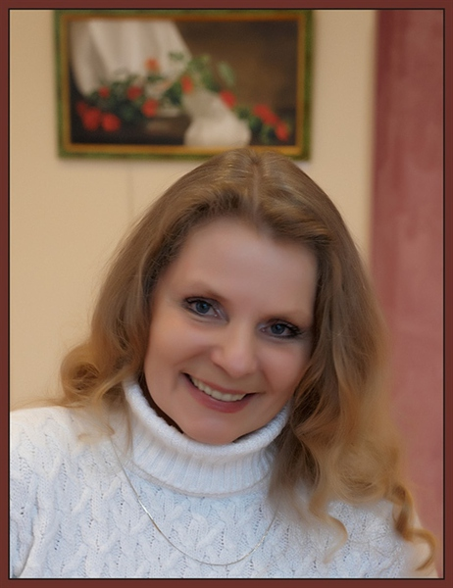
Her fascinating artworks decorate private galleries and connoisseurs’ homes in France, Belgium, Holland, Philippines and other countries.

Slide 6
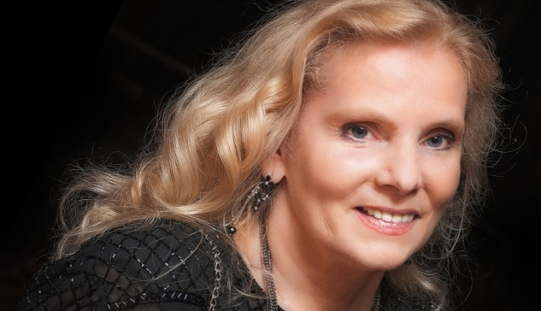
​Exhibitions and rewards
​​
Winner in “Best Russian Photographs”, 2011
International Exhibition “Orthodox Russia”, PhotoPodium Project 2011, 2010, 2009
Winner and Grand Prix at the Iinternational Exhibition of Russian Fine Arts Academy, “Environment, Human-being and Archetecture”, 2011
Grand Prix at International Exhibition “ Fourth Dimension”, 2011
International Exhibition of Russian and Philippine artists, 2010
International Exhibition of Russian Artists in Paris, 2010
Exhibitions in Moscow, St. Petersburg, Dubna, 2009 - 2011

Slide 7
Publications
​
1."Digital art of Luiza Gelts", Smashwords inc., USA
​2. “Best of Russia” Journal, 2012
3. “Eternal Russian Beauty” book, France, Paris
4. Journal “Photo”, 2005
​

Slide 8
You are entering into the fairy world of Russian Art
.It will fill you, your home and the space around you with joy, human warmth, the inner feeling of comfort and Divine Love.

Slide 9
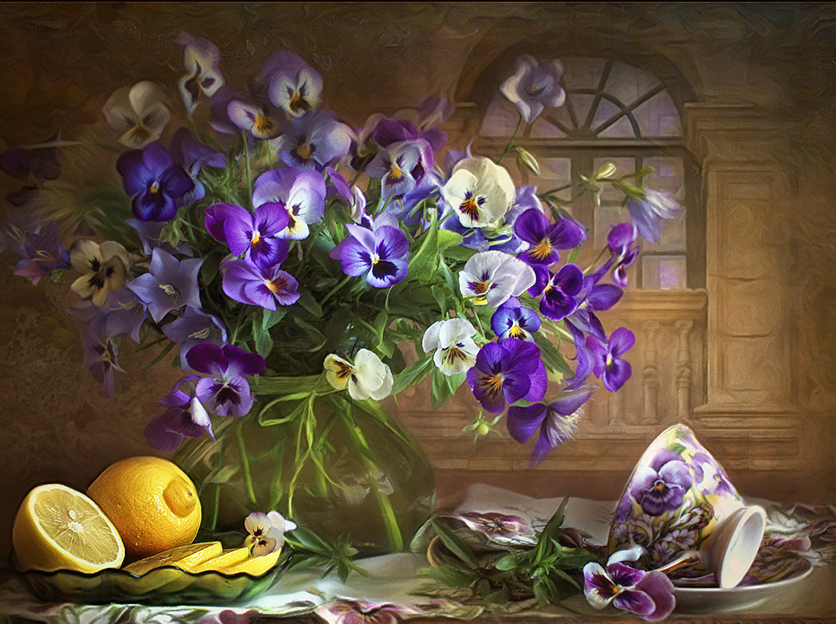
“The earth laughs in flowers.”
― Ralph Waldo Emerson

Slide 10
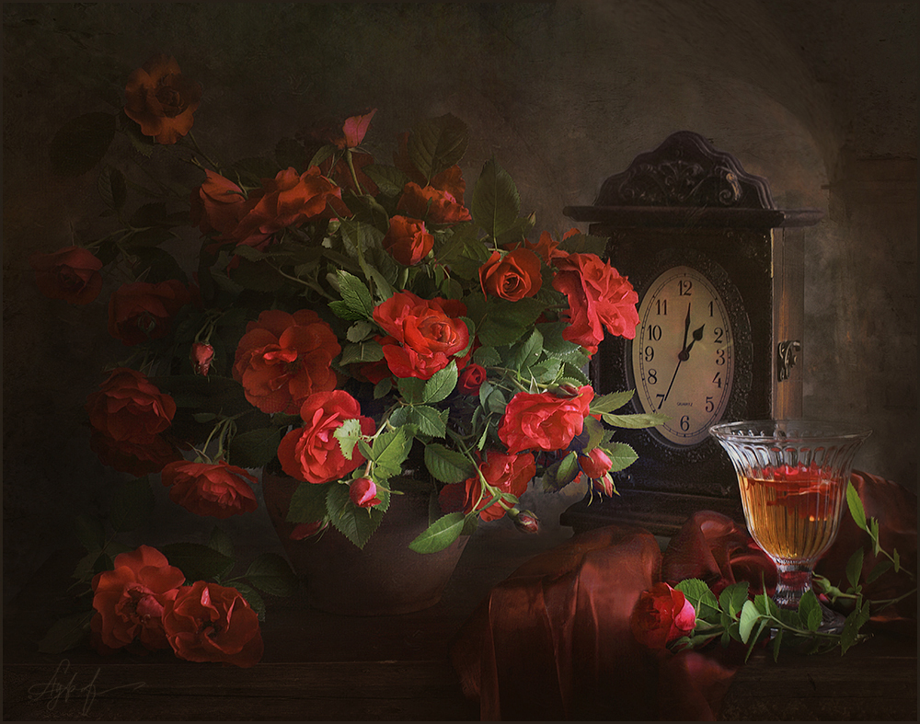
God has sown his name on the heavens in glittering stars; but on earth he planteth his name by tender flowers.
Jean Paul Richter

Slide 11
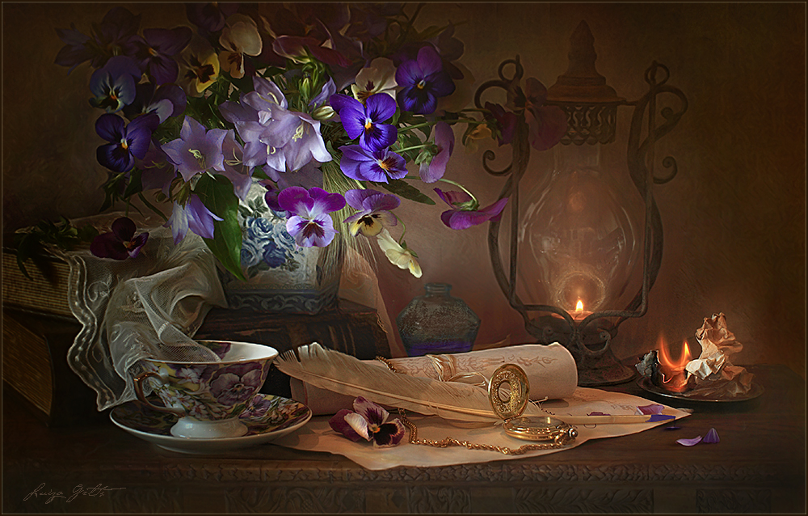
Don’t wait for someone to bring you flowers. Plant your own garden and your own soul. Luther Burbank

Slide 12
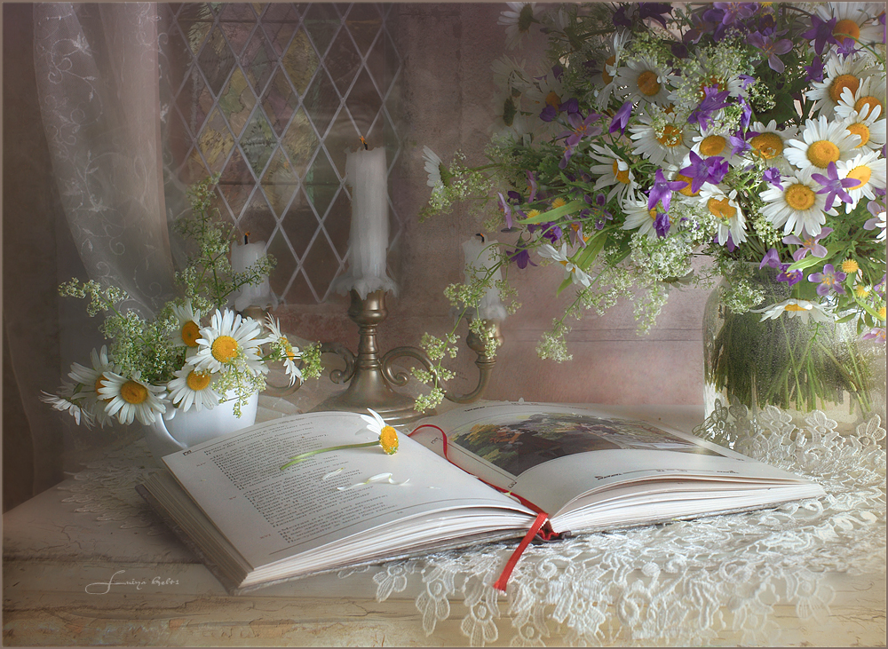
“Let us dance in the sun, wearing wild flowers in our hair...”
― Susan Polis Schutz

Slide 13
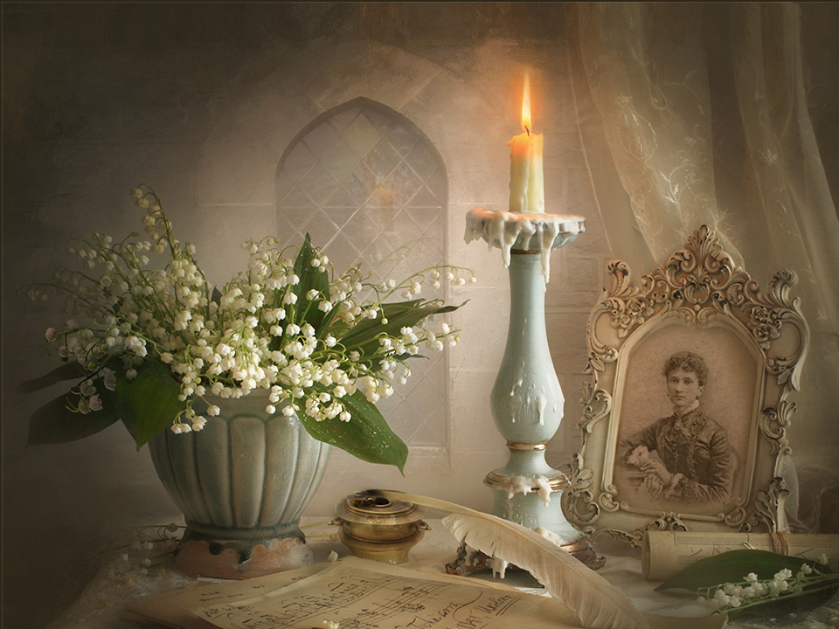
“I must have flowers, always, and always.”
― Claude Monet

Slide 14
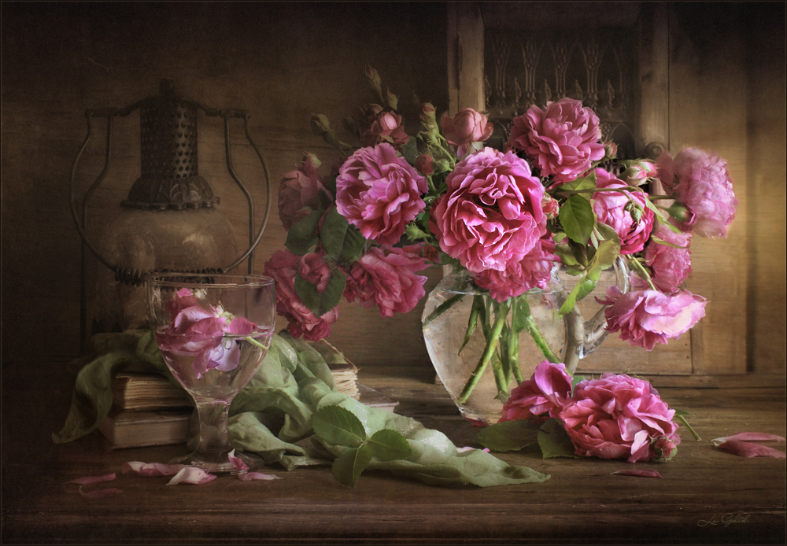
“Flowers always make people better, happier, and more helpful; they are sunshine, food and medicine to the mind.”
― Luther Burbank

Slide 15
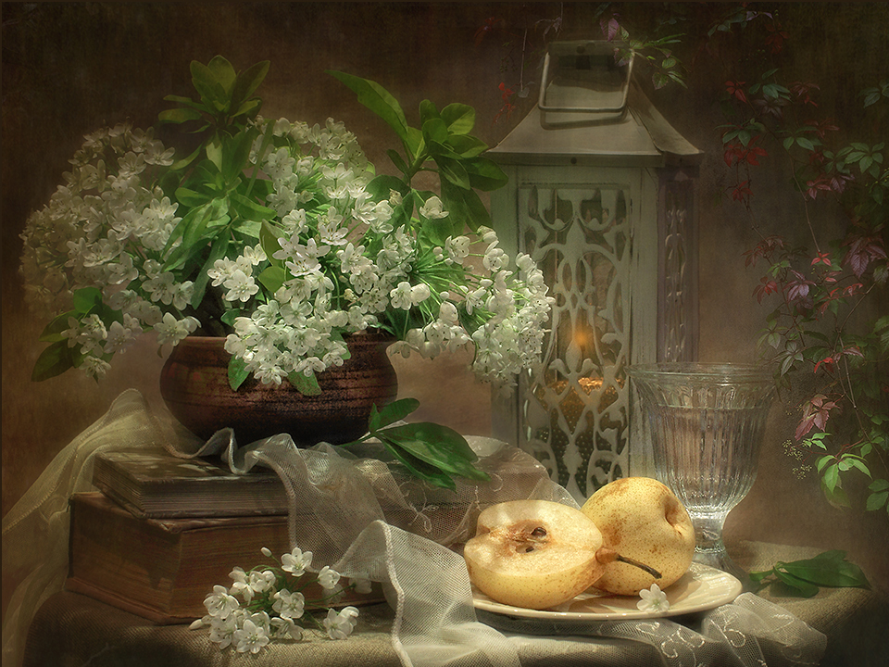
“Flowers are the beautiful hairs of the Mother Spring! Don’t pluck them!”
― Mehmet Murat ildan

Slide 16
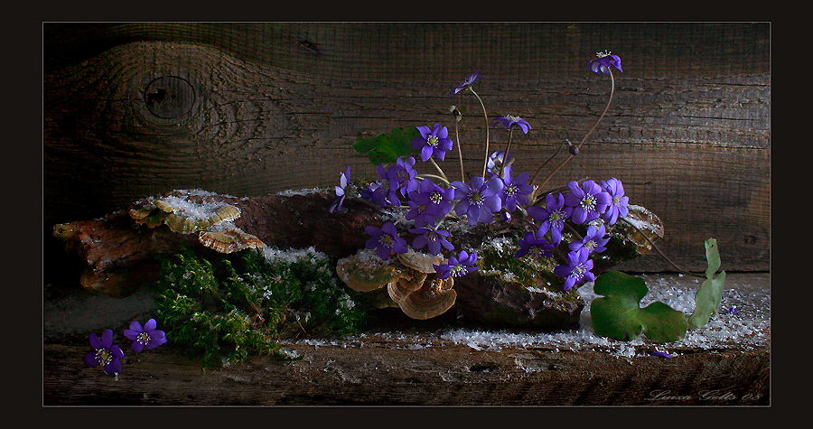
“Flowers are the music of the earth.”
― Marty Rubin

Slide 17
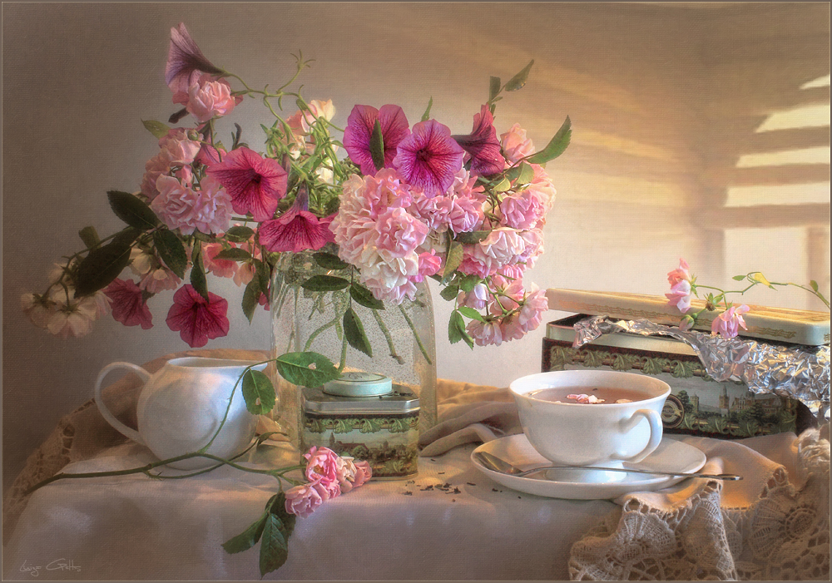
“A person who takes a concrete place and convert it into a garden of flowers is a real magician!”
― Mehmet Murat ildan

Slide 18
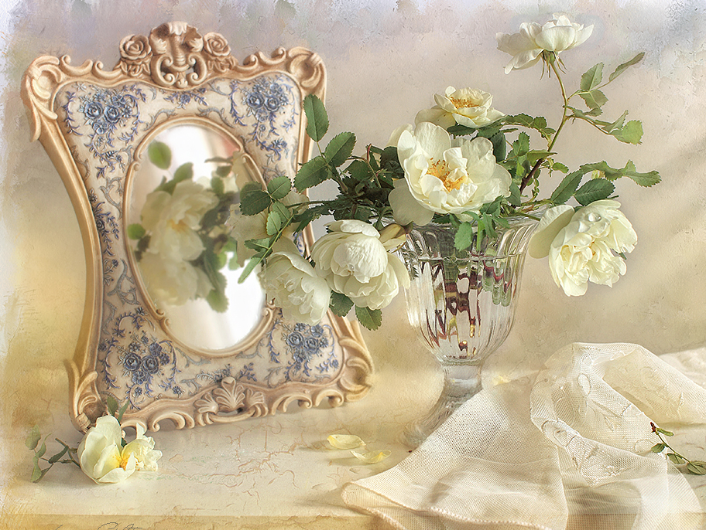
“Animals fight wars; flowers practice peace.”
― James Edwin Gunn

Slide 19
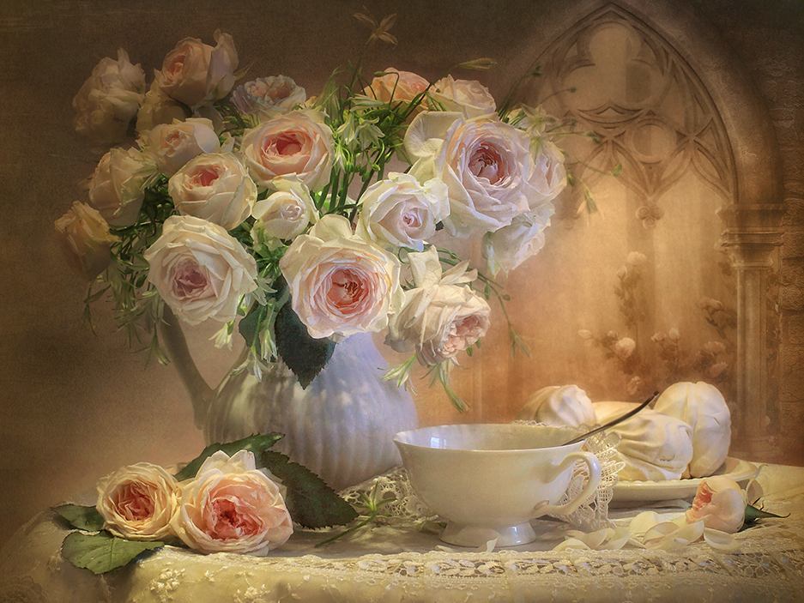
“Killing flowers for our own happiness is a wrong attitude, it is a wrong culture! We must change this attitude and abolish this culture! Let the flowers live!”
― Mehmet Murat ildan

Slide 20
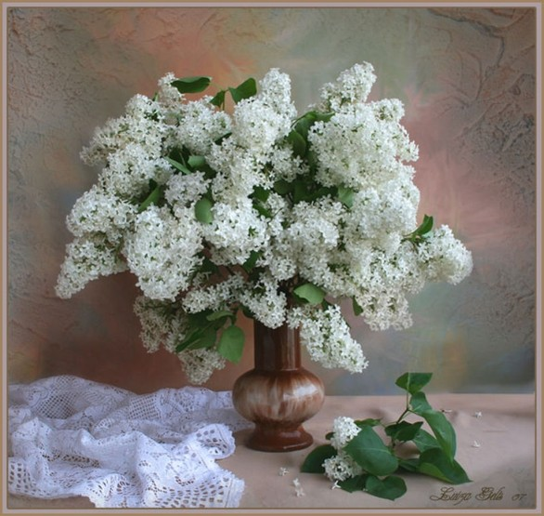
“I am in awe of flowers.
Not because of their colors,
but because even though they
have dirt in their roots,
they still grow.
They still bloom.”
― D. Antoinette Foy

Slide 21
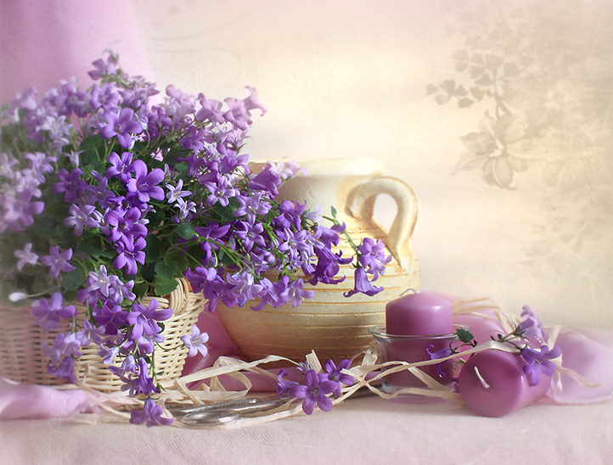
“But flowers feed our soul in a different way. They remind us of a God who creates beautiful things and takes notice of the tiniest detail”
― Tricia Goyer

Slide 22
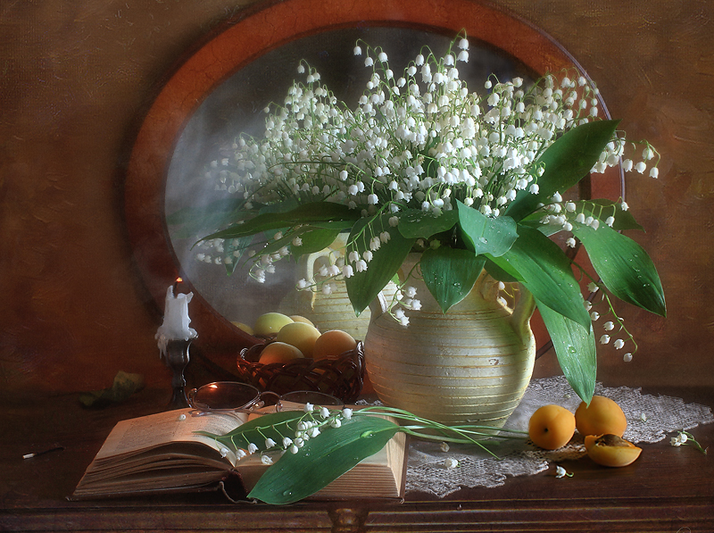
“Little flowers get more attention than the big mountains simply because they emit love around themselves!”
― Mehmet Murat ildan

Slide 23
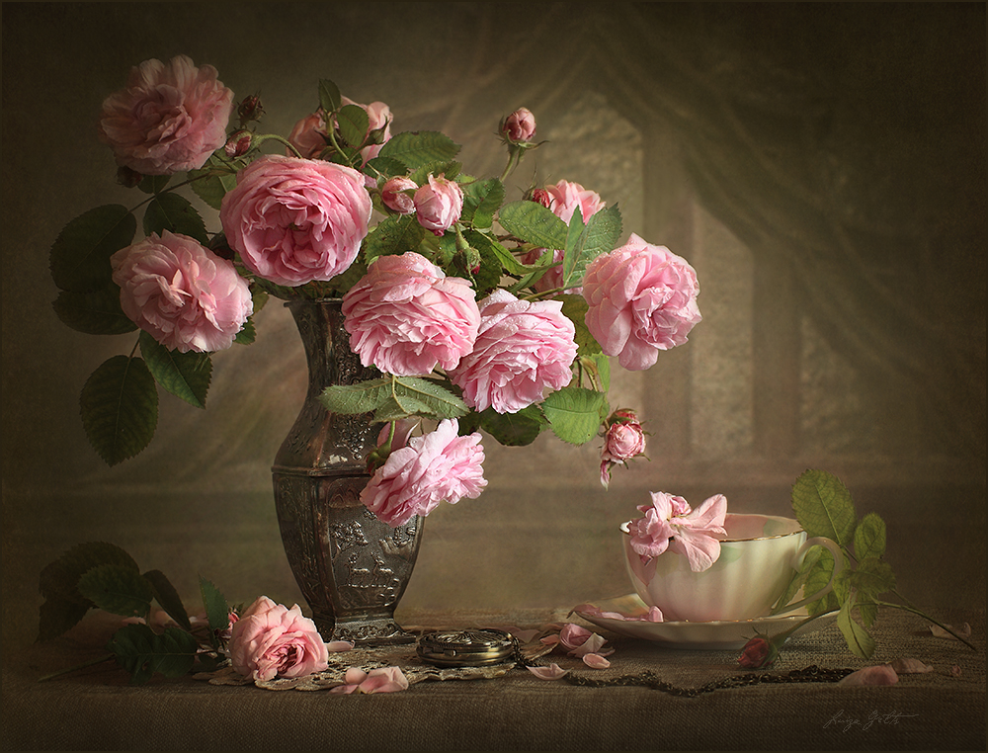
“Planting a flower's like opening a book, because either way you're starting something. And your garden's your library.”
― Nora Roberts

Slide 24
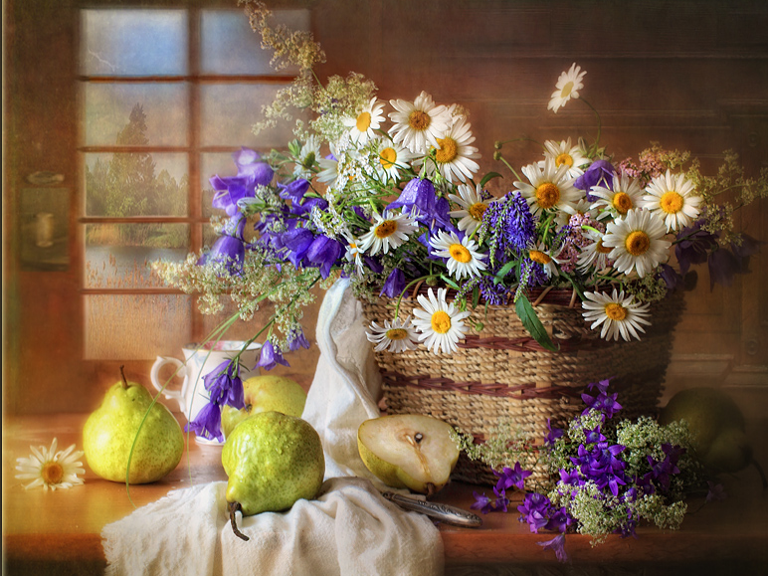
“Flowers, after love, must have been the best advert planet Earth had going for it.”
― Matt Haig

Slide 25
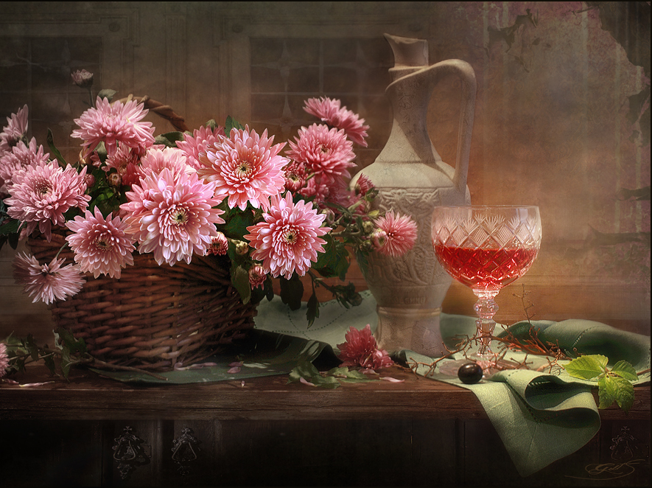
“There is so much hope in a little flower and so many flowers in a little hope!”
― Mehmet Murat ildan

Slide 26
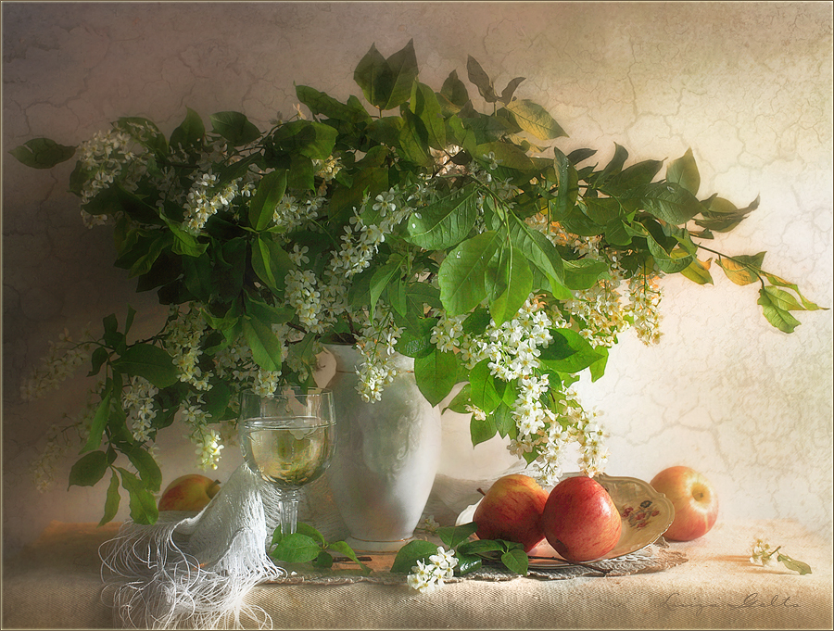
“There are no flowers in the Moon; that’s why the Moon is a boring place!”
― Mehmet Murat ildan

Slide 27
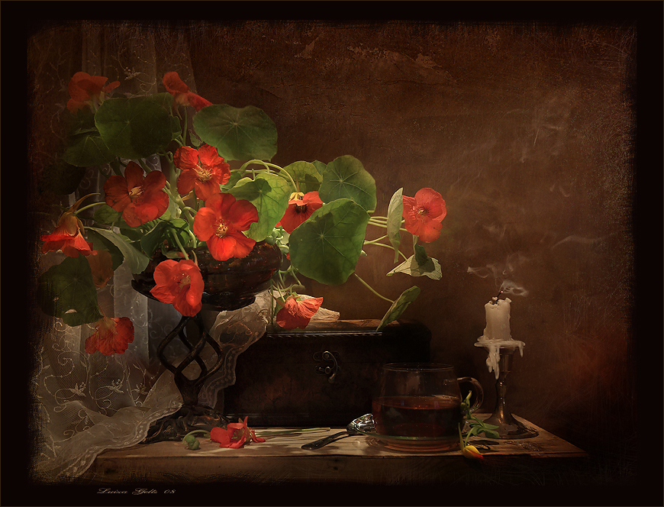
“In the cold dark days of the winter, dream about the flowers to get warmed up!”
― Mehmet Murat ildan

Slide 28
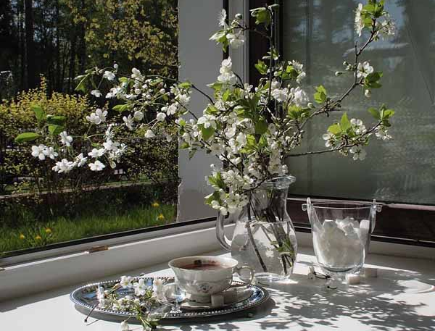
“Flowers are like the sweet babies of the nature; they make us to smile.”
― Mehmet Murat ildan

Slide 29
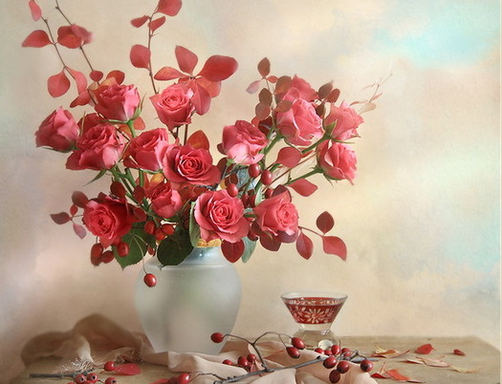
“You want to do something good for the flowers? Then, keep the flowers in the soil, in nowhere else!”
― Mehmet Murat ildan

Slide 30
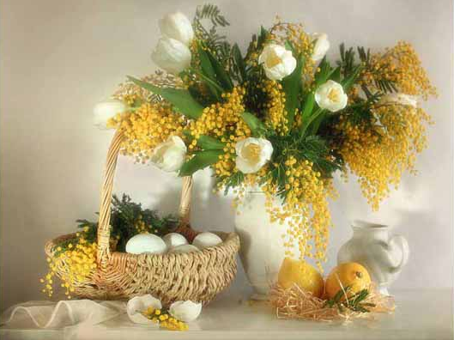
“Flowers have the greatest talent in converting an ordinary place into a magical palace!”
― Mehmet Murat ildan

Slide 31
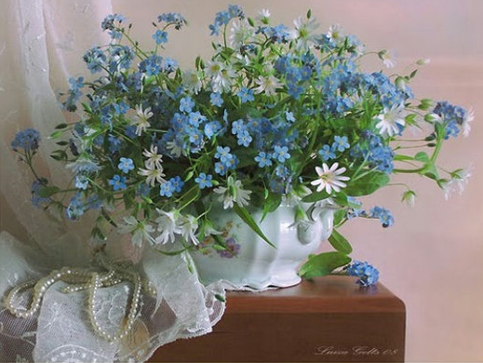
Flowers are
love's truest language.
Park Benjamin

Slide 32
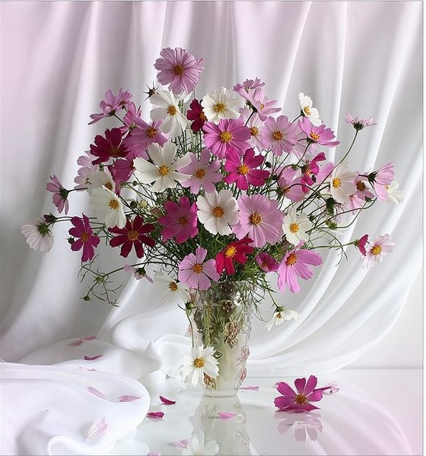
Just living is not enough... one must have sunshine, freedom, and a little flower.
Hans Christian Andersen

Slide 33
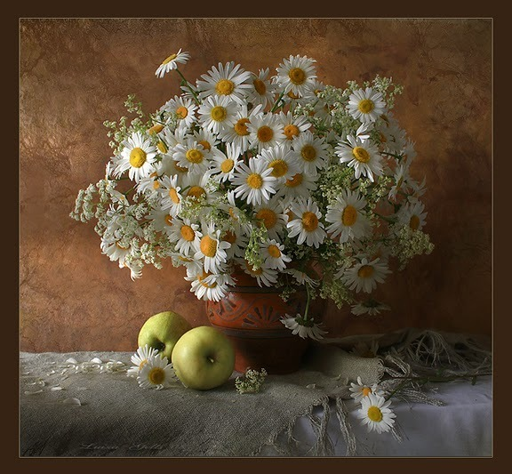
Life is the flower for which love is the honey.
Victor Hugo

Slide 34
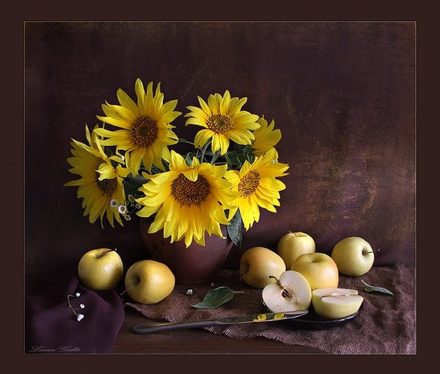
Autumn is a second spring when every leaf is a flower.
Albert Camus

Slide 35
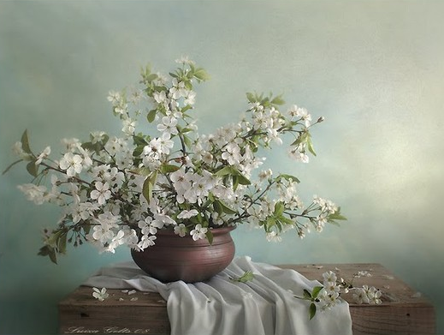
"Where flowers bloom so does hope.“
- Lady Bird Johnson

Slide 36
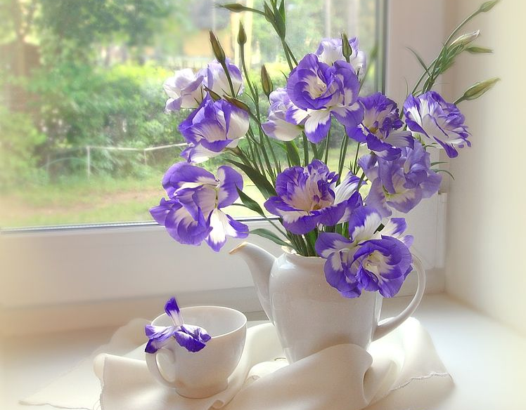
"To pick a flower is so much more satisfying than just observing it, or photographing it ... So in later years, I have grown in my garden as many flowers as possible for children to pick.“
- Anne Scott-James

Slide 37
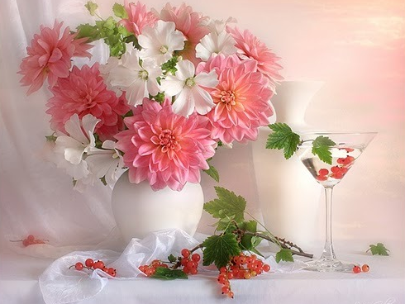
"The actual flower is the plant's highest fulfillment, and they are here first of all for delight."
- John Ruskin

Slide 38
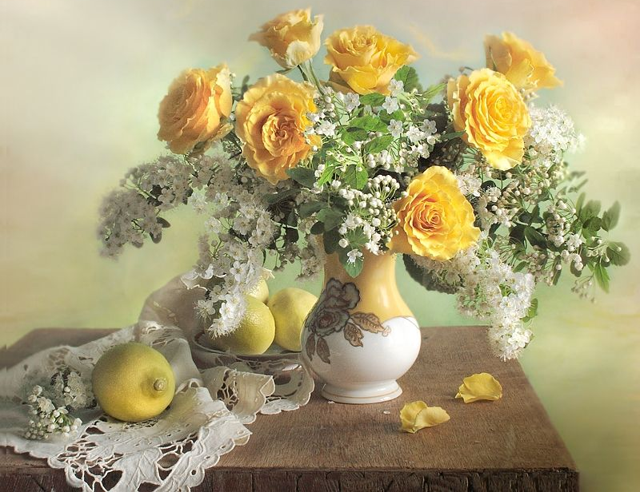
I'd rather have roses on my table than diamonds on my neck.
Emma Goldman

Slide 39
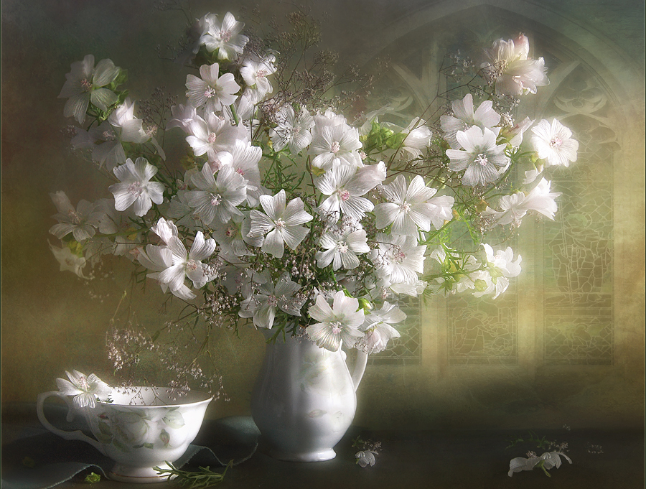
“Flowers are the sweetest things God ever made and forgot to put a soul into.”
― Henry Ward Beecher

Slide 40
The End
Thank you!
See you soon!

Slide 41
Sources
http://irinazaytseva.ru/natyurmorty-luizy-gelts-romanticheskie-grezy.html
http://my.mail.ru/mail/fialka49/photo/34582
http://www.livemaster.ru/topic/225217-dushevnye-natyurmorty-luizy-gelts
http://www.photounion.ru/show.php?fnum=1715
http://ru.scribd.com/doc/81665798/Levis-Fox-Art-Gallery-Ejournal-3
http://www.allgreatquotes.com/flower_quotes.shtml
http://www.brainyquote.com/quotes/keywords/flower.html
http://www.quotegarden.com/flowers.html
http://www.goodreads.com/quotes/tag/flowers?page=11

