Slide 1
Презентация по английскому языку
Подготовка к контрольной работе
(контроль говорения и чтения)
3 четверть, урок 50
2 класс
УМК М.З. Биболетова
Шайдурова Валентина Федоровна
Учитель английского языка
ГБОУ «Школа №106»
Санкт-Петербург
2015

Slide 2
Содержание
Практика в говорении-
описание животных
2. Практика в чтении.

Slide 3
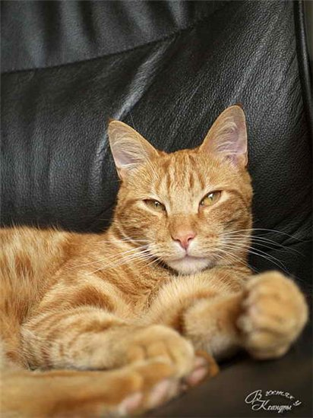
Speak about the cat!
I like the cat.
The cat is lazy.
It is big and red.

Slide 4
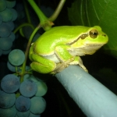
Speak about the frog!
The frog is big .
It is green.
I don’t like the frog.
It is not nice.

Slide 5
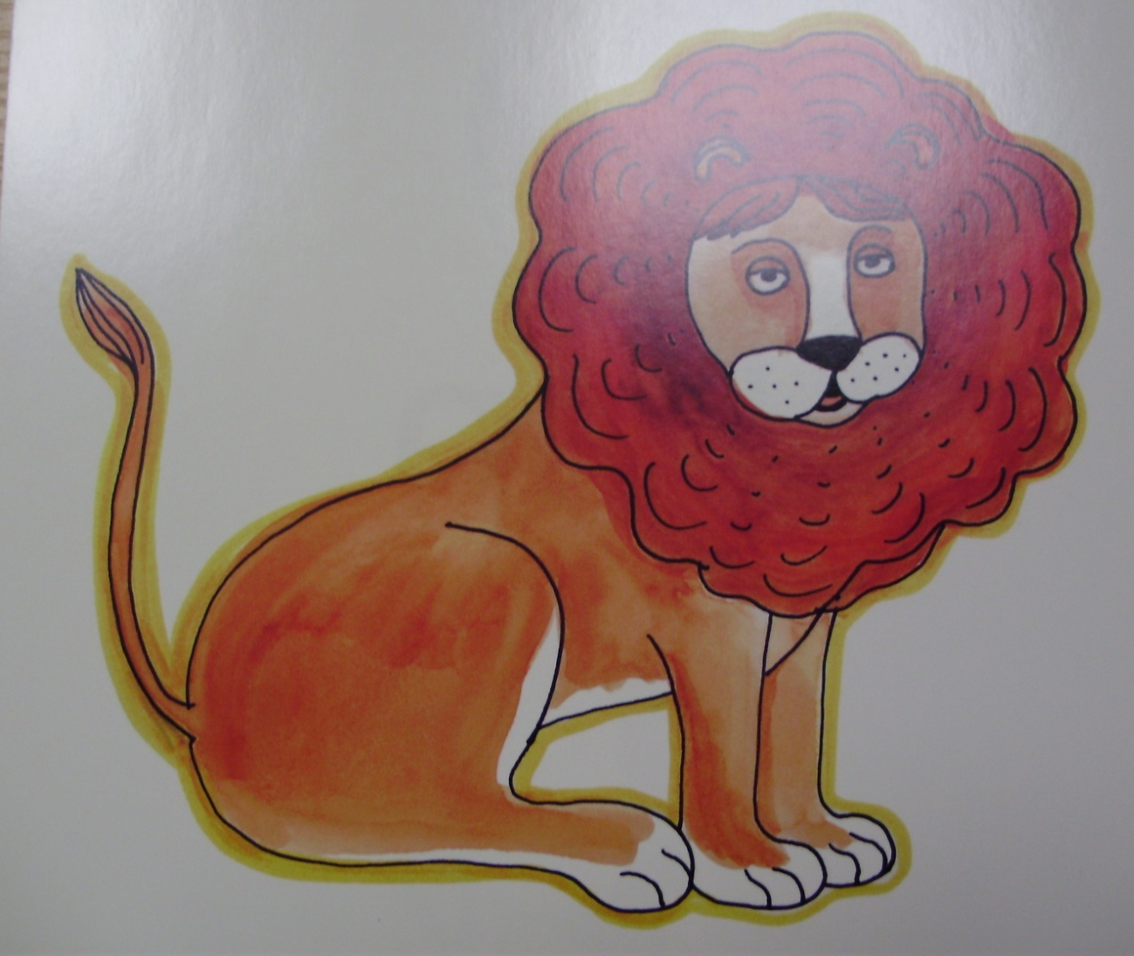
Speak about the lion!
The lion is big.
It is red.
The lion is brave
and strong.
I like the lion.

Slide 6
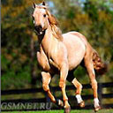
Speak about the horse!
The horse is big.
It is brown.
The horse is strong.
It can run fast.
I like the horse.

Slide 7
Отгадай загадку!
Ann has got a pet.
It isn’t big.
But it is merry and funny.

Slide 8
It isn’t black.
It is red.
It can run, jump and play.

Slide 9
It can’t swim.
Ann likes her…
a) Black dog
b) Red hen
c) Red cat

Slide 10
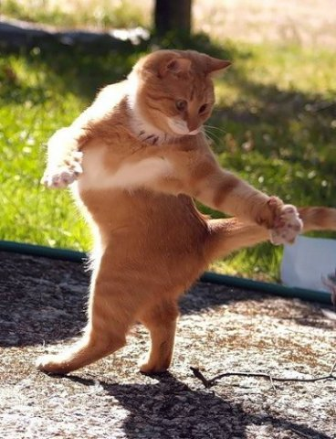
her red cat

Slide 11
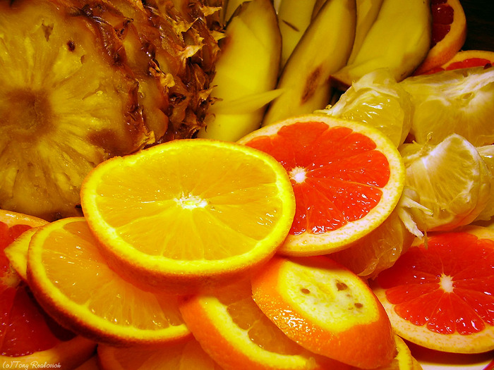
Well done!
Thank you!

