Slide 1
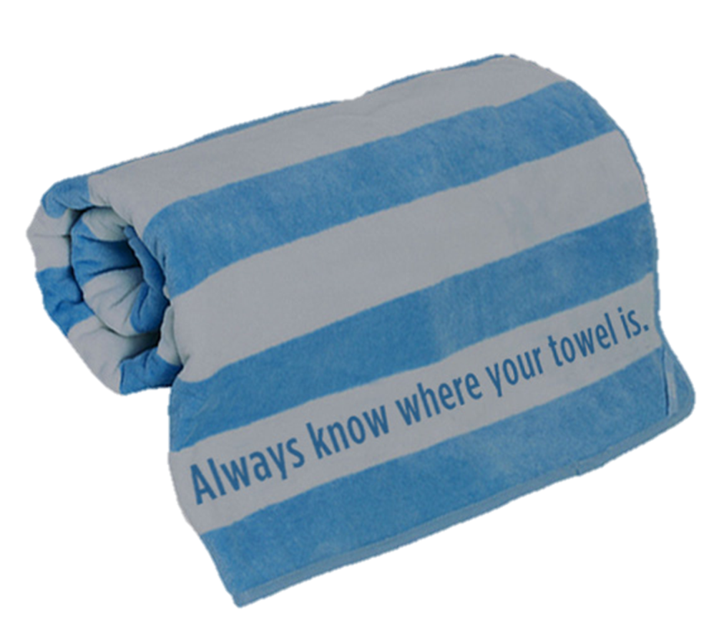
Its Majesty the Towel
Лекция
для учащихся 8 - 11 классов
Ольга Михайловна
Степанова
учитель
английского языка
МБОУ «Цивильская СОШ №2»
города Цивильск
Чувашской Республики
2015

Slide 2
Towel Day is an annual celebration on the 25th of May, as a tribute to the late author Douglas Adams
On that day,
fans around the
universe proudly
carry a towel
in his honour.

Slide 3
Douglas Adams (1952-2001)

Slide 4
Why Towel Day? “A towel,” Adams writes in chapter 3 of The Hitchhiker's Guide to the Galaxy, “is about the most massively useful thing an interstellar hitchhiker
can have. Partly it has great practical value.
Douglas Adams, author of the Hitchhikers Guide To The Galaxy, at home in Santa Barbara, California, in June 2000.

Slide 5
You can use your towel to sail a mini raft down the slow heavy River Moth; wet it for use in hand-to-hand-combat; wrap it round your head to ward off noxious fumes or avoid the gaze of the Ravenous Bugblatter Beast of Traal (such a mind-bogglingly stupid animal, it assumes that if you can't see it, it can't see you); you can wave your towel in emergencies as a distress signal, and of course dry yourself off with it if it still seems to be clean enough.”

Slide 6
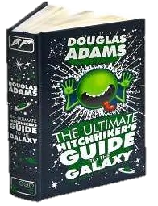
The Hitchhiker's Guide to the Galaxy is the first of five books in the Hitchhiker's Guide to the Galaxy comedy science fiction "trilogy" by Douglas Adams (with the sixth written by Eoin Colfer). The novel is an adaptation of the first four parts of Adams' radio series of the same name. The novel was first published in London on 12 October 1979.It sold 250,000 copies in the first three months.
The namesake of the novel is The Hitchhiker's Guide to the Galaxy, a fictional guide book for hitchhikers (inspired by the Hitch-hiker's Guide to Europe) written in the form of an encyclopedia.

Slide 7
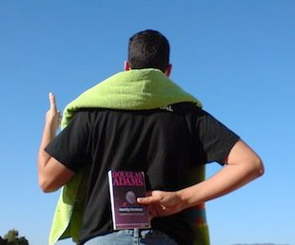
But what is a TOWEL according ‘The Hitchhiker's Guide to the Galaxy’?

Slide 8
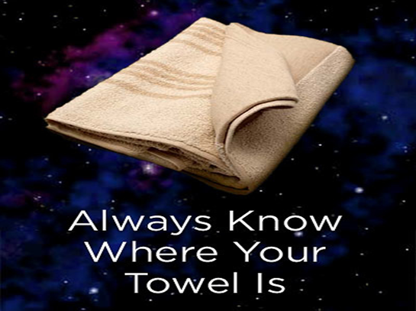

Slide 9
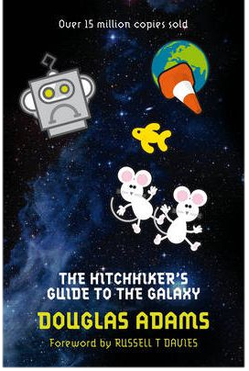
The Hitchhiker's Guide to the Galaxy states that a towel is the most important item a hitchhiker can have. It also mentions that "to know where one’s towel is" means to be in control of one's own life. It describes the towel as a multipurpose tool which can be converted into such things

Slide 10
And what is a TOWEL
for the modern people?

Slide 11
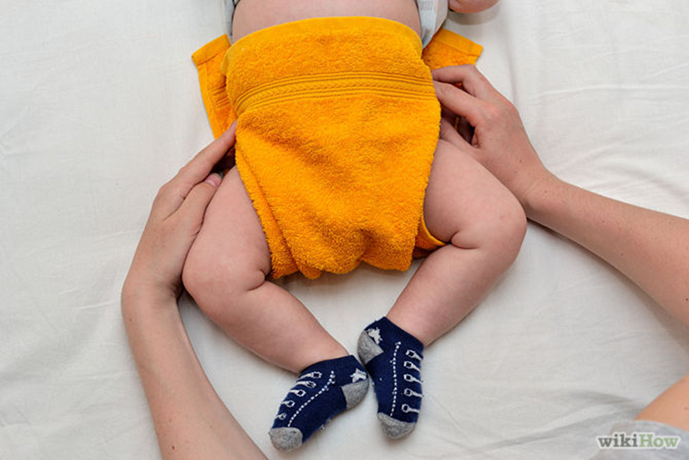
Even we can Make Cloth Diapers from Towels!

Slide 12
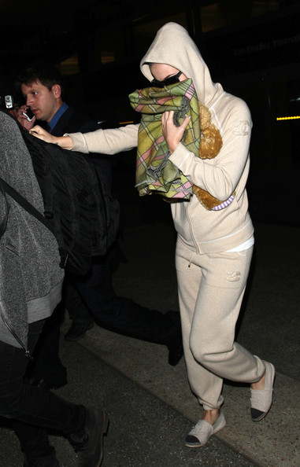
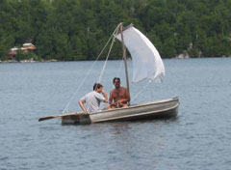
According to Adams Douglas The towel as a multipurpose tool which can be converted into such things as a sail for
a makeshift raft and a gas mask!

Slide 13
Our pets like towels very much!

Slide 14
Many nationalities meet
their
guests bread
and salt
on a towel with!

Slide 15
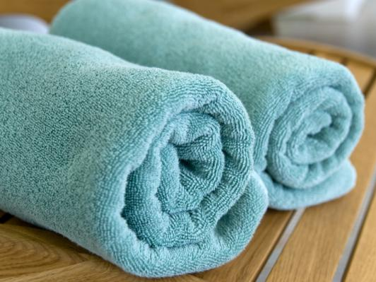
There are
lots of kinds of towels
in the world!
Soft and rude,
big and tiny,
colouered and …

Slide 16
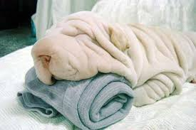
Is it a towel or a real dog?
Shar Pei puppy really looks
like an exotic towel!

Slide 17
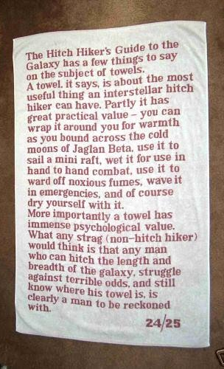
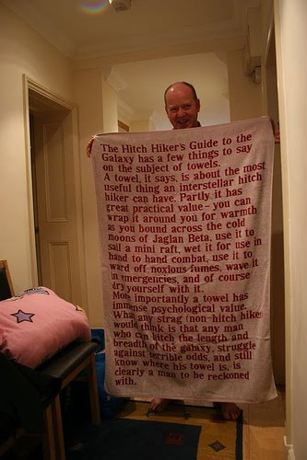
Two prototype towels were produced by Marks and Spencer and then Eugen Beer gave them to Douglas Adams in 1984One was red text on a white background which Douglas kept.

Slide 18
From Australia to the USA, Towel Day events are taking place in parks and public places, including recitals of Vogon poetry in Prague and Barcelona, a flashmob in Berlin, celebrations at the cafes at the End of the Universe in Bali, Indonesia, and a party in St Petersburg, Russia.

Slide 19
The commemorative day was first held in 2001, two weeks after Adams' death from a heart attack aged 49. Fans of Adams' are often seen carrying a towel with them throughout the day.

Slide 20
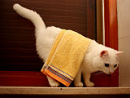
It’s Towel day!

Slide 22
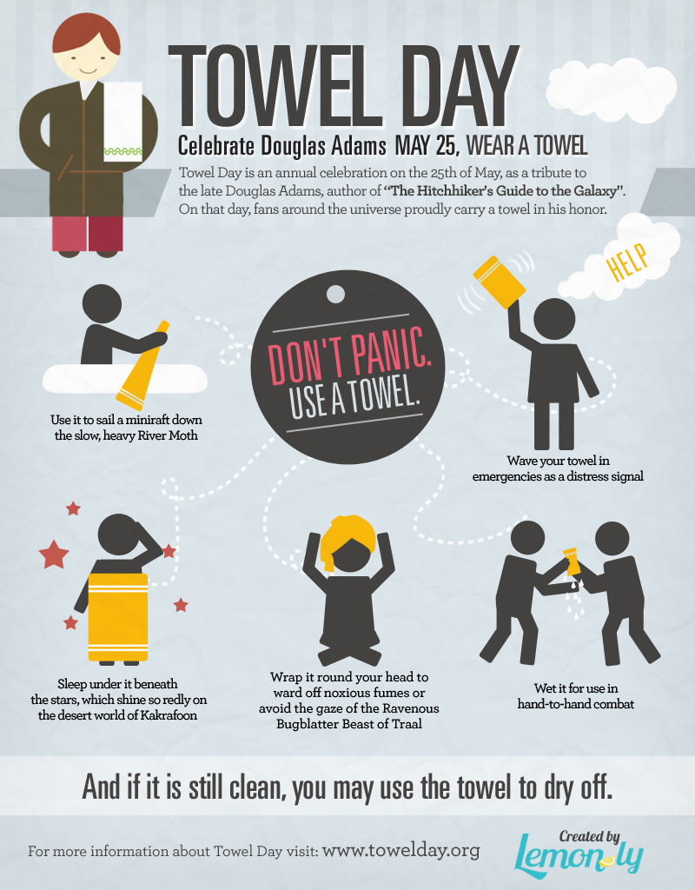
Do not panic!
Use a towel!

Slide 23
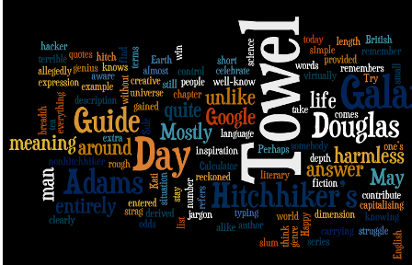

Slide 25
Let’s celebrate!

Slide 26
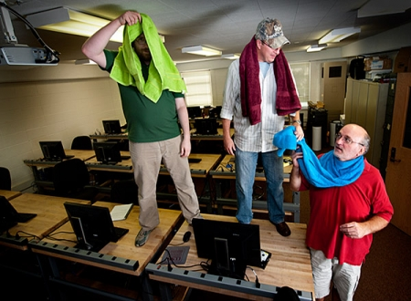
Ready to celebrate!

Slide 29
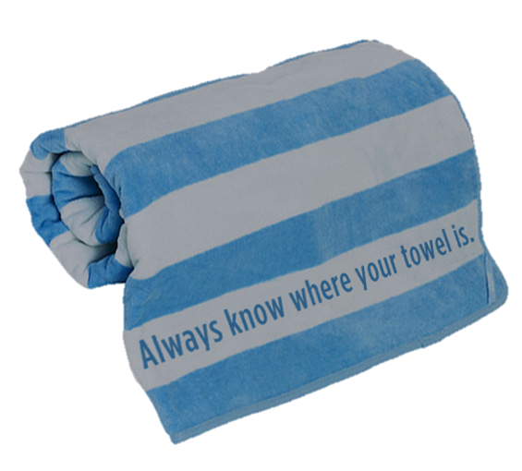

Slide 30
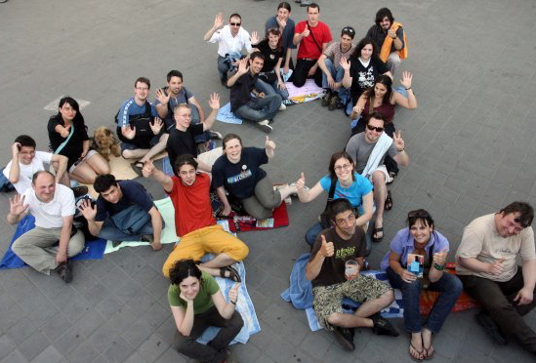
Hope you
do want to join the Day!

Slide 31
If you love Douglas Adams How can you get involved?
Help spread the word about Towel Day tweet, blog, post in forums, share a link in Facebook, make art, etc. On Towel Day, carry a towel. Where? Everywhere !

Slide 33
Adam's explains the inclusion of towels
in The Hitchhiker's Guide to the Galaxy.
Let’s enjoy!

Slide 34
Sources
http://www.bookdepository.com/Hitchhikers-Guide-Galaxy-Douglas-Adams/9780330508537
http://en.wikipedia.org/wiki/The_Hitchhiker's_Guide_to_the_Galaxy_(novel)
http://www.wired.com/geekmom/wp-content/uploads/2012/05/towel-day.png
http://einarkolumbus.files.wordpress.com/2013/05/towelday.png
https://bigheadbob.com/wp-content/uploads/2015/01/dont-panic-list.png
http://www.pribaikal.ru/uploads/pics/baikal-forum-0002.jpg
http://www.msstate.edu/web/memo/photos/2011-05-30.jpg
http://wypozyczalniaactif.pl/v3wordpress/wp-content/uploads/2015/02/1124_1.jpg
http://l1.yimg.com/bt/api/res/1.2/6tWgmCIvkA99_zv3N2RRew--/YXBwaWQ9eW5ld3M7cT04NQ--/http://media.zenfs.com/en-US/blogs/en-us-visit-britain-travel/TowelDay.jpg
http://alanbaxter.blob.core.windows.net/wordpress/wp-content/uploads/2013/03/douglas-adams.jpg
http://www.towel.org.uk/_/rsrc/1396639237517/home/the-quotation-towel/myspace_douglasadams.jpg
https://s-media-cache-ak0.pinimg.com/originals/8b/35/8d/8b358da441557e90e2fbc1a5ba54bda4.jpg
http://i.guim.co.uk/static/w-620/h--/q-95/sys-images/Guardian/About/General/2012/3/5/1330956047097/Douglas-Adams-author-of-t-007.jpg
http://www.doggyadvices.com/wp-content/uploads/2014/03/Dog-towel.jpg

