Slide 1
Презентация к занятиям по внеклассному чтению в 4–5 классах по сказке «Aladdin»
МАОУ СОШ № 67 с углубленным изучением
отдельных предметов г. Екатеринбурга
Ваторопина Елена Васильевна,
учитель английского языка
высшей квалификационной категории
2015

Slide 2
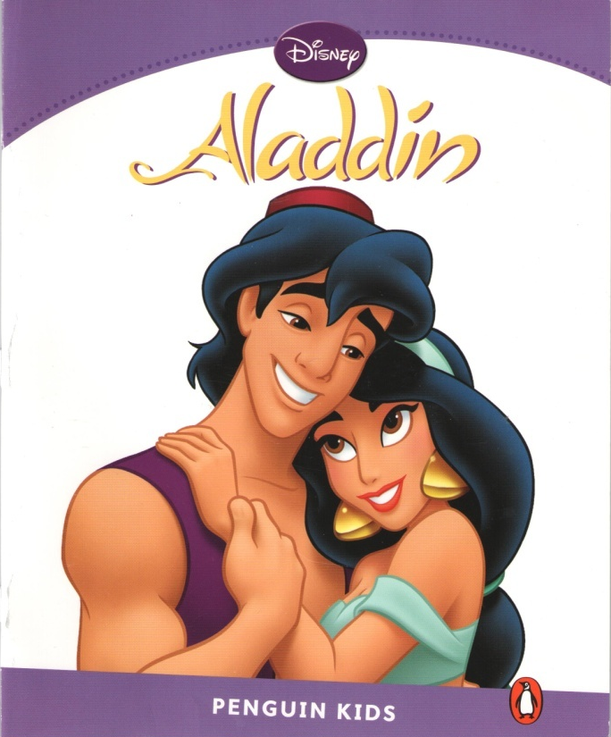
“Aladdin” by Jocelyn Potter

Slide 3
The main idea of the book
If you want to succeed, try to do everything possible and impossible!
Be kind and brave, and your dreams will come true!

Slide 4
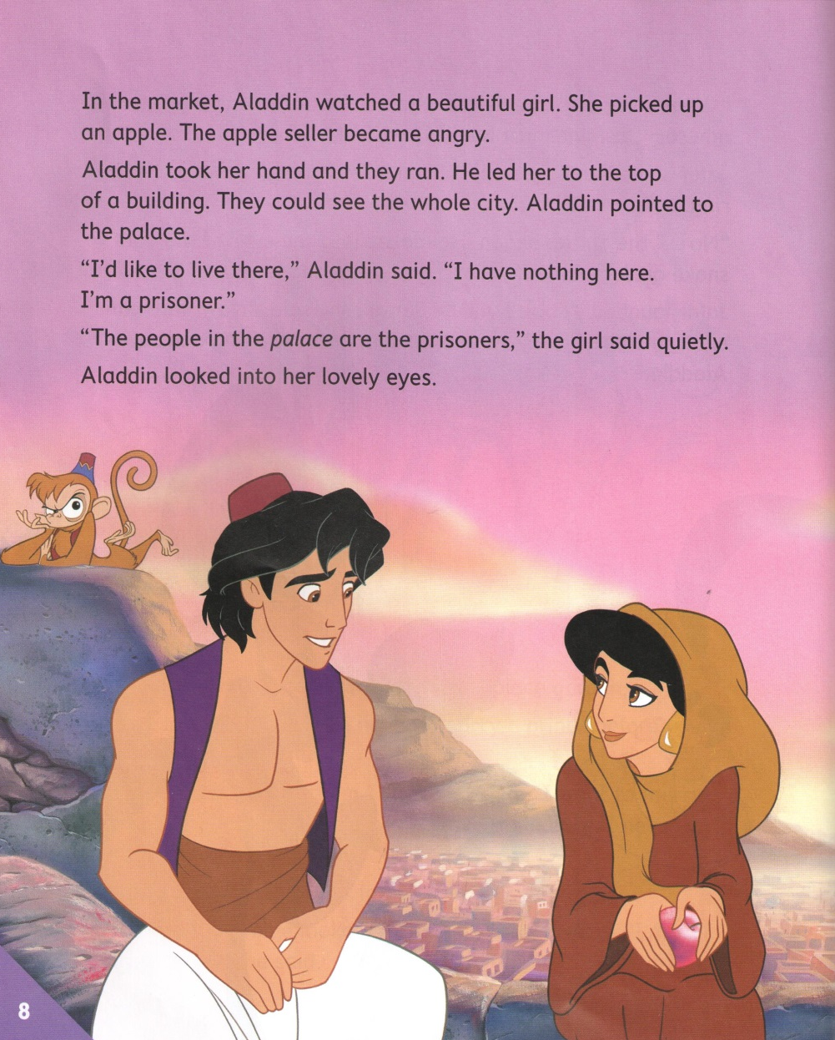

Slide 5
The main characters of the story
Aladdin, a street boy – kind and curious, smart and brave.
The Sultan – kind and merry.
Jafar, the Sultan’s advisor – angry and greedy.
Princess Jasmine, the Sultan’s daughter – beautiful and clever.
The Genie – kind and fair.

Slide 6
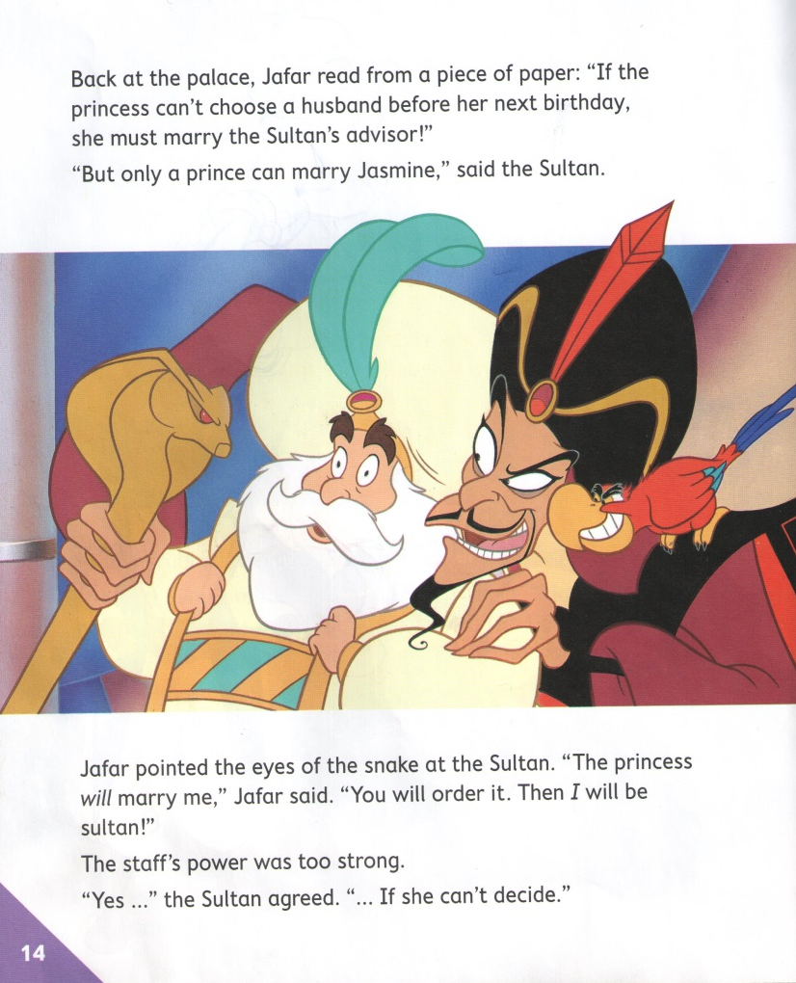

Slide 7
There lived Aladdin – a poor street boy. He had a friend Abu, the monkey.
The Sultan and his daughter lived in the palace. The Sultan wanted Jasmine to marry a prince. But Jasmine wanted to marry for love. She met Aladdin and they loved each other.
Sultan’s advisor Jafar did everything to marry a princess. But Aladdin and Jasmine won that struggle. The Genie, kind and fair, helped them. Jafar was a prisoner inside the lamp.
The Genie was free. And they all lived happily until the end of their days.

Slide 8
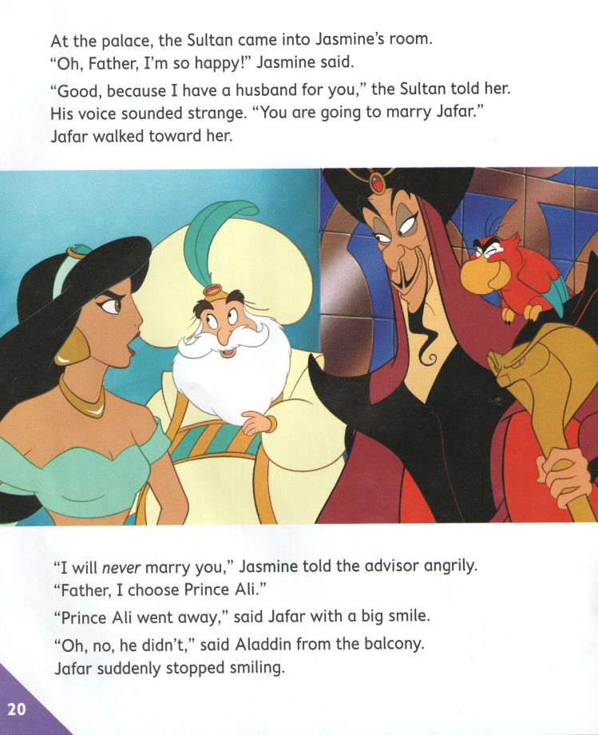

Slide 10
Enjoy reading!
We advise you to read this book!
It is interesting and rather unusual. The characters of the book are very different.
In addition the book is beautifully illustrated, bright and colourful.

Slide 11
Ребята рисуют героев сказки
by Iliza Arslanova
by Polina Ladigina

Slide 12
Источники
http://www.twirpx.com/file/890034/

Slide 13
The more we read,
the more we learn !

