Slide 1
Презентация к занятиям по внеклассному чтению в 4–5 классах по сказке “The Pied Piper of Hamelin” by Nicole Taylor
МАОУ СОШ № 67 с углубленным изучением
отдельных предметов г. Екатеринбурга
Ваторопина Елена Васильевна,
учитель английского языка
высшей квалификационной категории
2015

Slide 2
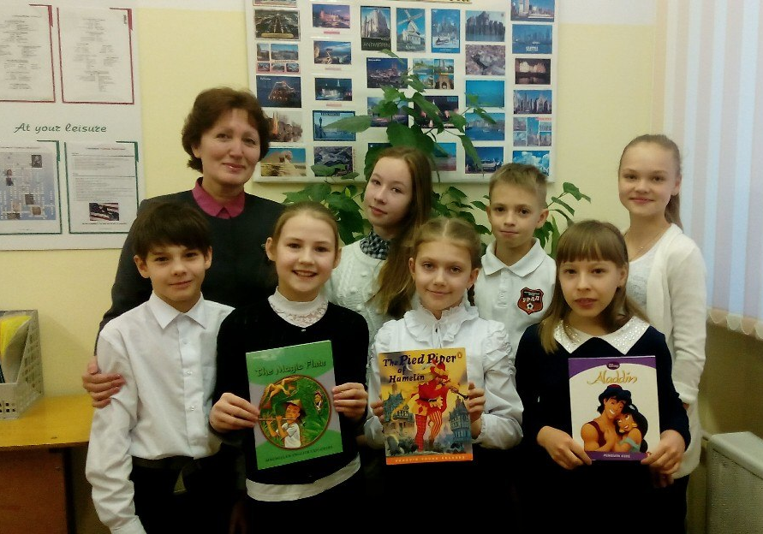
The more we read,
the more we learn !

Slide 3
“The Pied Piper of Hamelin”
by Nicole Taylor

Slide 4
The main idea of the book:
Don’t play a trick on people!
If you do it, you will be justly punished!

Slide 5
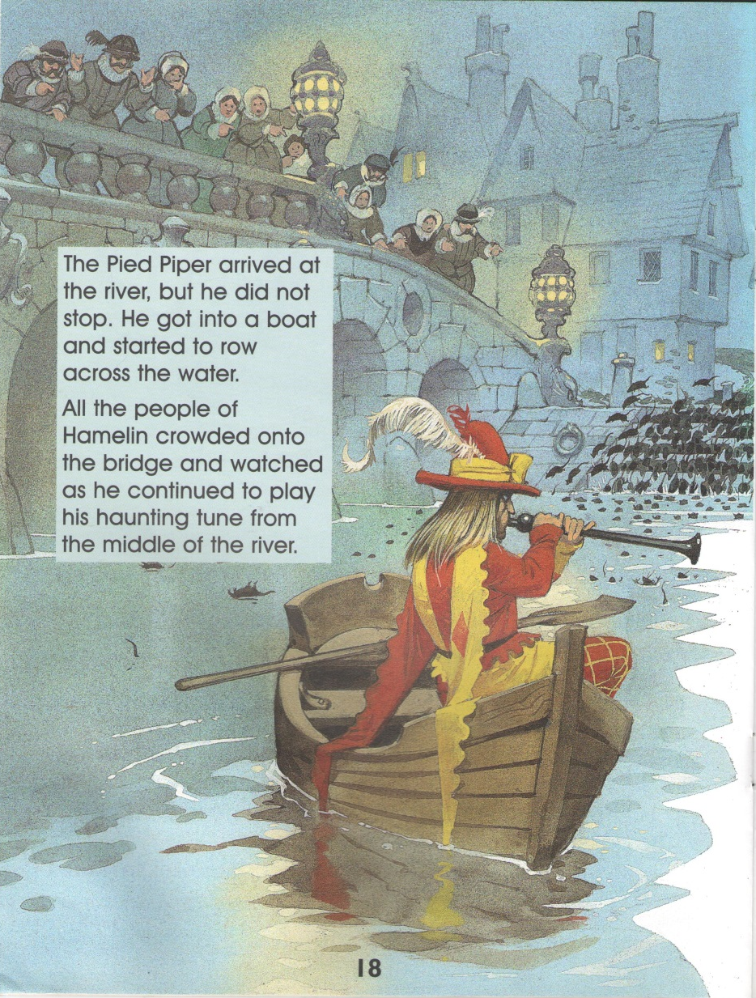

Slide 6
The Pied Piper was kind – he helped people kill the rats.
But after they played a trick on him, he became angry and decided to punish them!

Slide 7
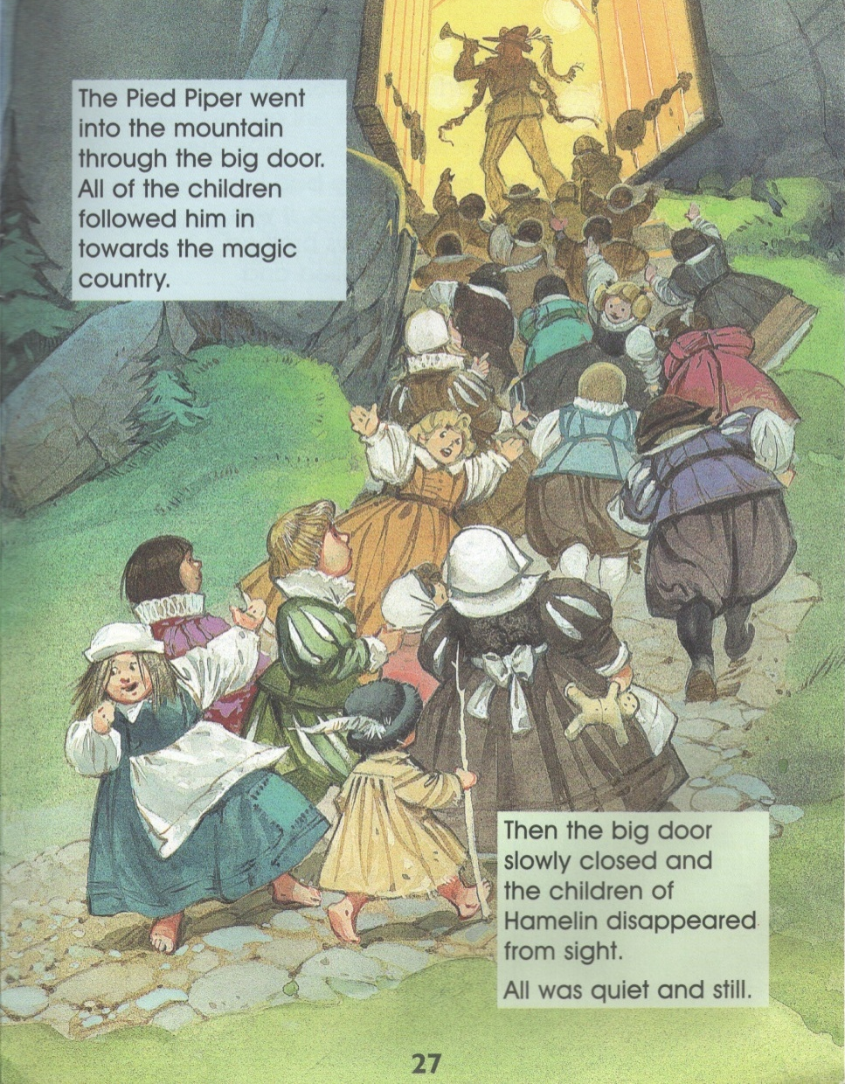

Slide 8
Enjoy reading!
The book is very interesting
and rather instructive!

Slide 9
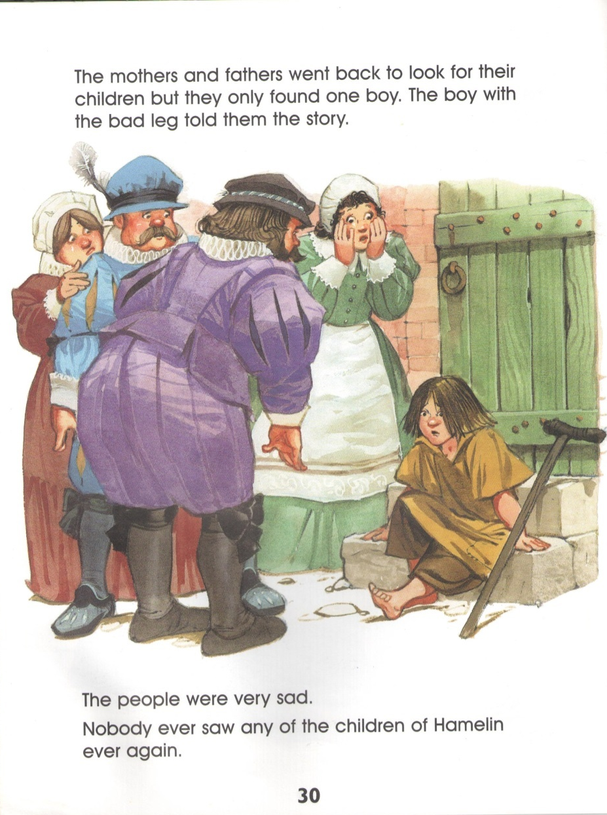

Slide 10
The Pied Piper helped people kill the rats.
They didn’t pay him and he was very angry .
He went into the mountain through the big door. And all the children followed him in towards the magic country. The people were very sad. Nobody ever saw any of the children of Hamelin again.

Slide 11
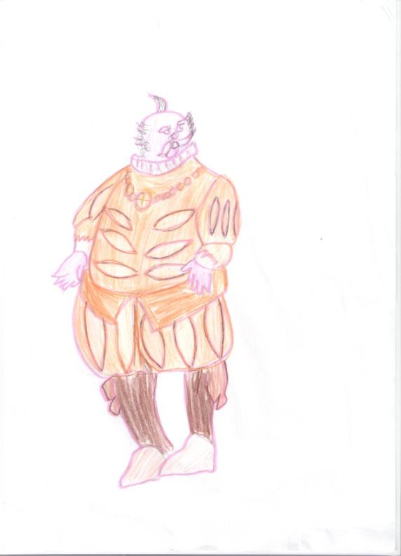
Ребята рисуют героев книги
by Sasha Kovalyova

Slide 12
Источники
http://www.books.ru/books/the-pied-piper-of-hamelin-3043105/

Slide 13
The more we read,
the more we learn !

