Slide 1
Презентация к занятиям по внеклассному чтению в 4–5 классах “The Princess and the Wizard” by Julia Donaldson
МАОУ СОШ № 67 с углубленным изучением отдельных предметов г. Екатеринбурга
Ваторопина Елена Васильевна,
учитель английского языка
высшей квалификационной категории
2015

Slide 2
Synopsis
The princess may try seven times to escape By changing her colour and changing her shape. But each time Princess Eliza changes into a blue fish, a yellow chick, a red fox or a black cat the wicked wizard finds her and sets her another horrible task. Will this plucky princess be able to outwit him and escape back to the palace in time to cut her birthday cake?

Slide 3
Author's Biography
Julia Donaldson is the UK's most successful picture book author, whose titles include the acknowledged modern classic, The Gruffalo, together with Room On The Broom, The Smartest Giant In Town and The Snail And The Whale, all illustrated by Axel Scheffler. This is her first picture book with Lydia Monks. Julia is also much in demand for her brilliant events for children at schools, libraries and literary festivals. Lydia Monks is one of the UK's most original picture book artists, whose brilliantly coloured collage images have given her a strong following. Her previous books for Macmillan include Esmerelda by Karen Wallace, and Queen Munch And Queen Nibble and The Skipping-Rope Snake, both by Carol Ann Duffy.

Slide 4
“The Princess and the Wizard”
by Julia Donaldson
The main idea of the book:
If you want to succeed, you’ll have to make it on your own: your own head, your own energy, your own ambitions.
If at first you don’t succeed, try, try and try again!

Slide 7
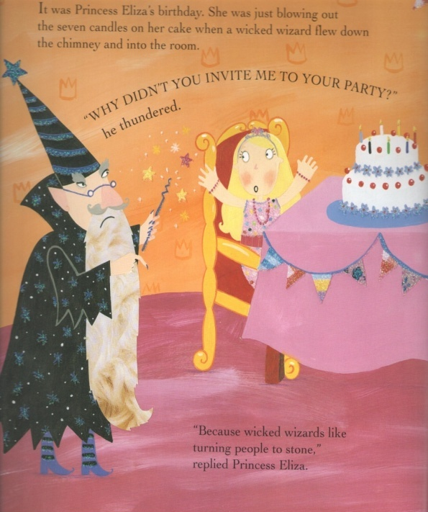
“The Princess and the Wizard”
by Julia Donaldson
Eliza is a young princess.
She is very clever, kind,
courageous and persistent.

Slide 8
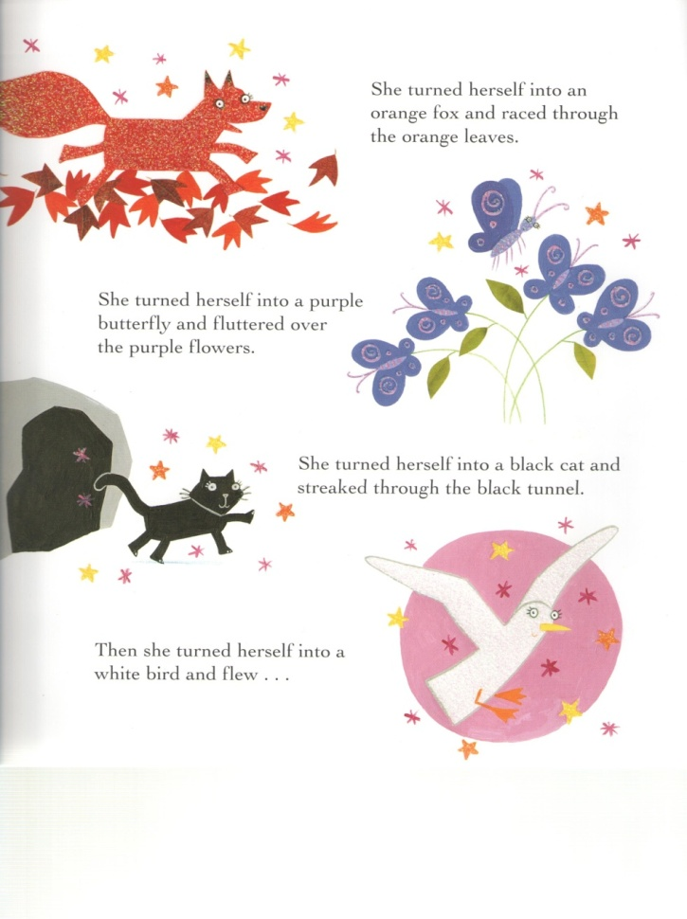
“The Princess and the Wizard”
by Julia Donaldson
The Princess has seven times to escape by changing her colour and changing her shape. The princess attempts to escape by changing into a fish, a chick, a grasshopper, fox, butterfly, cat and bird. Princess Eliza finally realizes that the Wizard is one step ahead and knows exactly what she is doing. Eliza cleverly turns herself into a blank page in the Wizards book and escapes just in time to re-join her party.

Slide 9
“The Princess and the Wizard”
by Julia Donaldson
Enjoy reading!
The book is very interesting! The readers feel as if they are on a journey with Eliza to escape from the castle of the wizard.
In addition the book is beautifully illustrated, bright and colourful with the use of glitter.

Slide 10
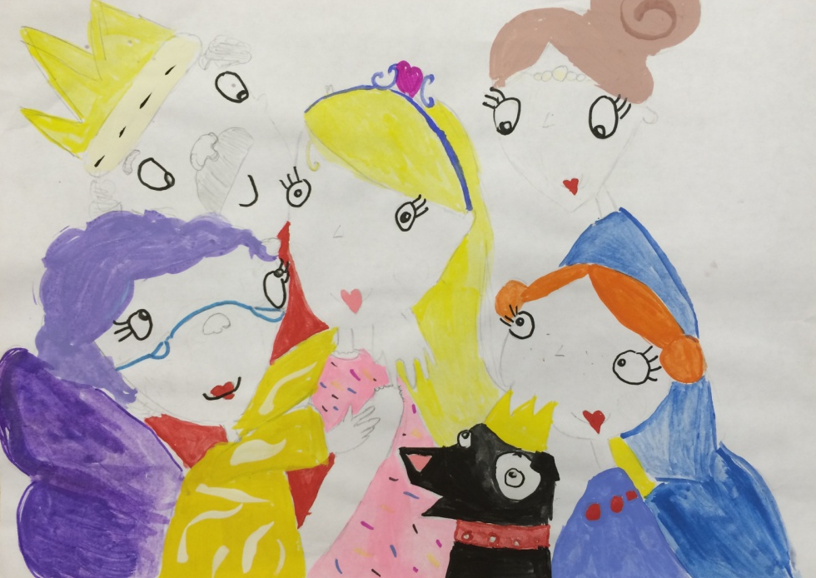
Рисунки учащихся по книге
Арсланова Илиза, 4 класс
Ладыгина Полина, 4 класс

Slide 11
Источники
http://www.tesco.com/direct/the-princess-and-the-wizard/A2F-K2UZ.prd
http://www.tesco.com/direct/sharing-a-shell/T5T-24RL.prd#dQ5dc3BSP8yjhfX5.99

Slide 12
Thank you for attention!
Enjoy reading!

