Slide 1
Презентация к занятиям по внеклассному чтению в 4–5 классах “The Magic Flute” (A Chinese legend adapted by Gill Munton)
МАОУ СОШ № 67 с углубленным изучением отдельных предметов г. Екатеринбурга
Ваторопина Елена Васильевна,
учитель английского языка
высшей квалификационной категории
2015

Slide 2
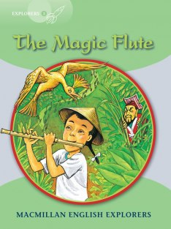

Slide 3
“The Magic Flute” A Chinese legend adapted by Gill Munton
The main idea of the book:
Kindness and friendship are above all!

Slide 4
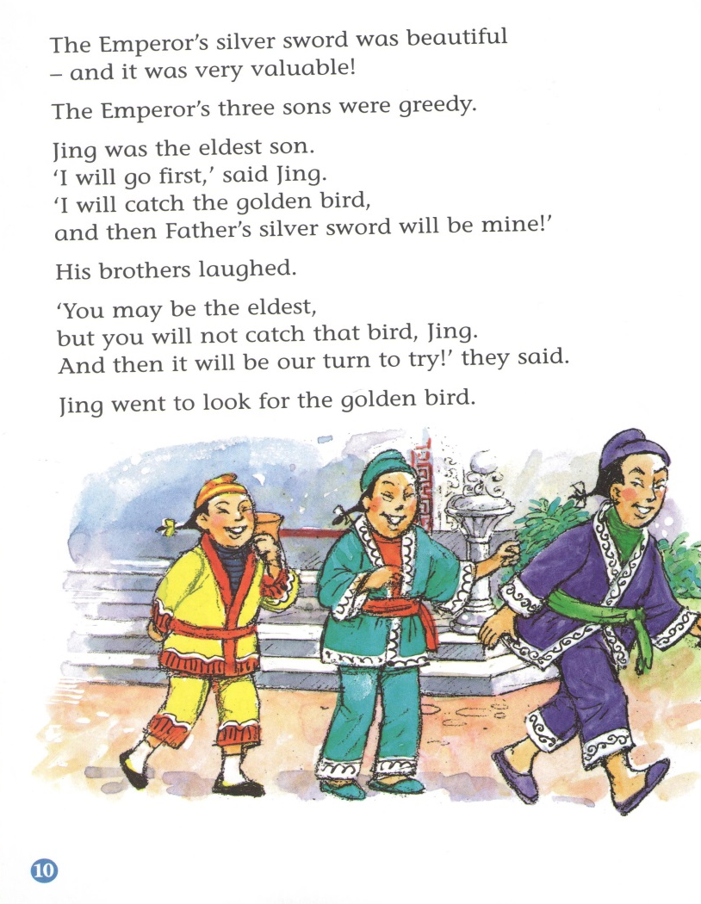

Slide 5
The main characters of the story:
Chang – a kind and just boy.
The Emperor – angry and greedy.
The Emperor’s three sons – greedy and lazy.
An old man – kind and wise.

Slide 6
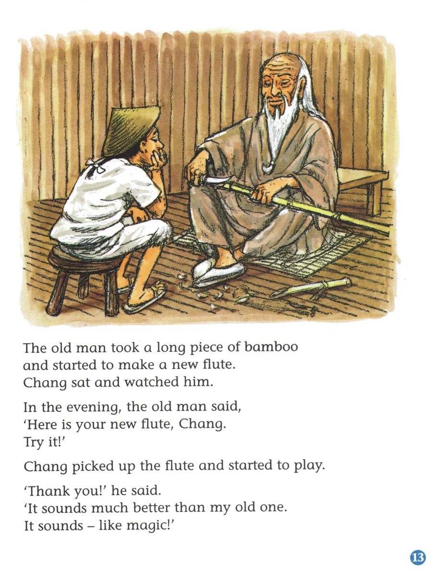

Slide 7
Chang loved playing his wooden flute, but the wicked Emperor was jealous of his skill and popularity. With the help of a mysterious old man and a golden bird, Chang outwitted the Emperor and helped the poor people of the village.

Slide 8
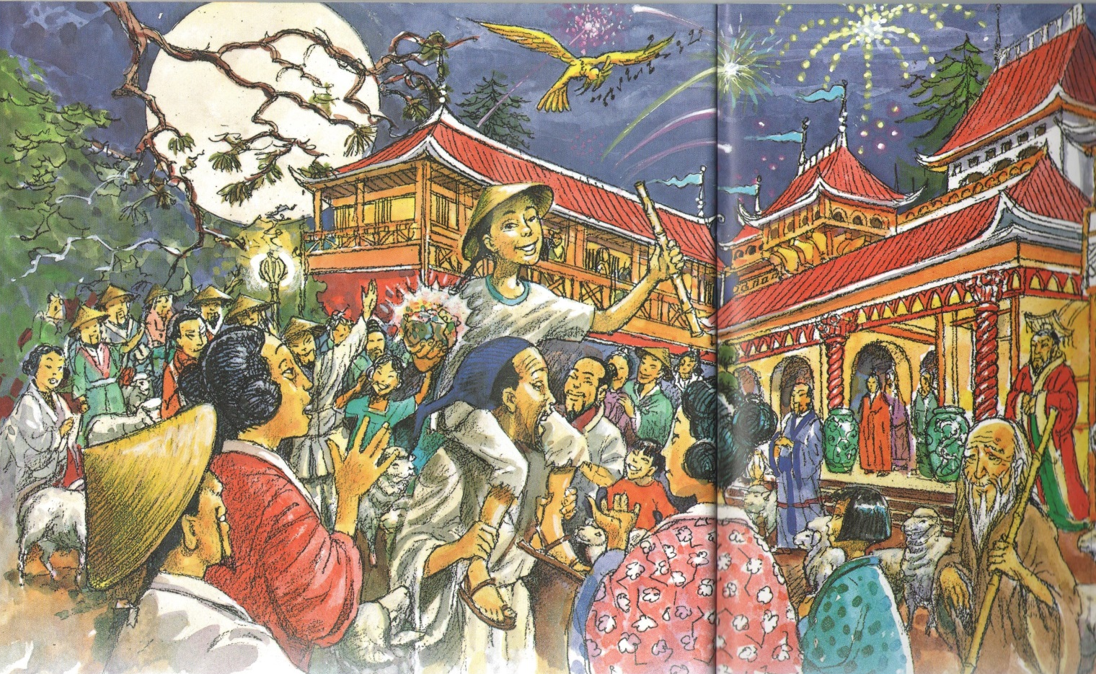

Slide 9
Enjoy reading!
It is interesting to read this book!
Kindness and friendship help us
to overcome all the difficulties.

Slide 10
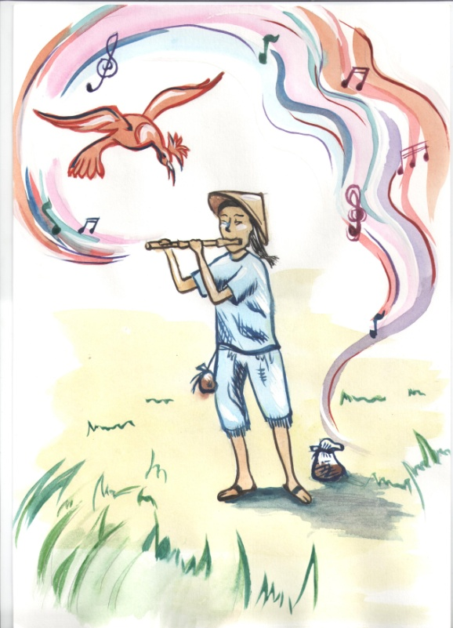
Учащиеся рисуют героев книги
Влада Абакумова

Slide 11
Источники
http://www.macmillan.ru/catalogue/31/25875/

Slide 12
The more we read,
the more we learn !

