Slide 1
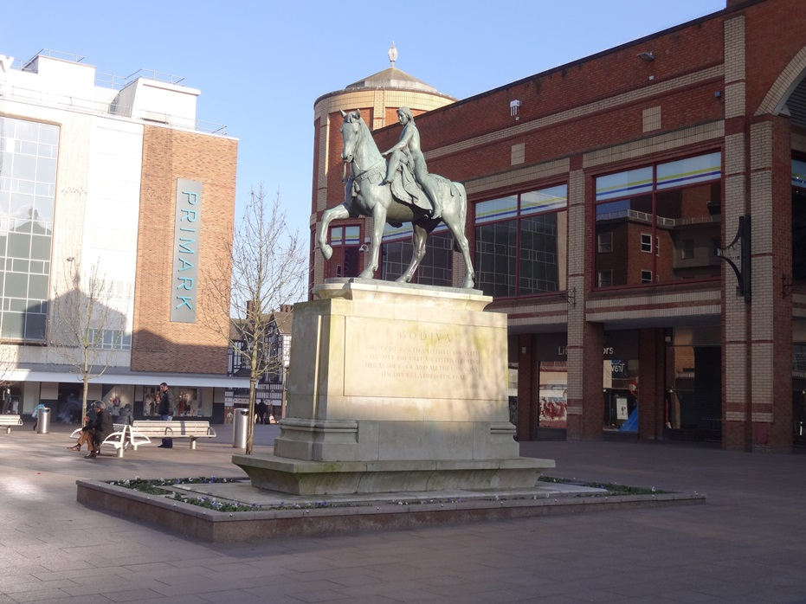
Coventry Lady
Рассказ об истории Англии
в лице Леди Годива
с интерактивными элементами
для учащихся 10-11 классов
Автор
Ольга Михайловна Степанова
Учитель английского языка
МБОУ «Цивильская СОШ №2»
города Цивильск
Чувашской Республики
2015

Slide 2
History of England
“… and She rode through the silent streets unseen by the people...”

Slide 3
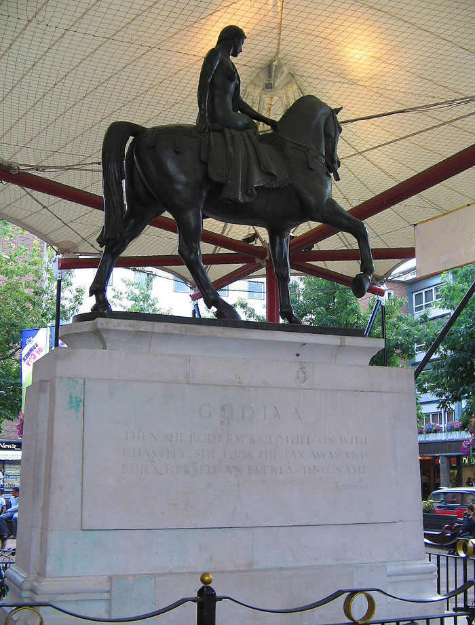
Statue of Lady Godiva by Sir William Reid Dick in Coventry city centre. unveiled at midday on 22 October 1949 in Broadgate, Coventry

Slide 4
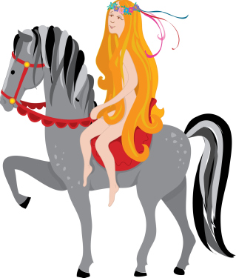
The legend has it that Godiva, a generous and kind-hearted lady, accepted a challenge from her husband, that if she rode naked through the streets of Coventry, he would reduce taxes for the commoners. She won the bet, letting down her long hair to cover her body so that no-one saw her nakedness.

Slide 5
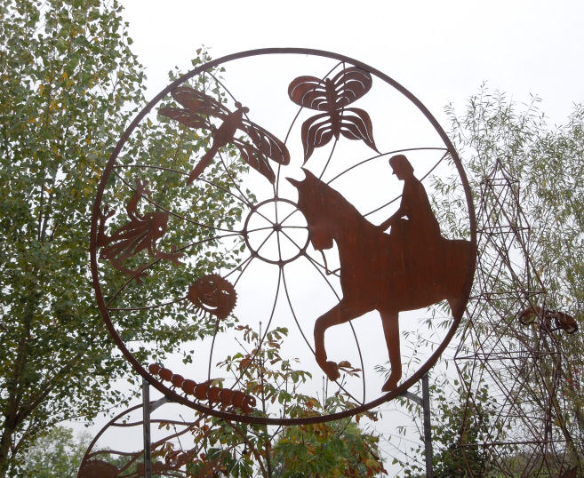
A screen based on local history and wild life, the main figure is based on a famous illustration of Lady Godiva with some local wild life designed by the local primary school

Slide 6
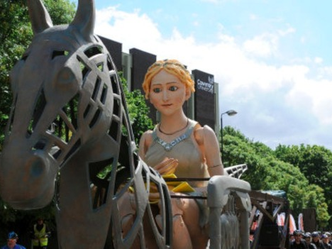
In Anglo-Saxon, Godiva's name was Godgifu, meaning "God's gift."

Slide 7
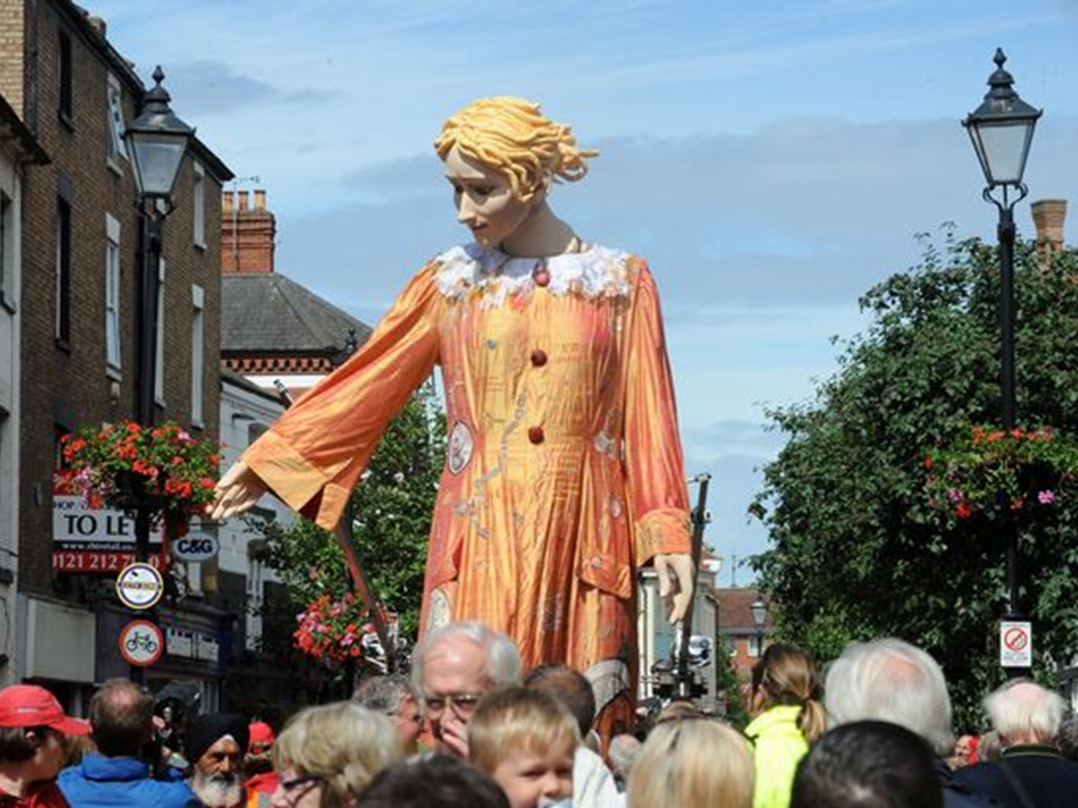
She was married to Leofric of Mercia, a powerful earl who controlled most of central England, a friend of the king, Edward the Confessor.
http://www.coventrytelegraph.net/whats-on/find-things-to-do/lady-godiva-returns-coventry-godiva-5684165

Slide 8
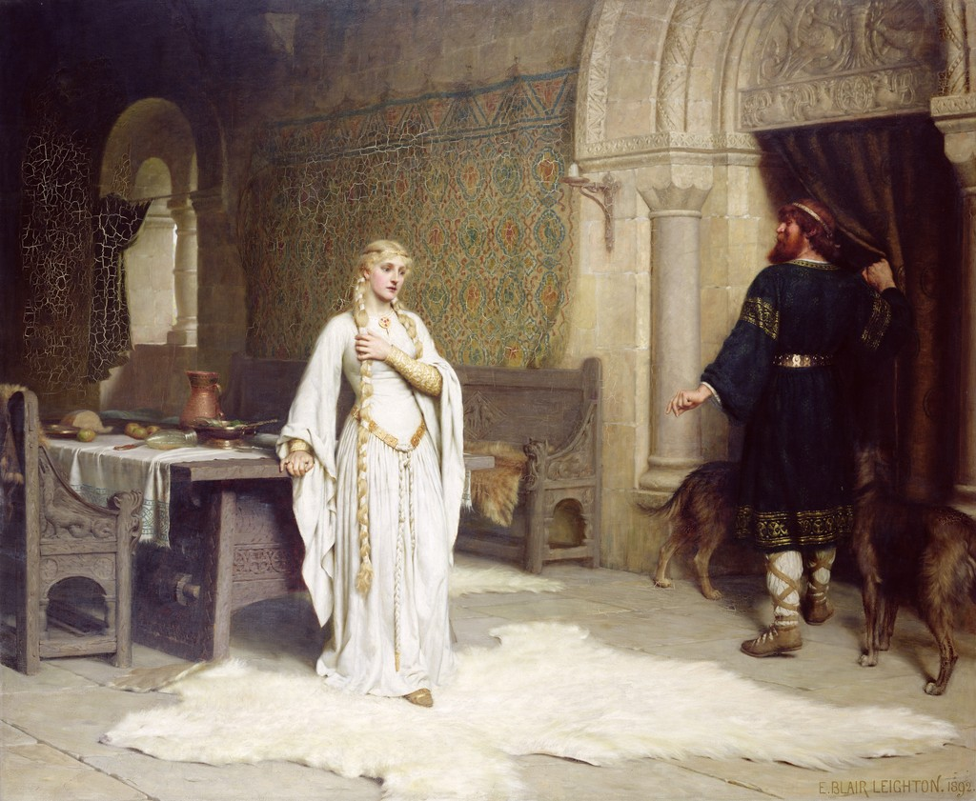
Lady Godiva was the wife of Leofric, lord of Coventry According to the story she felt that his taxes on the people were unfair. Irritated, he said that he would change them if she rode naked through the marketplace. She did so, wearing only her long hair.
The townspeople respectfully stayed indoors, but a tailor named Tom sneaked a peek out his window and was struck blind. This story seems to be the origin of the expression "peeping Tom."

Slide 9
Everyone knows the story of Lady Godiva, but do you know who she was or why she did it? Now you know: Godiva was a good woman who carried out her daring stunt to help the poor people of her home town.
Paul Perro's poem below tells
the story in a fun way.
Now it is high time to guess the rhymes of the famous poet!
Ready? Steady? Go!

Slide 10
Leofric was a rich man And he lived in Coventry. His wife was called Godiva And she was as kind as could …
be

Slide 11
Godiva said to her husband one day “It’s a terrible thing I’m sure That we have so much money While everyone else is … .
poor

Slide 12
Perhaps we can give some money away To help the hungry and needy. We can keep a little bit for ourselves But I think we should stop being… .”
greedy

Slide 13
Her husband laughed and said “My dear, Stay away from my moneybox! You wouldn’t last five minutes If we couldn’t afford your fine … .”
frocks

Slide 14
Godiva thought for a while then said, “Let us both take oaths That we will give our money away If I can prove I don’t need … .”
clothes

Slide 15
The next day she got on her horse And let down her long hair. Nobody could believe what they saw, Godiva was totally … .
bare

Slide 16
“We must avert our eyes” said one, “Or else it would be rude. It’s not polite to stare at a lady When she is in the … .”
nude

Slide 17
So everybody looked away Apart from Peeping Tom. He had a sneaky peak and saw Lady Godiva’s … .
bum

Slide 18
When Godiva got back home Her husband said “I guess We’ll have to give our money away. You’ve proved you don’t need your … .”
dress

Slide 19
Welcome to watching Lady Godiva

Slide 20
Thank you for being with me
The story told you how Godiva pleaded with her husband to relieve the heavy burden of taxes he had imposed
upon the citizens.
England, 11th century

Slide 21
http://www.history-for-kids.com/lady-godiva.html
https://upload.wikimedia.org/wikipedia/commons/8/8f/Godiva_statue_by_William_Reid_Dick.jpg
http://www.artinsteel.co.uk/userimages/screen%20finished%20020.JPG
http://www.coventrytelegraph.net/whats-on/find-things-to-do/lady-godiva-returns-coventry-godiva-5684165
http://www.bbc.co.uk/history/ancient/anglo_saxons/godiva_01.shtml

