Slide 1
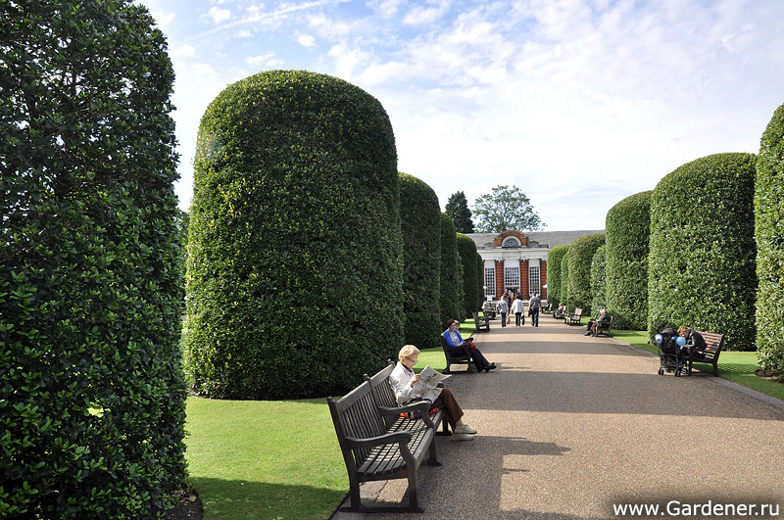
Hyde Park , London
Шайдурова Валентина Федоровна
Учитель английского языка
ГБОУ Школа №106»
Санкт-Петербург

Slide 2
London is full of wonderful parks
and Hyde Park is one of them.

Slide 3
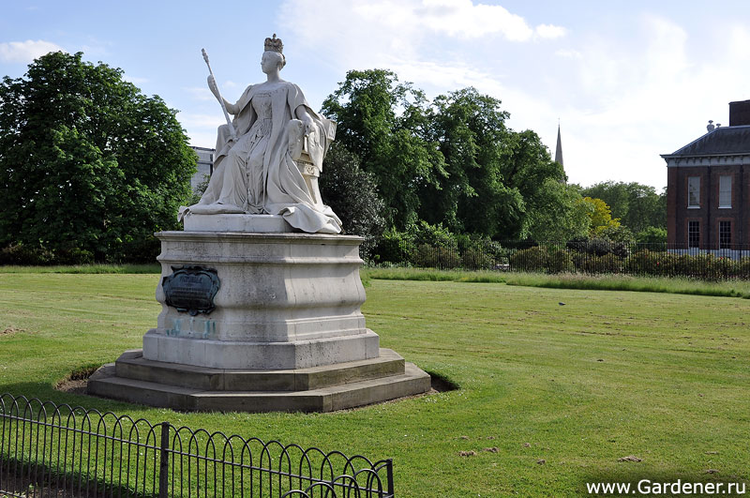
It’s considered to be a royal park.

Slide 4
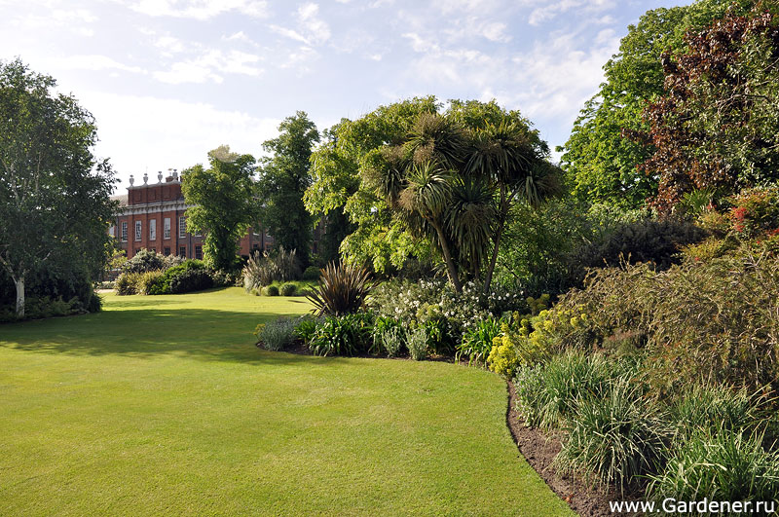
Hyde Park covers over 1, 4 square kilometers or 350 acres.

Slide 5
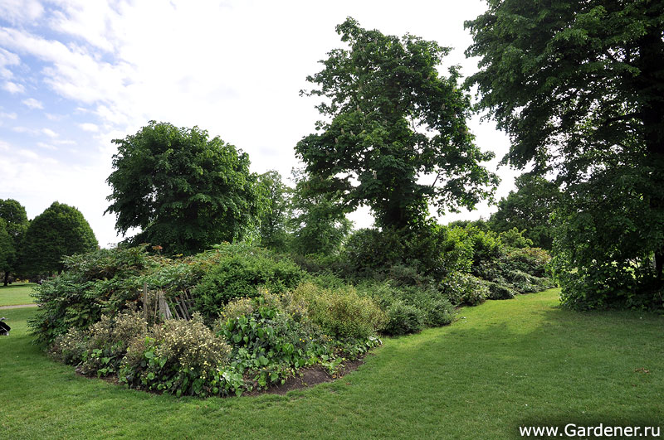
It has the finest landscape.

Slide 6
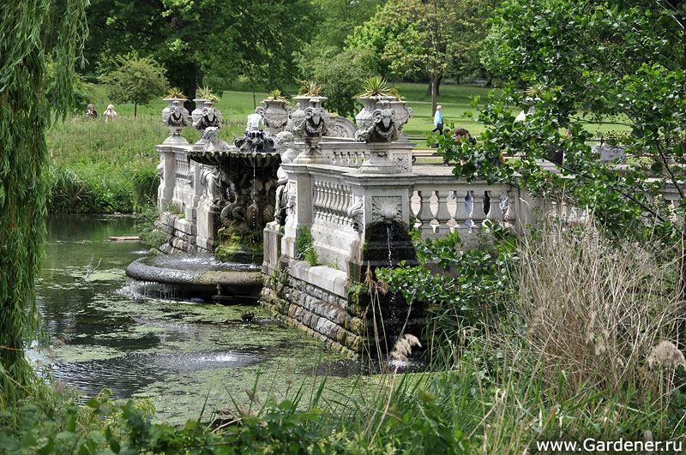

Slide 7
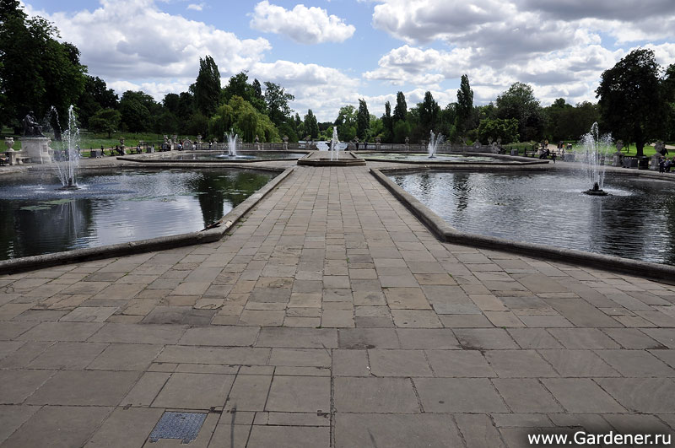

Slide 8
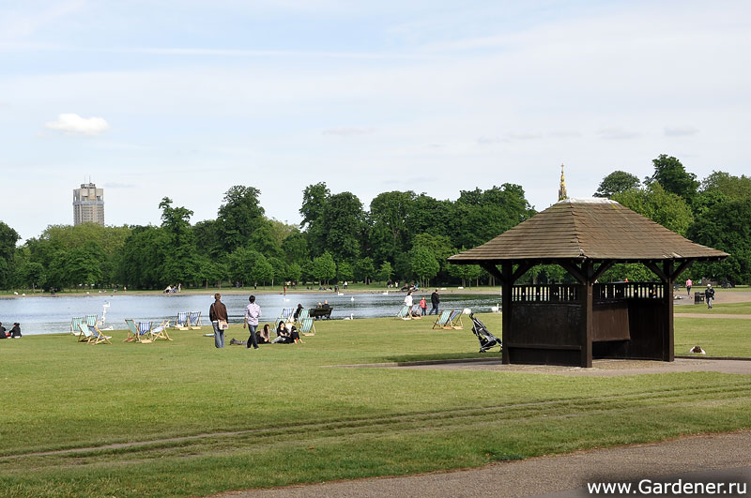
The main attraction of the park is Serpentine Lake which is
open for swimmers,
and the gallery of the same name.

Slide 9
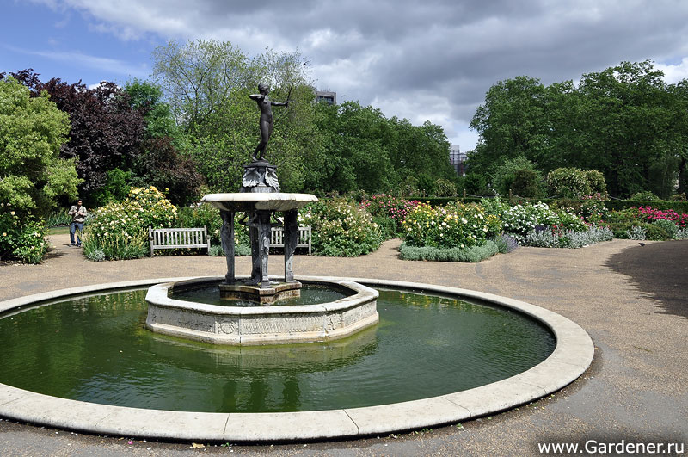
Another sight is the statue of Achilles,
which became the first almost naked statue in London
and caused uproar of citizens.

Slide 10
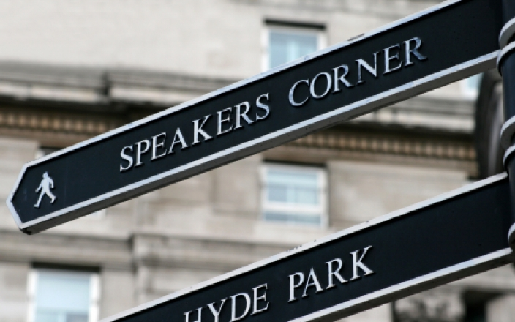
Hyde Park is also famous for its Speaker’s Corner.

Slide 11
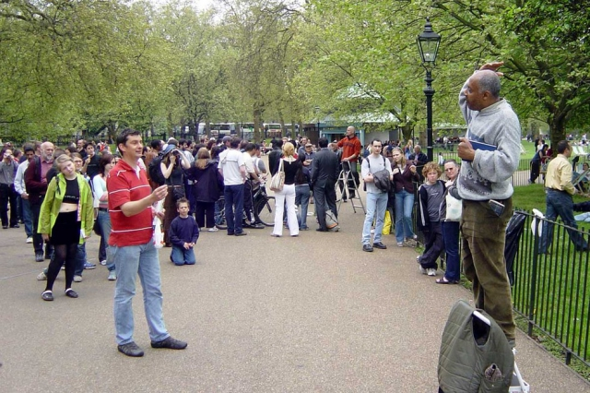
It’s the place where different orators and preachers demonstrate their eloquence.

Slide 12
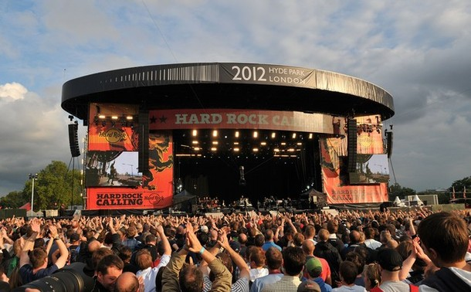
Nowadays Hyde Park is also often used for different rock concerts .

Slide 13
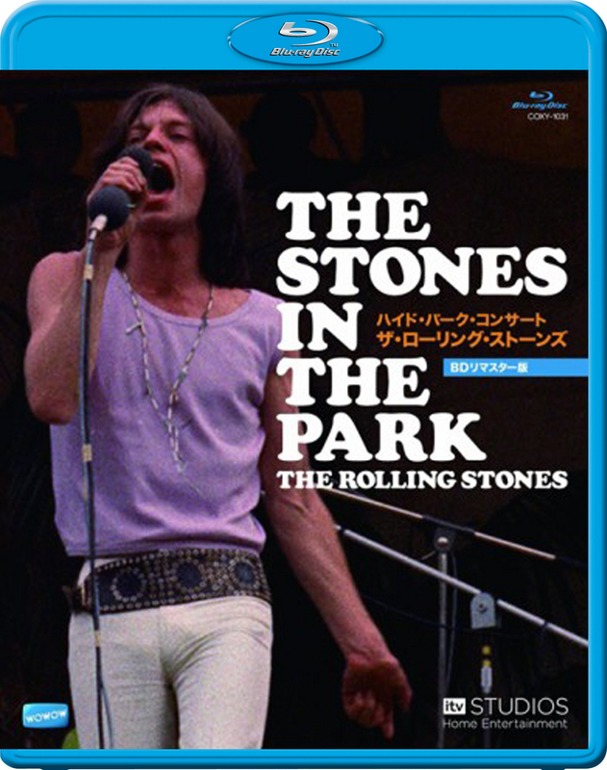
Many famous bands have already played here, among them Queen, Rolling Stones and others.

Slide 14
Resources
http://www.gardener.ru/gap/garden_guide/page174.php?cat=11
http://en365.ru/hyde_park.htm

