Slide 1
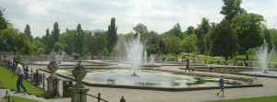
Top 10 Best Parks
in London
Шайдурова Валентина Федоровна
Учитель английского языка
ГБОУ «Школа №106»
Санкт-Петербург

Slide 2
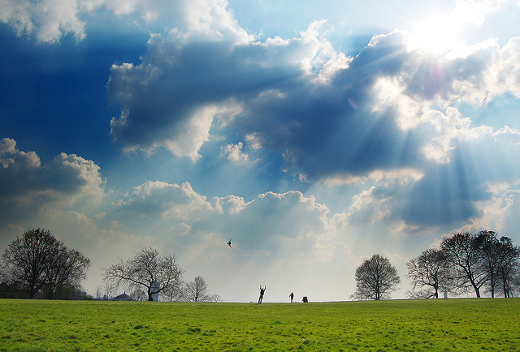
Take a break and
explore the city's delightful parks,
from picnic-perfect Hyde Park
to the countryside of Richmond Park.

Slide 3
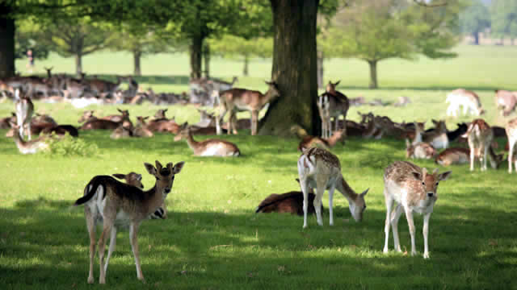
Richmond Park
As well as being the largest park in London
, Richmond Park is also home to over 650 deer.
And on top of the wildlife that there is on show here,
there are also play areas, a golf course and a fishing pond.

Slide 4
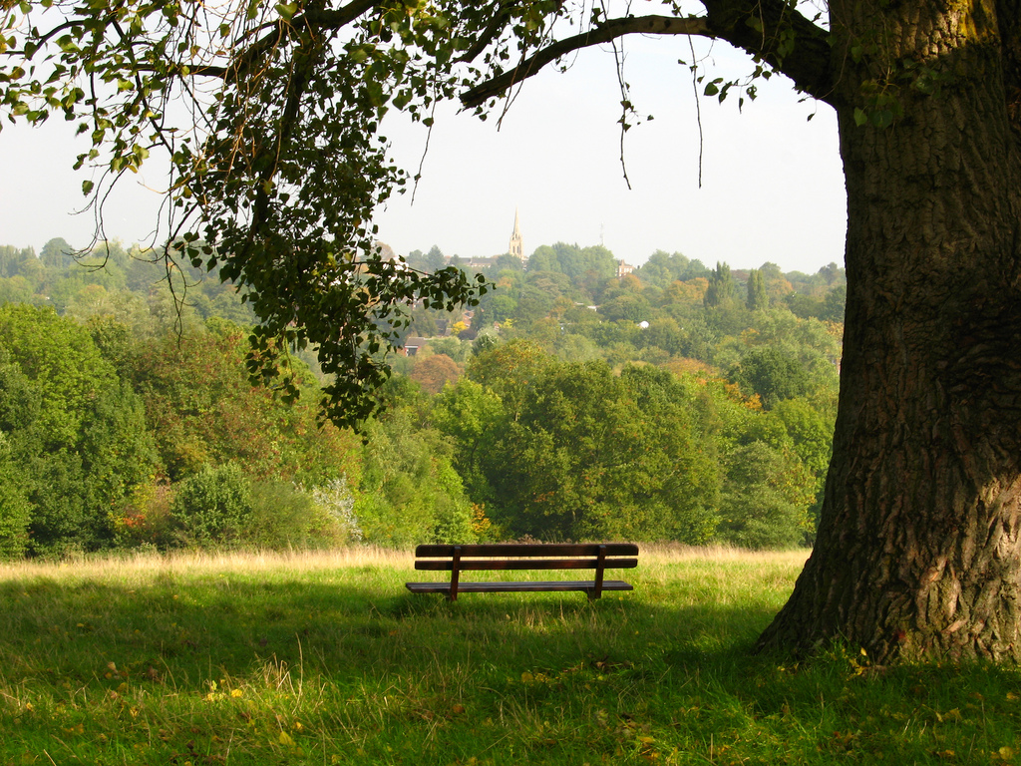
Hampstead Heath
Hampstead Heath is quite unlike the other parks in London.
It has been left to grow into a wild mass of trees and vegetation,
but this adds to its charm.
The north London park is the perfect picture of the countryside an
d it the ideal place to take a stroll and escape the city.

Slide 5
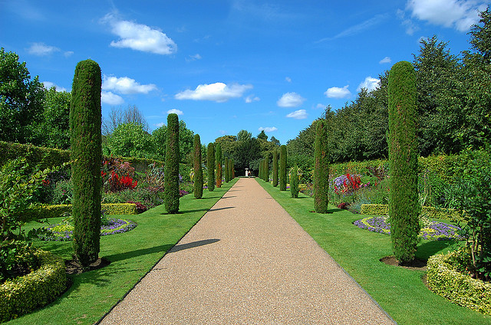
Regent’s Park
Another well-known and popular park in the capital,
Regent’s Park is a great place for a day outside.
Designed by architect John Nash in 1811,
the space is a huge open area which is perfect for all manner of sports.

Slide 6
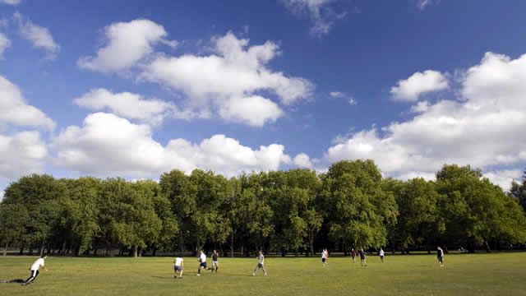
Victoria Park
‘
Vicky Park’, as it is affectionately known by locals,
is a large open space with plenty of facilities for sports an
d lots of room to run around and blow off some steam.
The park is situated in Tower Hamlets and
during the summer concerts take place here.

Slide 7
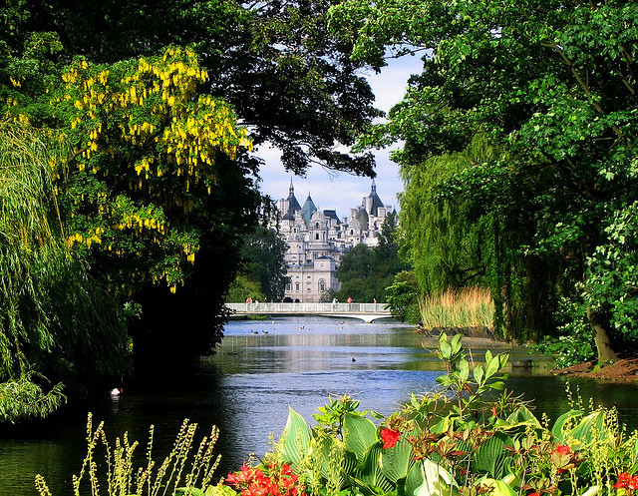
St James’s Park
Regal St James's Park is surrounded by three Royal palaces.
Spanning 23 hectares (58 acres) it has a lake - home to the park's famous pelicans.
You can watch them being fed at 2.30pm. It's also home to Horse Guards Parade and the Mall – the setting for countless ceremonial parades – and the stylish

Slide 8
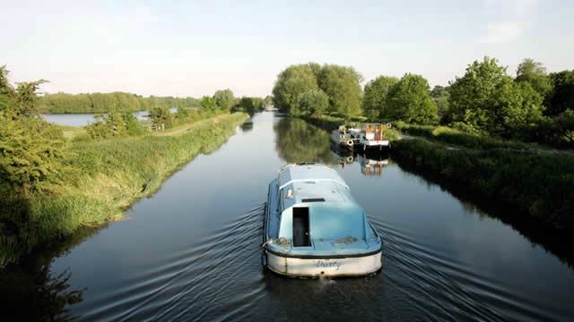
Lee Valley Regional Park
Lee Valley Regional Park stretches 26 miles (42 km) along the River Lee, from East India Docks, past Queen Elizabeth Olympic Park and up to Ware in Hertfordshire. This huge park offers green spaces, nature reserves and ample opportunity for sports.

Slide 9
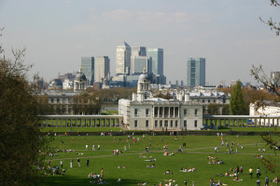
Green Park
Green Park was once purchased by Henry VIII as a hunting ground and in all honesty,
the space itself is quite unremarkable. However,
it is close to a number of other great attractions and
a stroll through its greenery can be rather pleasant on a bright London day.
St James’s Palace, Spencer House, Buckingham Palace, Piccadilly and Constitution Hill are
all within walking distance of the park.

Slide 10
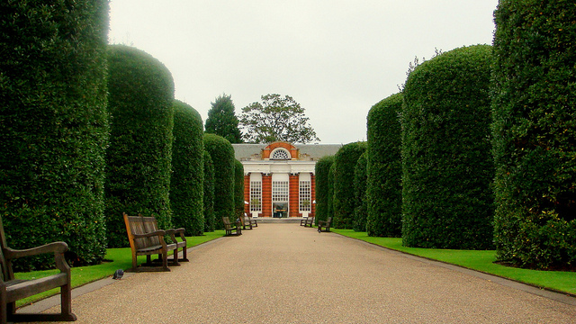
Kensington Gardens
Take a stroll through this beautiful Royal Park in Central London, home to Kensington Palace, the Albert Memorial, the Peter Pan Statue, beautiful flowers, green grass for picnics, and the Diana, Princess of Wales memorial playground.

Slide 11
Greenwich Park
Not only is Greenwich Park perfectly placed for a visit
to either of the National Maritime Museum or Royal Observatory
(two fantastic London institutions in their own right),
but the scene from the hill affords you
some of the best panoramic views of the entire city.

Slide 12
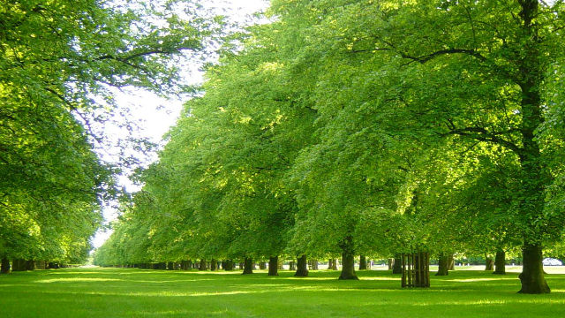
Bushy Park
Visit the historic Bushy Park, the second largest of London's Royal Parks,
and discover a wealth of wildlife, grassland, ancient trees,
woodlands, ponds and streams near Hampton Court Palace.Read More

Slide 13
Источники
http://www.visitlondon.com/things-to-do/openspace/best-parks-in-london
http://www.themontcalm.com/blog/10-best-parks-in-london

