Slide 1
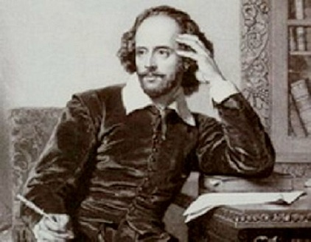
William Shakespeare
Шайдурова Валентина Федоровна
Учитель английского языка
ГБОУ «Школа №106»
Санкт-Петербург
2015

Slide 2
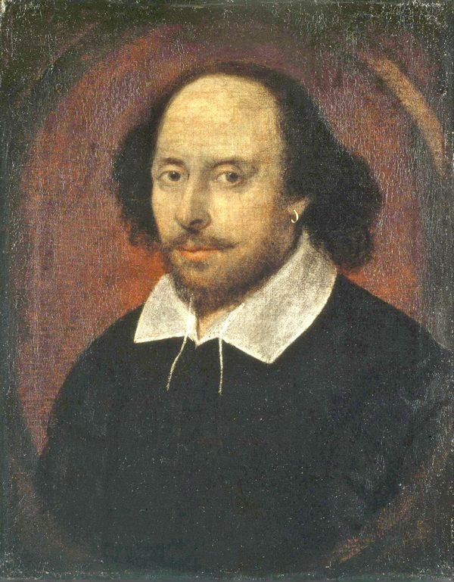
William Shakespeare (1564-1616).
English poet and playwright –
Shakespeare is widely considered to be the greatest writer
in the English language. He wrote 38 plays and 154 sonnets.

Slide 3
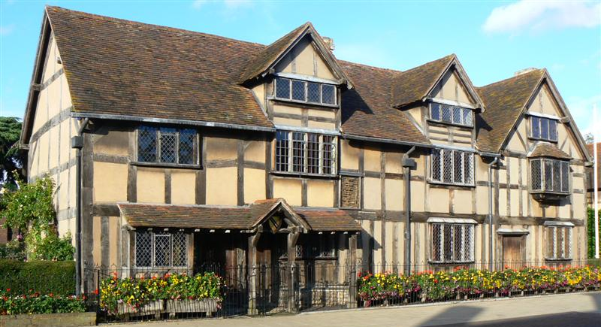
William Shakespeare was born in Stratford-upon-Avon on 23rd April 1564.
His father William was a successful local businessman and his mother Mary was the daughter of a landowner.

Slide 4
Relatively prosperous,
it is likely the family
paid for Williams education,
although there is no evidence
he attended university.

Slide 5
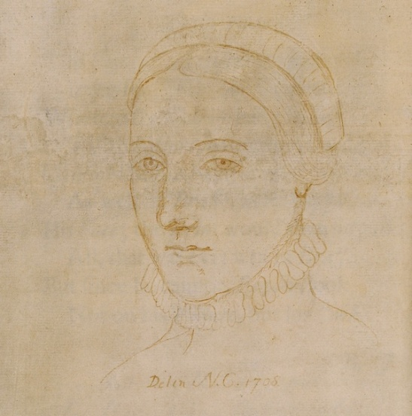
In 1582 William, aged only 18,
married an older woman named Anne Hathaway.
They had three children, Susanna, Hamnet and Juliet.
Their only son Hamnet died aged just 11.

Slide 6
After his marriage,
information about the life of Shakespeare
is sketchy but it seems
he spent most of his time in London –
writing and acting in his plays.

Slide 7
It is generally thought that during the 1590s he wrote the majority of his sonnets.
This was a time of prolific writing and his plays developed a good deal of interest and controversy.
His early plays were mainly comedies (e.g. Much Ado about Nothing, A Midsummer’s Night Dream) and histories (e.g. Henry V)

Slide 8
By the early Seventeenth Century, Shakespeare had begun to write plays in the genre of tragedy.
These plays, such as Hamlet, Othello and King Lear, often hinge on some fatal error or flaw in the lead character, and provide fascinating insights into the darker aspects of human nature.
These later plays are considered Shakespeare’s finest achievements.

Slide 9
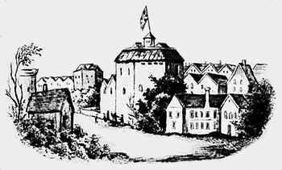
By 1599, William Shakespeare and his business partners built their own theater on the south bank of the Thames River, which they called the Globe.
In 1605, Shakespeare purchased leases of real estate near Stratford for 440 pounds, which doubled in value and earned him 60 pounds a year.
This made him an entrepreneur as well as an artist, and scholars believe these investments gave him the time to write his plays uninterrupted.

Slide 10
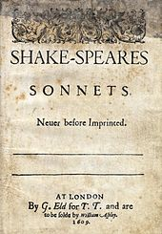
Shakespeare the Poet
William Shakespeare wrote 154 sonnets mostly in the 1590s. These short poems, deal with issues such as lost love. His sonnets have an enduring appeal due to his characteristic skill with language and words.
“Let me not to the marriage of true minds Admit impediments. Love is not love Which alters when it alteration finds, Or bends with the remover to remove:”
– Sonnet CXVI
Title page from 1609 edition of Shake-Speares Sonnets.

Slide 11
The Plays of Shakespeare
The plays of Shakespeare have been studied more than any other writing in the English language and have been translated into numerous languages. He was rare as a play-write for excelling in tragedies, comedies and histories. He deftly combined popular entertainment with a rare poetic capacity for expression which is almost mantric in quality.
“This above all: to thine ownself be true, And it must follow, as the night the day, Thou canst not then be false to any man. Farewell: my blessing season this in thee!”
-Lord Polonius, Hamlet Act I, Scene 3
.

Slide 12
His plays have retained an enduring appeal throughout history and throughout the world. Some of his most popular plays include:
Twelfth Night
Henry V
Romeo and Juliet
Macbeth
Hamlet
King Lear
Othello
Procession of Characters from Shakespeare's Plays by an unknown artist

Slide 13
Later Works: Tragedies and Tragicomedies
It was in William Shakespeare's later period, after 1600, that he wrote the tragedies Hamlet, King Lear, Othello and Macbeth.
In these, Shakespeare's characters present vivid impressions of human temperament that are timeless and universal.
Possibly the best known of these plays is Hamlet, which explores betrayal, retribution, incest and moral failure. These moral failures often drive the twists and turns of Shakespeare's plots, destroying the hero and those he loves.

Slide 14
In William Shakespeare's final period, he wrote several tragicomedies. Among these are Cymbeline, The Winter's Tale and The Tempest. Though graver in tone than the comedies, they are not the dark tragedies of King Lear or Macbeth because they end with reconciliation and forgiveness.

Slide 15
Writing Style
William Shakespeare's early plays were written in the conventional style of the day, with elaborate metaphors and rhetorical phrases that didn't always align naturally with the story's plot or characters.
However, Shakespeare was very innovative, adapting the traditional style to his own purposes and creating a freer flow of words.
With only small degrees of variation, Shakespeare primarily used a metrical pattern consisting of lines of unrhymed iambic pentameter, or blank verse, to compose his plays.
At the same time, there are passages in all the plays that deviate from this and use forms of poetry or simple prose.

Slide 16
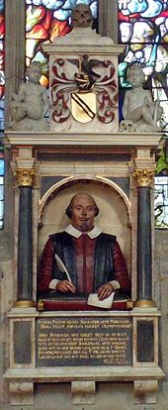
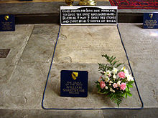
Shakespeare's grave, next to those of Anne Shakespeare, his wife
Death
Tradition has it that William Shakespeare died on his birthday, April 23, 1616, though many scholars believe this is a myth. Church records show he was interred at Trinity Church on April 25, 1616.
Shakespeare's funerary monument in Stratford-upon-Avon

Slide 17
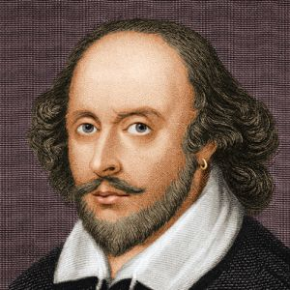
It is true to say that each line of Shakespeare has been poured over by scholars and students – no idea or concept has been left unturned. Shakespeare has left a profound and lasting impact on literature, cinema and theatre.

Slide 18
Resources
http://www.biographyonline.net/poets/william_shakespeare.html
http://www.poemhunter.com/william-shakespeare/biography
http://www.biography.com/people/william-shakespeare-9480323#controversy-and-literary-legacy
https://en.wikipedia.org/wiki/William_Shakespeare

