Slide 1
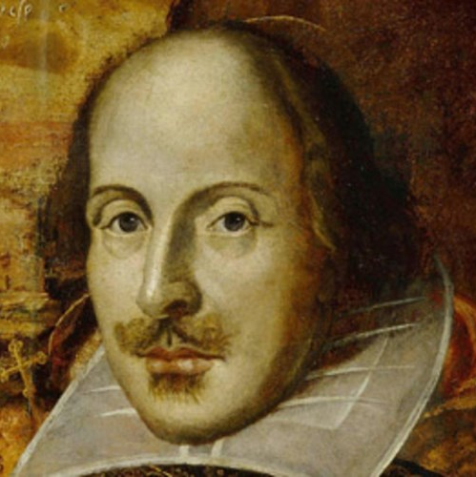
Shakespeare Quiz
Шайдурова Валентина Федоровна
Учитель английского языка
ГБОУ «Школа №106»
Санкт-Петербург
2015

Slide 2
The kind of a lyric poem
consisting of 14 lines
Sonnet

Slide 3
The name of a character
of a love tragedy
Romeo

Slide 4
The name of the main character of one of the famous tragedies
Othello

Slide 5
Shakespeare’s name
William

Slide 6
The kind of a play
with a dramatic plot
Tragedy

Slide 7
A comedy which title
contains an ordinal
Twelfth Night

Slide 8
What city did W. Shakespeare
leave Stratford for?
London

Slide 9
The main character of a tragedy.
His name is Julius
Caesar

Slide 10
.
The genre of a play
with a funny plot.
Comedy

Slide 11
.
Ресурсы
http://www.ukstudentlife.com/Travel/Tours/England/Stratford/Shakespeare2.jpg
http://en.wikipedia.org/wiki/William_Shakespeare.
https://yandex.ru/images/search?text=%
https://yandex.ru/images/search?img_url=http%3A%2F%2Fcdn.timerime.com%2Fcdn-4%

