Slide 1
He said…
Интерактивная викторина
по цитатам Мартина Лютера Кинга,
посвященная
Дню Независимости США
для учащихся 9-11 классов
Автор
Ольга Михайловна Степанова
Учитель английского языка
МБОУ «Цивильская СОШ №2»
города Цивильск
Чувашской Республики
2015

Slide 2
USA Independence Day devoted to

Slide 4
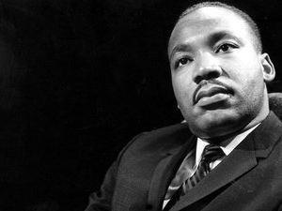
America's legendary political leader, Martin Luther King Jr. was a man of great strength and wisdom. All his life, he espoused the principles of equality and peace. Martin Luther King won the Nobel peace prize for following non-violent practices to eradicate racial discrimination.

Slide 5
He said…
Ready?
Steady?
Go!

Slide 6
So let freedom ring from the prodigious hilltops of … .
Alabama
New Hampshire
Alaska
New Hampshire

Slide 7
Let freedom ring from the mighty mountains of … .
New York
Montana
Tennessee
New York

Slide 8
Let freedom ring from the heightening Alleghenies of… !
Ohio
Oregon
Pennsylvania
Pennsylvania

Slide 9
Let freedom ring from the snowcapped Rockies of … !
North Dakota
Oklahoma
Colorado
Colorado

Slide 10
Let freedom ring from the curvaceous peaks of … !
California
Nevada
New Mexico
California

Slide 11
But not only that; let freedom ring from Stone Mountain of … !
North Carolina
Georgia
Vermont
Georgia

Slide 12
Let freedom ring from Lookout Mountain of … !
Maryland
Nebraska
Tennessee
Tennessee

Slide 13
Let freedom ring from every hill and every molehill of … .
Mississippi
Minnesota
Michigan
Mississippi

Slide 14
From every mountainside, let … ring.
freedom
love
independence
freedom

Slide 15
The End
Thank you for doing this Quiz!

Slide 16
America the Beautiful

Slide 17
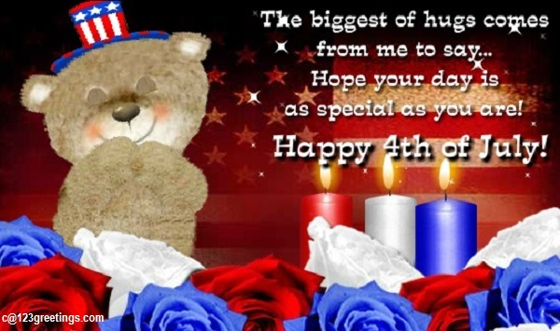

Slide 18
Sources
http://quotations.about.com/od/holidaysandspecialdays1/a/4th-Of-July-Quotes.htmNew
http://quotations.about.com/od/stillmorefamouspeople/a/martinluther1.htm
http://allholidayphotos.com/wp-content/uploads/2015/06/4th-of-july-greetings_1435366764.jpg
http://allholidayphotos.com/wp-content/uploads/2015/06/4th-of-july-greetings_1435366752.jpg

