Slide 1
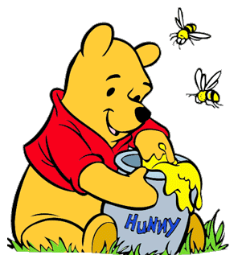
Honey the Sweet
Интерактивная викторина
для учащихся 8-11 классов
Автор
Ольга Михайловна Степанова
Учитель английского языка
МБОУ «Цивильская СОШ №2»
города Цивильск
Чувашской Республики
2015

Slide 2
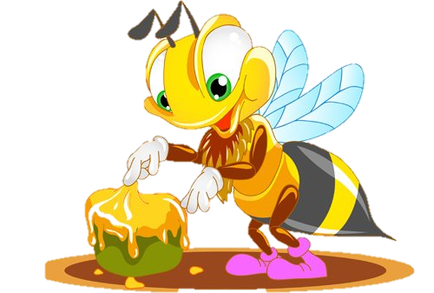
Bees that have honey in their mouths have stings in their … .
Scottish Proverb
tails

Slide 3
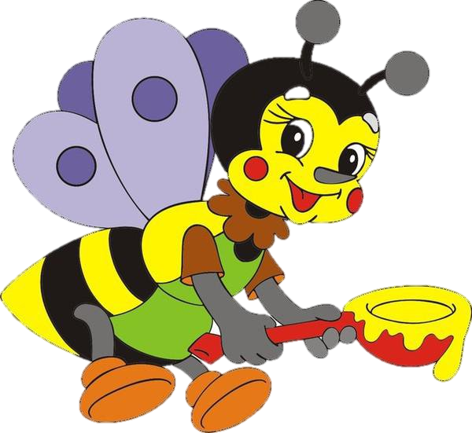
Honey in his mouth,
knives in his … .
Chinese Proverb
heart

Slide 4
Flies are easier caught with honey than with … .
French Proverb
vinegar

Slide 5
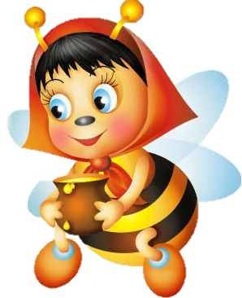
He that has not money in his … should have honey in his mouth.
French Proverb
purse

Slide 6
What's the use of putting honey in an ass's … .
German Proverb
mouth

Slide 7
Who divides honey with the … , will be like to get the lesser share..
Italian Proverb
bear

Slide 8
When the sea turned into honey, the poor man lost his … .
Bulgarian Proverb
spoon

Slide 9
Honeyed speech often conceals … and gall.
Danish Proverb
poison

Slide 10
… is best at the beginning, honey at the end, and wine in the middle.
Dutch Proverb
Oil

Slide 11
To a starving man … is sweeter than honey.
Lithuanian Proverb
bread

Slide 12
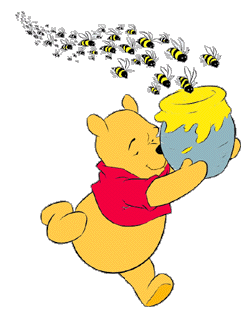
No bees, no honey; no work, no … .
Traditional Proverb
money

Slide 13
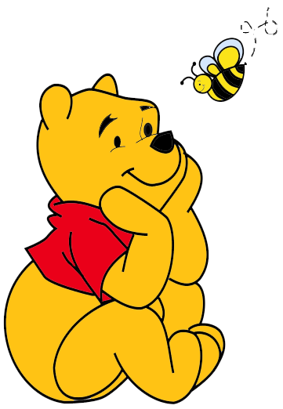
The bear knows seven … and they are all about honey.
Turkish proverb
songs

Slide 14
It's better to eat … and be happy than to eat honey and be sad.
African Proverb
pepper

Slide 15
First harvest honey and wax during the day, then dance and play in the open during the … .
Sicilian Proverb
evening

Slide 16
One bee makes no honey, one grain makes no
rice … .
Chinese Proverb
soup

Slide 17
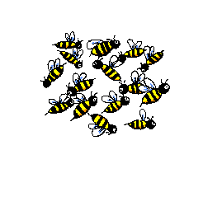
The End

Slide 18
Enjoy the Song, Relax…
‘Hello, Honey!’

Slide 19
Sources
http://www.special-dictionary.com/proverbs/keywords/honey/7.htm
http://img-fotki.yandex.ru/get/6203/20140578.d8/0_a6d47_46c9bc3e_M.jpg
http://s41.radikal.ru/i093/0809/4a/833a041d6cb7.gif
http://kladraz.ru/images/photos/medium/article301.jpg
http://staff.rentonschools.us/hle/sdufresne/images/beeflower.gif
http://community.macmillan.org.uk/cfs-file.ashx/__key/communityserver-discussions-components-files/32036/0383.prs1.gif

