Slide 1
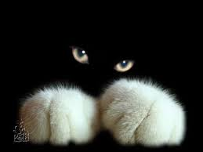
White Cats by Arthur Heyer
Экскурсия в художественную галерею
для учащихся 5-9 классов
Автор:
Ольга Михайловна Степанова
учитель английского языка
МБОУ «Цивильская СОШ №1»
города Цивильск
Чувашской Республики
2015

Slide 2
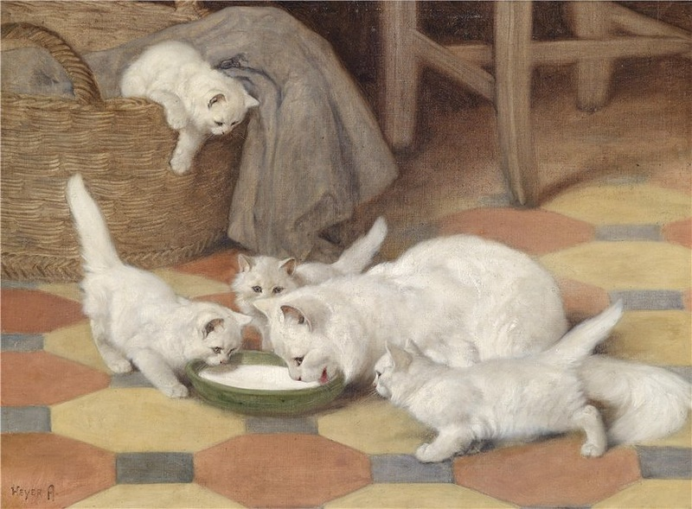
Mother and Kittens drinking milk

Slide 3
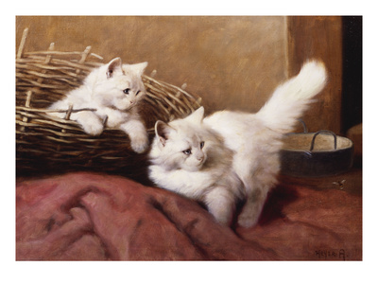
White Persian Kittens with a Bee

Slide 4
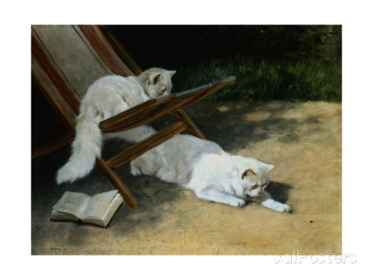
Painting of Two White Persian Cats with a Ladybug

Slide 5
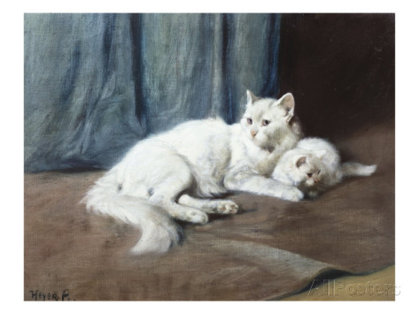
White Persian Cat with Her Kitten

Slide 6
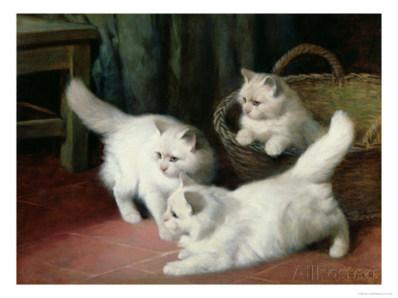
Three White Angora Kittens

Slide 7
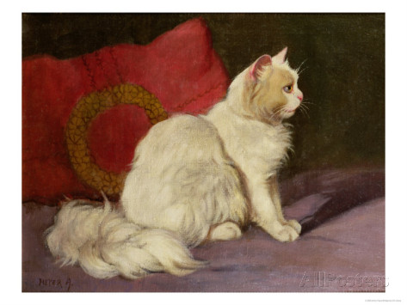
White Persian Cat

Slide 8
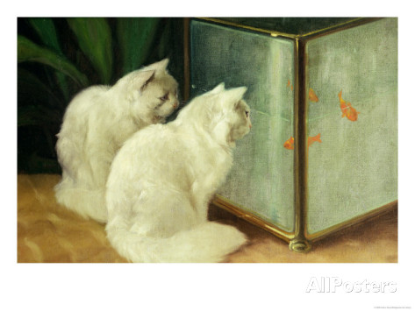
White Cats Watching Goldfish

Slide 9
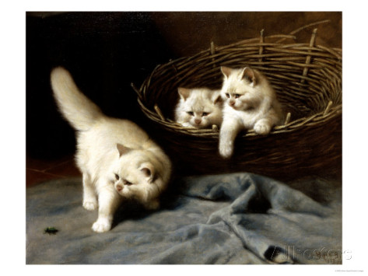
White Angora Kittens with a Beetle

Slide 10
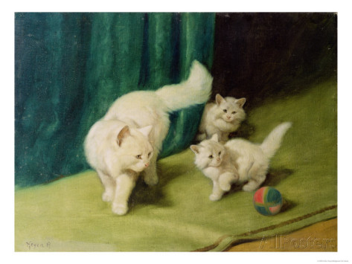
White Persian Cat with Two Kittens

Slide 11
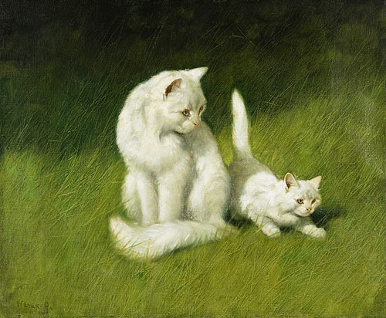
Angora cat and Kitten

Slide 12
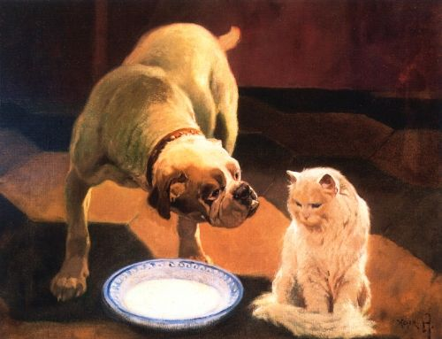
Bulldog and Cat

Slide 13
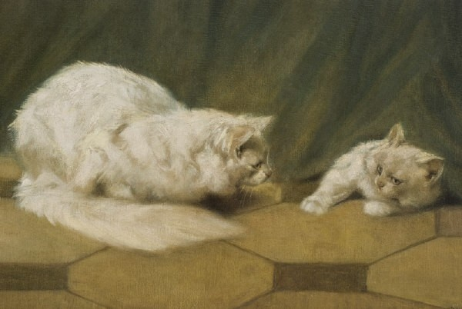
Mother with her son

Slide 14
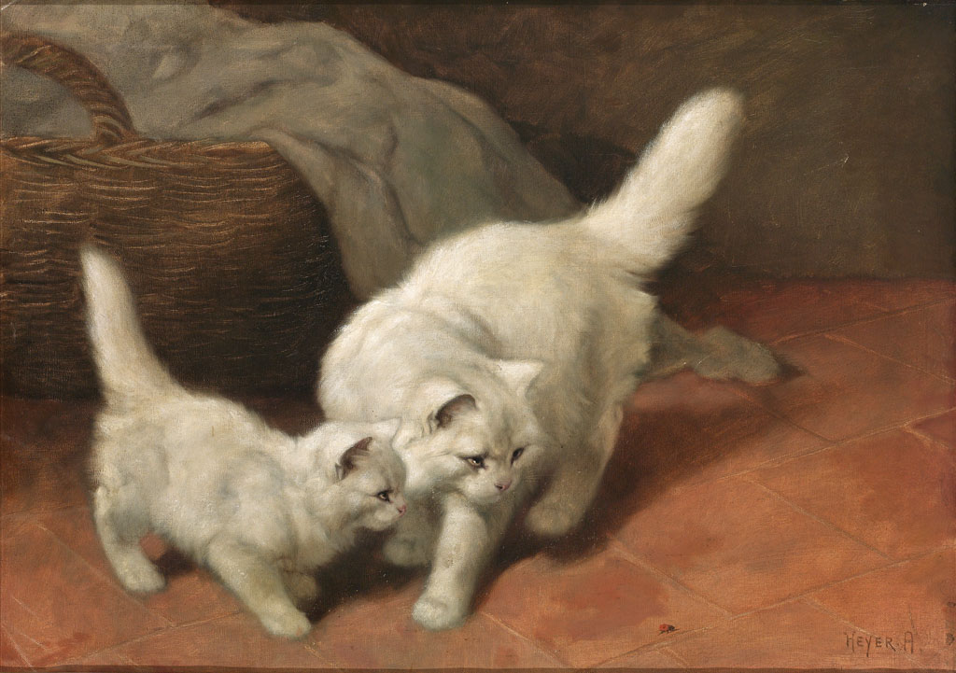
Cats and Ladybug

Slide 15
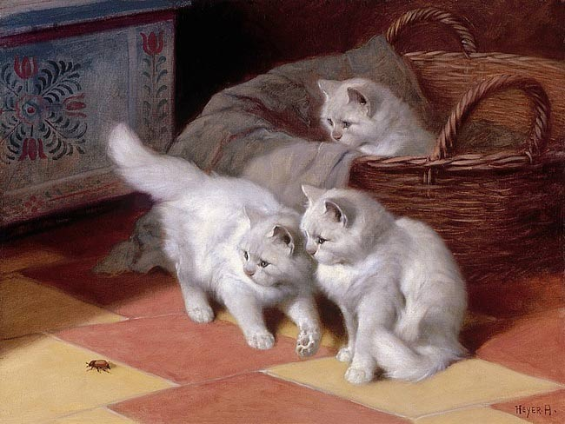
Watching a Bug

Slide 16
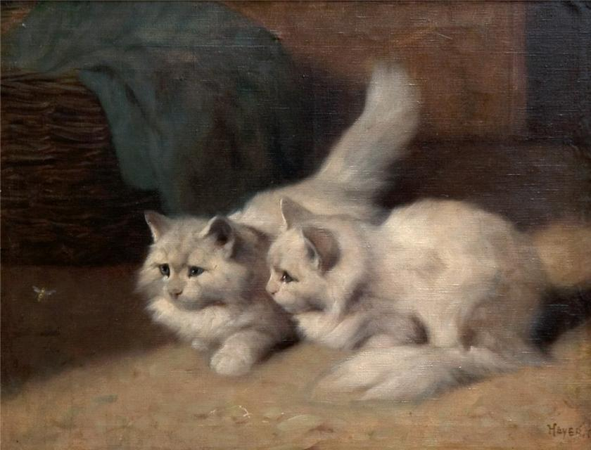
Watching a Fly

Slide 17
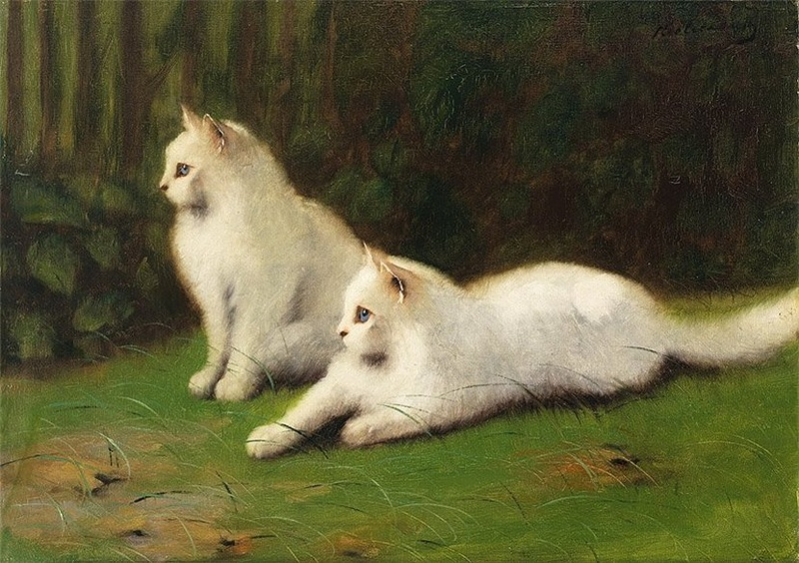
Two cats on Grass

Slide 18
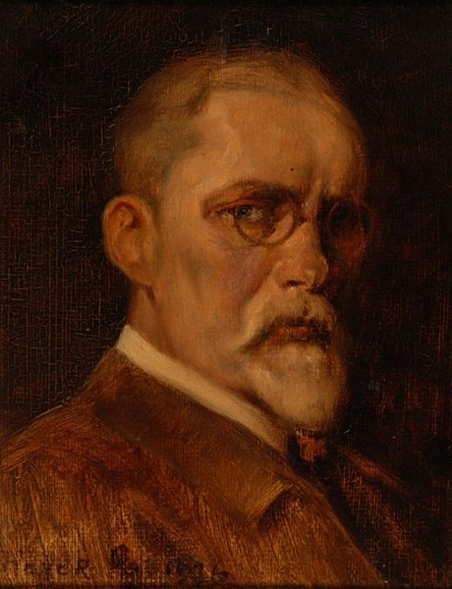
Born: 1872 - Haarhausen Died: 1931 –
Budapest
Known for:
painting
Arthur Heyer
Sef-Portrait
1926

Slide 19
Arthur Heyer is known for his many paintings of cats, in particular White Angoras. Because he loved to draw and paint cats so much, he acquired the nickname “Cat” Heyer. Heyer was interested in art at an early age and attended art school in the Museum in Decorative Arts in Berlin. He began his career by illustrating local newspaper articles. Later he moved to Budapest where he held his first exhibition in 1906. Heyer painted other animals, but his favorite was a white cat.

Slide 20
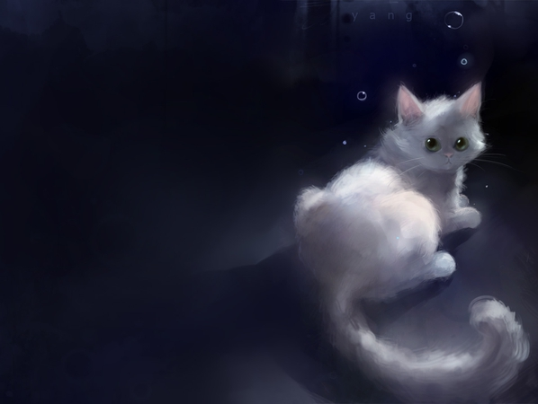
Thanks for Visiting our White Cats Gallery!

Slide 21
Sources
https://pt.wikipedia.org/wiki/Arthur_Heyer
http://www.thegreatcat.org/the-cat-in-art-and-photos-2/cats-in-art-20th-century/arthur-heyer-1872-1931-german-hungarian/

