Slide 1
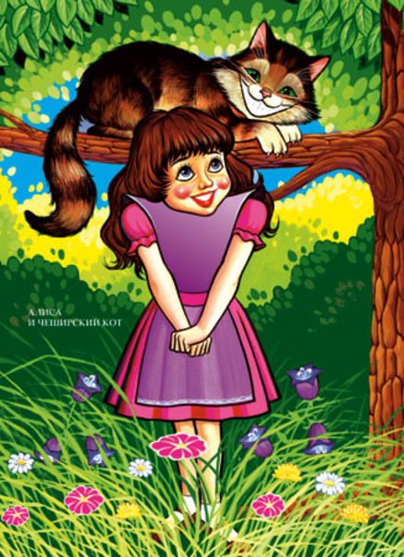
Cheshire Cat
Quotes and Sayings
Шайдурова Валентина Федоровна
Учитель английского языка
ГБОУ «Школа №106»
Санкт-Петербург
2015

Slide 2
Most of the characters is “Alice in Wonderland”
are remembered for their zany antics and penchant for gibberish.
The Cheshire cat may be the only character in wonderland
who is known for his cynicism.
These Cheshire Cat quotes sum up all of the good
and the mad that have made him such a beloved character.

Slide 3
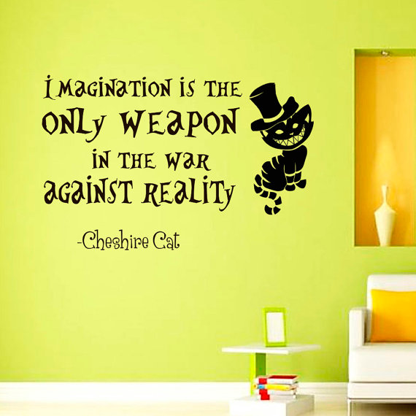

Slide 4
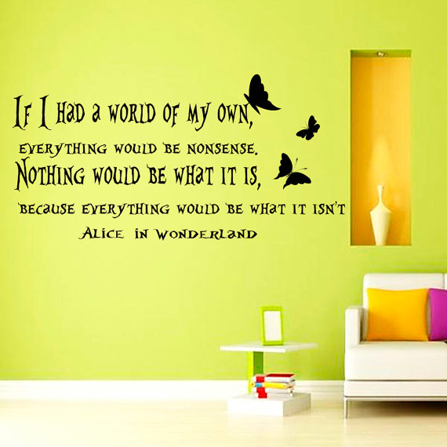

Slide 5
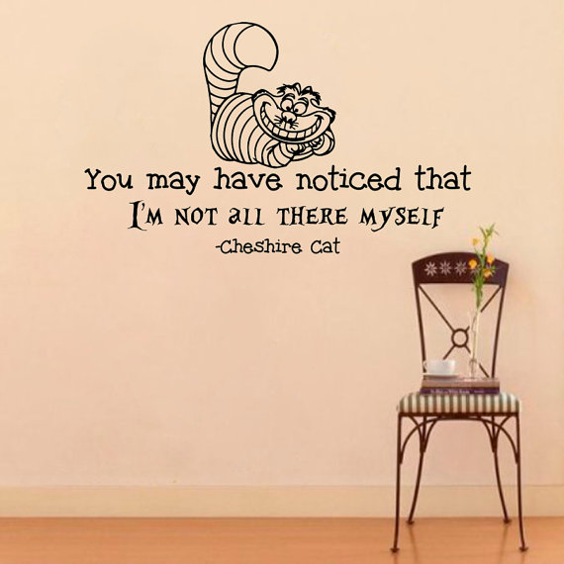

Slide 7
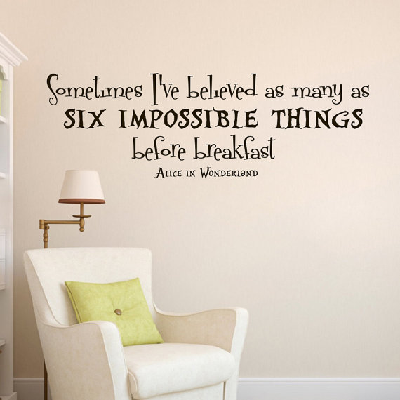

Slide 8
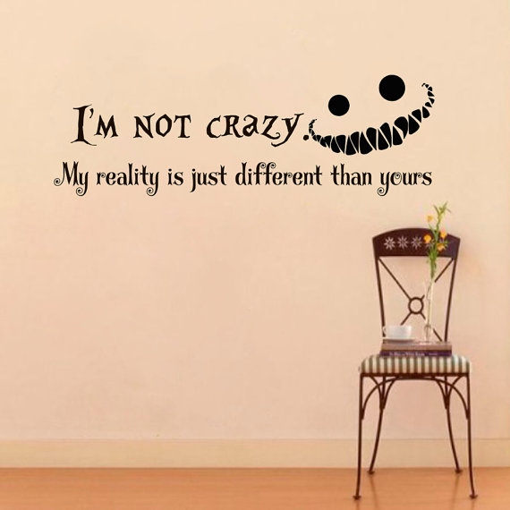

Slide 9
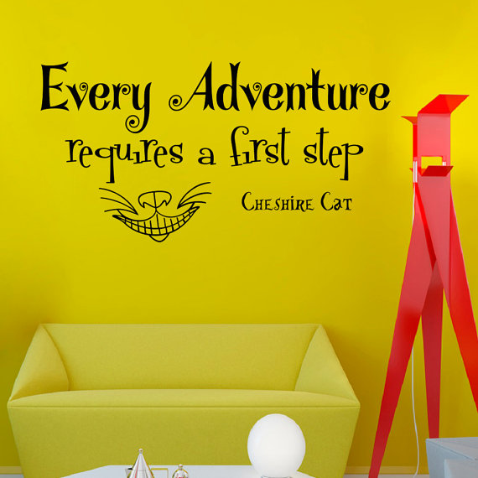

Slide 10
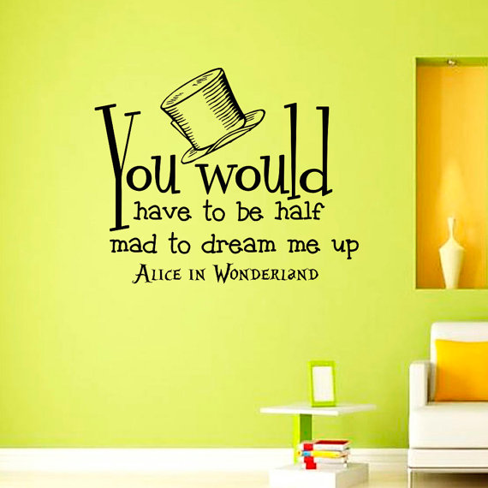

Slide 11
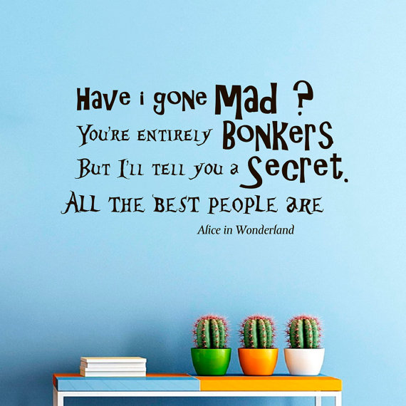

Slide 12
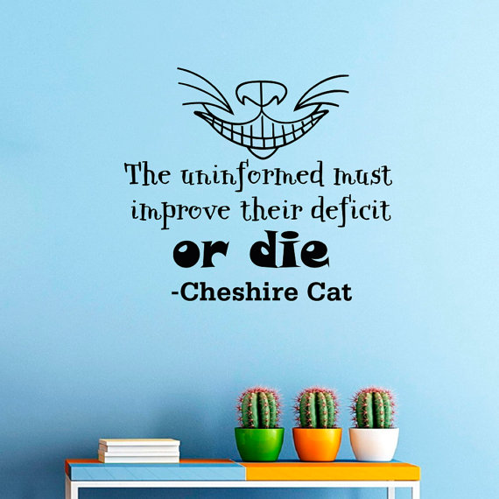

Slide 13
Источники
https://www.etsy.com/ru/listing/203269545/wall-decals-alice-in-wonderland-cheshire
http://www.goodreads.com/quotes/tag/cheshire-cat
http://www.searchquotes.com/quotes/author/Cheshire_Cat/4

