Slide 1
Photo Calendar in Proverbs
Фотовыставка-календарь
для учащихся
8-9 классов
Автор:
Ольга Михайловна Степанова
учитель английского языка
МБОУ «Цивильская СОШ №1
имени Героя Советского Союза
М.В. Силантьева»
города Цивильск
Чувашской Республики
2015

Slide 2
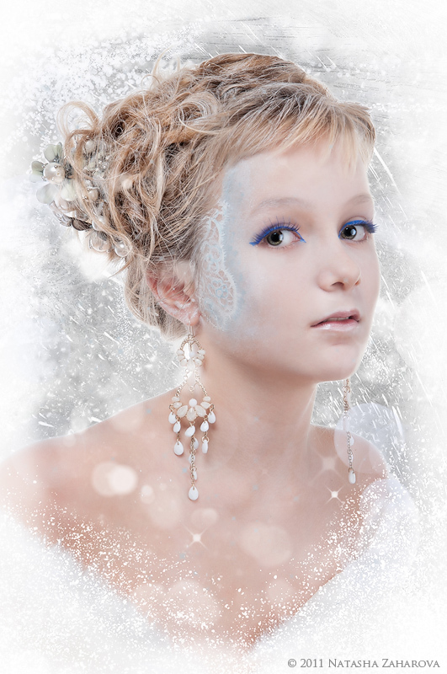
Don't marry a girl who wants … in January.
American Proverb
Watermelon
Strawberries
Lemons
strawberries

Slide 3
In February, don't postpone
a … .
Corsican Proverb
Holiday
Wedding
Trip
trip

Slide 4
March comes in like a lion and goes out like a … .
Lamb
Rabbit
Cock
lamb

Slide 5
An April flood carries away the … and her brood.
Cat
Frog
Goose
frog

Slide 6
A cold May is kindly and fills the … finely.
Barn
Pail
Glass
barn

Slide 7
June brings … , lilies, roses,
Fills the children’s hands with posies.
Tulips
Tomatoes
Nettles
tulips

Slide 8
Bow-wow dandy fly,
Brew no … in July.
Beer
Juice
Milk
beer

Slide 9
In August most of Europe goes on … .
Tony Visconti
Foot
Holiday
Fishing
holiday

Slide 10
All the … will mature in a warm and dry September.
Sicilian Proverb
Fruit
Vegetables
Nuts
fruit

Slide 11
October is crisp days and cool nights, a time to curl up around the dancing flames and sink into a good … . John Sinor
Mood
Book
Sea
book

Slide 12
November's … is chill and drear,
November's leaf is red and sear.
Sir Walter Scott "Marmion“
Moon
Day
Sky
sky

Slide 13
"God gave us our memories so that we might have … in December."
J. M. Barrie
Presents
Roses
Snowflakes
roses

Slide 14
The End!
Thank you for being with us!
Special Thanks to Natalia Zahahrova
for fantastic photos!

Slide 15
В презентации использован популярный фотокалендарь , составленный известным фотографом Наталией Захаровой
Другие источники:
http://lovelyangell.35photo.ru/
http://www.mamalisa.com/blog/april-proverbs-from-around-the-world/
http://www.bartleby.com/89/65.html
http://www.special-dictionary.com/proverbs/keywords/february/
http://www.special-dictionary.com/proverbs/keywords/march/
http://www.gardendigest.com/monmay.htm
http://www.corsinet.com/braincandy/qmonths.html

