Slide 1
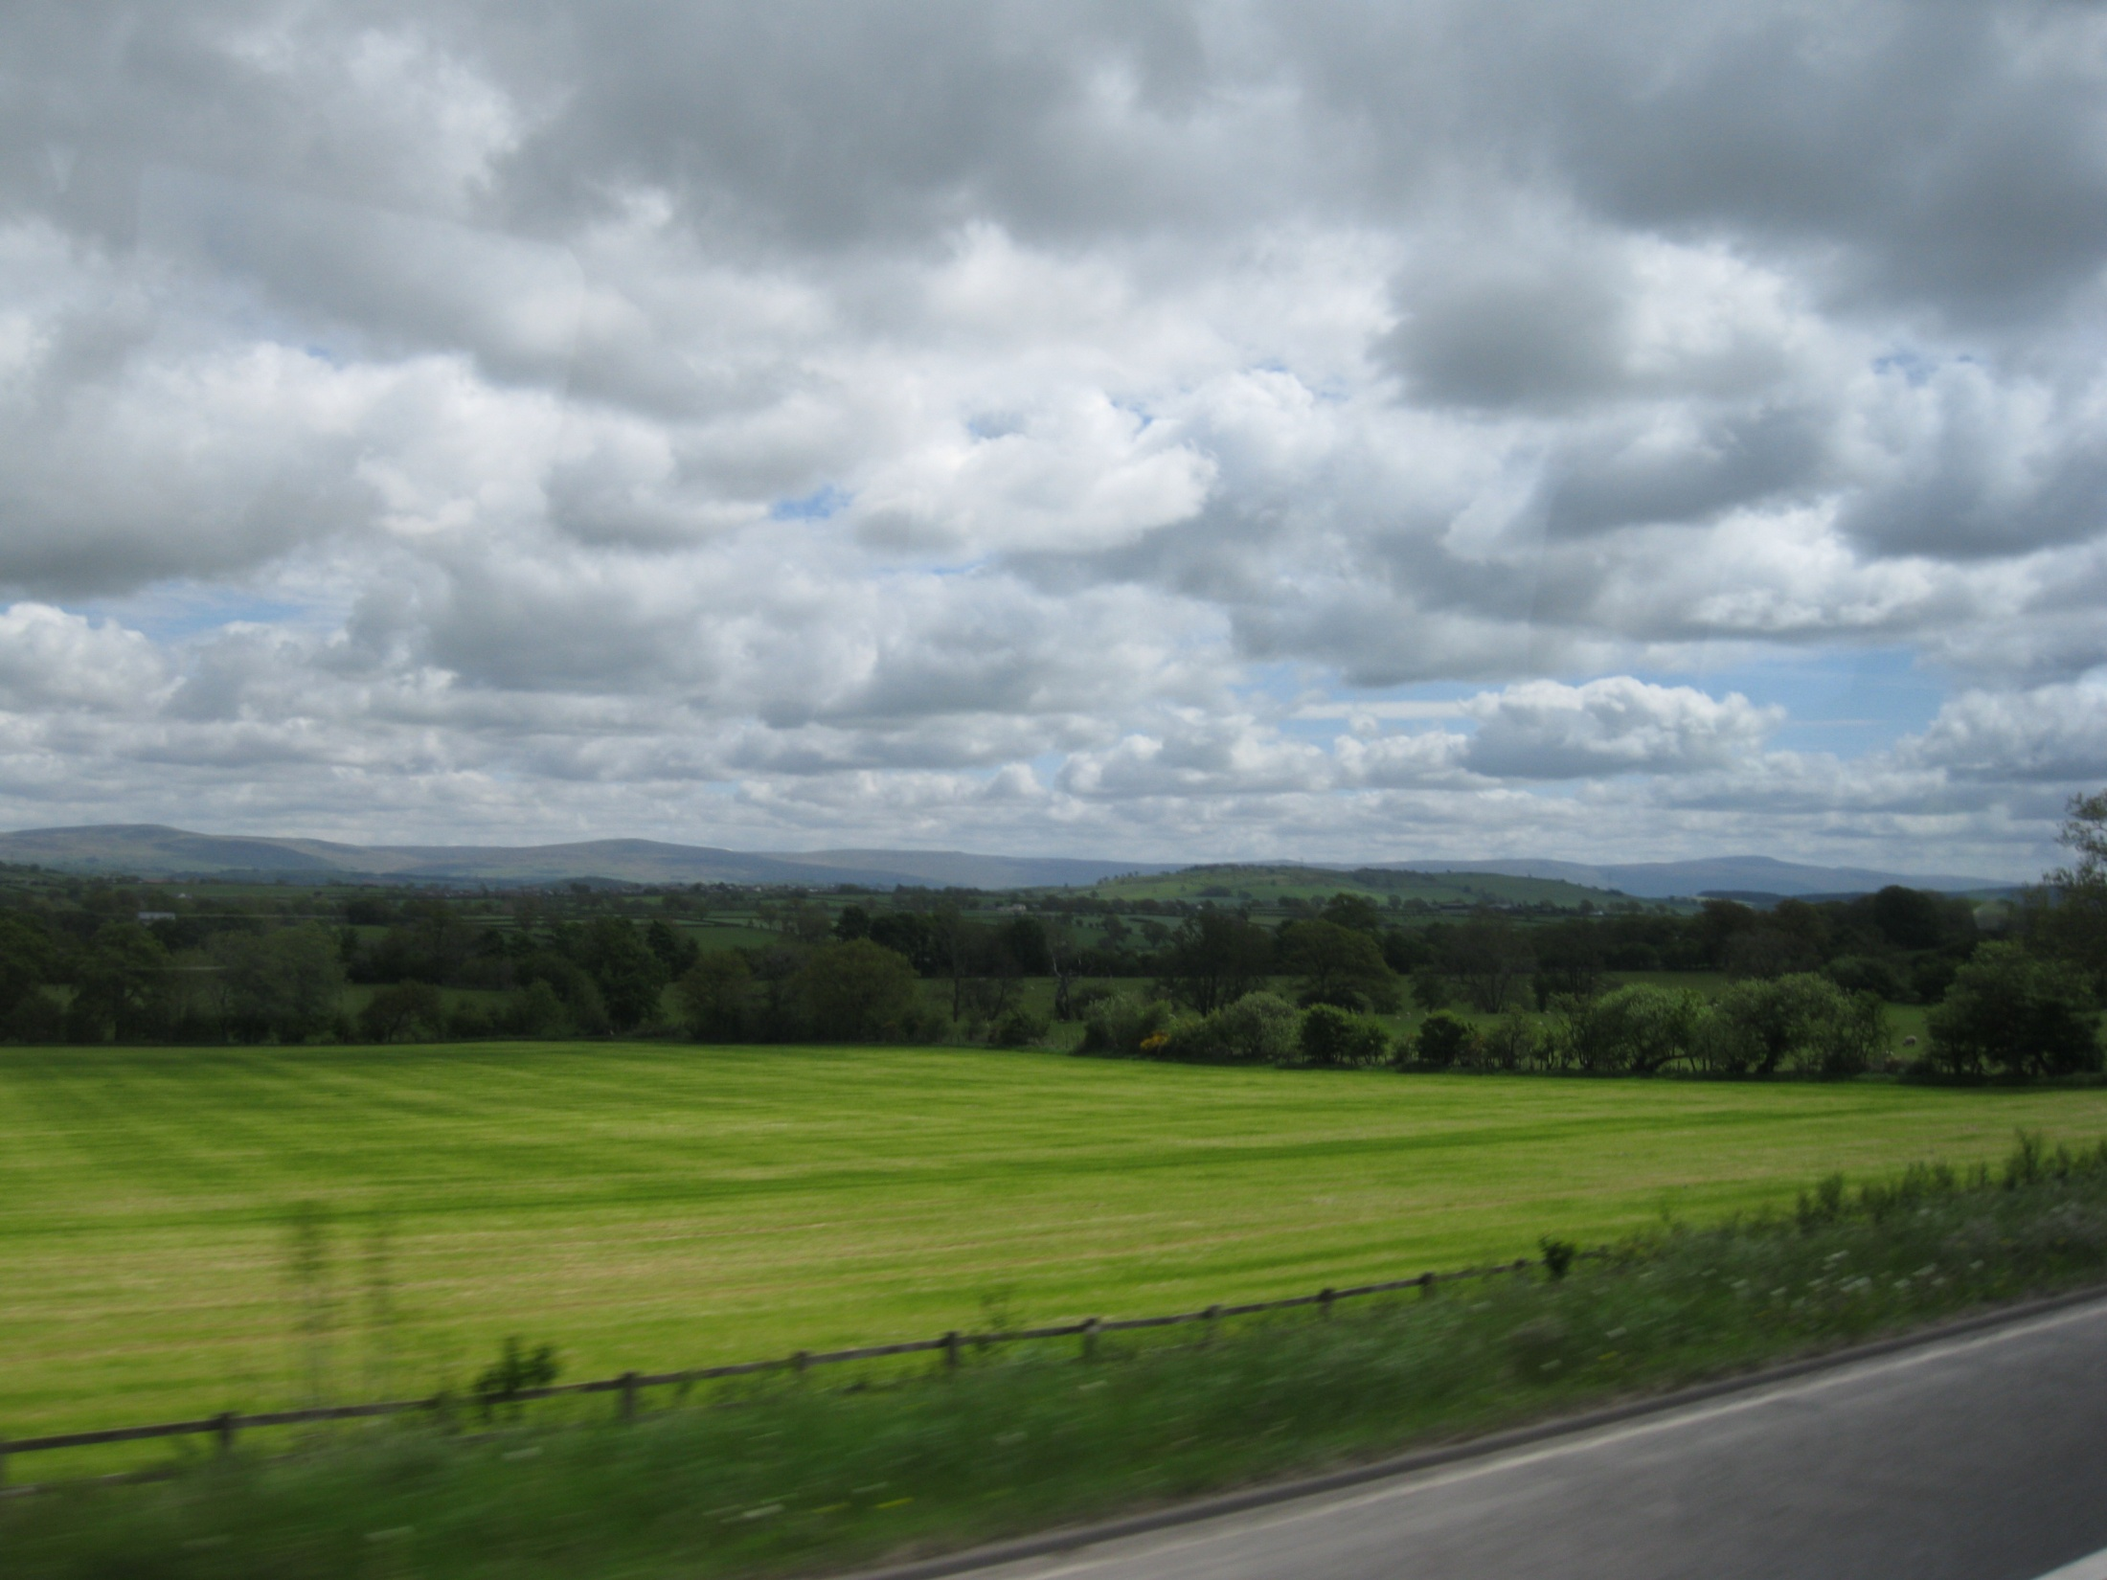
English countryside
Шайдурова Валентина Федоровна
Учитель английского языка
ГБОУ «Школа №106»
Санкт-Петербург
2015

Slide 2
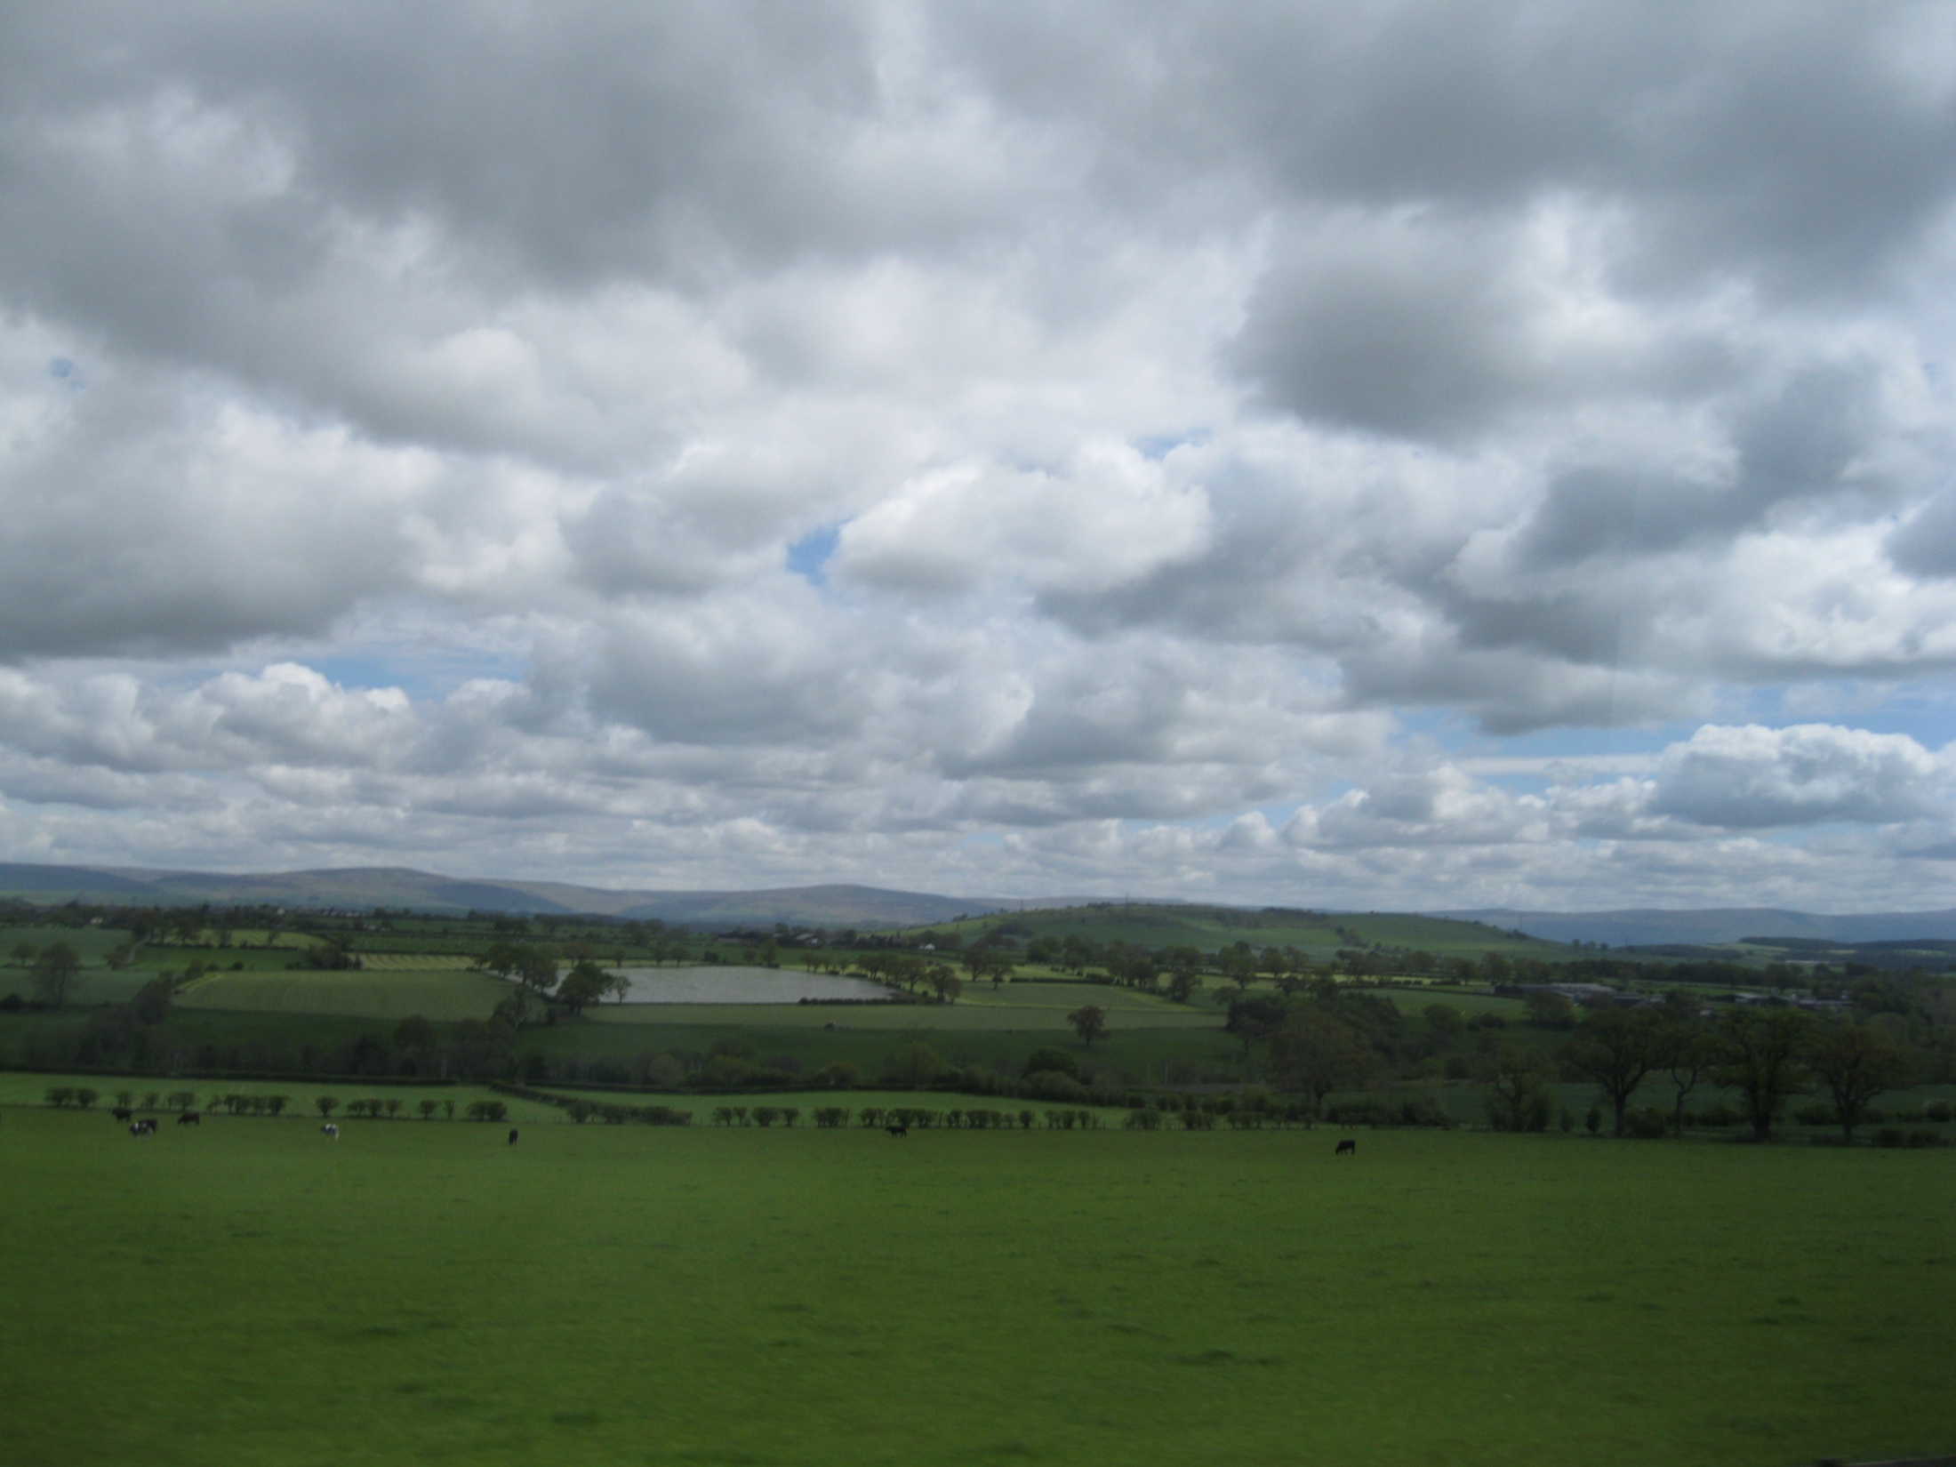
“There’s peace and holy quiet there,
Great clouds along pacific skies …”
Rupert Brooke (1887–1915)

Slide 3
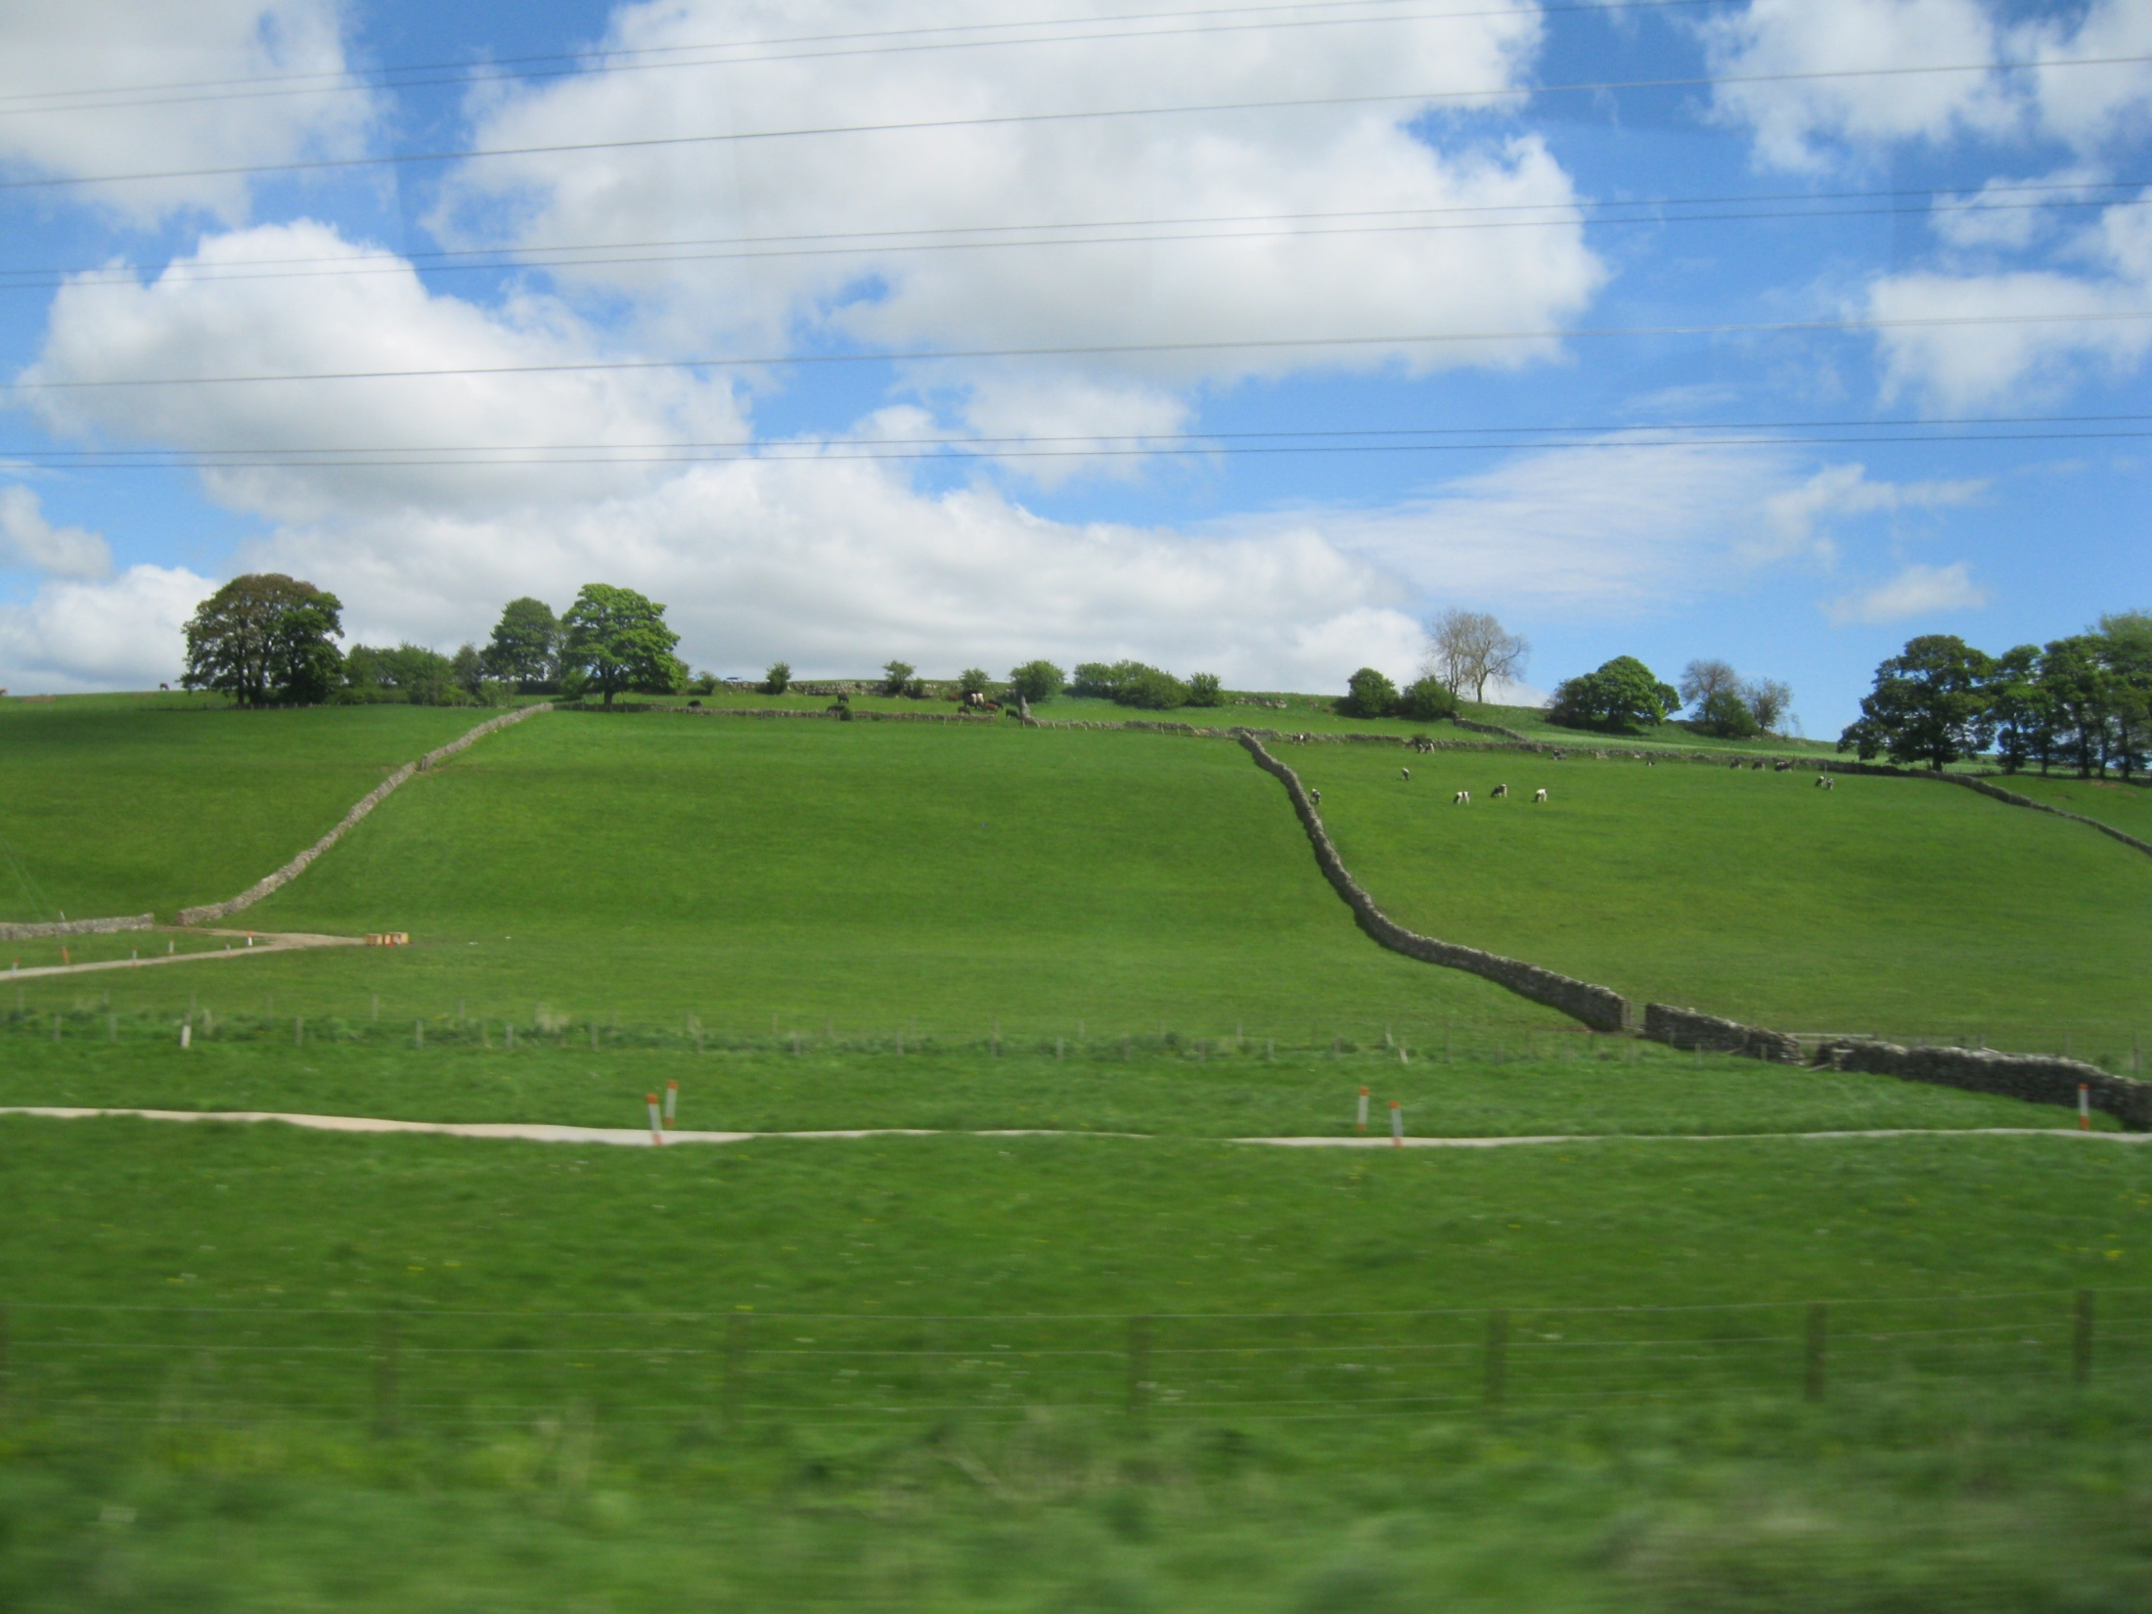
“I only know that you may lie
Day long and watch the Cambridge sky”

Slide 4
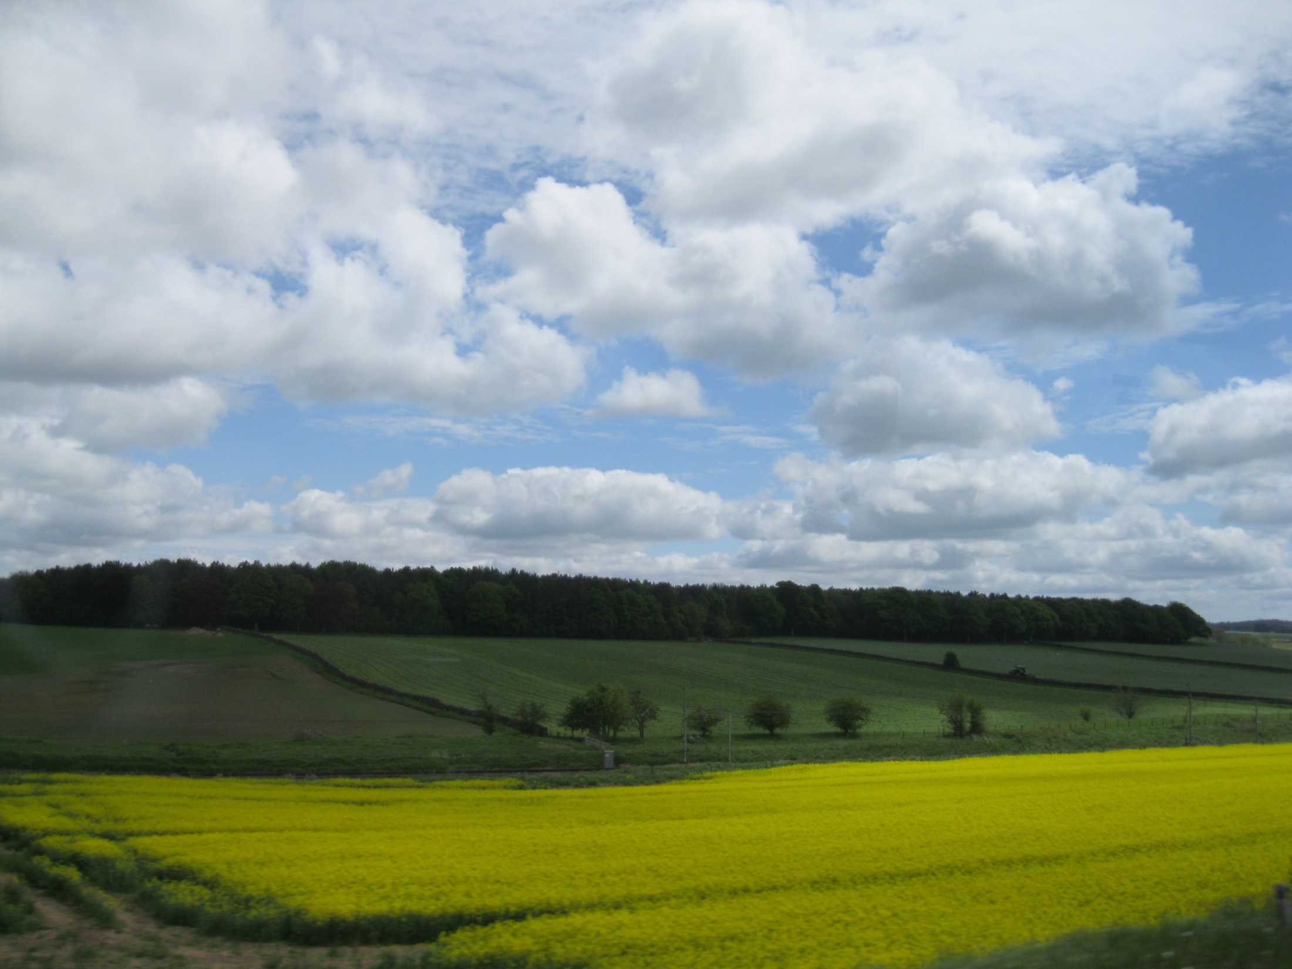
“I know
How the May fields all golden show …”
Rupert Brooke (1887–1915)

Slide 5
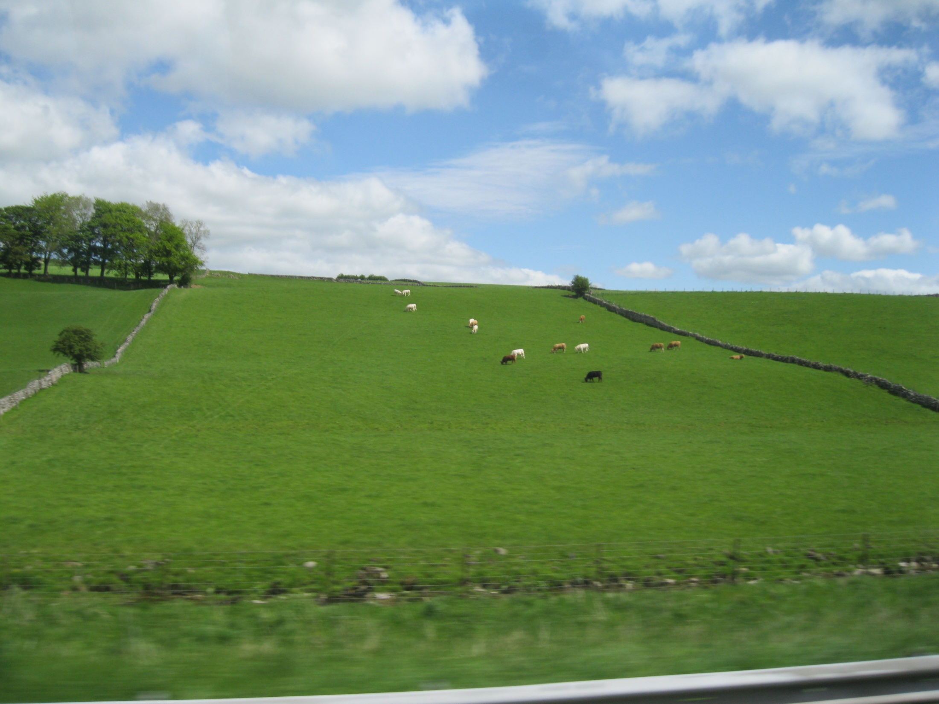

Slide 6
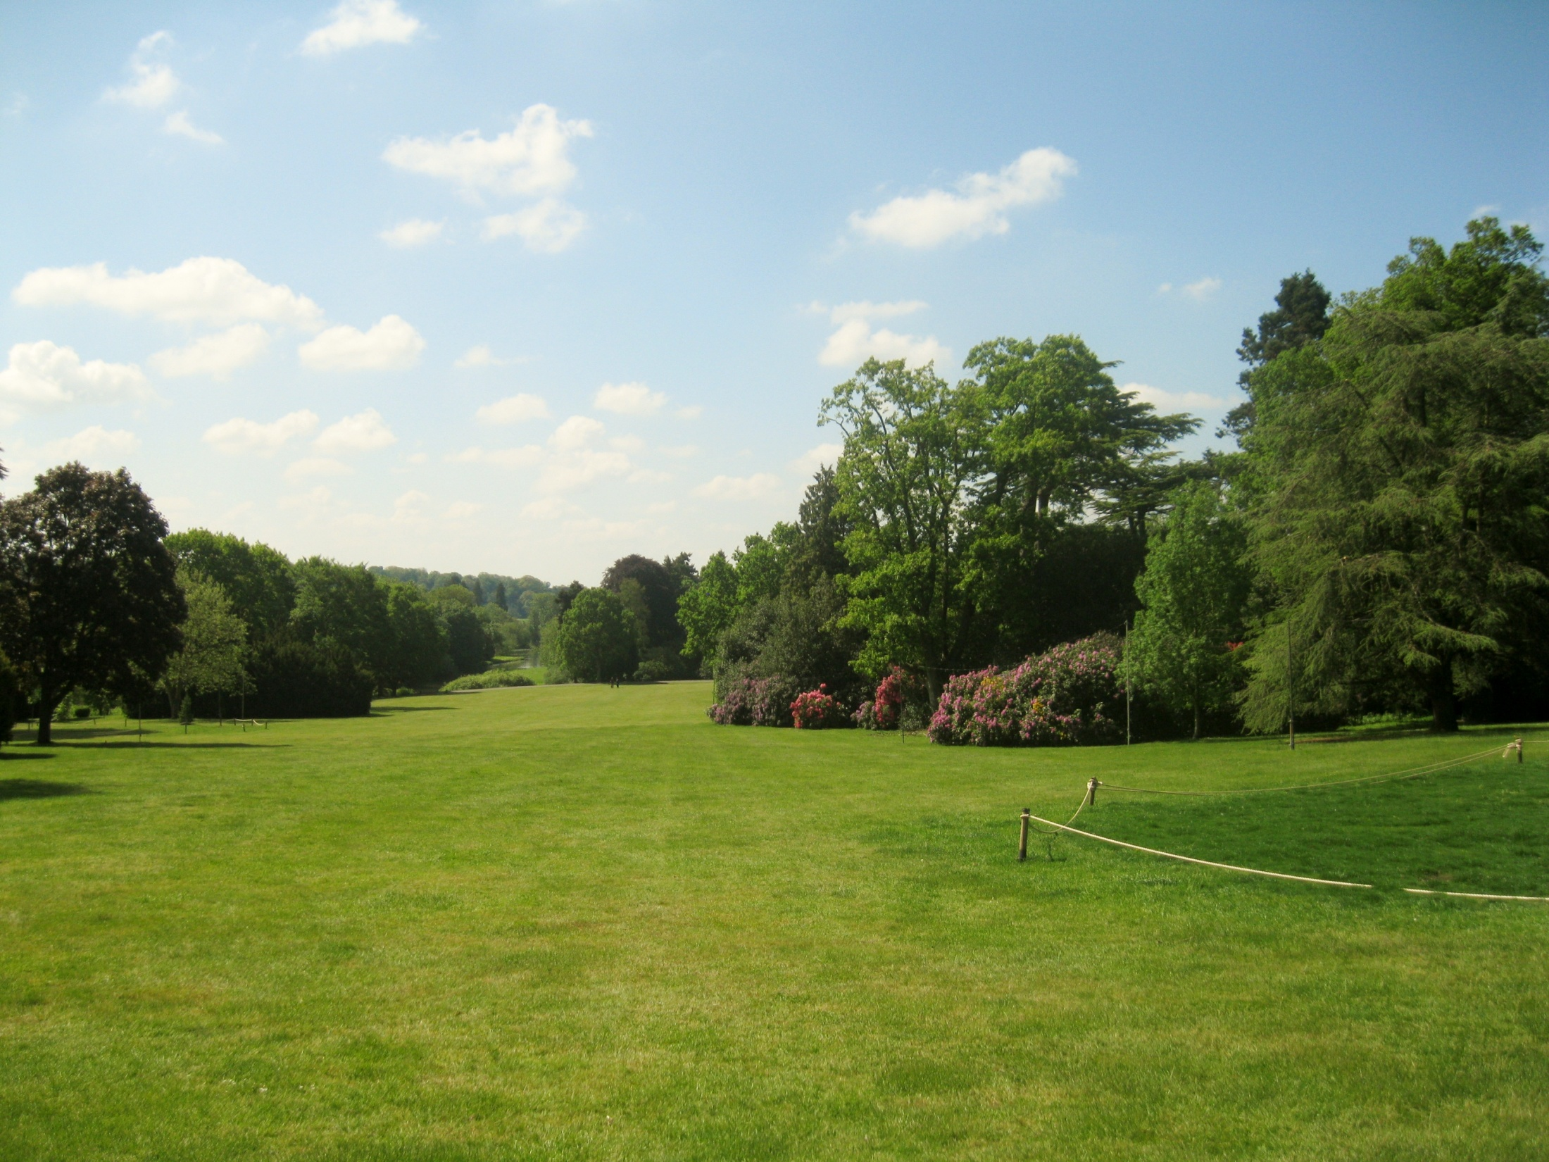
Warwick Castle Meadows

Slide 7
“God! I will pack, and take a train,
And get me to England once again!”

Slide 8
Фотографии автора презентации
http://www.bartleby.com/232/701.html стихи Rupert Brooke (1887–1915)

