Slide 1
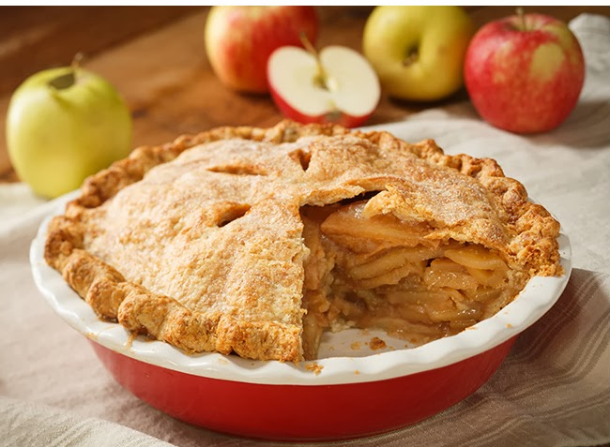
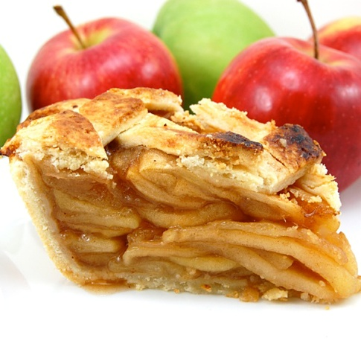
How to Make an Apple Pie
Шайдурова Валентина Федоровна
Учитель английского языка
ГБОУ «Школа №106»
Санкт-Петербург
2015 г

Slide 2
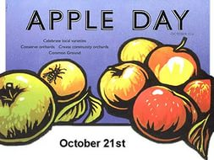

Slide 3
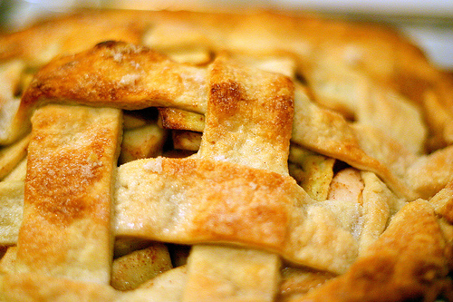
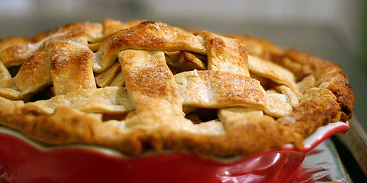
Apple pie (and its many variations) is typically a southern English dish, due to the vast number of orchards in the south.
However traditional recipes can be traced as far north as Scotland.
Most modern recipes require sugar but the very earliest recipes did not, as sugar was not widely available at that time.

Slide 4
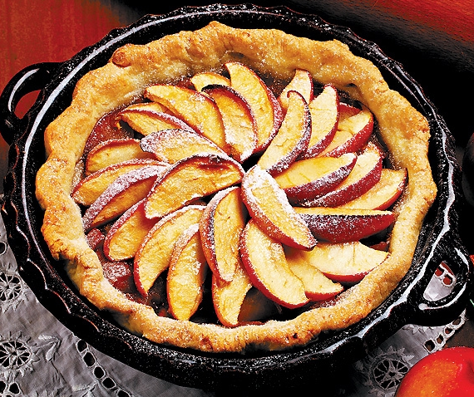
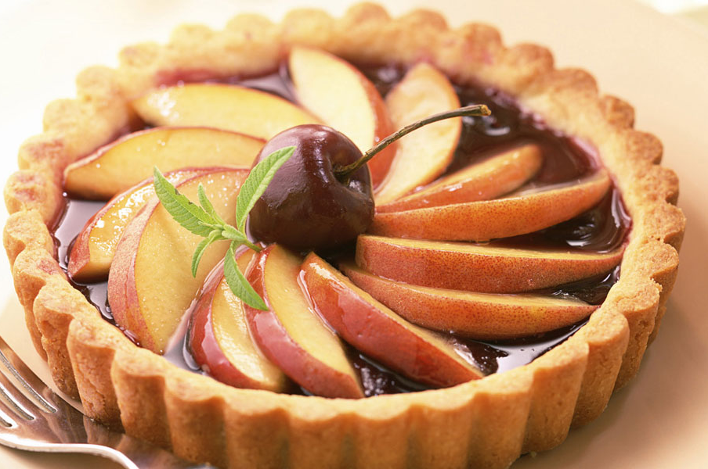
A homemade apple pie is definitely a labor of love -- what better reason to make one?
If this is your first attempt, don't worry if the crust has a tear or two; the pie will still be juicy and delicious.
Pie-making just takes a little patience -- but watching your friends and family enjoy the results makes it all worthwhile.

Slide 5
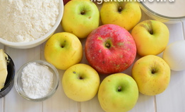
Ingredients
300 grams short crust pastry
500 grams cooking apples (Bramleys)
100 grams sugar
1 teaspoon cinnamon

Slide 6
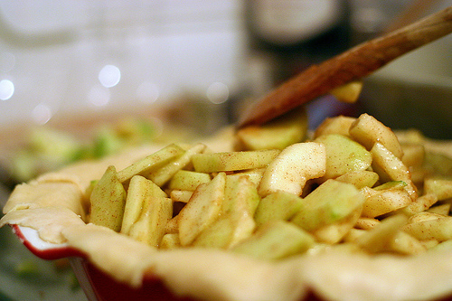
How to Make an Apple Pie
- Heat the oven to 190 °C (Gas 6).
- Peel and slice the apples into a deep pie dish. Sprinkle on sugar and cinnamon.
Roll out the pastry slightly larger than the shape of the pie dish.
- Seal the pastry onto the dish, crimp edges with a fork and trim off any overlaps.

Slide 7
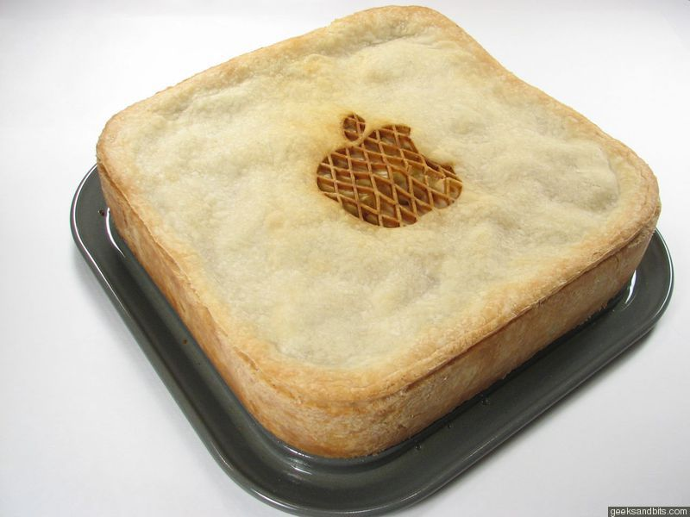
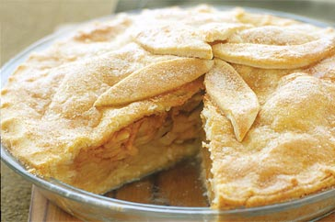
Use the pastry off cuts to decorate the pastry with leaf-shaped pieces.
Make a small hole in the centre.
Brush over the top with a little milk.
Place on a sheaf and bake for approximately 30 minutes until golden brown.

Slide 8
Serving Suggestions
Serve hot or cold with ice cream, custard or cream.
However, for a real taste of the west country, serve with a generous spoonful of Cornish Clotted Cream

Slide 9
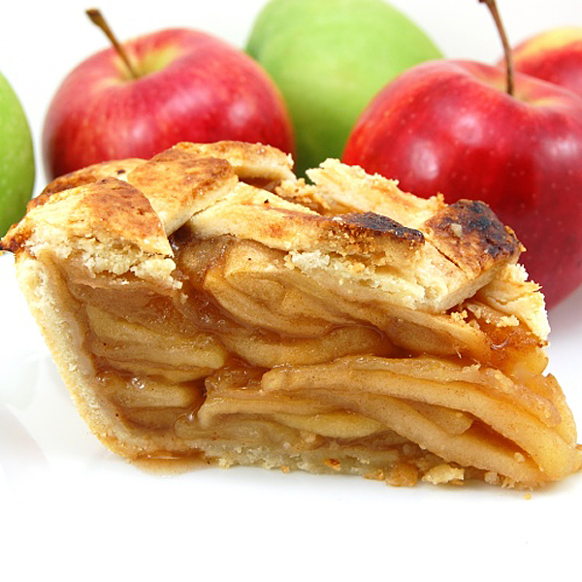
Enjoy your meal!

Slide 11
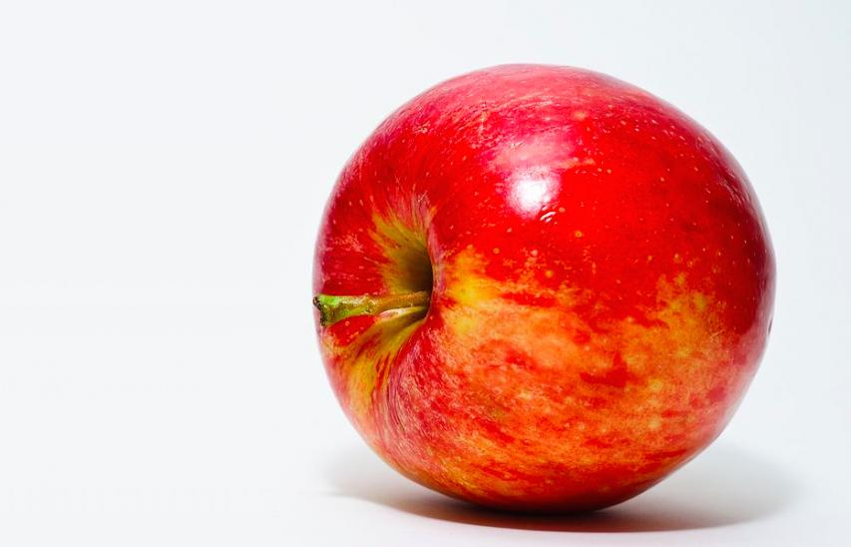

Slide 12
http://www.dishbase.com/recipe/british-traditional-apple-pie/
http://www.travelaboutbritain.com/recipes/blackberry_apple_pie.php

