Slide 1
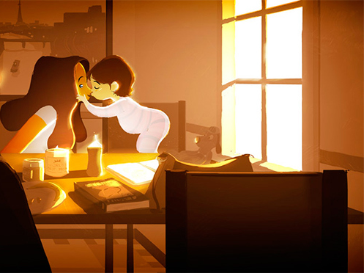
Mother’s Kiss
Интерактивная
викторина
для учащихся
7-11 классов
Автор
Ольга Михайловна Степанова
Учитель английского языка
МБОУ «Цивильская СОШ №1
имени М.АВ. Силантьева»
города Цивильск
Чувашской Республики
2015

Slide 2
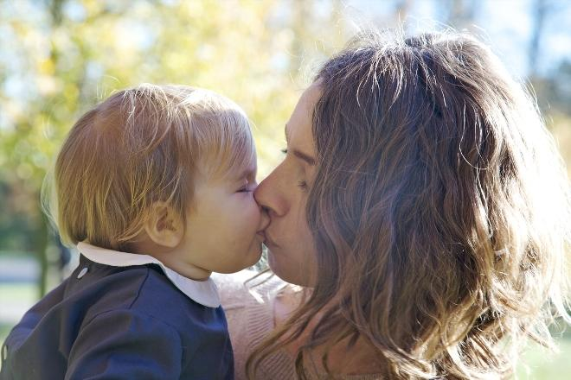
pocket
rocket
basket
A … full of stars
A handfull of wishes
I'm sitting here patiently.
Waiting for one of your kisses.
pocket

Slide 3
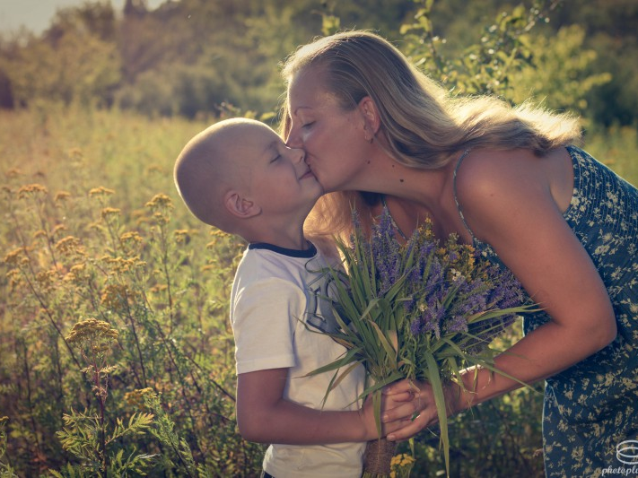
pants
gloves
hat
Tom and Jane sitting in the tree
K-i-s-s-i-n-g! First comes love.
Then comes marriage.
Then comes baby in the baby carriage,
Sucking his thumb,
Wetting his … .
pants

Slide 4
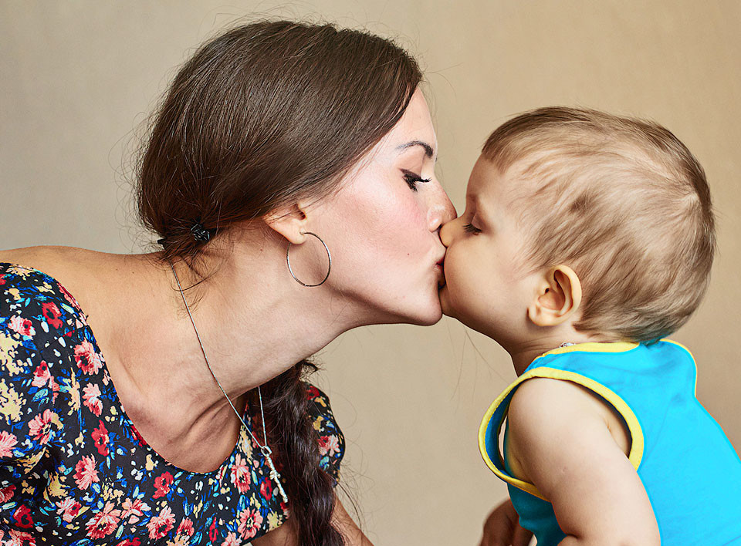
bouquet
pile
bunch
Snowflakes from Heaven as white as can be!
Can build a Snowman
for all to see!
He's cute and cuddly - and full of good wishes
And wants to give you a whole … of his kisses!
bunch

Slide 5
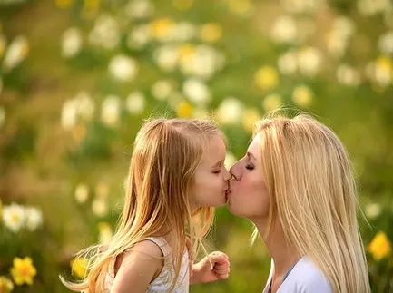
I like to laugh and be happy
With a beautiful kiss,
I tell you, in all the world
There is no … like this. .
cheese
peace
bliss
bliss

Slide 6
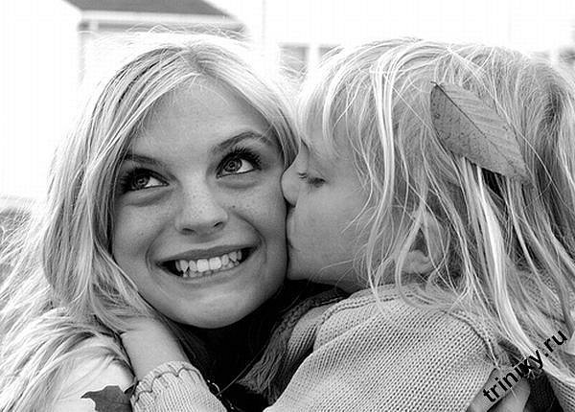
actor
stranger
anger
If you sneeze on Monday, you sneeze for danger;
Sneeze on a Tuesday, kiss a … ;
Sneeze on a Wednesday, sneeze for a letter;
Sneeze on a Thursday, something better.
stranger

Slide 7
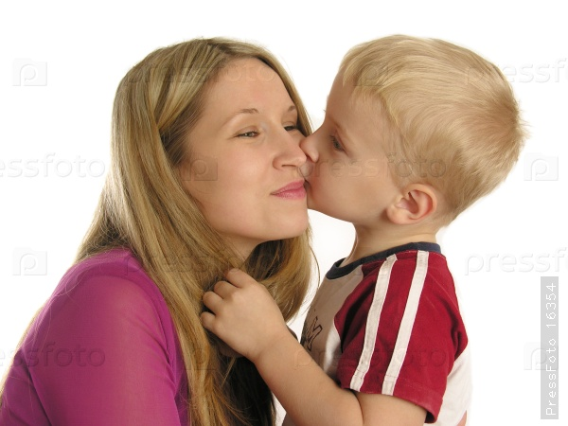
lord
board
sword
Yet each man kills the thing he loves,
By each let this be heard,
Some do it
with
a bitter look,
Some with a flattering word.
The coward does it with a kiss,
The brave man with a … !
sword

Slide 8
And the sunlight clasps the earth,
And the moonbeams kiss the … :
What are all these kissings worth,
If thou kiss not me?
sea
tea
bee
sea

Slide 9
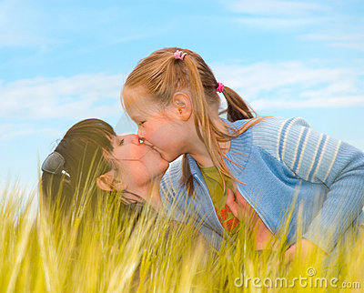
brow
plow
bow
My mother's kiss, my mother's kiss,
I feel its impress now;
As in the bright and happy days
She pressed it on my … .
brow

Slide 10
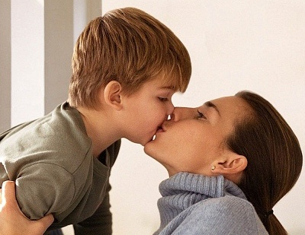
niece
bliss
piece
To my very special mother
I'm sending you this kiss
Close your eyes
and take a bite
And enjoy
the chocolate … !
bliss

Slide 11
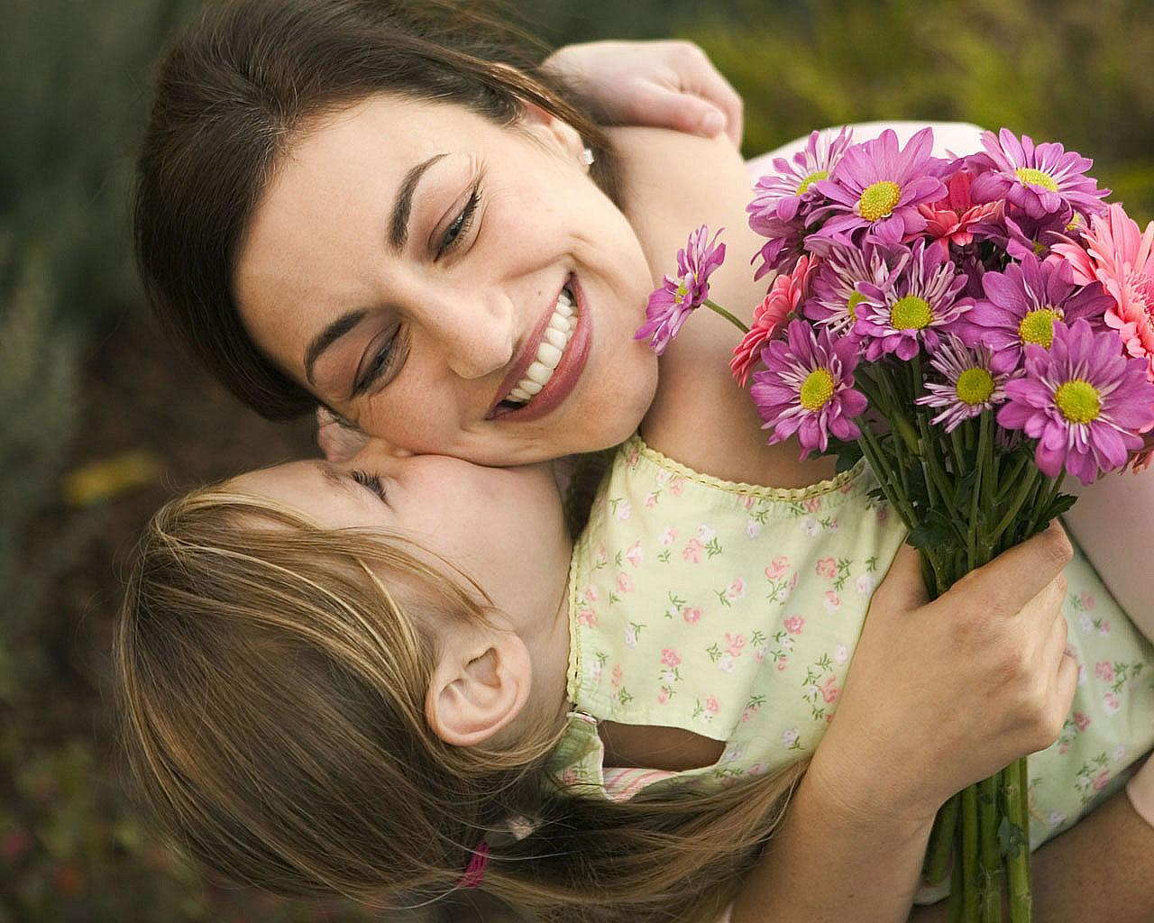
A chocolate kiss
Is sent
your …
Enjoy it
Happy Mother's Day .
way
hay
sleigh
way

Slide 12
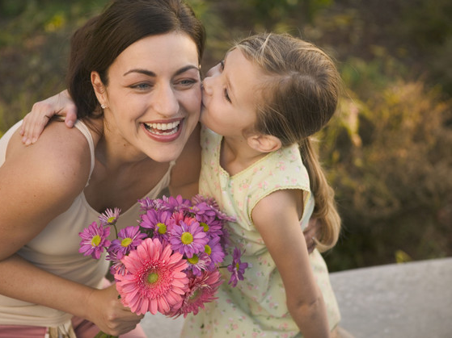
world
planet
Earth
Take this kiss and savour it
It means so much you see
It's sent with love to someone
Who means
the … to me .
world

Slide 13
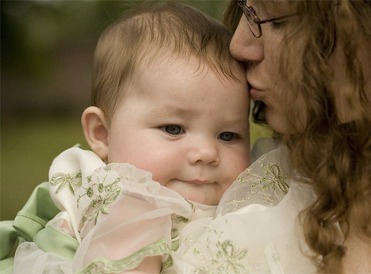
A mother's hugs and kisses
Can never be replaced
Nothing feels much better
Than her … upon my face.
freckles
tears
breath
breath

Slide 14
I think when … made mothers
He knew just what to do
And he filled her up with kisses
And hugs for me and you!
God
Angel
Fairy
God

Slide 15
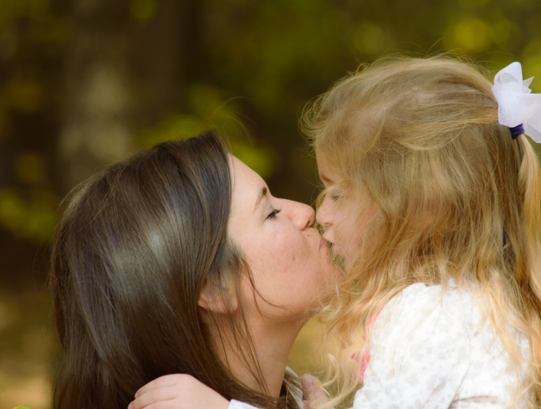
Dear mommy here's a treat for you
On Mother's Day this year
A … of hugs and kisses
Because you are so dear!
jar
box
packet
box

Slide 16
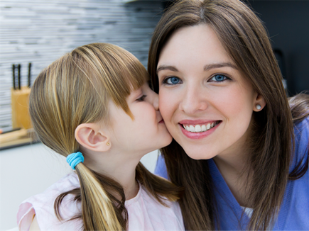
A hug and kiss
Just for my mum
Because to me
She's … one !
person
number
fun
number

Slide 17
Because of all the things you do,
Sending you 'Hugs and Kisses' too!
Hope you enjoy this sweet … ,
It's made with love
and can't be beat!!
wheat
meat
treat
treat

Slide 18
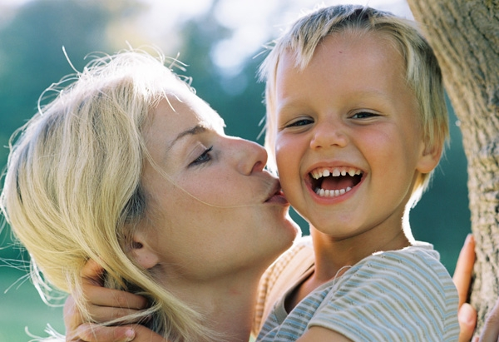
And now, hark at the rain,
Windless and light,
Half a kiss, half a tear,
Saying good ...
luck
night
bye
night

Slide 19
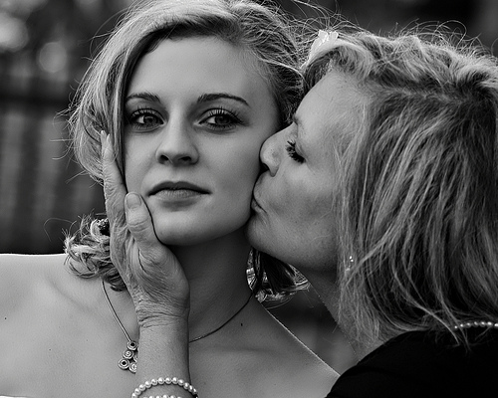
lime
time
chime
Travel, trouble, music, art,
A kiss, a frock, a rhyme-
I never said they feed my heart,
But still they pass my … .
time

Slide 20
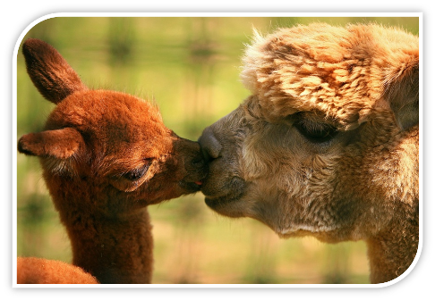
This is the End of the Quiz but the Beginning of the Kiss!
Thank you for taking part in the Quiz!

Slide 21
Sources
http://www.mamalisa.com/?t=es&p=111&c=23
http://www.poetrysoup.com/famous_poems/short/kiss?term=kiss
http://www.allgreatquotes.com/kissing_quotes.shtml
http://allpoetry.com/poem/10868343-Wishes-Kisses-by-buckleysavanna
http://www.apples4theteacher.com/holidays/mothers-day/poems-rhymes/a-mothers-kiss.html
http://www.craftsayings.com/forum/viewtopic.php?f=45&t=7142
http://www.panorama.am/g_image.php?id=208248&t=b

