Slide 1
Лекция для 7-11 классов
Автор
Ольга Михайловна Степанова
Учитель английского языка
МБОУ «Цивильская СОШ №1 имени М. В Силантьева» города Цивильск Чувашской Республики
2015

Slide 2
Mother's Day is a modern celebration that started in North America to honor one's own mother, as well as motherhood, maternal bonds, and the influence of mothers in society.

Slide 3
It is celebrated on different days in various parts of the world, but usually falls in March or May.

Slide 4
Mother’s Day falls on the second Sunday in May and is a celebration of Motherhood.

Slide 5
Mother’s Day is a day set aside to express love, respect and thanks to Mothers.

Slide 6
The day is observed by giving gifts, visiting, or taking Mothers out for dinner and celebration.

Slide 7
Julia Ward Howe was the first person to suggest the observance of a Mother’s Day in 1872. The day was dedicated to peace. She held an annual meeting, for several years in the city of Boston, Massachusetts for this observance.

Slide 8
In 1887, Mary Towles Sasseen, a Kentucky school teacher, began conducting Mother’s Day celebrations and in 1904, Frank E. Hering of South Bend, Indiana began a campaign for the observance of Mother’s Day.
However, it wasn’t until Anna Jarvis, of West Virginia, began a nationwide campaign for its observance that the idea took root.

Slide 9
Woodrow Wilson signed a joint resolution of Congress recommending observance of Mother’s Day by executive branches of the government on May 9, 1914.
The following year, Mother’s Day was designated an annual national observance.

Slide 10
Many other countries of the world celebrate their own Mother’s Day at different times throughout the year.

Slide 11
Denmark, Finland, Italy, Turkey, Australia, and Belgium celebrate Mother’s Day on the second Sunday in May, as in the U.S.

Slide 12
Russia has a Mother’s Day on the last Sunday of November.

Slide 13
Russian Mother’s Day also follows the same template of the American celebration, which is full of gifts, cards and flowers.

Slide 14
Carnations are the traditional flower
for Mother's Day.

Slide 15
Enjoy some cards from the Mother’s Day!

Slide 16
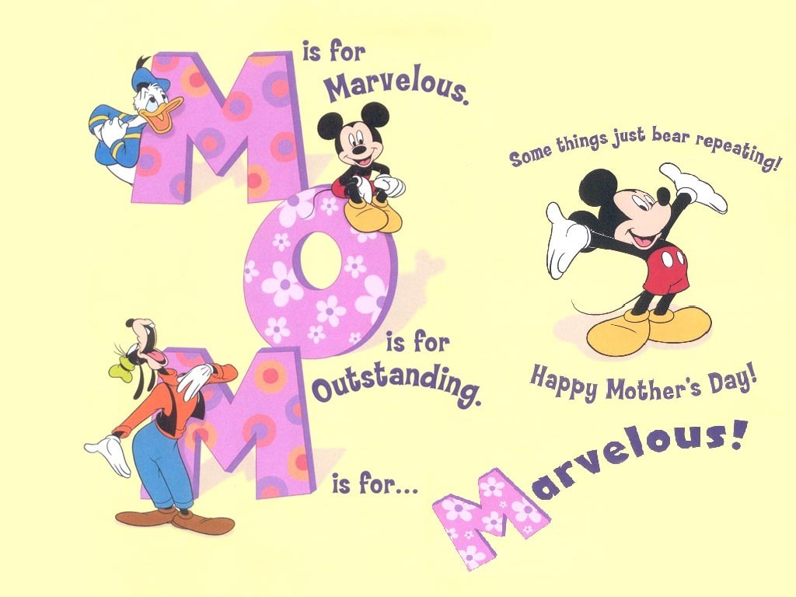

Slide 20
The End
Do not forget to send your greetings to Your Moms

Slide 21
Использованные ресурсы
http://www.ducksters.com/holidays/mothers_day.php
https://kidskonnect.com/holidays-seasons/mothers-day/
http://i.123g.us/c/thank_everyday/card/311838.gif
http://brosia.com/images/MayGodBlessYou.gif
https://encrypted-tbn1.gstatic.com/images?q=tbn:ANd9GcRyK-khZTFTfJTe94yrrbrby4GjoIOXNhXlOEAtUfNdtt-pmZzs
http://www.tumblr18.com/t18/2013/11/Happy-Mothers-day-cute-mother-and-baby-statue.jpg
http://www.designsmag.com/wp-content/uploads/2015/05/Happy-Mothers-Day-Funny-Cartoon3.jpg
http://img.poemhunter.com/i/poem_image/90/42197090_poem_44.gif
http://i.123g.us/c/emay_mothersday_happy/card/108624.gif
http://www.johannesburg-guesthouses.co.za/blog/wp-content/uploads/2015/05/12.mothers-day-wallpaper.jpg
http://theartmad.com/wp-content/uploads/2015/05/Mothers-Day-Wallpaper-Gif-4.gif
http://media.meme4u.com/ecards/holidays/mothers-day/hugs/1154-all-the-love.jpg
https://s-media-cache-ak0.pinimg.com/originals/51/6a/dd/516add18468dbc3c221f315feb3ae7c6.gif
http://images2.fanpop.com/images/photos/6000000/Disney-Mother-s-Day-Wallpaper-disney-6039761-1024-768.jpg
http://www.makingdifferent.com/wp-content/uploads/2013/05/8.jpg

