Slide 1
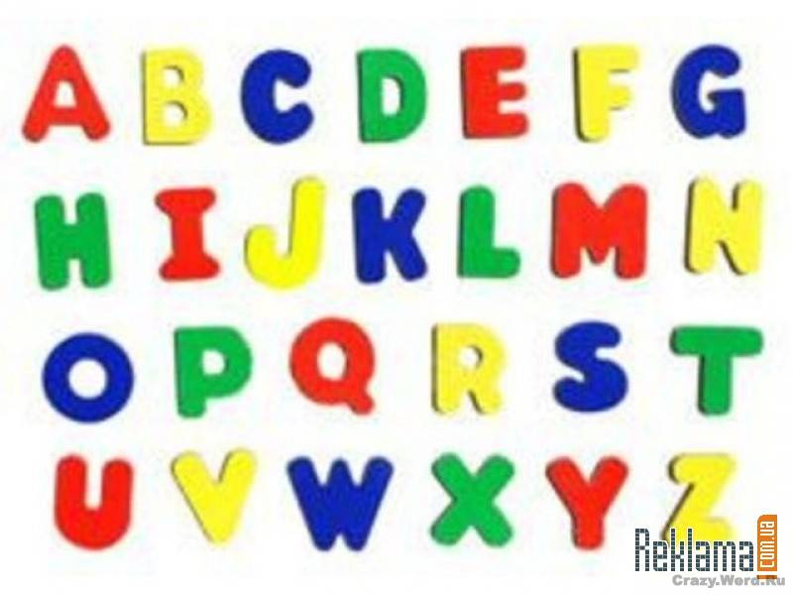
Шайдурова Валентина Федоровна
Учитель английского языка
ГБОУ «Школа №106»
Санкт-Петербург
2015
Reasons
to Learn English

Slide 2
English is commonly spoken throughout much of the world
due to Great Britain’s expansion during the colonial age.
People in Australia, New Zealand, Canada, parts of Africa,
India, and many smaller island nations speak English.
English is the commonly adopted second language
in Germany, Norway, Sweden, Denmark and the Netherlands.
Speaking English opens these countries and cultures up to you.

Slide 3
English is the most commonly used language
among foreign language speakers.
Throughout the world, when people with different languages
come together they commonly use English to communicate.

Slide 4
Another reason why English is so important is that
it is the language of science.
The majority of the electronically stored information
around the world is in English.
To excel in science you need to know English.

Slide 5
Contact scientists from other countries!
Go to international conferences!
Visit academic centers abroad!
Learn about new scientific discoveries by reading papers, books, and magazines.

Slide 6
International business is done in English.
And all business today is international.

Slide 7
The universal language on the Internet is the English.
Most computer applications are in English, so you will understand them better — and become a better employee.

Slide 8
Most pages on the Web are in English.
That’s over a billion (1,000,000,000) pages of information!
It’s amazing that learning just one language gives you access
to almost all knowledge on the Internet.

Slide 9
English is also the language of the Film Industry and
English means you no longer have to rely on subtitles.

Slide 10
It is necessary to learn English if you are planning to study
at a foreign university or school.
Usually many educational institutions
will provide you preparatory courses
to improve your English language skills
but you have to have at least a medium level of knowledge.

Slide 11
You can travel to any English speaking country
without the need of have a translator.
Usually, if you don't know the language your trip
would be hard and maybe you wouldn't enjoy it.

Slide 12
English is not only the most useful language in the world.
It is also one of the easiest languages to learn and to use:
Simple alphabet — no special symbols.
Easy plurals — simply add s to a word.
There are very few exceptions.

Slide 13
Short words. Most of the basic words are short: run, work, big, go, man.
Long words are often shortened:
sitcom = situational comedy, fridge = refrigerator,
OS= operating system.
Call everybody “you”.
You can say “Do you speak English?” to your friend or to your teacher.
In other languages, you have to use the right word for the right person. I
n English, everybody is equal.

Slide 14
Nowadays in the competitive job market
it is necessary to speak English.
So if you learn English you will have
a better chance of getting a job that pays more.

Slide 15
Resources
http://www.learnenglishguide.com/language/whyenglish.asp
http://www.5minuteenglish.com/why-learn-english.htm
http://www.englishisapieceofcake.com/why-learn-english.html
http://www.amlanguage.com/en/about/why-learn-english

