Slide 1
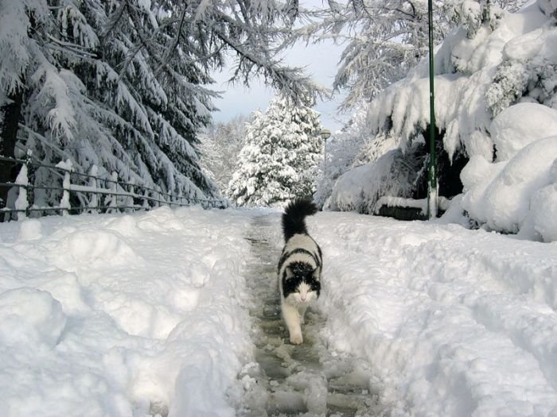
Winter Cats
with
Winter Wisdom
Interactive Quiz 7-11 классов
Автор
Ольга Михайловна Степанова
Учитель английского языка
МБОУ «Цивильская СОШ №1
имени М. В Силантьева»
города Цивильск
Чувашской Республики
2015

Slide 2
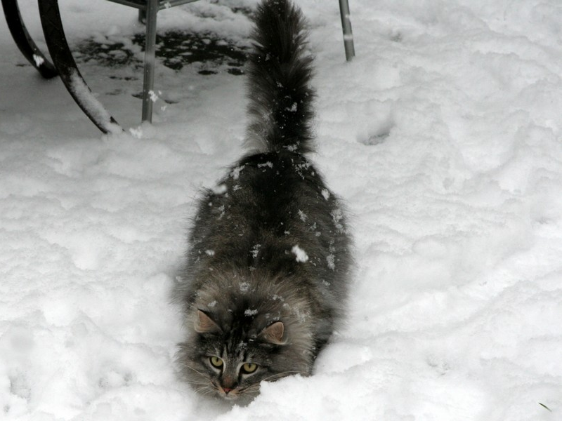
Laughter is the sun that drives winter from the human
… .
Victor Hugo
face

Slide 3
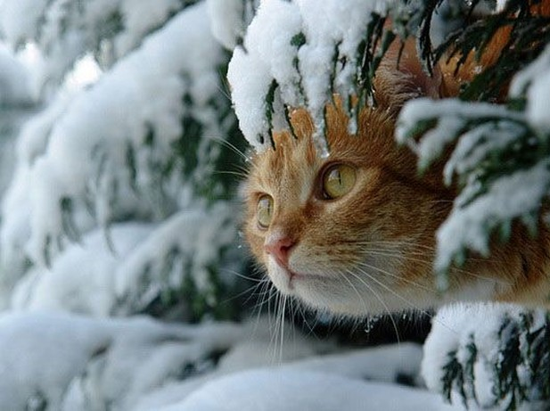
People don't notice whether it's winter or summer when they're … .
Anton Chekhov
happy

Slide 4
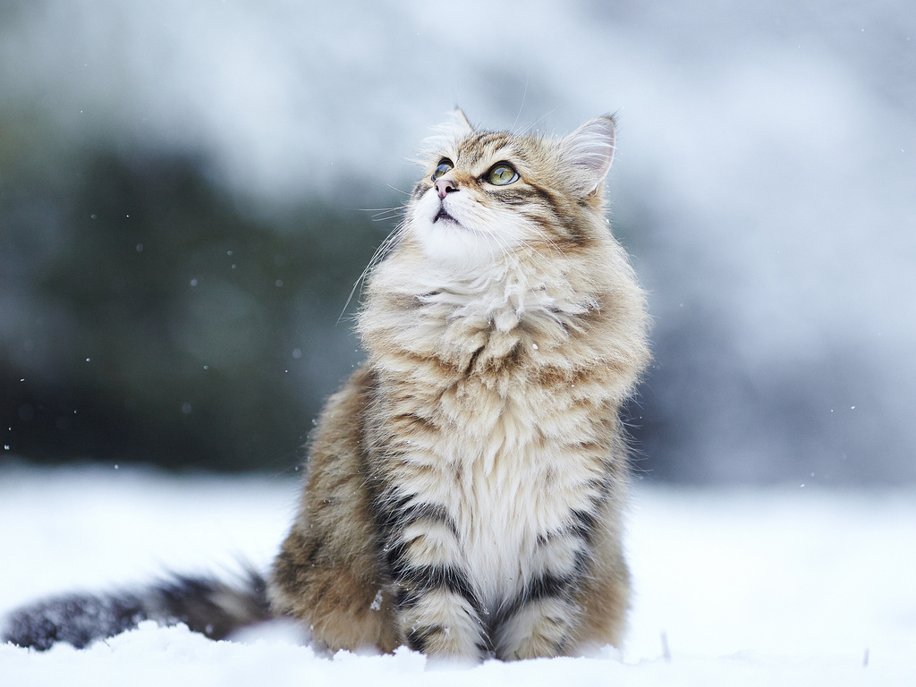
In the depth of winter
I finally learned that there was in me an invincible … .
Albert Camus
summer

Slide 5
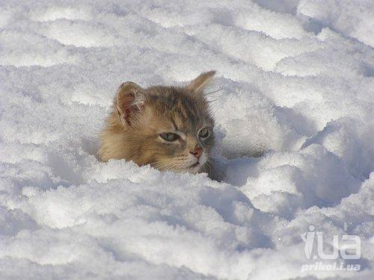
Baseball
There are only two seasons - winter
and … .
Bill
Veeck

Slide 6
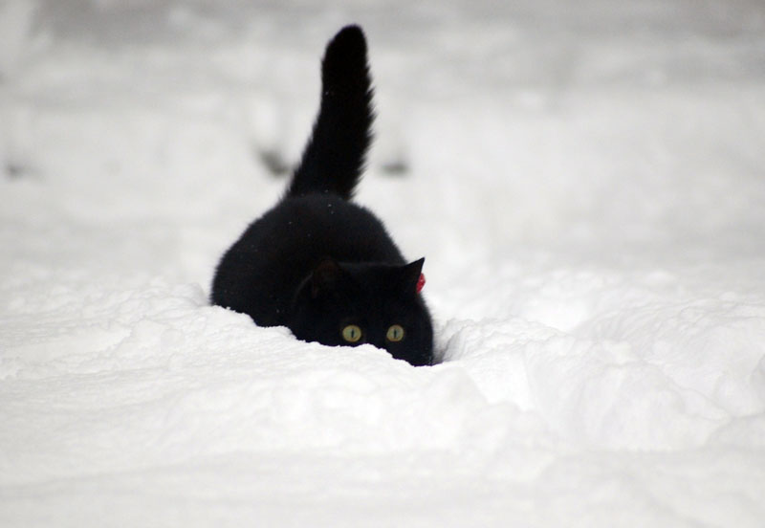
I love hats and winter is the perfect time for them. I love winter
time … .
Rebecca Ferguson
fashion

Slide 7
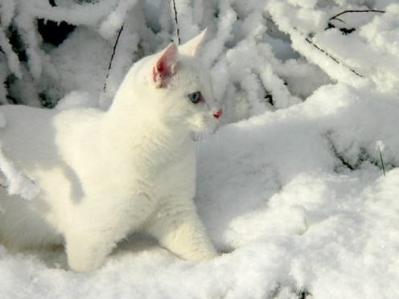
The combination of olive oil, garlic
and…juice lifts
the spirits in winter.
Yotam Ottolenghi
lemon

Slide 8
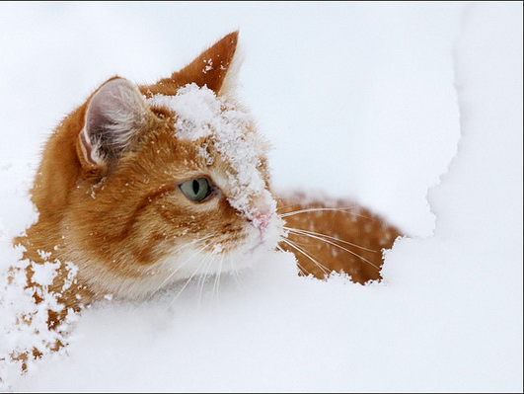
Let us love winter, for it is the spring of … .
Pietro Aretino
genius

Slide 9
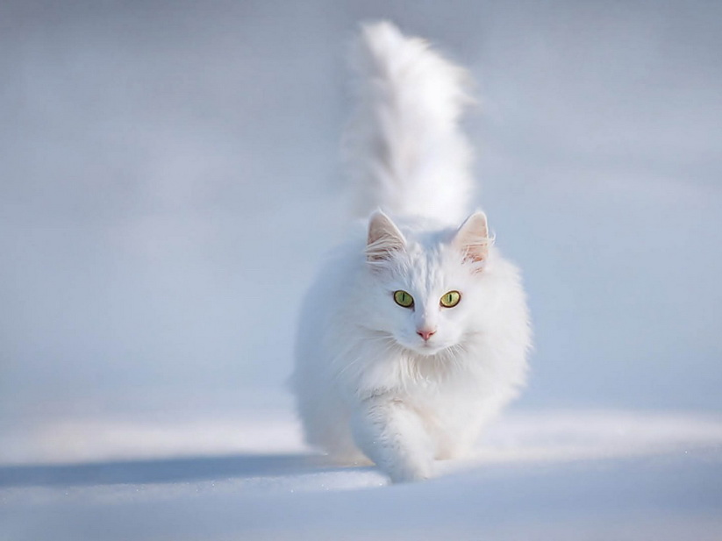
During the winter my attention was attracted to the changes in the stars and planets in the … .
Paul Nurse
sky

Slide 10
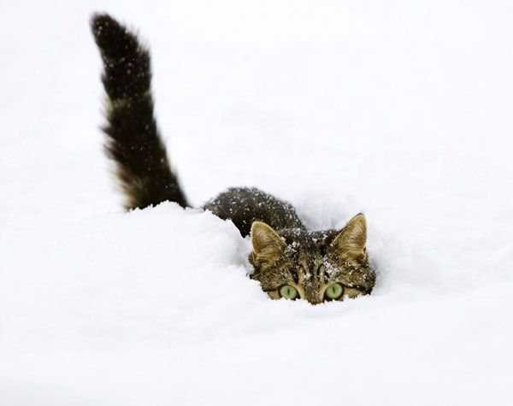
Even the strongest blizzards start with a single … .
Sara Raasch
snowflake

Slide 11
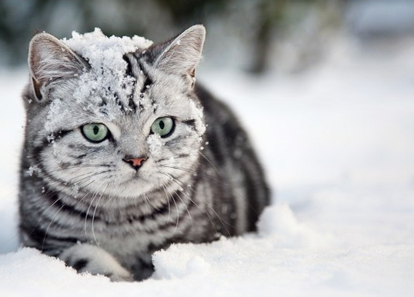
A lot of people like snow. I find it to be an unnecessary freezing of … .
Carl Reiner
water

Slide 12
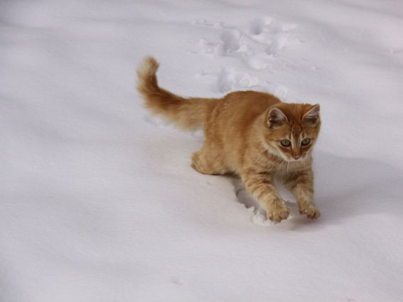
You have to feel the bite of the wind to appreciate the warmth
of a winter … .
Fennel Hudson
coat

Slide 13
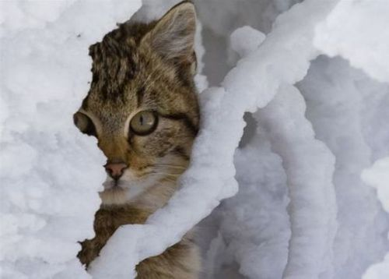
I read, much of the night, and go south in the … .
T.S. Eliot
winter

Slide 14
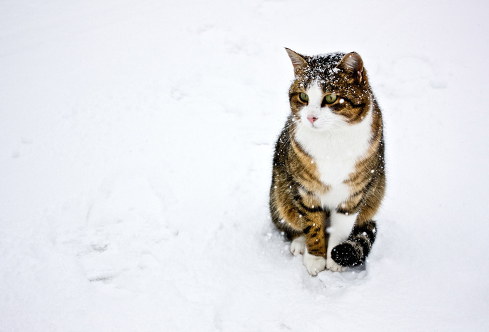
Winter
brings
cold dry
harsh
weather and trees are
without … .
Lailah Gifty Akita
leaves

Slide 15
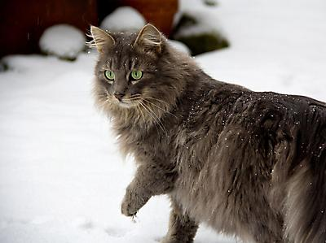
It is winter--the best time to dream of … .
Debasish Mridha
spring

Slide 16
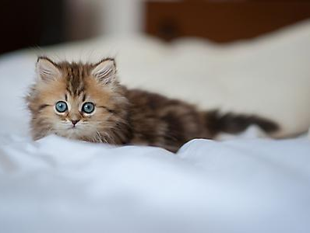
Winter gold: the sparrow's footprints in the … .
Marty Rubin
snow

Slide 17
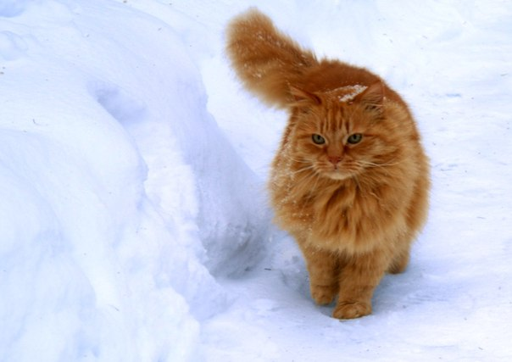
When you look at a great winter scenery, see the flowers, see the bees, see the … , they are all there!
Mehmet Murat ildan
butterflies

Slide 18
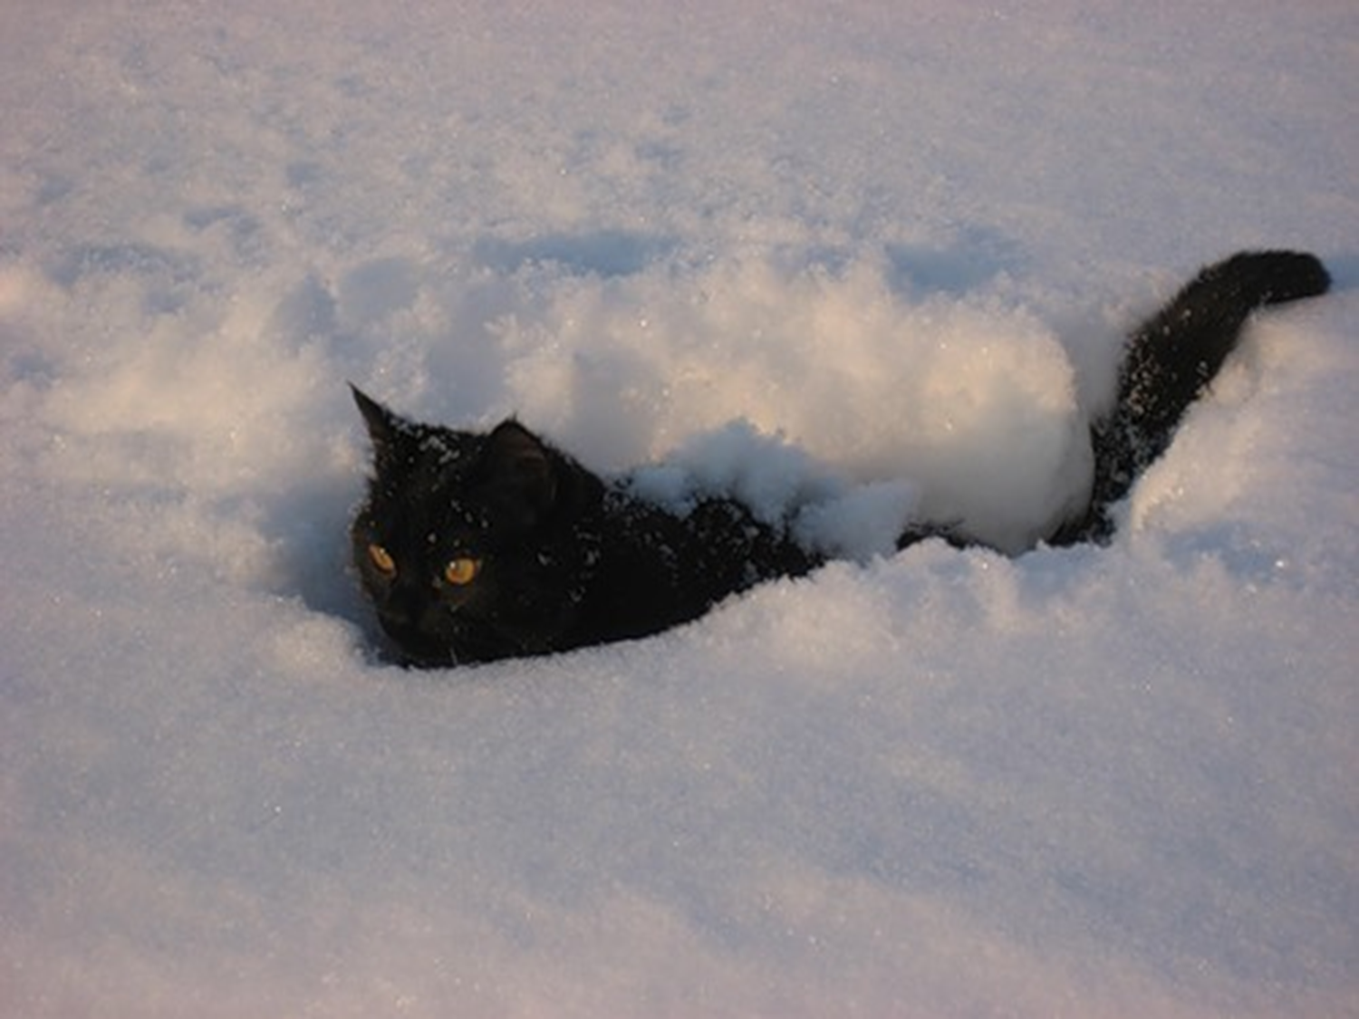
Winter changes into stone the
water
of
heaven and the … of man.
Victor Hugo
heart

Slide 19
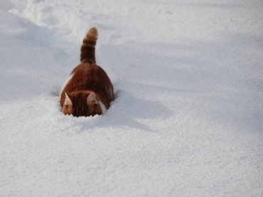
In spring we are on Earth; in summer we are on Earth;
in autumn
we are on
Earth, but
in winter we are in another planet; winter is another … .
Mehmet Murat ildan
planet

Slide 20
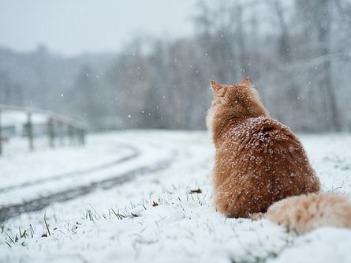
How many lessons of faith and beauty we should lose,
if there were no winter
in our … !"
Thomas Wentworth Higginson
year

Slide 21
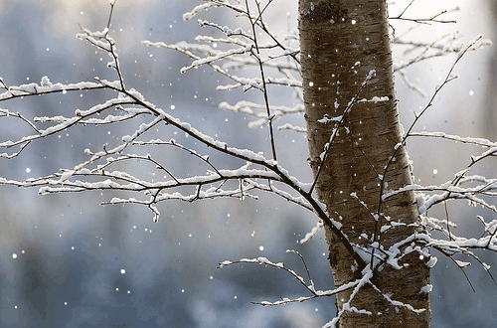
Well Done!
Have a Nice Winter!

Slide 22
Использованные ресурсы:
http://cat-story.ru/wp-content/uploads/2011/12/kot-zima.jpg
http://vashipitomcy.ru/_pu/4/18133552.jpg
http://www.nastol.com.ua/pic/201302/1366x768/nastol.com.ua-40659.jpg
http://i1.i.ua/prikol/pic/7/4/881347.jpg
http://catfoto.com/uploads/images/00/00/01/2010/12/28/25.jpg
http://img0.liveinternet.ru/images/attach/c/7/96/603/96603882_9.jpg
http://img.videla.ru/cats_snow/5.jpg
http://img.nnov.org/data/myupload/4/440/4440479/1158.jpg
http://prikolyuxi.ru/img/koshki_prikoly_foto/koshki_prikoly_foto_18.jpg
http://cs619827.vk.me/v619827463/d05d/VOfXokP-6yU.jpg
http://img.izismile.com/img/img4/20111210/640/marvelous_cats_having_a_blast_in_the_snow_640_48.jpg
http://xorst.ru/images/wallpapers/details/zhivotnye/2812120742_1415831219.jpg
https://pp.vk.me/c308726/v308726898/b794/KivADaZBQ18.jpg
http://img-fotki.yandex.ru/get/21/degtyannikovaa.2/0_b477_ae9218e1_L.jpg
http://img-fotki.yandex.ru/get/6418/155295907.8c/0_92ba9_a8bd0532_L
http://fishki.net/picsw/122009/29/post/kot1/kot_10.jpg
http://nordligdrom.co.uk/1/uploads/Gallery/180113snow7.jpg
http://www.inc.com/geoffrey-james/30-inspiring-quotes-about-winter.html
http://www.goodreads.com/quotes/tag/winter
http://www.google.com/search?q=Winter+gold%3A+the+sparrow%27s+footprints&oq=Winter+gold%3A+the+sparrow%27s+footprints&sourceid=chrome&ie=UTF-8
http://www.brainyquote.com/quotes/keywords/winter.html

