Slide 1
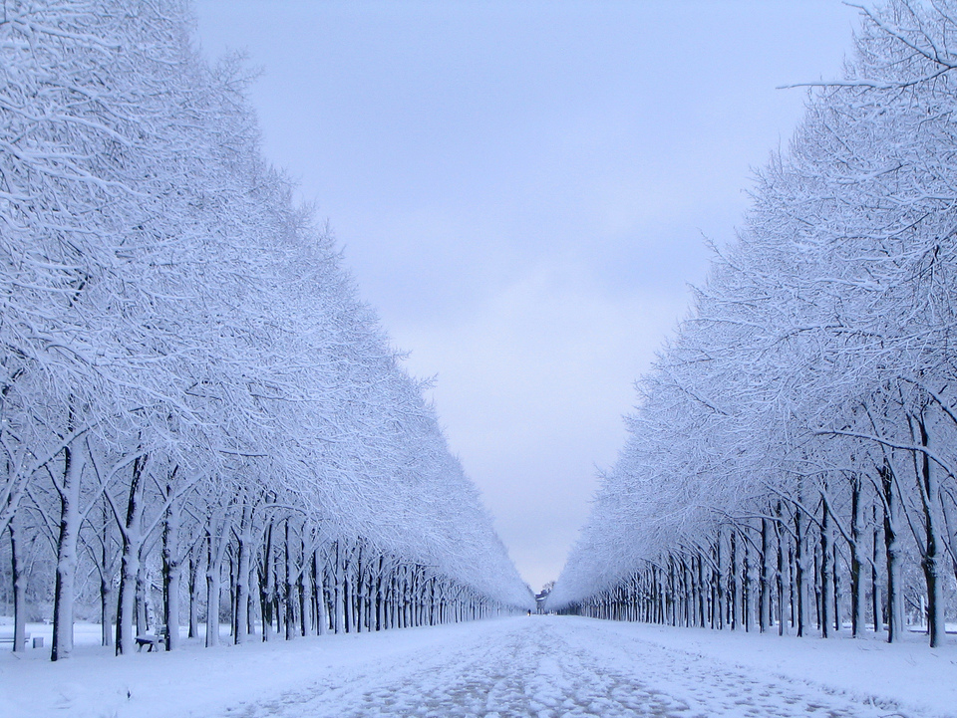
Walking
through the Winter
Interactive Quiz 7-11 классов
Автор
Ольга Михайловна Степанова
Учитель английского языка
МБОУ «Цивильская СОШ №1
имени М. В Силантьева»
города Цивильск
Чувашской Республики
2015

Slide 2
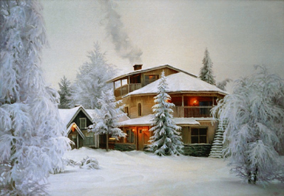
The snow comes down
In the dark of night.
When we awake
The
world
is … .
white

Slide 3
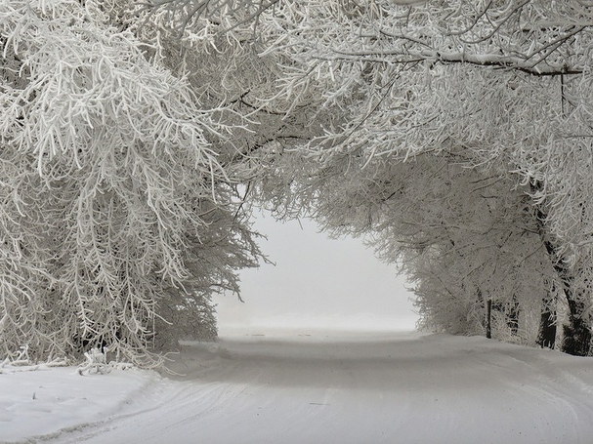
Delicate
and feathery,
Crystal clear
And white,
Six-point
stars
Come tumbling,
Softly
In the … .
night

Slide 4
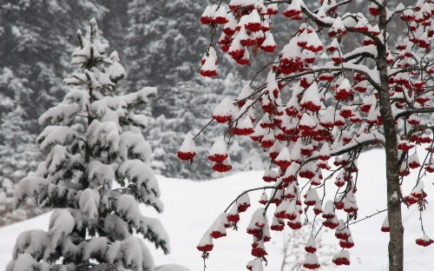
See the pretty snowflakes
Falling
from
the sky;
On the wall
and housetops
Soft and
thick they … .
lie

Slide 5
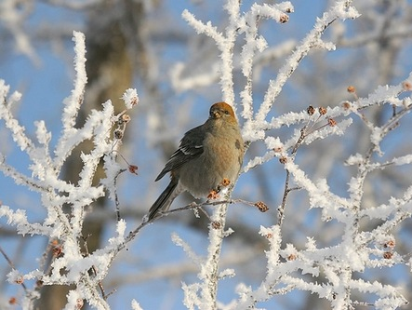
Sing a song of winter,
Frost is in the air.
Sing
a song
of winter,
Snowflakes every… .
where

Slide 6
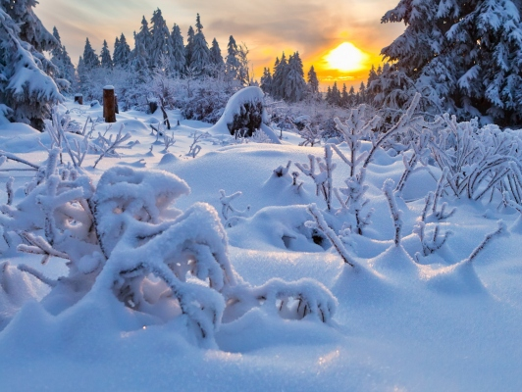
Snow on the mountain tops,
Snow on the trees,
Snow everywhere
I walk,
Way up to my … .
knees

Slide 7
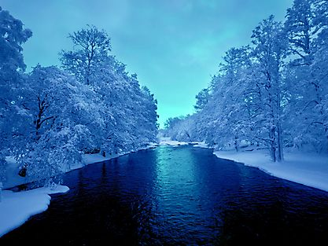
Winters season,
may be dark and cold,
But if you look closer,
there's plenty of … .
gold

Slide 8
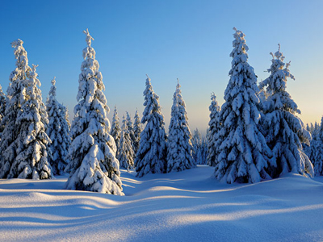
The frost is on the roof,
The frost
is on
the ground.
The frost is
on
the window,
The frost is all … !
around

Slide 9
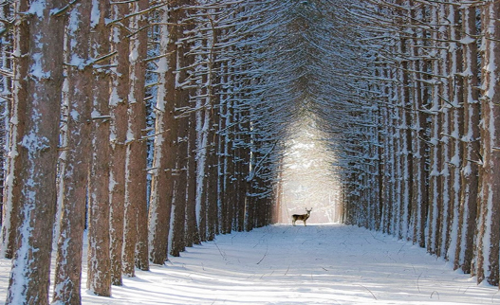
The snow fell gently all the night.
It made a blanket soft and white.
It covered
houses,
flowers
and ground
But did not make
a single … .
sound

Slide 10
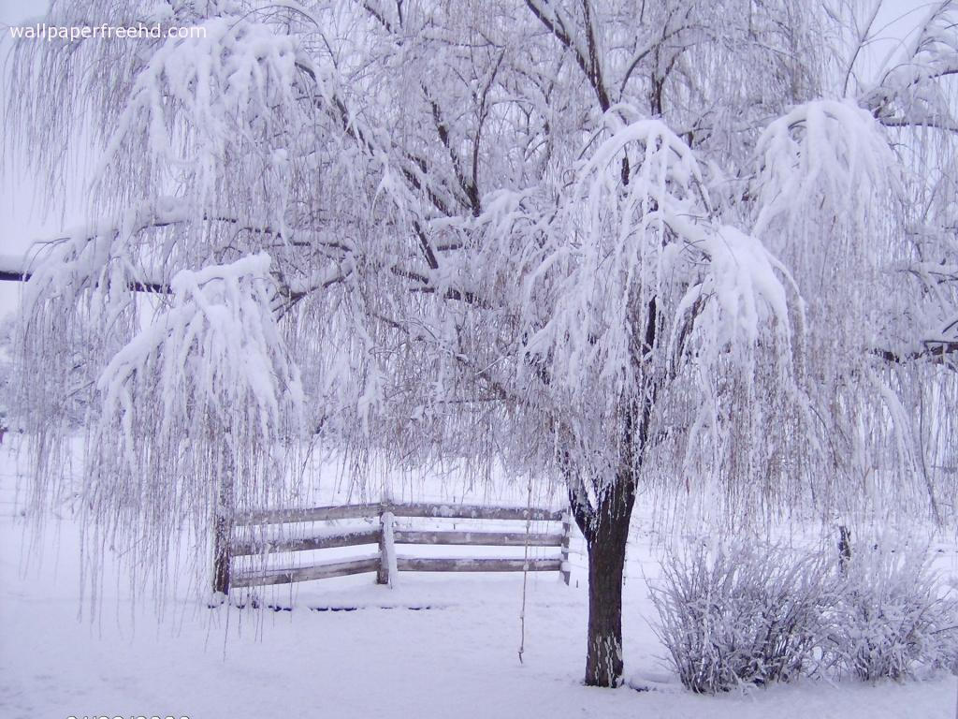
It Snowed Last Night
Oh, it snowed last night It snowed last night.
The sky
bears
had a
PILLOW
… .
FIGHT

Slide 11
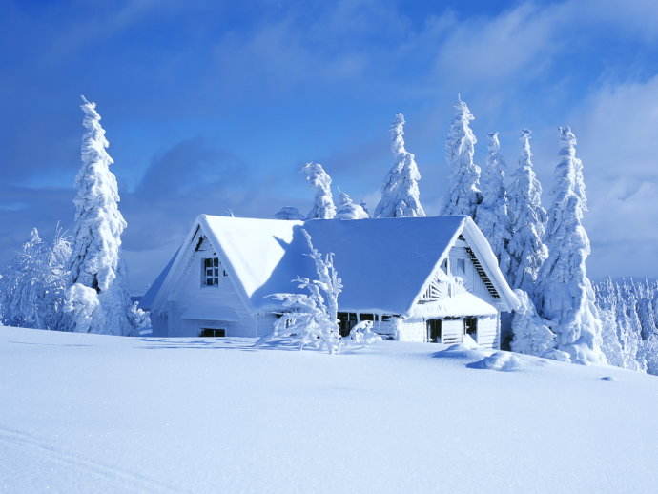
The little snowbirds
Dart along together
As they chatter love-words.
They love the snow … .
weather

Slide 12
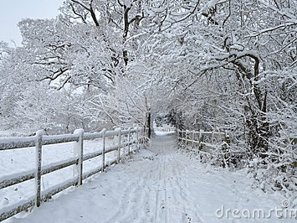
The winter wind blows
The winter wind blows
It gives me
the shivers
From my head to my … !
toes

Slide 13
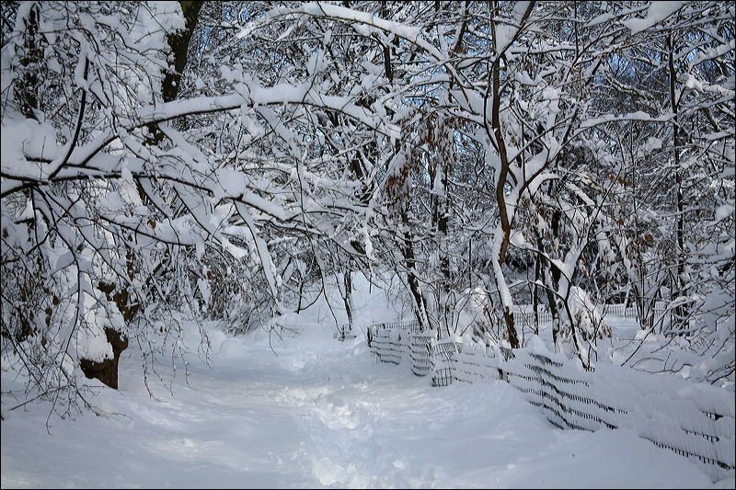
Outside
the snow
is falling
The children
are
sleighing
Sometimes
they start snowballing
Outside the snow is …
falling

Slide 14
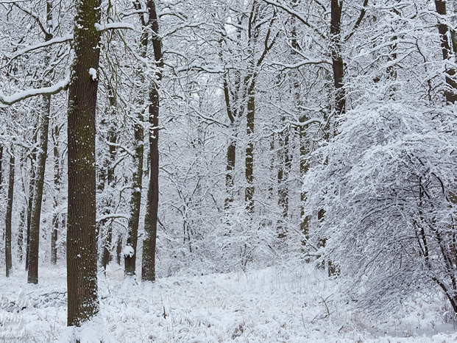
Dance like snowflakes, dance like snowflakes
In the air,
in the air
Whirling, twirling snowflakes
Whirling, twirling snowflakes
Here and there, here and … .
there

Slide 15
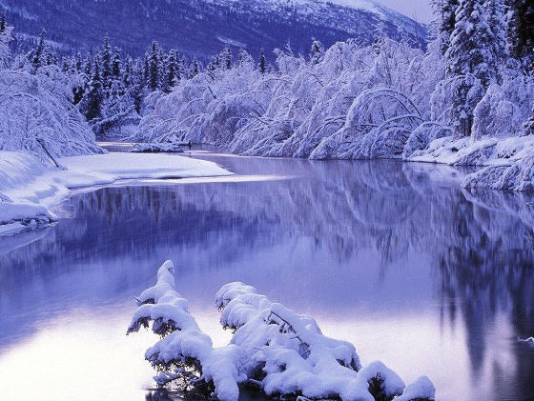
Snow on the puddles,
Snow
in the street,
Snow in the gutters,
Snow on my … !
feet

Slide 16
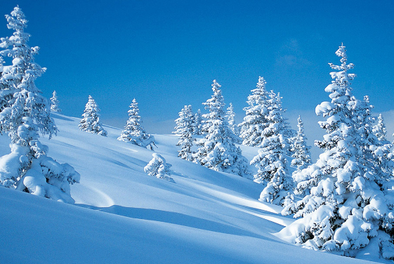
The wind is howling
Over
my house
But I’m snuggled up
Like a little … .
mouse

Slide 17
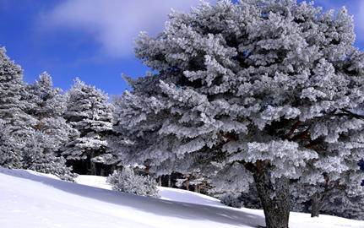
Frosty is the morning;
But the sun is bright,
Flooding all the landscape
With its golden … .
light

Slide 18
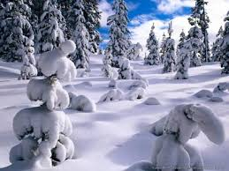
I never
know
Just where
to go,
When
all
the world
Is full of … .
snow

Slide 19
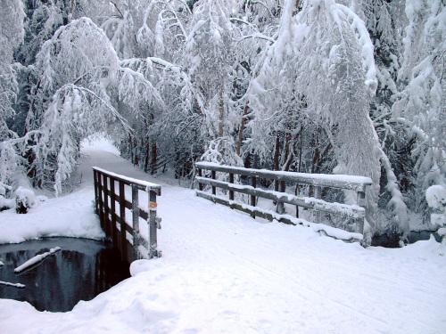
The day is cloudy and the wind is bold. Dress up warmly, you mustn't get … !
cold

Slide 20
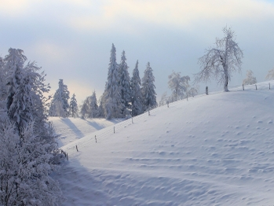
Snow forts, snowballs, angels, too,
In the snow, so white and new.
Slip and
slide and
skate so fast.
Wintertime is here at … .
last

Slide 21
Well Done!
Have a Nice Winter!

Slide 22
Использованные ресурсы:
http://img-fotki.yandex.ru/get/6515/39663434.237/0_7cb38_d9fb24c7_L.jpg
http://wpapers.ru/wallpapers/nature/Winter/15116/PREV_%D0%97%D0%B8%D0%BC%D0%BD%D0%B8%D0%B9-%D0%BF%D0%B5%D0%B9%D0%B7%D0%B0%D0%B6.jpg
http://www.phototuning.ru/upload/image/4-lg.jpg
https://picload.files.wordpress.com/2014/04/4-magical-winter-in-quebec-forest-canada.png
http://7-themes.com/data_images/out/14/6816034-winter-landscape-wallpaper.jpg
http://hdpicorner.com/wp-content/uploads/2015/05/Winter-Snow-Images-690x518.png
http://thumbs.dreamstime.com/x/english-winter-snow-17663870.jpg
https://pbenjay.files.wordpress.com/2011/01/jan-11-freshly-fallen-snow.jpg
http://i382.photobucket.com/albums/oo270/katichika_photo/zima.jpg
http://dybiz.com/sites_randomblog/wp-content/uploads/2011/09/winter-snow-beautiful-season-photo.jpg
https://encrypted-tbn3.gstatic.com/images?q=tbn:ANd9GcSx9FYL87HqwQ8TFa8ULfC0i97RhV97uxSc-muqdYSs-DtiVfGW
http://www.wetcanvas.com/Community/images/21-Jan-2008/114249-Bridge_at_Russian_Jack.jpg
http://www.canteach.ca/elementary/songspoems7.html
http://hubpages.com/literature/The-Winter-Poems#mod_23223763
http://www.mrsjonesroom.com/themes/winter.html#songs
http://www.childfun.com/themes/seasonal/snow/#Snow_Songs_Poems_and_Finger_Plays
http://www.poetrysoup.com/poems/about/funny_snow_poems

