Slide 1
Thank You Day Lecture for the 8-11 Formers
Автор:
Ольга Михайловна Степанова
учитель английского языка
МБОУ «Цивильская СОШ №1
имени Героя Советского Союза
М.В. Силантьева»
города Цивильск
Чувашской Республики
2016

Slide 2
January 11
If you`re looking for
something to do today then you should give thanks
to all
because
it`s
International
Thank
You Day!

Slide 3
International Thank You Day got its start in 1994 and there are actually multiple thank you days; January 11th to January 18th.

Slide 4
Hearing thank you when you do something for someone else makes you feel better.
It`s almost like a priceless payment for
what you did and it makes you continue doing good things for others.

Slide 5
In our busy and stressful lives, it is important to remember that each day truly is a blessing. We sometimes take things, and each other, for granted. Whether we are facing a health crisis, are currently unemployed or
underemployed or are enjoying
a rich and prosperous year,
it’s important to remember
circumstances can change
when we least expect it.

Slide 6
Today is the perfect opportunity to be thankful for friends, family, freedom, food, shelter and basic necessities.
We should even be thankful for that cranky co-worker or rotten boss
because at least we have a job!

Slide 7
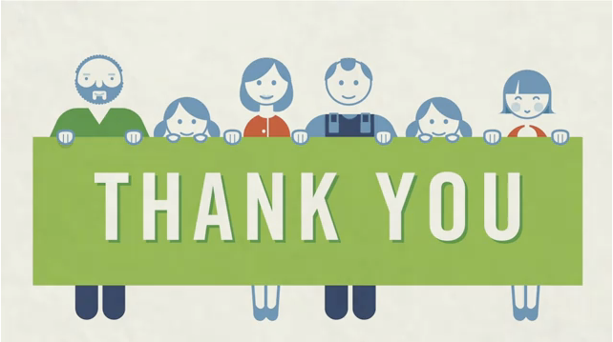
How can you celebrate
International Thank You Day?
It`s pretty simple,
just give thanks for all things today;
let people know that you`re grateful for what they do for you.

Slide 8
In honor of International Thank You Day, thank those around you. Try it all day long - people will wonder what you're up to! And who knows? Maybe that pearly white smile or sincere “thank you” will lift someone’s spirits more than you realize.

Slide 10
I really appreciate you,
Your helpful, giving ways,
And how your generous heart
Your unselfishness displays.
I thank you for your kindness,
I will not soon forget;
You’re one of the nicest people
I have ever met.
By Joanna Fuchs

Slide 11
For All You Do
Thank you so much for all you do;
You're truly a delight;
When my life overwhelms and does me in,
You make everything all right.
By Karl and Joanna Fuchs

Slide 12
Thanks for the Good Times Thank you for the good times, The days you filled with pleasure. Thank you for fond memories, And for feelings I'll always treasure. By Karl Fuchs

Slide 15
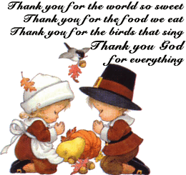

Slide 16
Dear students,
on this very special days,
Do not forget to give special Thanks
to your Parents and your Teachers!

Slide 17
Sources
http://news.flarus.ru/?topic=1489
http://www.examiner.com/article/happy-international-thank-you-day
https://www.youtube.com/watch?v=4Rela23drPc
http://www.poemsource.com/thank-you-poems.html
http://media.meme4u.com/ecards/celebrate-the-date/butterfly-day/1580-thank-you.jpg
http://www.desibucket.com/dbp/01/63557/63557.gif
http://www.sadmuffin.net/cherrybam/graphics/comments-thank-you/thank-you017.gif
http://i.123g.us/c/eaug_thankyouday/card/111382.gif

