Slide 1
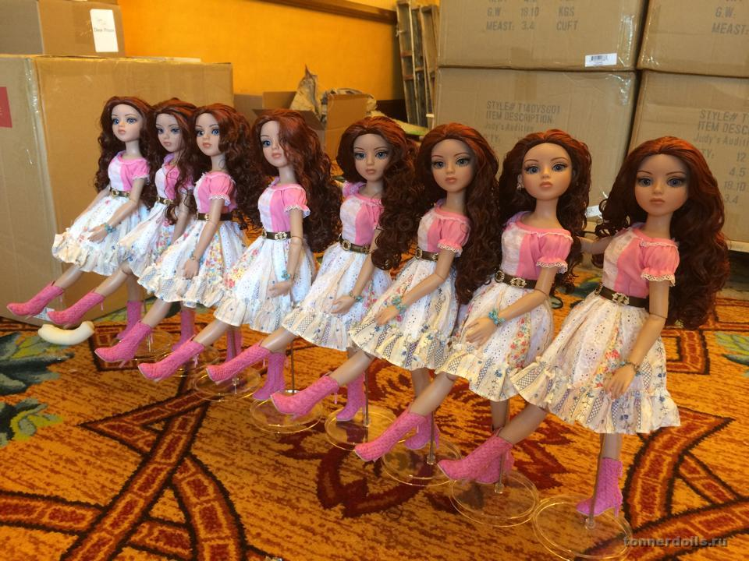
Robert Tonner Dolls
Dolls Exibition for 8-11 Formers
Автор:
Ольга Михайловна Степанова
учитель английского языка
МБОУ «Цивильская СОШ №1
имени Героя Советского Союза
М.В. Силантьева»
города Цивильск
Чувашской Республики
2016

Slide 2
Meet Robert Tonner Dolls!

Slide 3
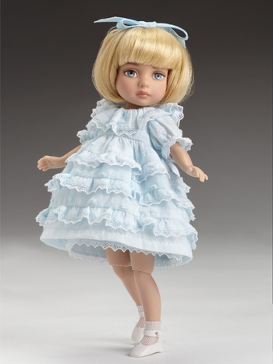
Robert Tonner (born July 14, 1952) is an American entrepreneur, fashion designer, sculptor, doll artist and owner of Tonner Doll Company, Inc.

Slide 4
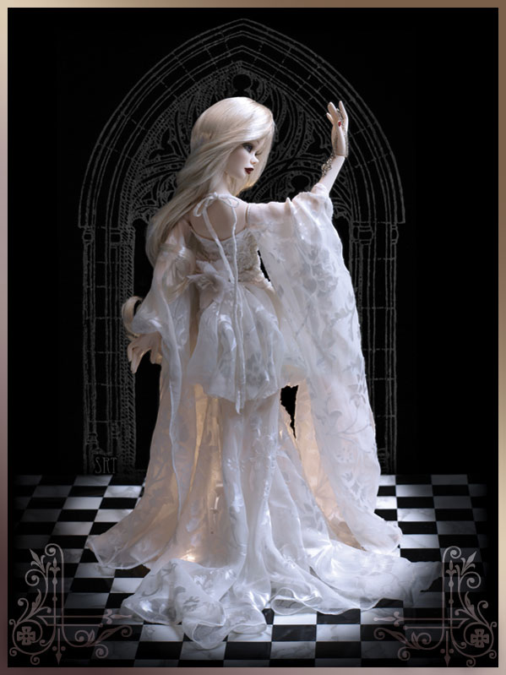
Robert Tonner is best known for his fashion doll designs and the creation of the Tonner Doll Company, Inc., which designs a number of original doll lines.

Slide 5
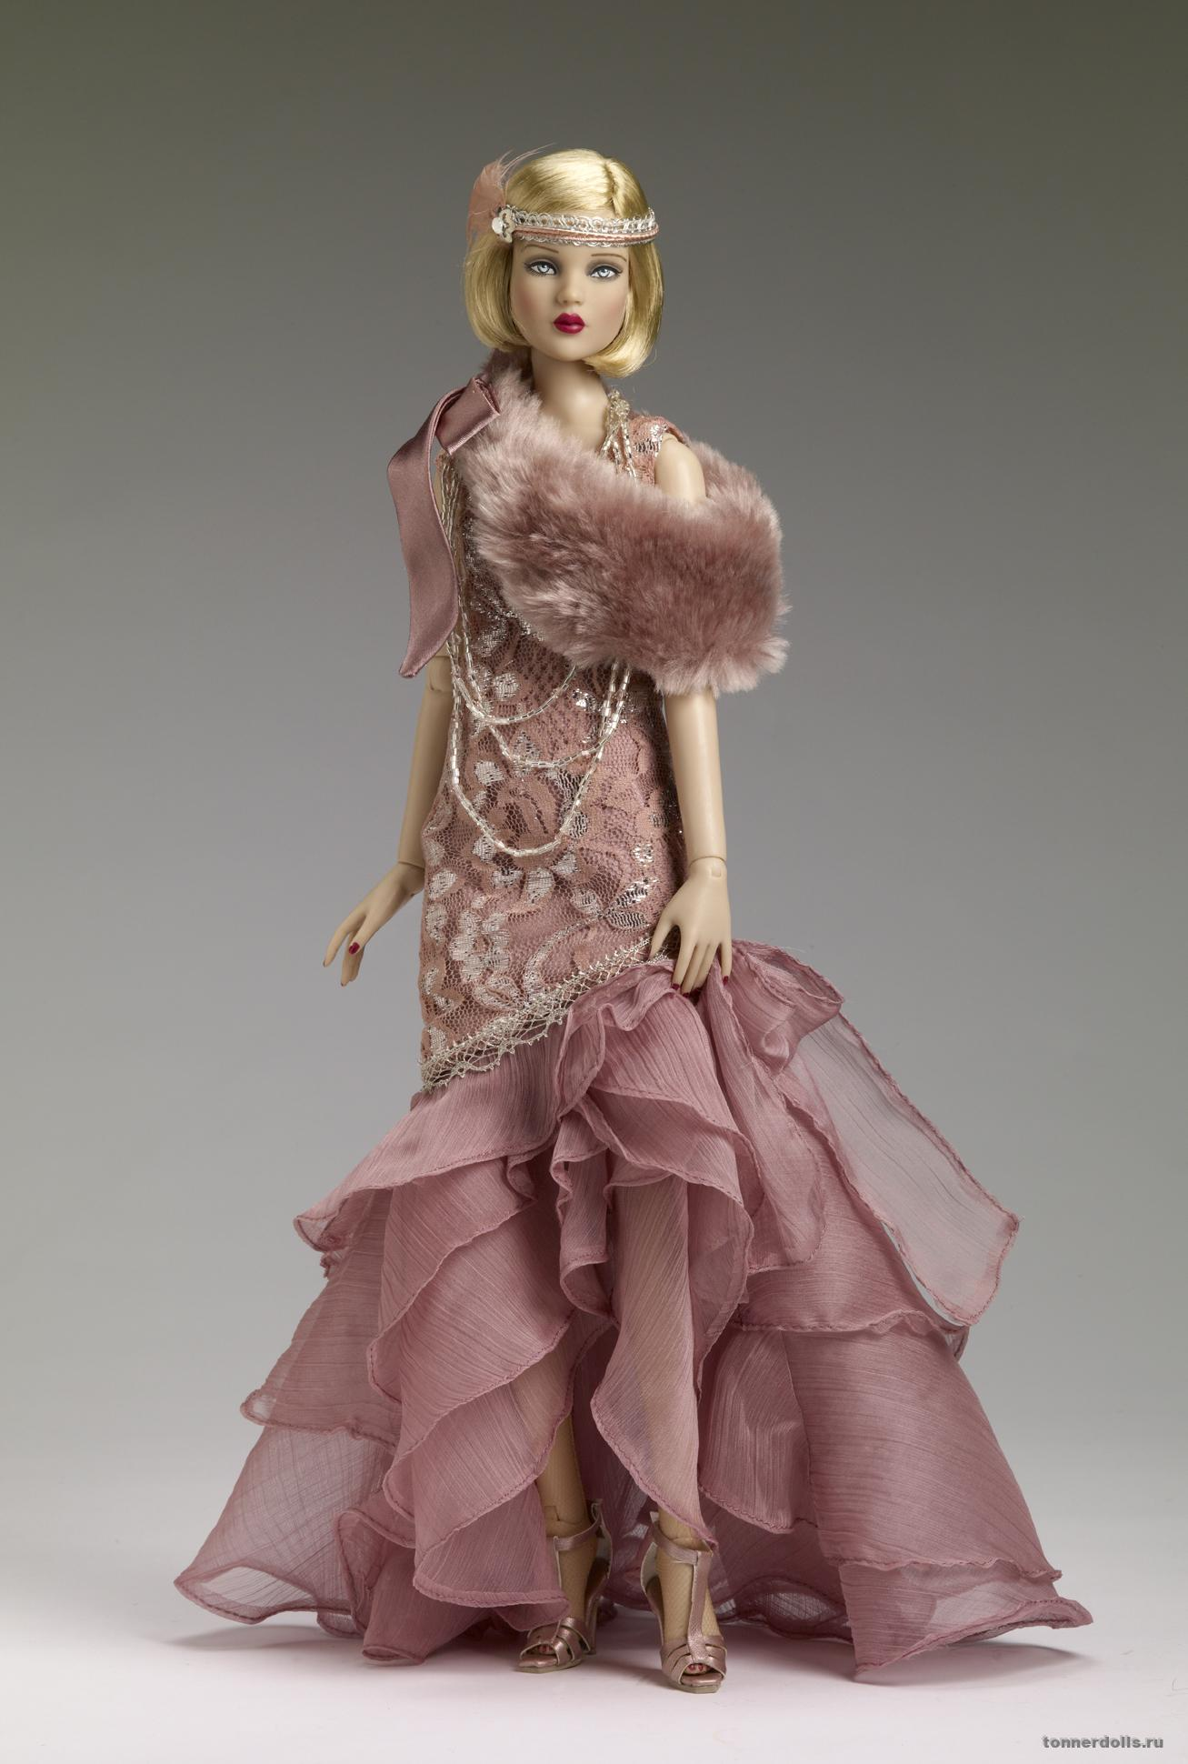
Robert Tonner has received national and international artistic awards and recognition including a permanent piece at The Louvre Museum of Decorative Arts in Paris.

Slide 6
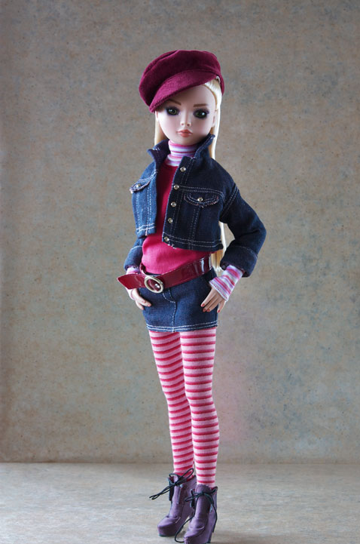
Robert Tonner has also served as President of the National Institute of American Doll Artist
(NIADA)

Slide 7
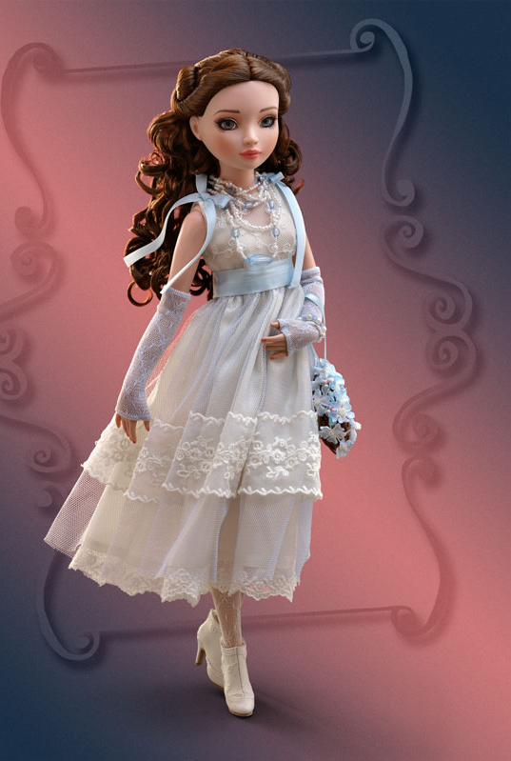
Robert Tonner was born as a twin, to a working class family in Bluffton, Indiana. Martin Tonner, his father, was a self-educated engineer, and his mother, Virginia, a housewife. Robert has one older brother, John; his twin brother, David; and a younger sister, Mary.

Slide 8
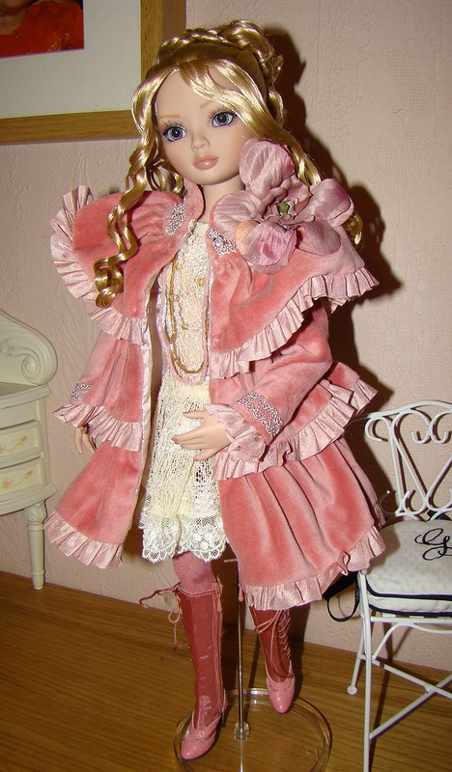
As a child, Tonner turned to drawing and television as an escape from the difficult home situation. Programs such as The Mickey Mouse Club, The Wonderful World of Disney as well as many comic book superheroes, such as the members of The Justice League, would be his greatest inspiration. At the age of eight, Tonner learned to sew.

Slide 9
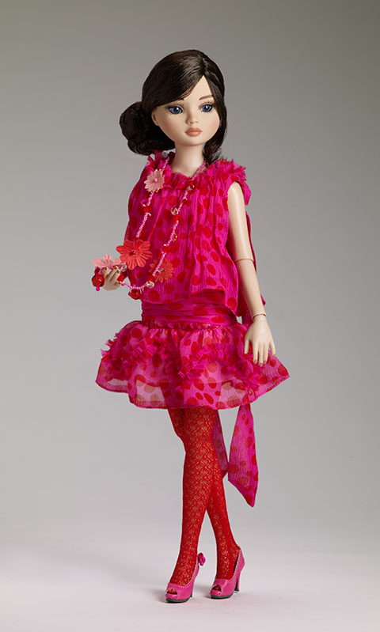
Tonner began his college career as a pre-med major, attending three different universities. However, in 1973 the struggling student abandoned his goal of becoming a surgeon.

Slide 10
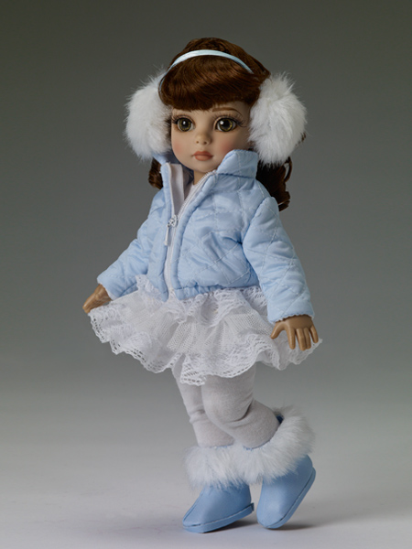
Very soon he decided to pursue his true passion of becoming a fashion designer. That same year he would attend the Parsons School of Design in New York City.

Slide 11
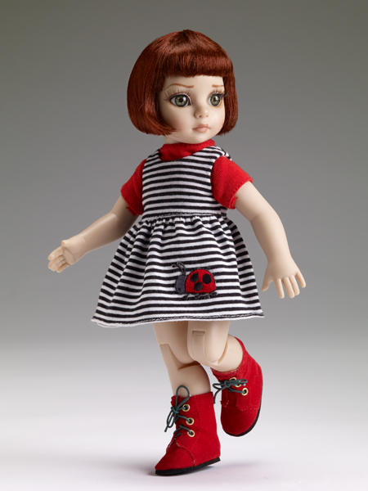
In 1975, at the age of 23, Tonner was hired as the Personal Assistant to Don Sayres, a designer for Gamut, a sportswear company located in New York City.

Slide 12
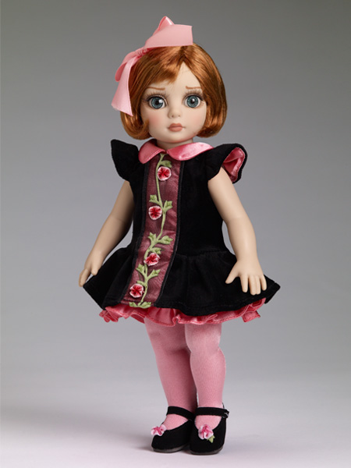
After three years with Gamut, Tonner accepted a position with fashion designer Bill Blass and was later asked to head the Blassport label.
In 1983 Tonner launched his personal fashion label, "Robert Tonner for Tudor Square".

Slide 13
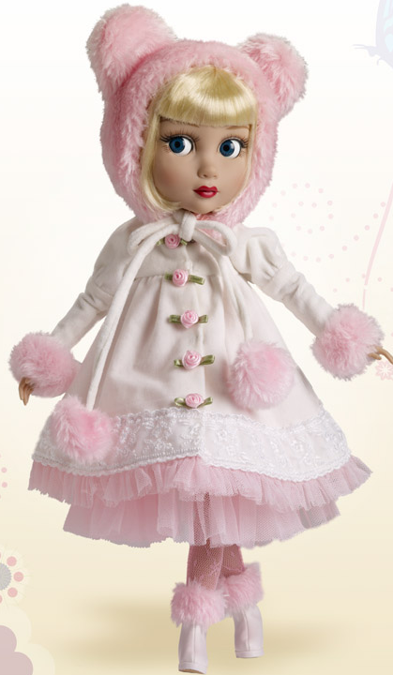
After leaving the fashion industry, Tonner joined the National Institute of American Doll Artists (NIADA). He served as Standards Chairman from 1991–1995 and was later elected President of NIADA 1995, a post which he held until 1997.

Slide 14
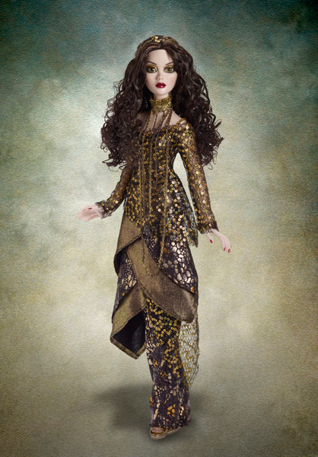
Tonner launched Robert Tonner Doll Design (RTDD) in 1991 with his partner Harris Safier. The first RTDD designs were introduced at the American International Toy Fair that same year.

Slide 15
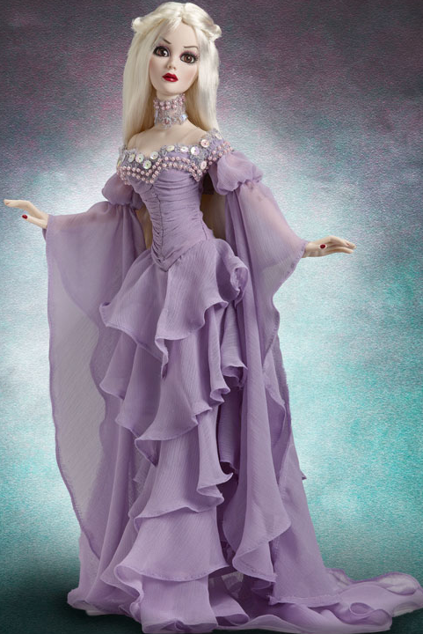
Backed by past connections within the NIADA and fashion design world, and the aggressive publicizing by Tonner’s partner Harris, RTDD saw exponential growth within the first few years. In 2000, RTDD was renamed Tonner Doll Company, Inc.

Slide 16
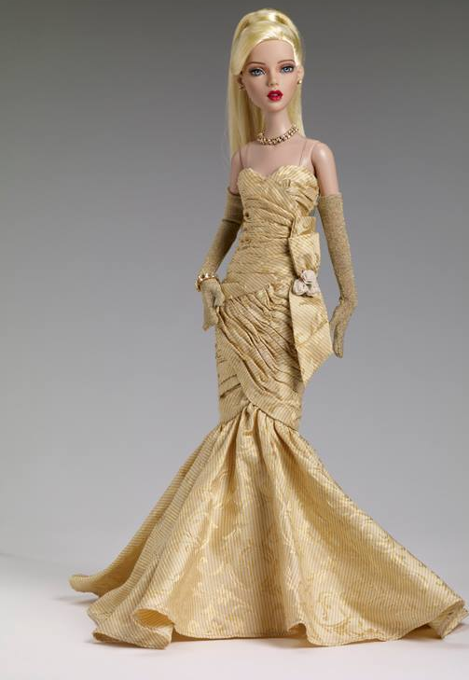
In 2006, Robert Tonner created the direct-marketing company, Wilde Imagination, which built a collectible fashion doll design business based on Tonner’s fictional character, Ellowyne Wilde.

Slide 17
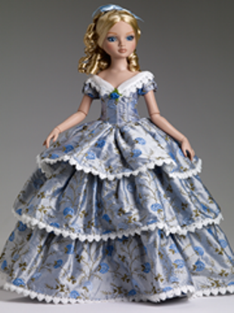
Recently, Tonner has returned to the world of fashion design with the introduction of the Robert Tonner 2010 Spring Collection which debuted on September 9, 2009, at the Metropolitan Pavilion in New York City.

Slide 18
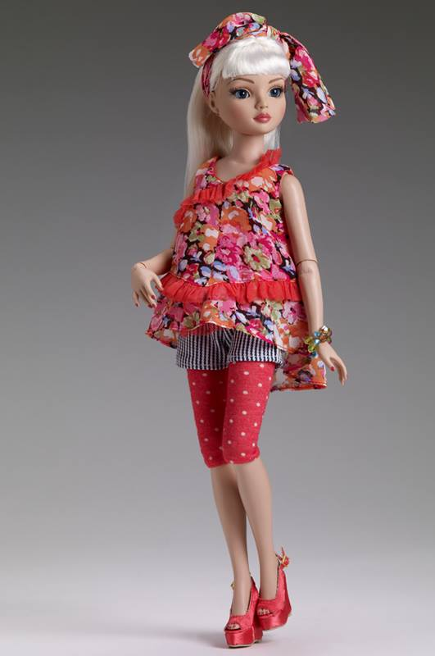
Today, Robert Tonner resides in the Mid-Hudson River Valley town of Stone Ridge, New York with his family.

Slide 19
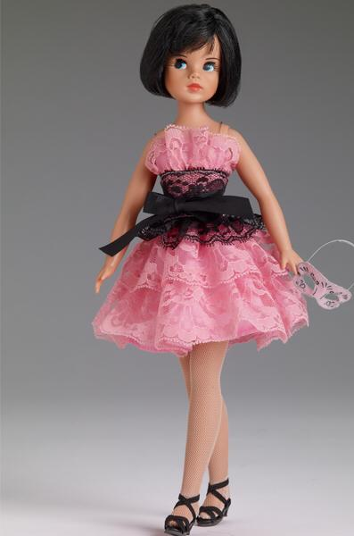
An avid reader and pop culture connoisseur, Tonner spends a great deal of time traveling for business.

Slide 20
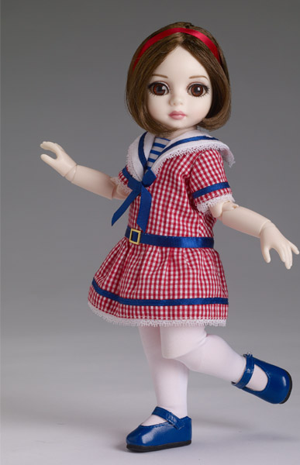
However, he much prefers the comforts of home where one of his hobbies includes collecting original illustration art.

Slide 21
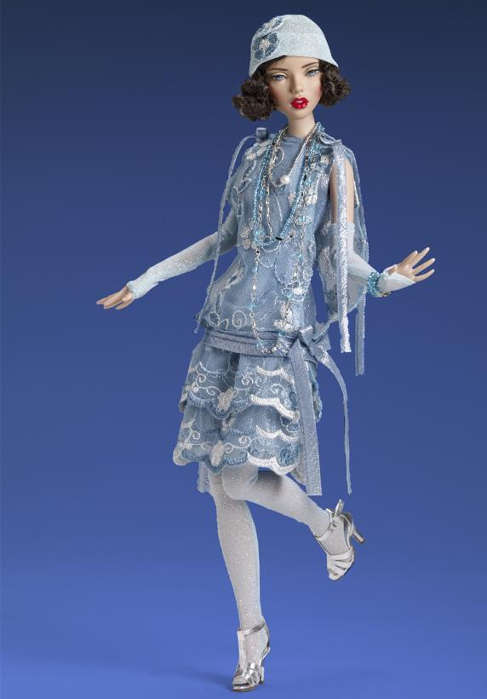
Tonner is still the owner and director of Tonner Doll Company, Inc., while also working on his self-funded clothing line.

Slide 22
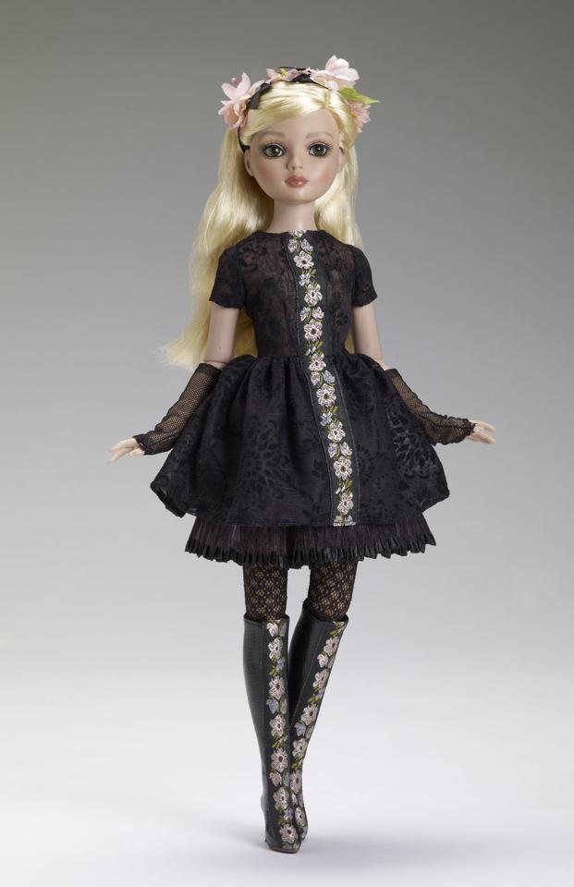
Still a member of NIADA, however no longer explicitly active, Tonner also belongs to the National Toy and Doll Collectors Club in New York City.

Slide 23
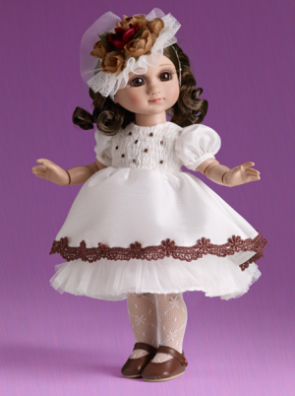
Robert Tonner is a sitting member of the Kingston Hospital Foundation in Kingston New York.

Slide 24
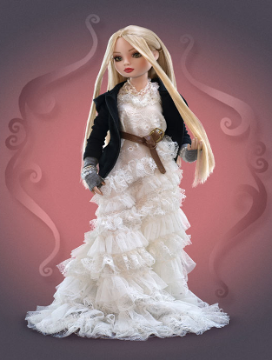
Whether you are searching for classic look-alikes or modern movie characters, you won’t be disappointed in Robert Tonner dolls.

Slide 25
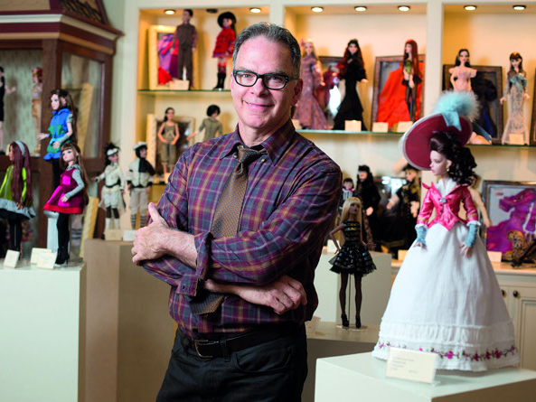
Robert Tonner is “one of the most influential doll designers of all time,” says Pat Henry, publisher of Fashion Doll Quarterly magazine and a book about Tonner.

Slide 26
Thank You
for being with Robert Tonner Dolls!

Slide 27
Source
https://en.wikipedia.org/wiki/Robert_Tonner

