Slide 1
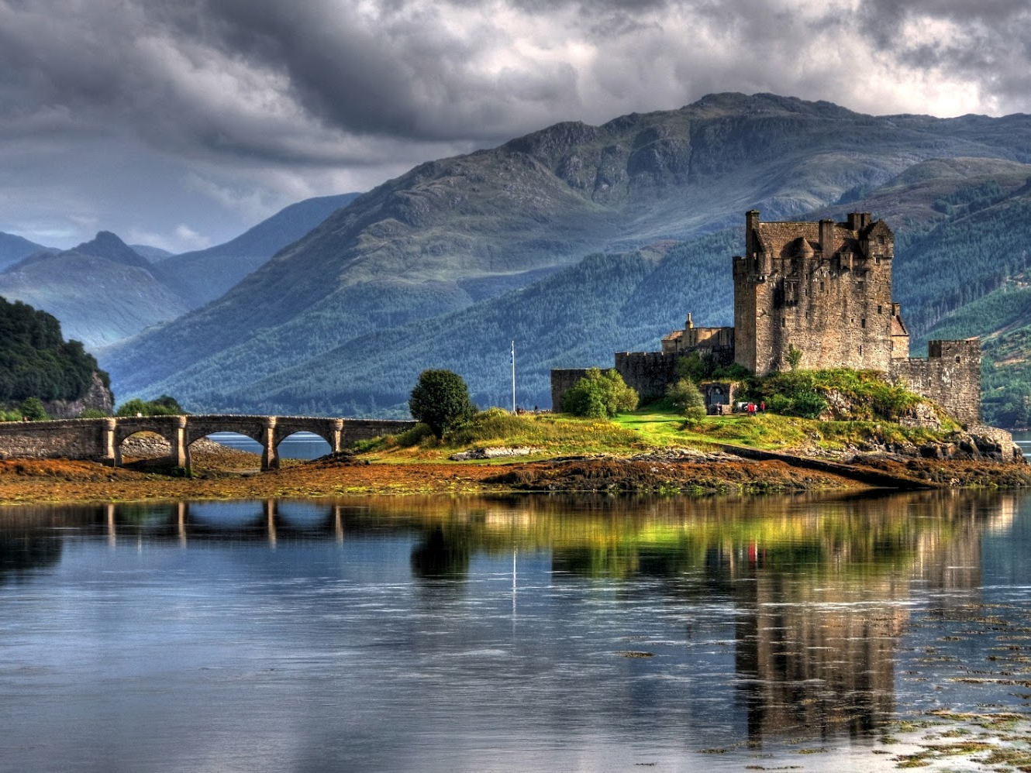
Happy Robbie Burns Day
Story for 8-11 Formers
Автор:
Ольга Михайловна Степанова
учитель английского языка
МБОУ «Цивильская СОШ №1
имени Героя Советского Союза
М.В. Силантьева»
города Цивильск
Чувашской Республики
2016

Slide 2
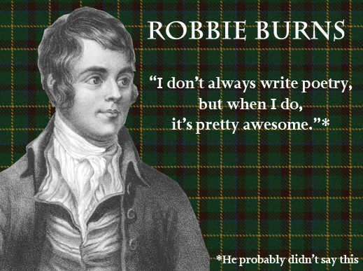

Slide 3
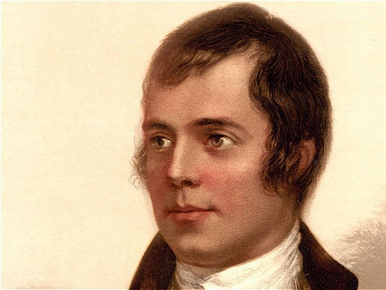
Robbie Burns Day is a Scottish holiday named after poet and writer, Robert Burns. The world celebrate his work every January 25th!

Slide 4
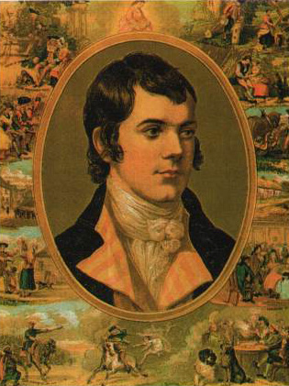
Robert Burns was born on January 25th, 1759, in Alloway, Scotland. At the age of 37, he died from rheumatic heart disease, which he had suffered from since he was a child.

Slide 5
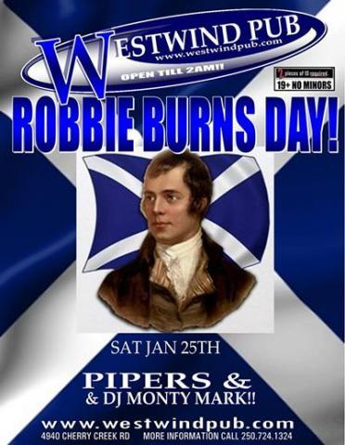
Robbie was the oldest of seven children born to a struggling farmer and his wife. After his mother introduced him to Scottish folk songs, legends and proverbs, he began writing touching poems and songs.

Slide 6
Some of Robbie Burns' most famous songs include "Auld Lang Syne" (the song people sing at New Years), "Ye Banks and Breaes of Bonnie Doon" and "My Love's Like a Red, Red Rose."

Slide 7
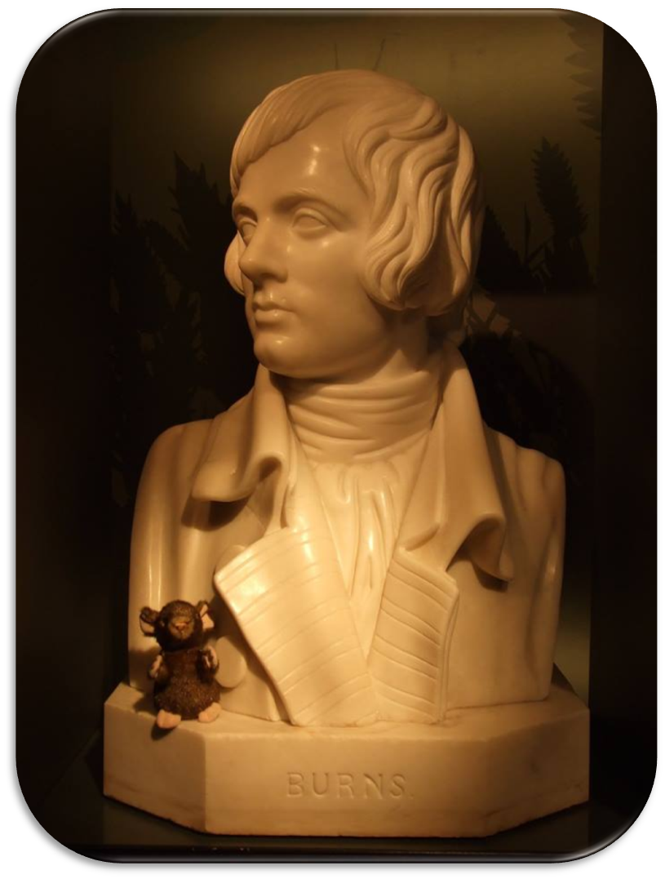
His first book of poems was published in 1788. Robbie Burns married Jean Armour the same year that his first book of poetry was published. They moved to Dumfries, where he rented a farm.

Slide 8
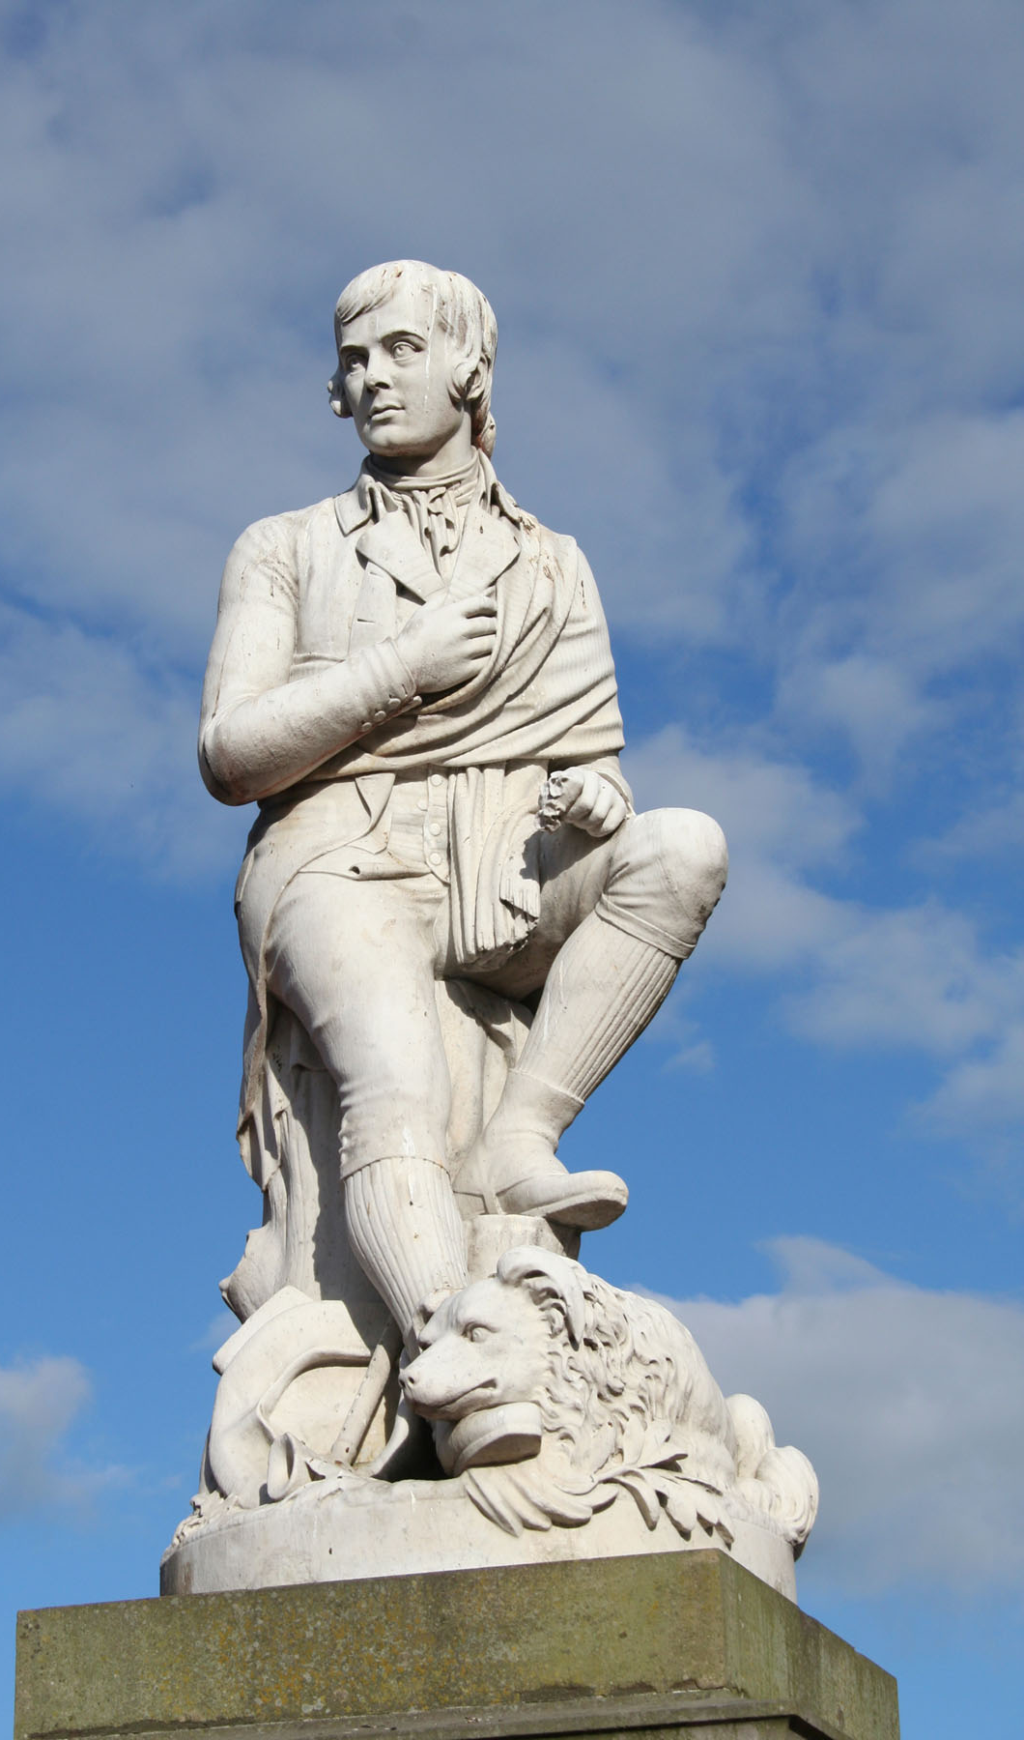
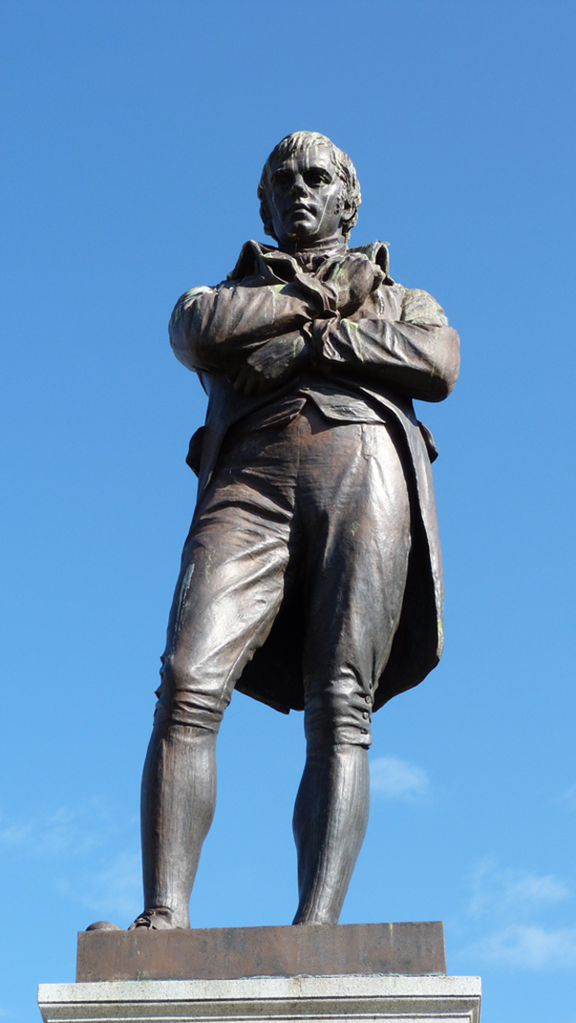
Because Robbie Burns' work is loved so much, his birthday is celebrated
all over the world on January 25th.
Statue of Robert Burns in Dumfries, Scotland.
Robert Burns in Burns Statue Square, Ayr, Scotland

Slide 9
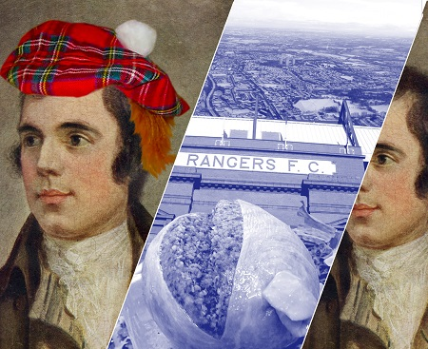
Highlights of any Robbie Burns festival often include the bagpipes, Scotsmen in kilts and the reading of Burns' poem, "To A Haggis."

Slide 10
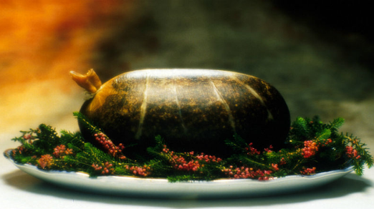
But no Robbie Burns' feast would be complete without the dish of choice - haggis. Haggis served on a bed of heather

Slide 11
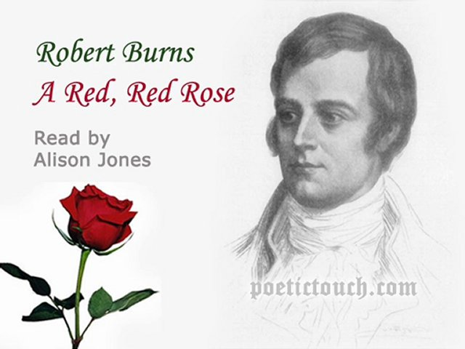
My love is like a red, red rose
That's newly sprung in June:
My love is like the melody
That's sweetly played in tune.

Slide 12
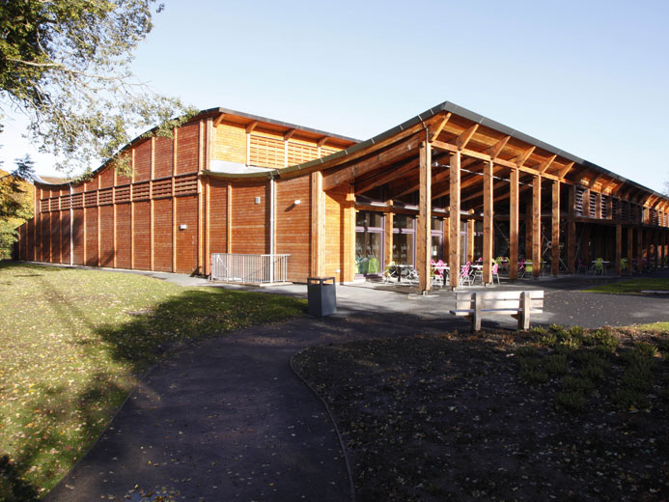
The Robert Burns Birthplace Museum is an ideal family destination. The displays within the main museum exhibition and Burns cottage include plenty of hands-on and interactive exhibits and various installations around the museum site are bound to delight young and old visitors alike.

Slide 13
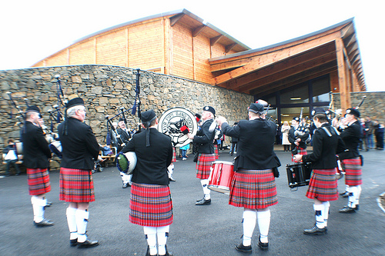
Kids’ meals are always on offer in our restaurant, which includes a play corner, and there is an outdoor play area in the main museum gardens. All of our shops stock plenty of affordable pocket money items as well as children’s books by some of Scotland’s best children’s writers.

Slide 14
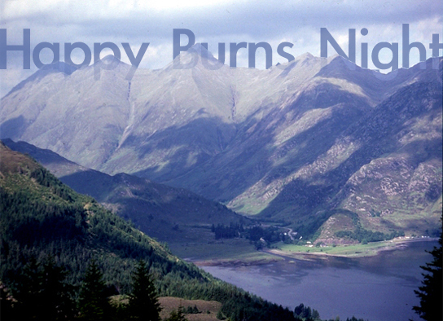
My heart's in the Highlands, my heart is not here,
My heart's in the Highlands a-chasing the deer -
A-chasing the wild deer, and following the roe;
My heart's in the Highlands, wherever I go...

Slide 15
SOURCES
http://www.kidzworld.com/article/1728-robbie-burns-day
http://www.burnsmuseum.org.uk/before-you-visit/parents-survival-guide
https://en.wikipedia.org/wiki/Robert_Burns

