Slide 1
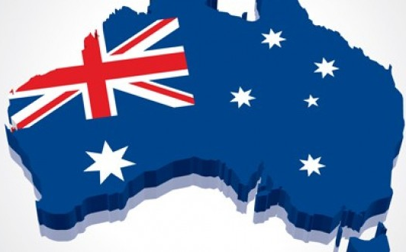
What is Australia made of?
Презентация стихотворения
Автор:
Ольга Михайловна Степанова
учитель английского языка
МБОУ «Цивильская СОШ №1
имени Героя Советского Союза
М.В. Силантьева»
города Цивильск
Чувашской Республики
2016

Slide 2
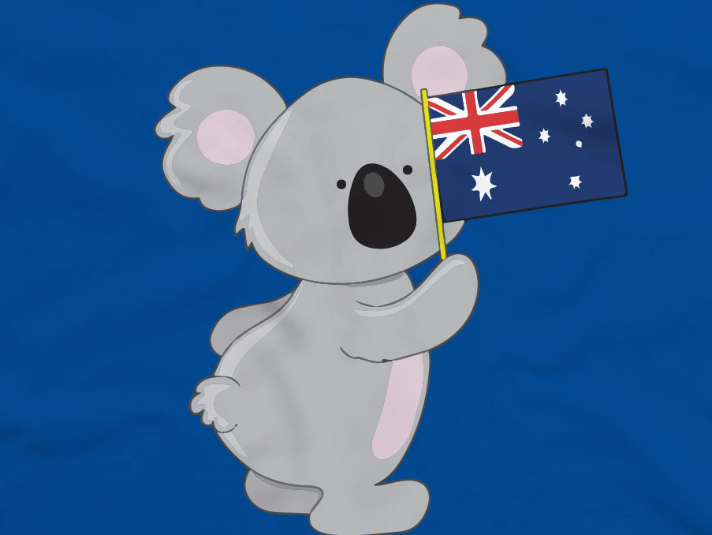
How do you do!
Welcome
to the Land
of a
Didgeridoo!

Slide 3
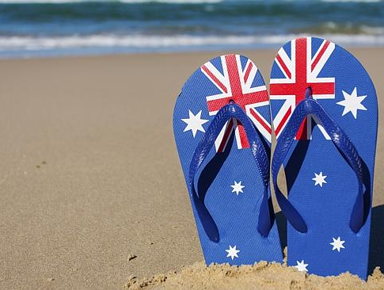
The extraordinary country to explore -
There are lots and lots to see and more!

Slide 4
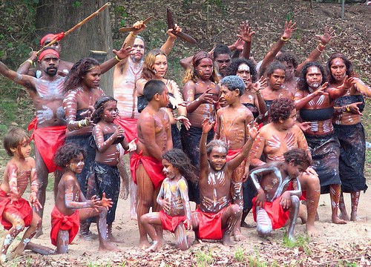
What can we compare
the country with
Where everyone Aborigines sees,

Slide 5
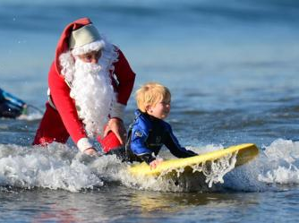
Where summer in December begins,
Where Christmas
crazy sunbathes
brings,

Slide 6
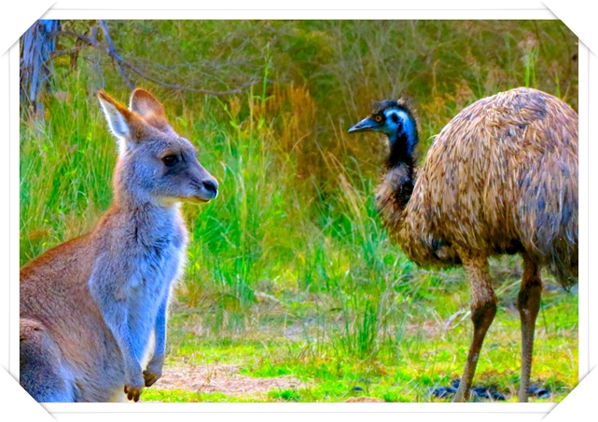
Where birds run instead of flying
And animals hopping instead of running!

Slide 7
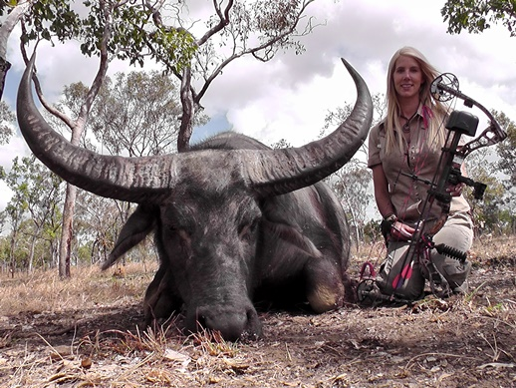
This is Australia you know
You are greeted there by a buffalo,
!

Slide 8
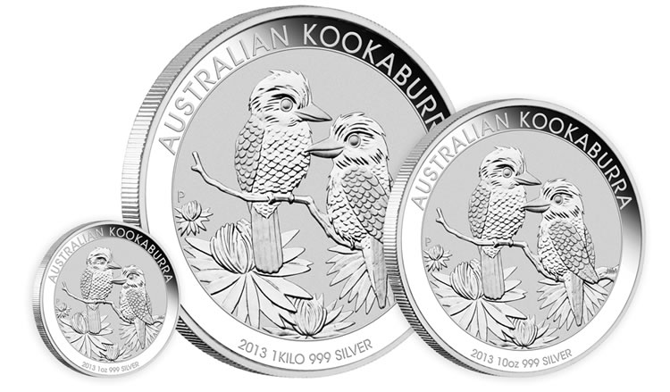
By a Lyrebird, a dingo and a cockatoo!
Kookaburras laughing will meet you, too!

Slide 9
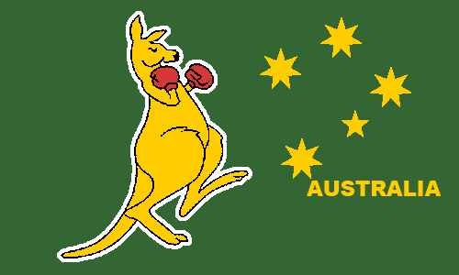
I feel joy when I meet an emu,
Oh what a pride for an Australian to live with a kangaroo!

Slide 10
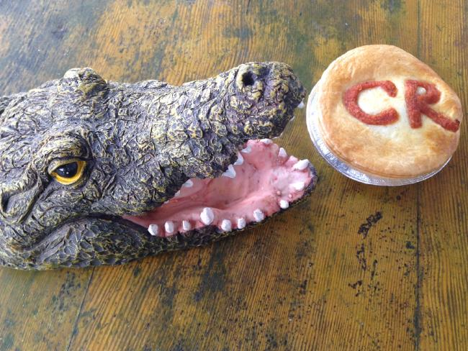
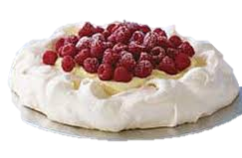
Australia is famous for its Pavlova cake!
You can even taste here a crocodile steak!

Slide 11
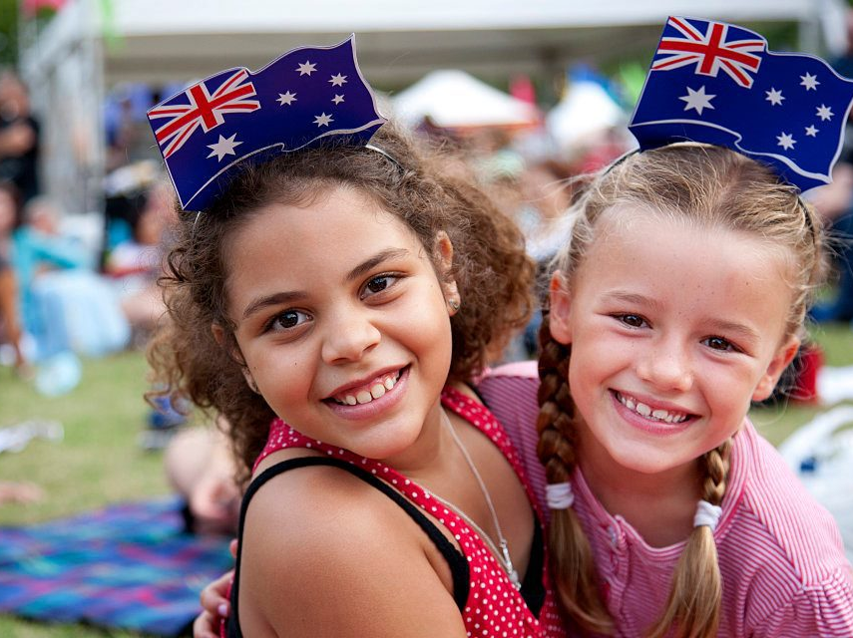
Funny Wonders meet you face to face.
Australia is really a fantastic place!

Slide 12
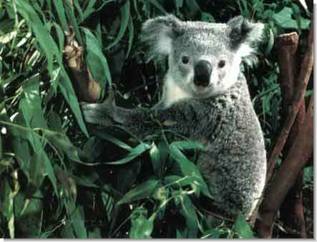
There are lots of things there to see
With koala up and under the eucalyptus tree!

Slide 13
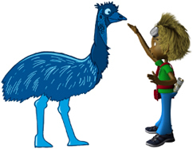
People there try to live in peace.
There real Sun, Fun and Surf you kiss!

Slide 14
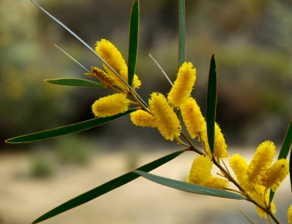
Hooly-Dooly! This is what
This Land Down Under made of!

Slide 15
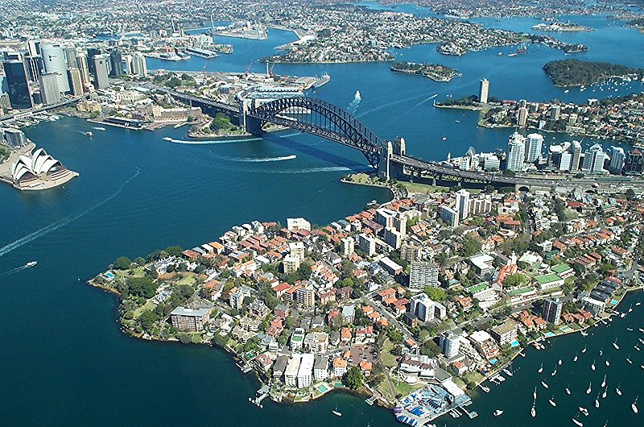
Meet this unique sunny corner
on the Earth
The happiest person is the one
who is given there the birth!

Slide 16
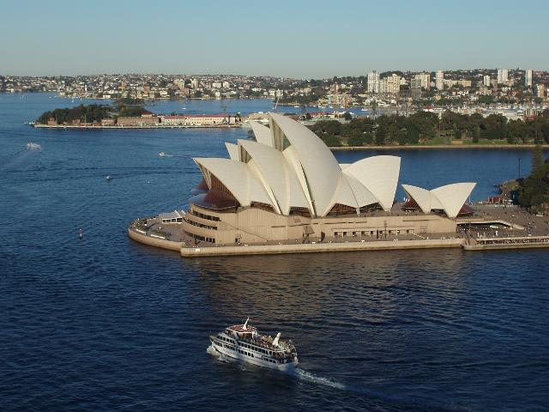
Hope, You liked my poem “What is Australia made of?”

Slide 17
Picture sources
http://lifeplanet.org/uploads/images/animals/koala.jpg
http://www.weekendnotes.com/im/006/00/med_thumb_australia-day-2013-australia-day-2013-marrickville91467121.jpg
http://www.zazzle.fr/rlv/svc/view?rlvnet=1&realview=113832943684393659&design=4f54861c-cf3f-42a9-8f6a-21e024227304&color=black&size=a_l&style=ladies_fitted_tshirt&max_dim=152&r=1453570027362
http://i.istockimg.com/file_thumbview_approve/43392602/3/stock-photo-43392602-australian-flag-beach-thongs.jpg
https://s-media-cache-ak0.pinimg.com/236x/66/a6/be/66a6be89fa220e0555384ab4358b2474.jpg
https://www.chayka.org/sites/default/files/styles/large/public/sidney_santa.jpg?itok=K1EJ-NMI
http://www.contentedtraveller.com/wp-content/uploads/2014/06/1.jpg
http://legendsoutfitting.com/basecamp/wp-content/uploads/2012/02/Australia-03-036.jpg
http://russian.firstcoincompany.com/silver-bullion-coin-australian-kookaburra-2012-1kg
http://cdn.newsapi.com.au/image/v1/f3bce0b3acb835ba75e1bbef4000dd67?api_key=zw4msefggf9wdvqswdfuqnr5

