Slide 1
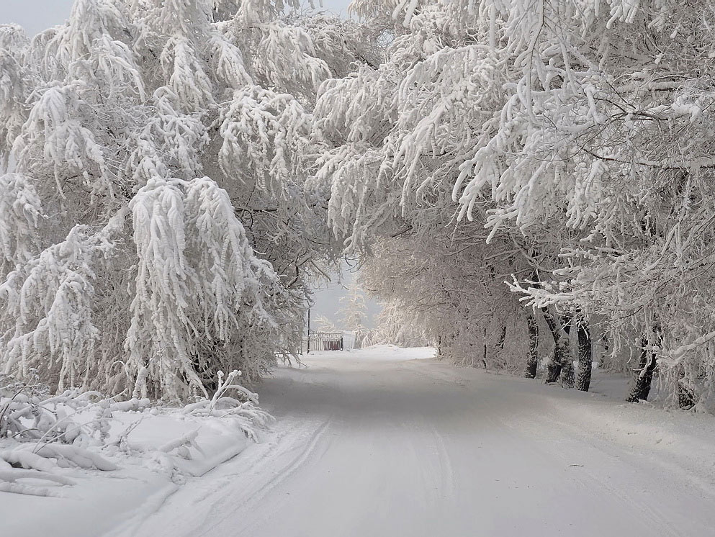
Winter Cinquain Quiz
Interactive game for 7-9 Formers
Автор:
Ольга Михайловна Степанова
учитель английского языка
МБОУ «Цивильская СОШ №1
имени Героя Советского Союза
М.В. Силантьева»
города Цивильск
Чувашской Республики
2016

Slide 2
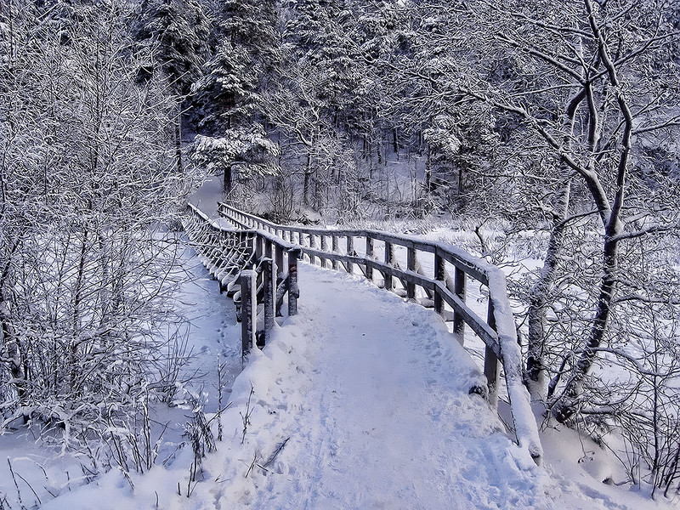
Santa
Nice, funny
Smiling, flying, working
Santa delivers presents
….…
Kris Kringle

Slide 3
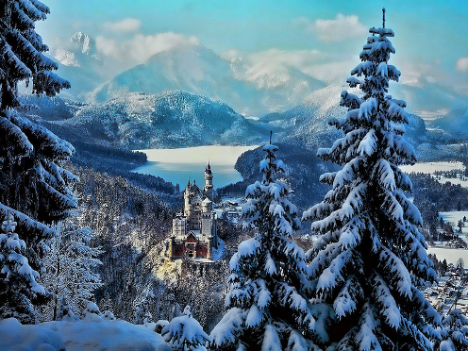
Snowflakes
Different, shaped
Falling, drifting, melting
Snowflakes are small
…
Snow

Slide 4
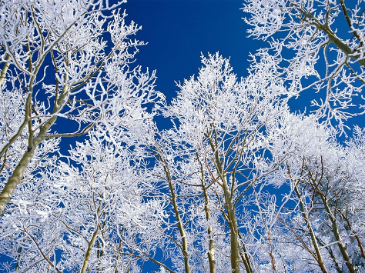
Santa
Nice, happy
Smiling, flying, working
Santa is awesome
…
St. Nick

Slide 5
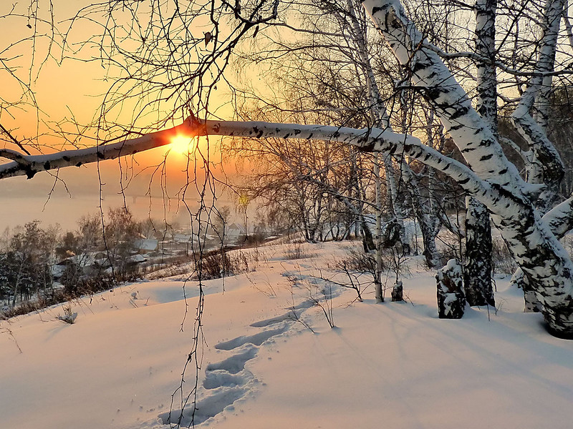
Bird
White feathery, nocturnal
Flying, searching, sleeping
It can blend in with snow
…
Owl

Slide 6
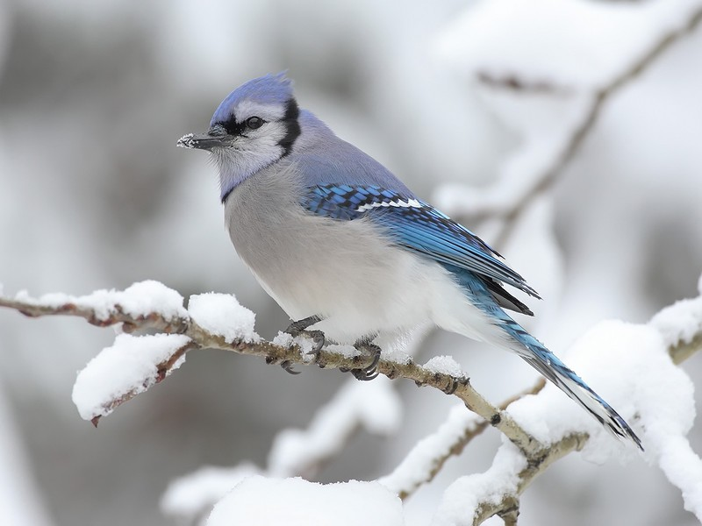
Winter
Nice, giving
Skiing, decorating, playing
Gives me the presents
I want
…
Santa

Slide 7
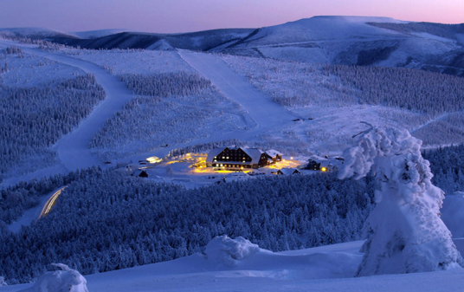
Winter
Cold, white
Freezing, frosting, growing
It is on the ground and houses
…
Frost

Slide 8
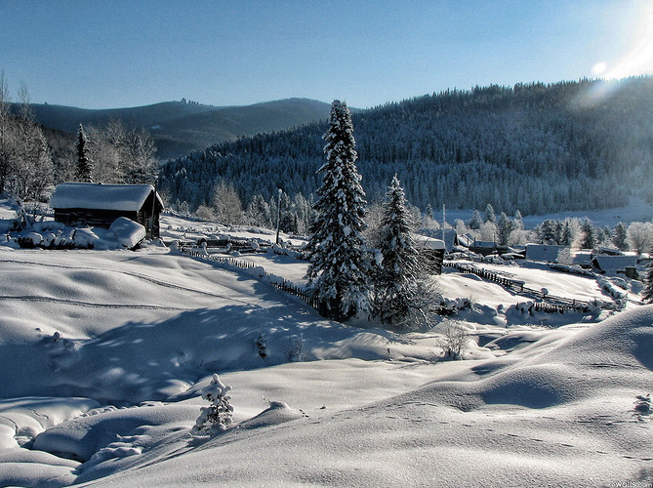
Animal
White tail, awesome antlers
Sneaking, smelling, finding
Only he comes out in the winter
…
Deer

Slide 9
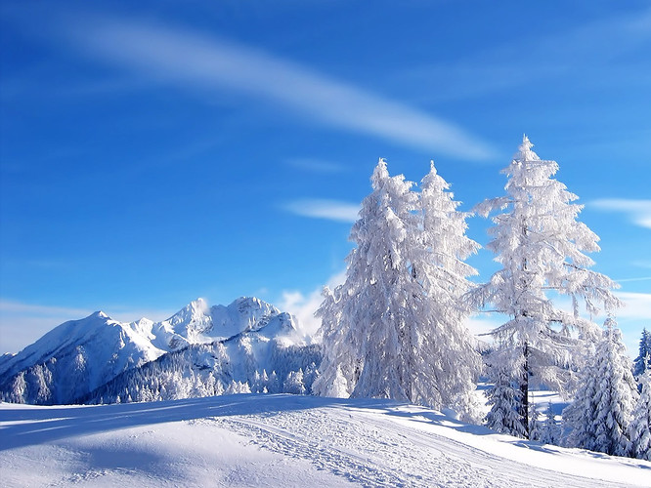
Santa
big fatty
flying, singing, swooping
going in a chimney
…
nice

Slide 10
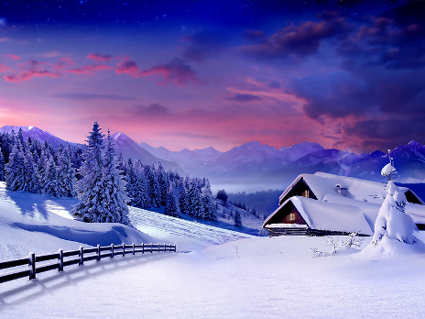
Christmas tree
green, colorful
shining, buying, decorating
with lights and ornaments
…
beautiful

Slide 11
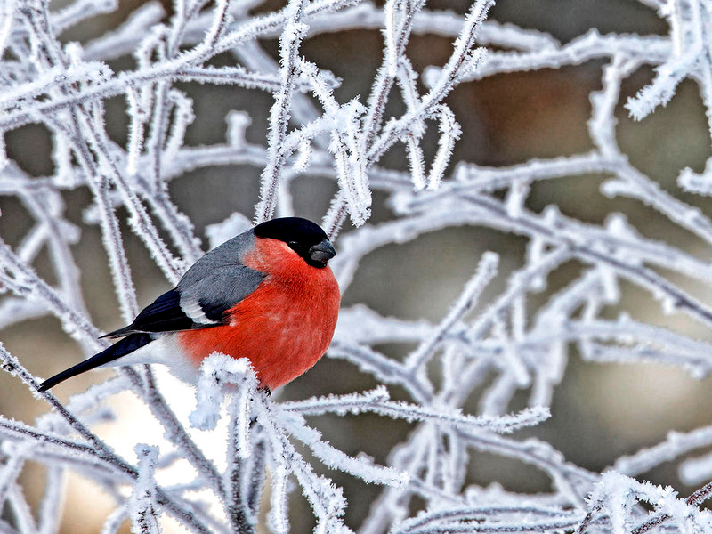
Rudolph
horns, fur
leaping, flying, falling
safely to the ground
…
brown

Slide 12
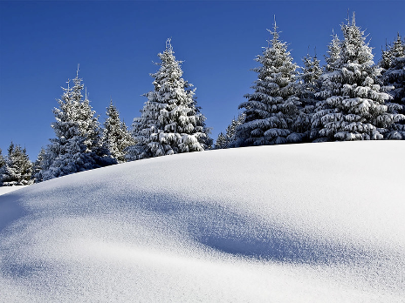
Presents
cool, awesome
wrapping, buying, decorating
putting under the tree
…
colourful

Slide 13
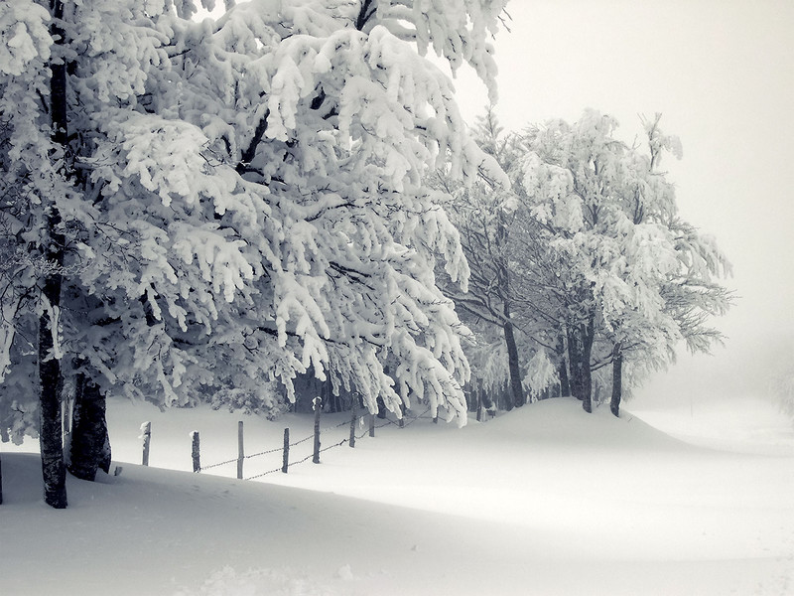
Sledding
red, sled
going, being, falling
sledding to the bottom
…
fun

Slide 14
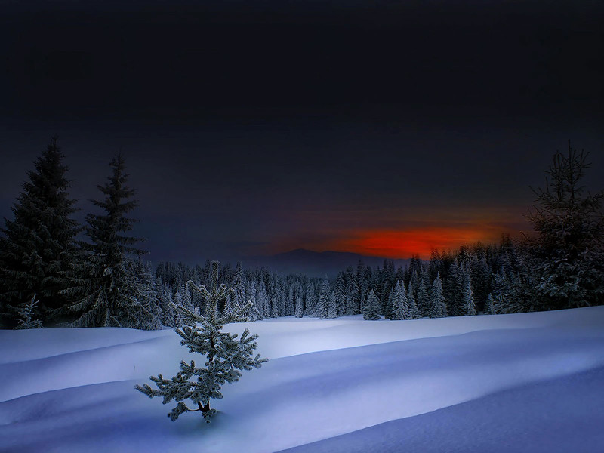
Ice
slick, cold
slipping, falling, sledding
on the big mountain
…
cool

Slide 15
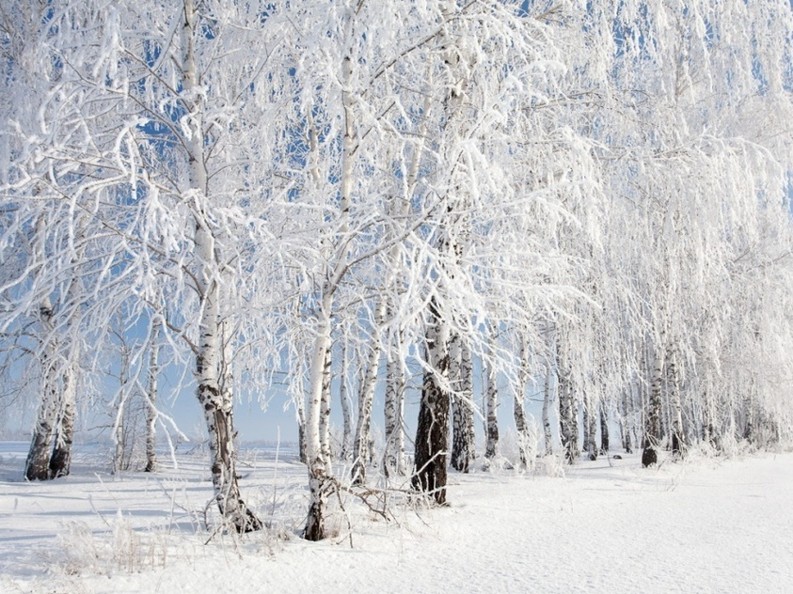
Snowflakes
white, different
drifting, dancing, twirling
to the snowy ground
…
cold

Slide 16
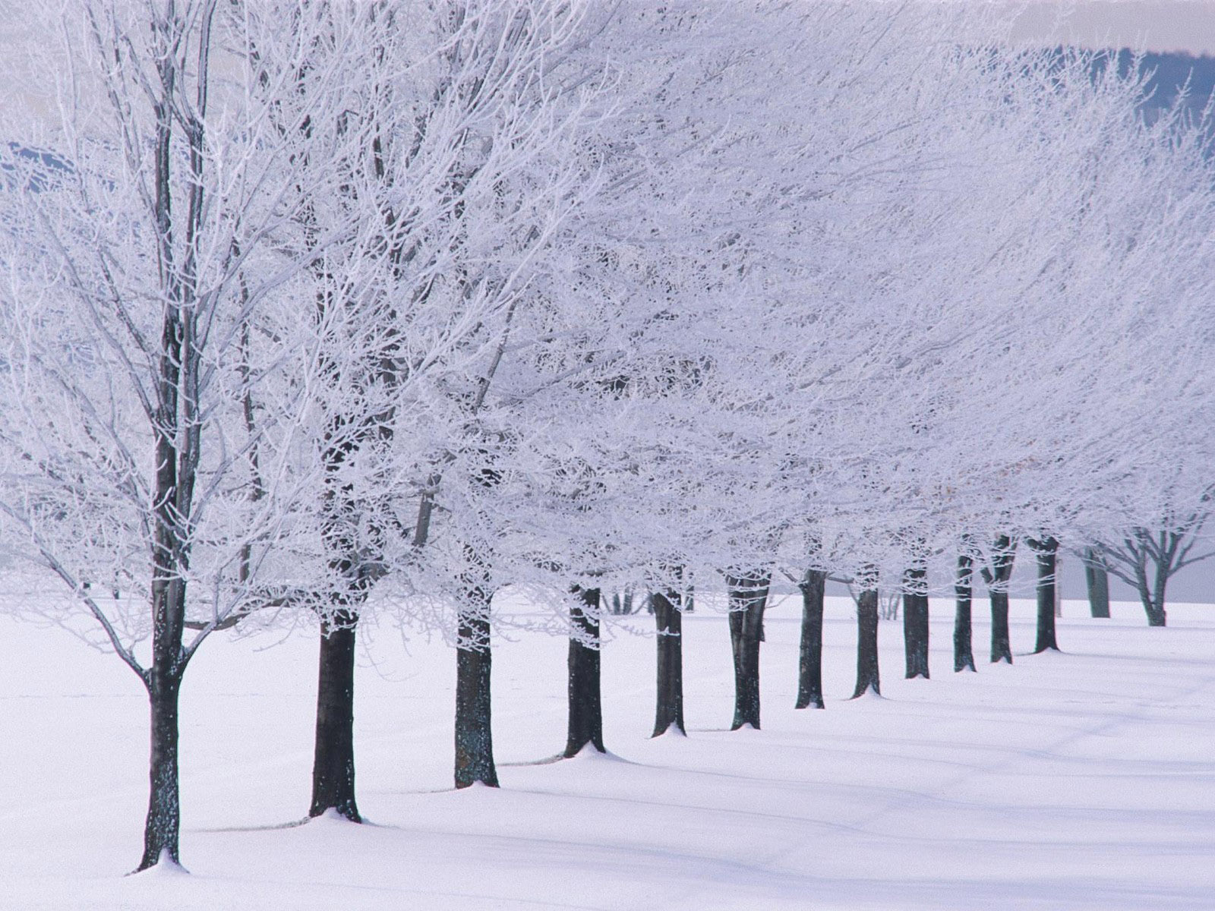
You have done it!
Great!
Who is the winner?
You?
Congratulations!

Slide 17
Sources
https://news.google.com/newspapers?nid=2137&dat=20051222&id=7GQzAAAAIBAJ&sjid=1BEGAAAAIBAJ&pg=2545,46172&hl=ru
http://seibert306.blogspot.ru/2012/11/winter-cinquain-poems.html

