Slide 1
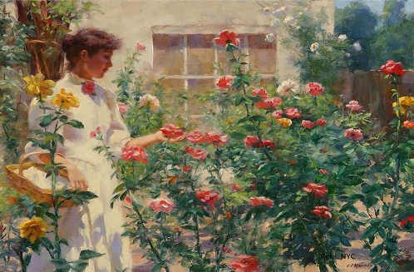
Gregory Franc Harris
Picture Gallery
Art gallery
for 9-11 Formers
Автор:
Ольга Михайловна Степанова
учитель английского языка
МБОУ «Цивильская СОШ №1
имени Героя Советского Союза
М.В. Силантьева»
города Цивильск
Чувашской Республики
2016

Slide 2
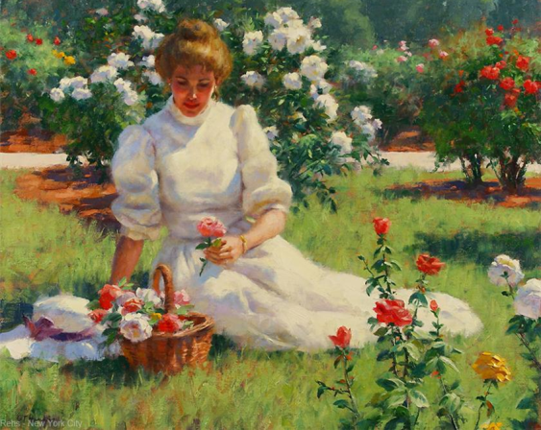
Gregory Frank Harris (Greg Harris) was born in southern California in 1953

Slide 3
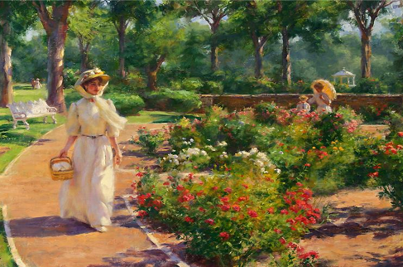
His mother was a painter and his father a miner. He also has a twin brother, an entomologist and drummer.
Можно сказать, что во сне мы становимся умнее. Во сне запускаются более мощные

Slide 4
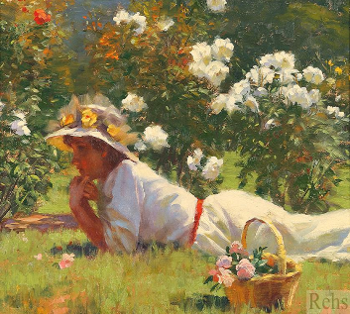
He began drawing and sculpting in clay by the age of five. At eight years old he began to sing and play the piano by ear.

Slide 5
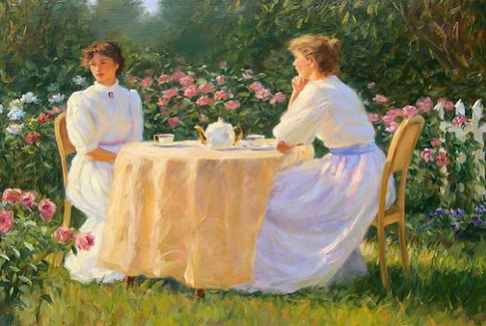
Throughout junior high and high school he had art and music classes, later studying ceramics and raku firing.

Slide 6
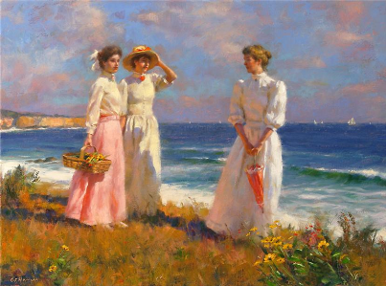
In 1972, he attended Long Beach University studying art and theater. He also, at this time, began watercolor painting and song writing.

Slide 7
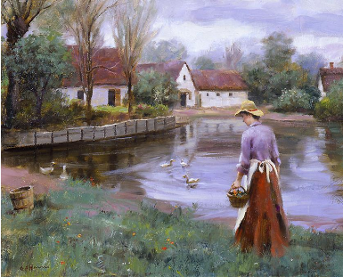
From 1973 to 1986, he played in bands at local nightclubs, then later professional ‘gigs’ in hotels on the west coast.

Slide 8
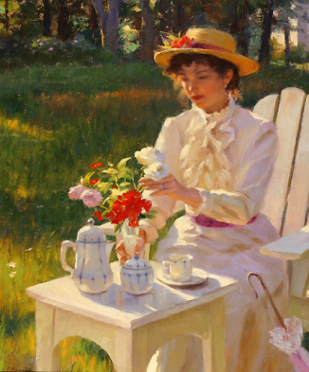
In 1977 while on the road in Spokane, Washington, inspired by a book on French impressionism, he began to paint in acrylic and oils, copying and studying the impressionists and old masters.

Slide 9
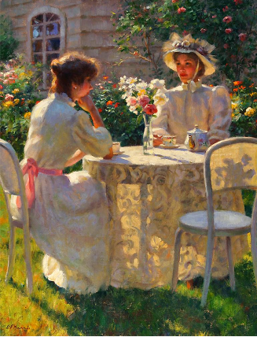
In 1980, through
a twist a fate, three of his old master copies ended up in the movie “Annie”. From 1982 to 1996, a personal agent sold his original impressionist oils, pastels, and watercolors to galleries across the US

Slide 10
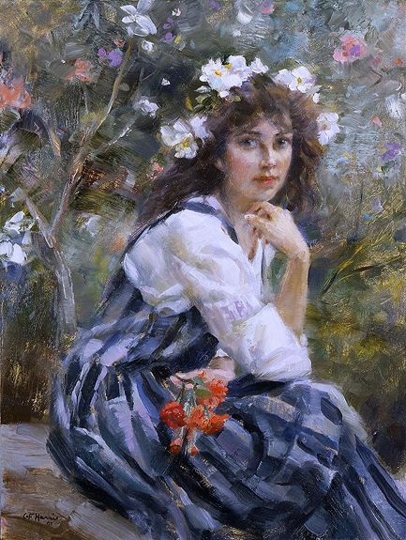
During those years he was exhibiting at juried shows and winning awards, all the while plein air painting in the Laguna and Irvine Canyons.

Slide 11
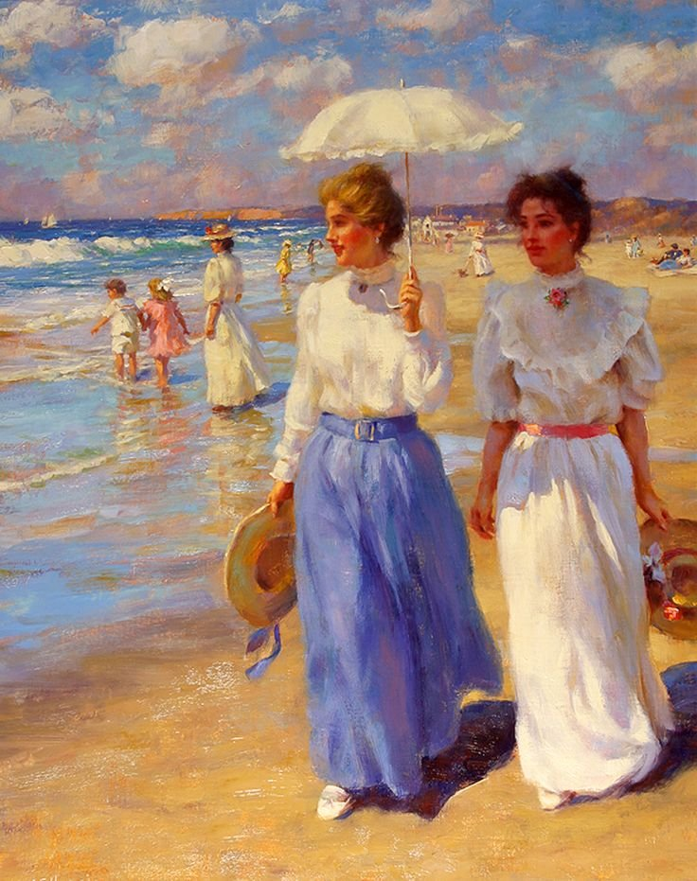
In the fall of 1985, he studied at the Art Student’s League in New York; and in 1987, he put together a large band performing his original music at the Roxey Theater in L.A.

Slide 12
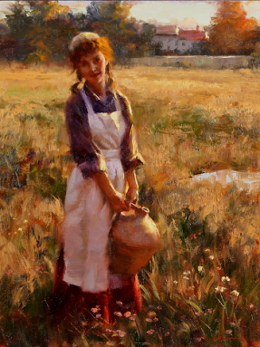
From 1991 to 1996 he and his wife, now divorced, lived in Duxbury, Massachusetts. While in Duxbury he performed in community theater plays and musical productions.

Slide 13
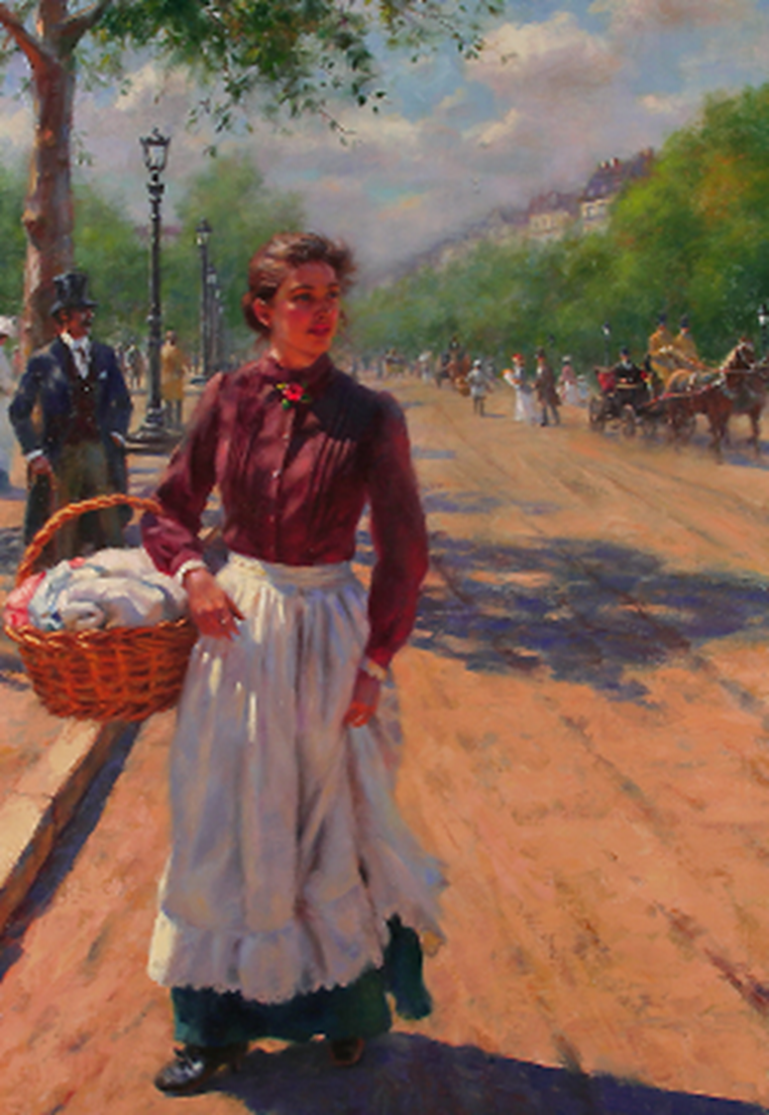
In 1996, after doing a workshop at the Fechin Institute, New Mexico, he decided to move to Santa Fe.

Slide 14
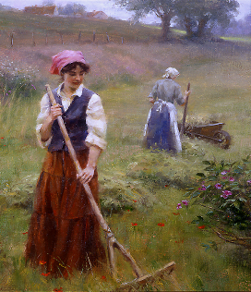
He lived
there
for five years and
Continued
his studies
of contemporary realism
and plain-air painting.

Slide 15
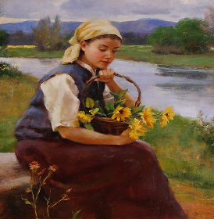
In November 2000 he moved to Lyme, CT to further paint from life.

Slide 16
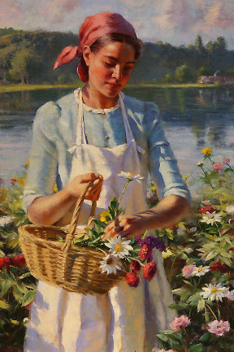
He also became a part-time teacher and elected member of the Lyme Art Association as well as a private instructor.

Slide 17
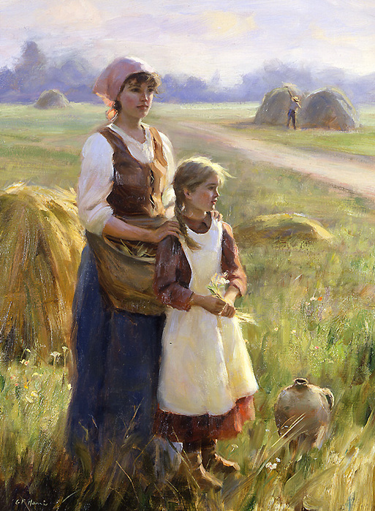
Currently he is a member of the Putney painters group in Vermont with Richard Schmid.

Slide 18
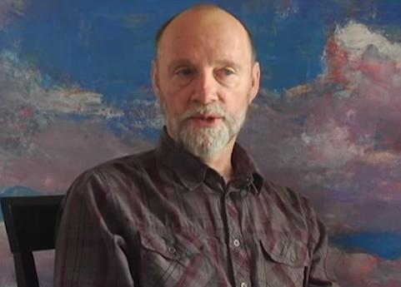
This is the link for you
to Meet Mr. GREGORY FRANK HARRIS
Enjoy the Great Painter Speaking!
Чтобы услышать , как и о чем говорит в своём интервью великий художник, ссылку перенесите, пожалуйста, в свой браузер. Голос его обворожителен. Речь тонка и красива.
https://www.youtube.com/watch?feature=player_embedded&v=9cNRoehSrAU

Slide 19
Source
http://www.rehs.com/gregory_frank_harris.html?page=71&key=62

