Slide 1
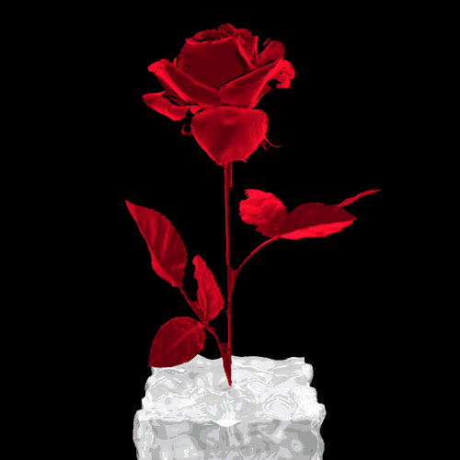
St. Valentine’s Day
Roses
Romantic Roses Poem Digest
for 8-11 formers
Автор:
Ольга Михайловна Степанова
учитель английского языка
МБОУ «Цивильская СОШ №1
имени Героя Советского Союза
М.В. Силантьева»
города Цивильск
Чувашской Республики
2016

Slide 2
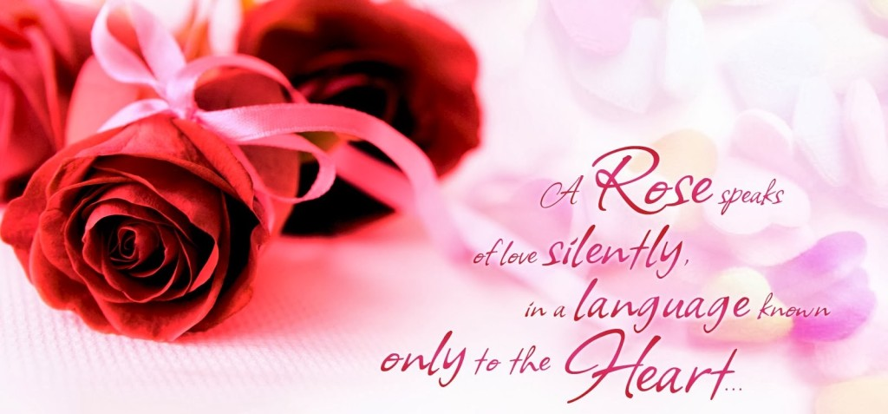
Roses are red,
Violets are blue,
I want to spend
My life with you!

Slide 4
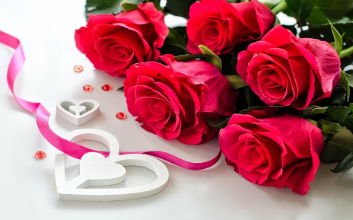
Roses are red, violets are blue,
the depth of my love. If you only knew....

Slide 5
Roses are red;
Chocolate is sweet.
I want you to know
That I think you’re neat.
Roses are red, violets are blue,
I'm seeing a future filled with me and you.

Slide 6
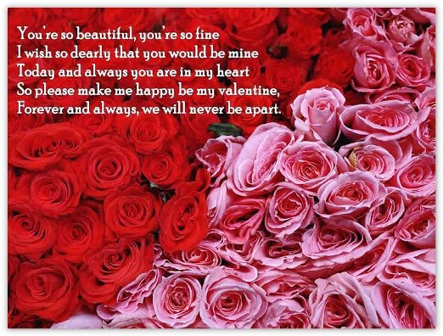

Slide 7
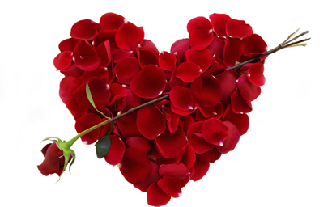
Roses are red, violets are blue, The center of my world begins and
ends with you.

Slide 10
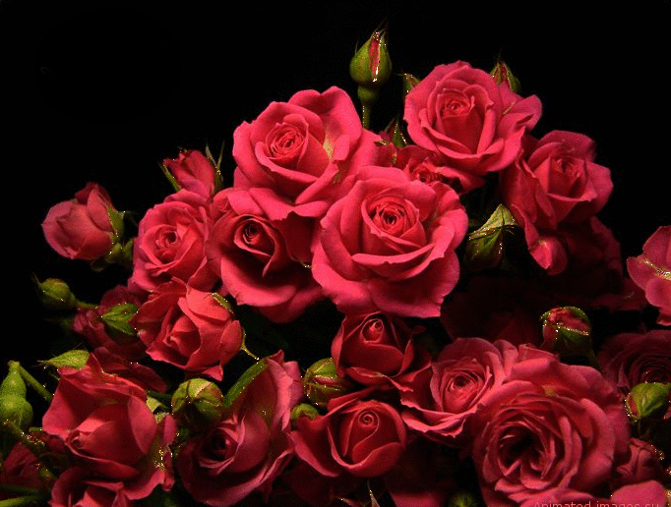
These Roses are to say with each passing day
I fall a little more in Love with You

Slide 12
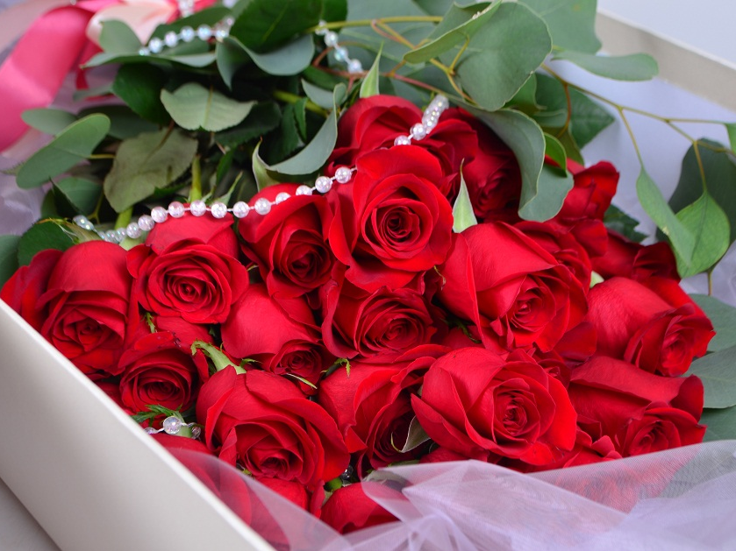
Roses are red, violets are white,
I just wanna love you with all my might.

Slide 13
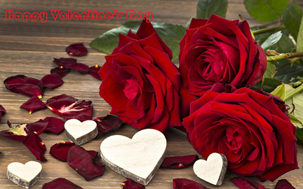
Roses are red,
violets are yellow,
being with you,
makes me happy and mellow…

Slide 14
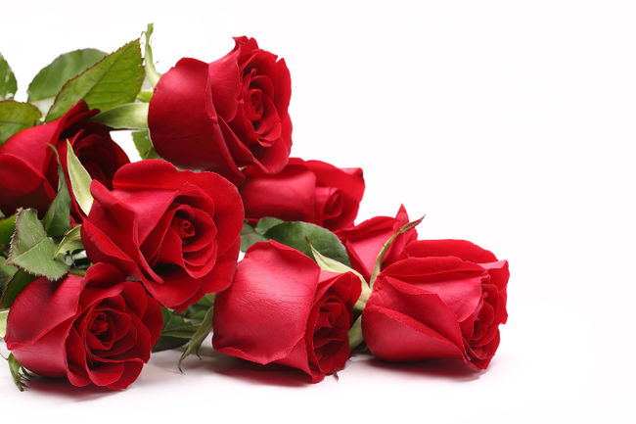
Roses are red,
violets are blue,
I've never seen
anyone
as beautiful
as you.

Slide 15
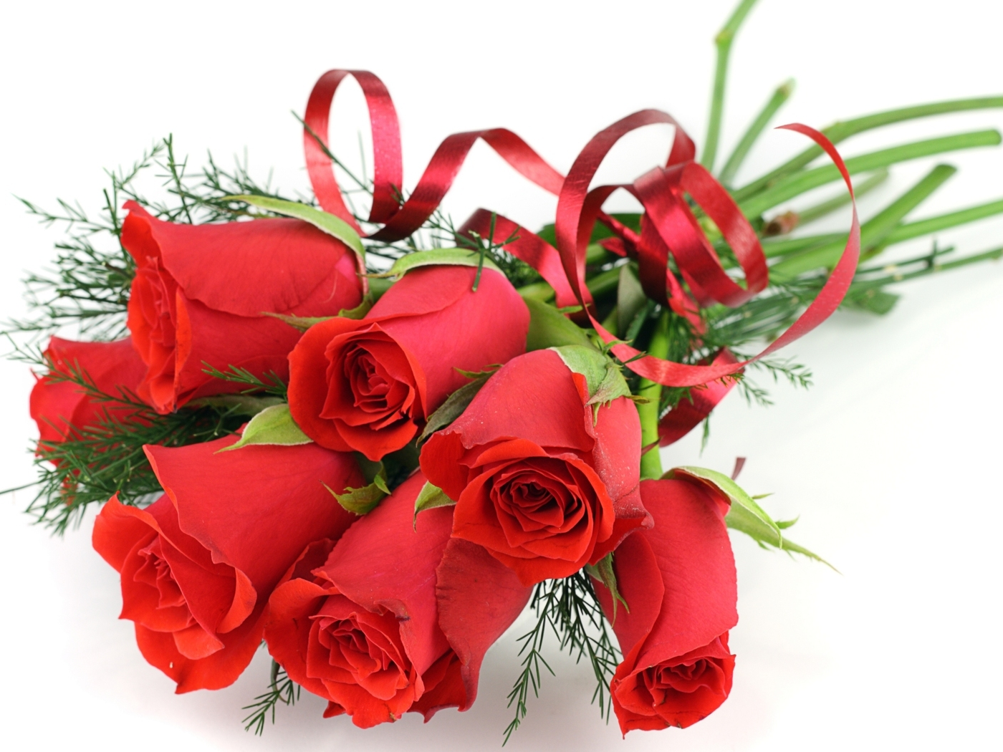
Roses are red, violets are pink,
its a good thing, because you know what I think.....
I love you.

Slide 16
Roses are red, violets are blue,
What you make me feel,
is crispy and new.
Like fresh dew in a meadow,
after a long rainy day.
With a beautiful rainbow,
sporting a colorful array.

Slide 17
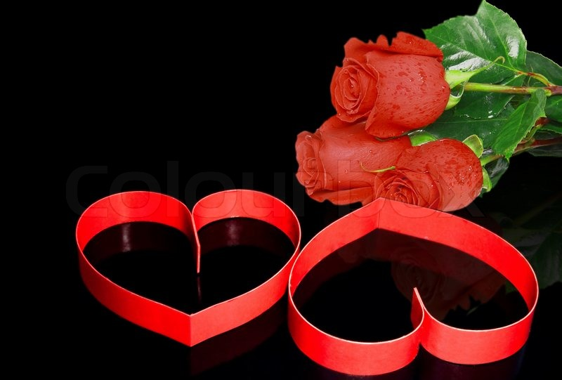
Roses are red, violets are blue,
you are amazing,
and I'm blessed
to have you.

Slide 21
Roses are pink
Your eyes so blue
With lips so sweet
I want to kiss you
Come into my arms
My darling love
You are my Valentine
From heaven above

Slide 23
I love you

Slide 24
Sources
http://www.mywordwizard.com/roses-are-red-poems.html
http://www.bethanyroberts.com/valentine-poems-roses-are-red.htm

