Slide 1
Happy St. Valentine’s Day!
Romantic Art and Poetry Gallery
for 8-11 formers
Автор:
Ольга Михайловна Степанова
учитель английского языка
МБОУ «Цивильская СОШ №1
имени Героя Советского Союза
М.В. Силантьева»
города Цивильск
Чувашской Республики
2016

Slide 9
Бббббб

Slide 20
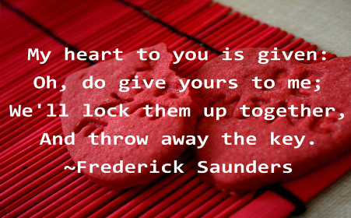

Slide 25
Sources
http://img.bollywoodsargam.com/albumsbolly/Valentines_Day_Greeting_Cards/Valentines_Day_Greeting_Cards_BollywoodSargam_interview_195910.jpg
http://www.kiddyhouse.com/Valentines/valenclips/valentinegirl.png
https://hdwallpapers.cat/wallpaper/friendship_poem_bears_teddies_abstract_love_hd-wallpaper-1153554.jpg
https://lh3.googleusercontent.com/e77OPe8ulRznjAUw2-n5fRrM4Zv1ZpUo9UYg_rnqs_elpJHt5n7kTOUUXYXw5a_7ECl2=s151
http://2.bp.blogspot.com/-1POF3inYyvk/TVqdZ2RxIjI/AAAAAAAAH-g/BzRm0PzGqjA/s1600/red%2Brose%2B%25252815%252529.jpg
http://www.happyholi2015quoteswishes.com/wp-content/uploads/2016/01/Happy-Valentines-Day-Quotes-To-Friends.png
https://valentinessday.files.wordpress.com/2015/01/valentines-day-quotes-5.jpg?w=503&h=315
http://www.skyhdwallpaper.com/happy-valentines-day-quotes-for-boyfriends
http://goplengo.xyz/wp-content/uploads/2016/01/quotes-about-love-heart-valentines-day-helen-keller-2-1.jpg

