Slide 1
Love is …
Proverb Digest
for the 8-11 Formers
Автор:
Ольга Михайловна
Степанова
учитель английского языка
МБОУ «Цивильская СОШ №1
имени М.В. Силантьева»
города Цивильск Чувашской Республики
2016

Slide 4
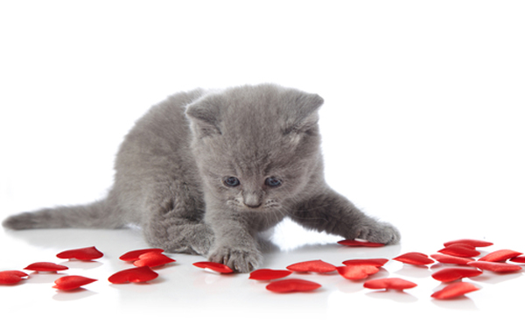
There is only one happiness in life –
to love and to be loved.
George Sand

Slide 5
Love all, trust
a few, do wrong to none.
-William
Shakespeare

Slide 6
Love comforteth like sunshine after rain.
-William Shakespeare

Slide 7
Where there is love there is life.
-Mahatma Gandhi

Slide 8
The first duty of love is to listen.
Paul Tillich

Slide 9
Life is the flower for which love is the honey.
Victor Hugo

Slide 10
Love is composed of a single soul inhabiting two bodies.
Aristotle

Slide 11
Every love story
is beautiful, but
ours is my favorite.
-Unknown

Slide 12
Speak low, if you speak love.
-William Shakespeare

Slide 13
No three words have greater power than
I Love You.
Unknown Source

Slide 14
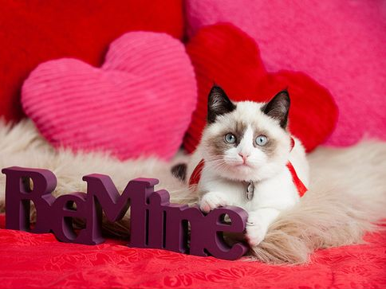
Love is the master key which opens the gates of happiness.
Oliver Wendell Holmes

Slide 15
A heart that loves is always young.
Greek proverb

Slide 16
Love is the bridge between two hearts.
Unknown Source

Slide 17
A flower cannot blossom without sunshine, and man cannot live without love.
-Max Muller

Slide 18
Loving people live in a loving world. Hostile people live in a hostile world. Same world.
Wayne Dyer

Slide 19
Love is the joy of the good, the wonder of the wise, the amazement of the Gods.
Plato (BC 427-BC 347) Greek philosopher.

Slide 20
The End
Thank you for Discussing Love with us!

Slide 21
Источник
http://www.curatedquotes.com/love-quotes/short/
http://en.proverbia.net/shortlovequotes.asp?page=3

