Slide 1
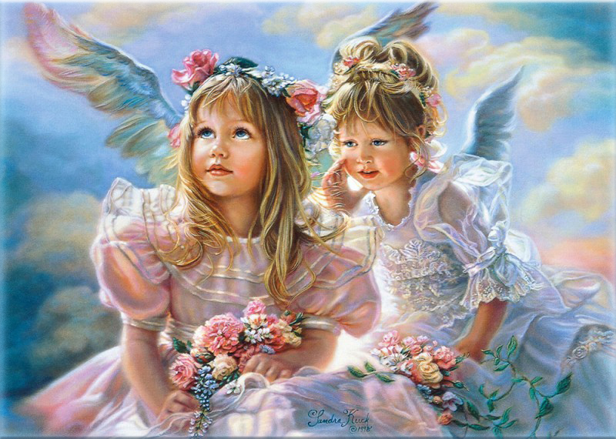
Angels by Sandra Kuck
Angels
Gallery
for 8-11
Formers
Автор:
Ольга Михайловна Степанова
учитель английского языка
МБОУ «Цивильская СОШ №1
имени Героя Советского Союза М.В. Силантьева»
города Цивильск Чувашской Республики
2016

Slide 2
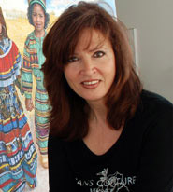
Meet
Sandra’s
Angels!
Sandra Kuck is one of America's most collected artists. Her artistry creates images of nostalgia, peaceful memories and the beauty of childhood.

Slide 3
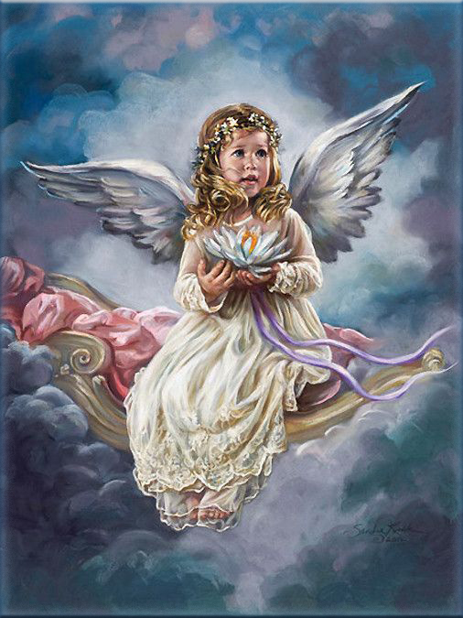
Sandra Kuck describes herself as a “romantic realist.” Her nostalgic settings and angelic children evoke memories and emotions of childhood.

Slide 4
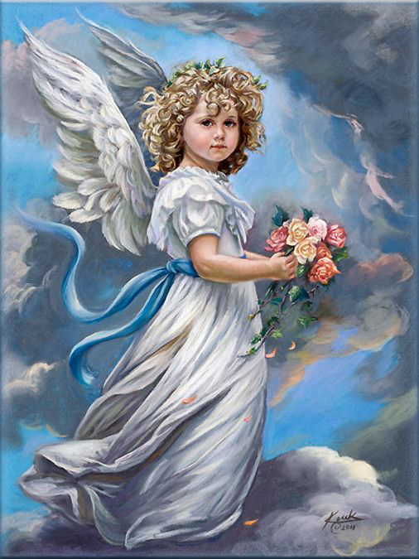
With vibrant color, delicate lighting, and exquisite lace and flowers, Sandra creates a romantic and peaceful atmosphere, capturing the beauty and simplicity of days gone by.

Slide 5
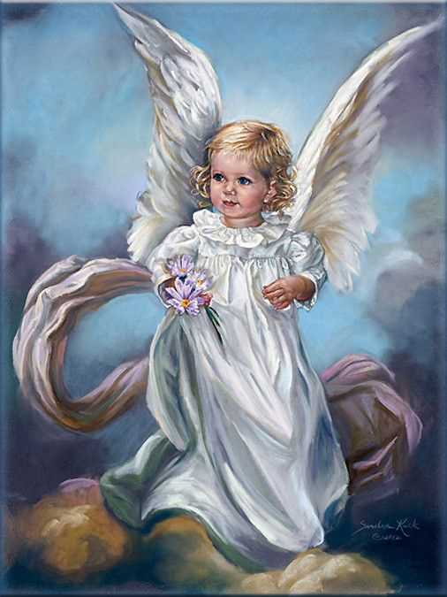
Encouraged by her mother, another gifted painter, Sandra Kuck started painting at 14 years old.

Slide 6
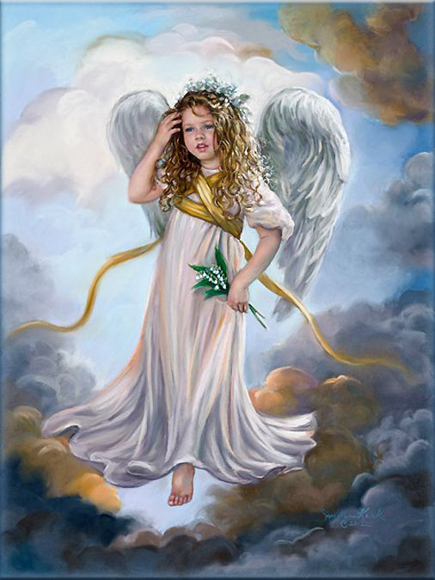
She was born in East Liverpool, Ohio, and after graduating from high school in California continued her education at University of California, Los Angeles and the Arts Students League, New York City

Slide 7
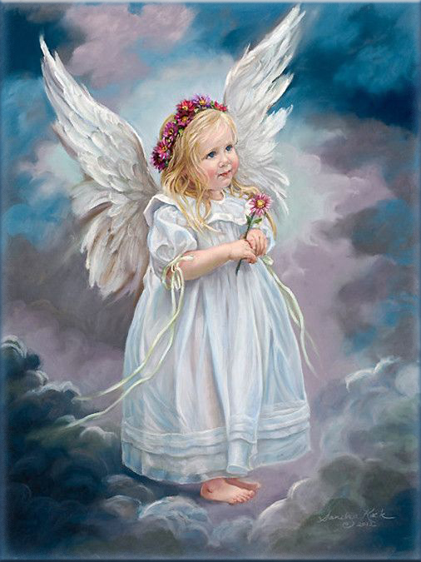
She is an unprecedented seven times National Association of Limited Edition Dealers Artist of the Year award winner.

Slide 8
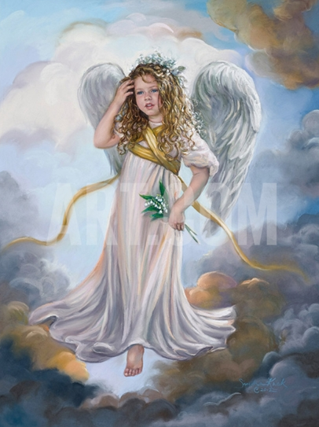
"My paintings are meant to be an escape from reality, an escape to the charm and romanticism of a Victorian era, rich in detail, pattern and decoration. “

Slide 9
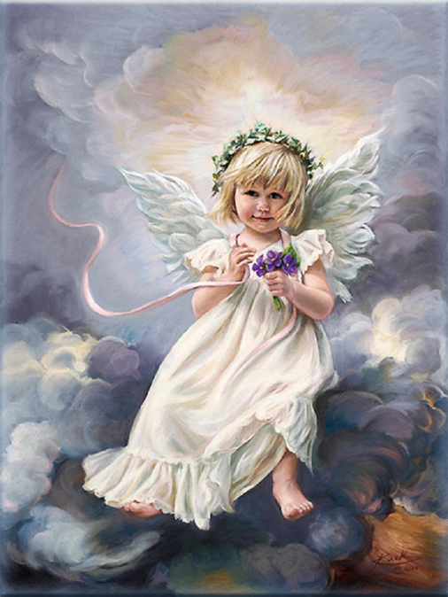
“I am interested in creating a peaceful mood through the subject matter, but also one that is visually exciting through the interplay of light and pattern and color."

Slide 10
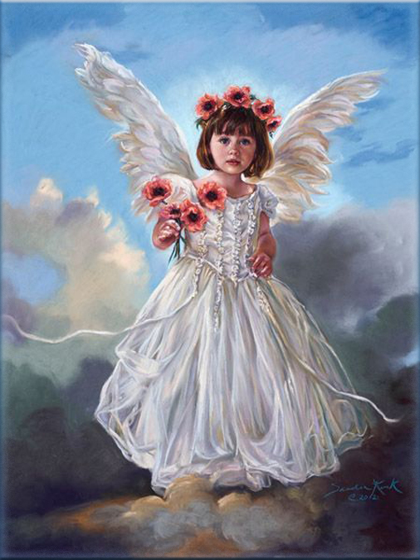
Her art has become a National institution, with massive print sales, illustrations in many books and on collectible limited edition plated, greeting cards and gift bags.

Slide 11
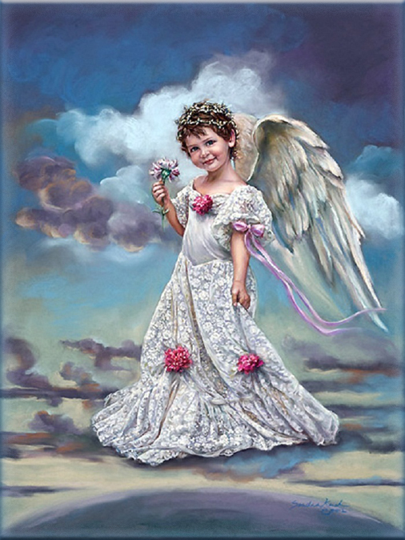
She finds the children who are her subjects on annual trips to the Cotswolds, an area of outstanding natural beauty in England: "There is a "fresh from God" look that children under 5 convey.

Slide 12
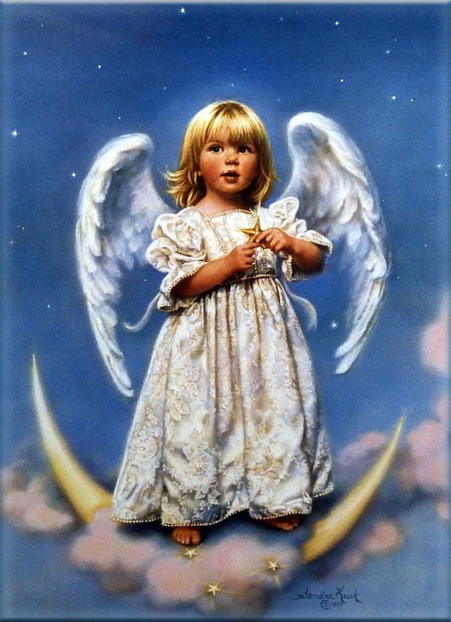
“Their skin is perfect, their eyes full of innocence. They look like little angels. I take those qualities and romanticize them…”

Slide 13
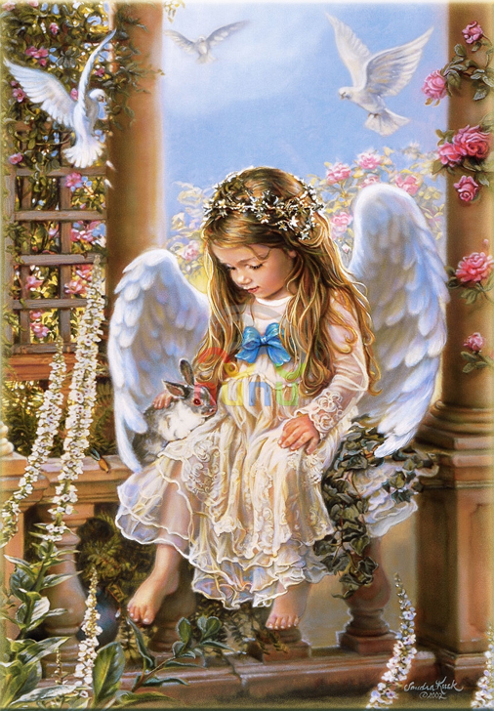
As far as the pink–cheeked children who pose for me, most are from Cotswold, England where we travel once a year."

Slide 14
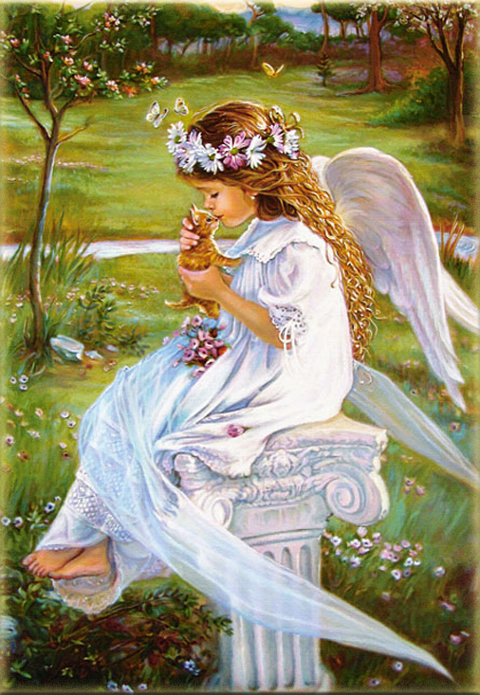
Sandra finds her inspiration from many different sources, including the special relationship between mother and child, the beauty of a country garden, or the fine furnishings and the clothing of the Victorian era.

Slide 15
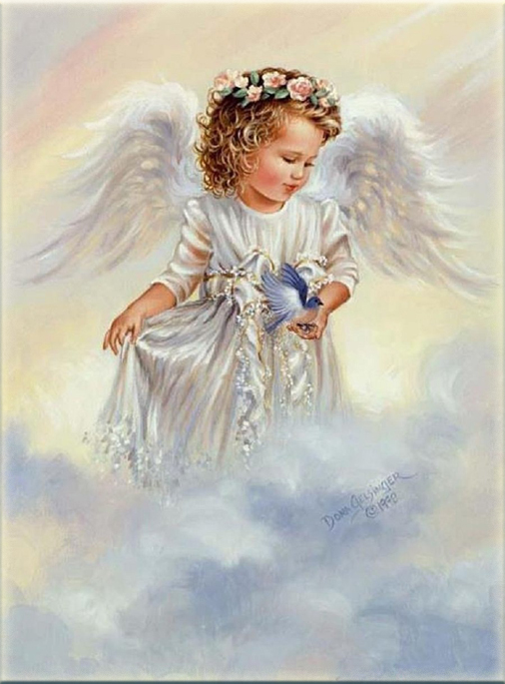
Born in East Liverpool, Ohio, she attended University of California, Los Angeles and the Arts Students League, New York City.

Slide 16
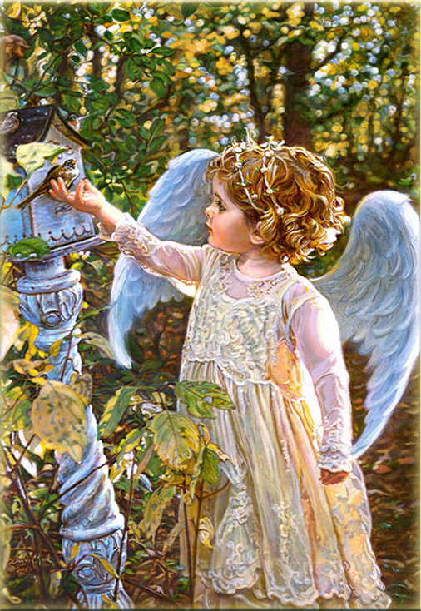
She is five-time award winner, Artist of the Year, Association of Limited Edition Dealers (unprecedented in the 92 year history of limited editions) and selected "Woman of the Year", by the Council of Cerebral Palsy.

Slide 17
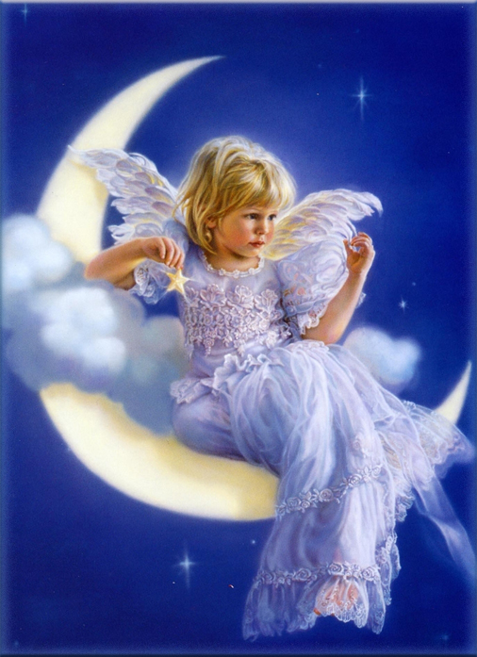
Admirers of Sandra Kuck know that this talented artist puts a little of herself into every painting. Her strong sense of family and appreciation for beauty is echoed in all of her works, with which she has captured a loyal and appreciative audience.

Slide 18
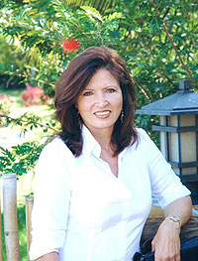
Sandra Kuck lives and maintains a studio in Boca Raton, Florida, where she paints art, prints and posters.

Slide 19
Источник
http://www.prints.com/art.php/Sandra_Kuck/?artist_id=1340&type=6
https://www.texasartdepot.com/t-kuck_morebio.aspx
http://www.art.com/gallery/id--b22457/sweet-angels-posters.htm?ui=79C8792E32D4415D8258AD8C8DF65ED5

