Slide 1
Touch
Eternity
Beauty and Wisdom Gallery
for 8-11 Formers
Автор:
Ольга Михайловна Степанова
учитель английского языка
МБОУ «Цивильская СОШ №1
имени Героя Советского Союза
М.В. Силантьева»
города Цивильск Чувашской Республики
2016

Slide 2
Russian painter
Татьяна Марковцева is becoming one of the most interesting
artists-Minimalists of today.
She is able to express powerful and complex human feelings just via a few elegant lines, capturing a wide variety of human emotions with amazing simplicity and clarity. Tatyana literally makes viewers feel the lines of her works. Now, her original Minimalistic style is finding many fans around the world.

Slide 3
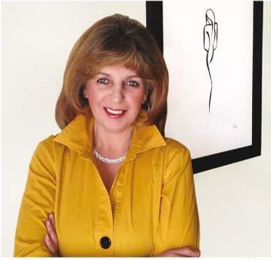
Born and raised in Moscow, Russia, she immigrated to the U.S. with her family over 16 years ago, settling just northwest of Chicago. Tatyana, an engineer by trade, has never imagined that one day her works would have universal appeal and touch hearts of virtually everyone who has seen them.
Her truly unique, Minimalistic style brings lines to live, combining fresh elegance and dynamics of movement in each eternal moment.
Tatyana is able to communicate complex emotions without ever drawing faces.
She doesn’t name her works, believing that viewers should not be affected by her interpretation of the scene, but make their own minds.

Slide 4
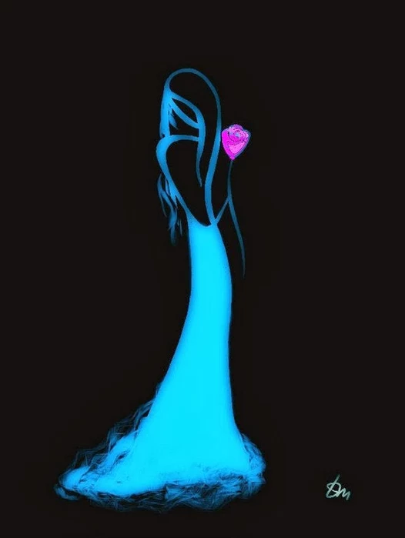
When God pushes you to the edge trust Him because only one of two things can happen. Either He will catch you when you fall or He will teach you how to fly.

Slide 5
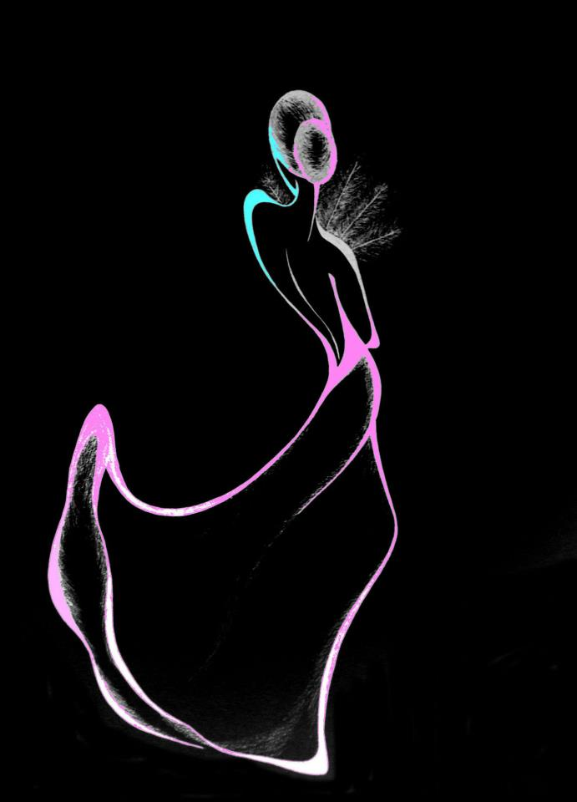
Don't waste a minute not being happy. If one window closes, run to the next window or break down the door.

Slide 6
Don't allow yourself to wake up with yesterday's issues troubling your mind. Refuse to live backwards, see everyday as a new chapter.

Slide 7
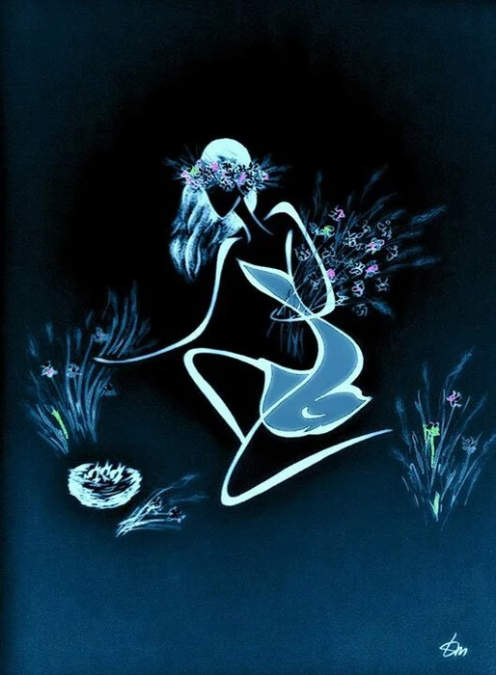
“Youth is happy because it has the capacity to see beauty. . Anyone who keeps the ability to see beauty never grows old.”
― Franz Kafka

Slide 8
Never tell your problems to anyone...
20% don't care and the other 80% are glad you have them.”
― Lou Holtz

Slide 9
Success is walking from
failure to failure
with no loss of enthusiasm.

Slide 10
"The future depends on what you do today." Mahatma Gandhi

Slide 11
The longer you live
in the past, the less future
You
have
to enjoy.

Slide 12
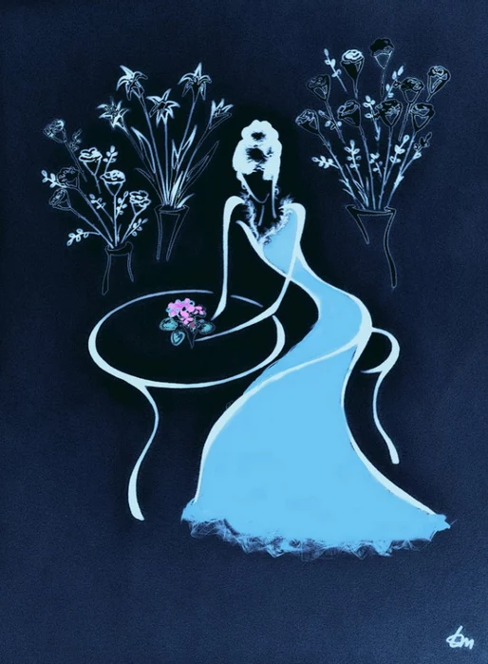
The positive thinker sees the invisible, feels the intangible and achieves the impossible.
– Winston Churchill

Slide 13
Nobody can go back and
start
a new beginning, but anyone can start today and make a new ending.
– Maria Robinson

Slide 14
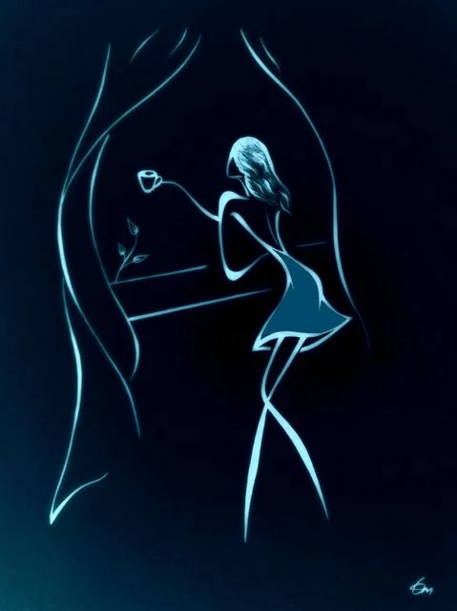
Don’t be the slave of a negative character. Be the master of a positive character.
– Dr T.P.Chia

Slide 15
“Luck is a dividend of sweat. The more you sweat, the luckier you get.”
– Ray Kroc

Slide 16
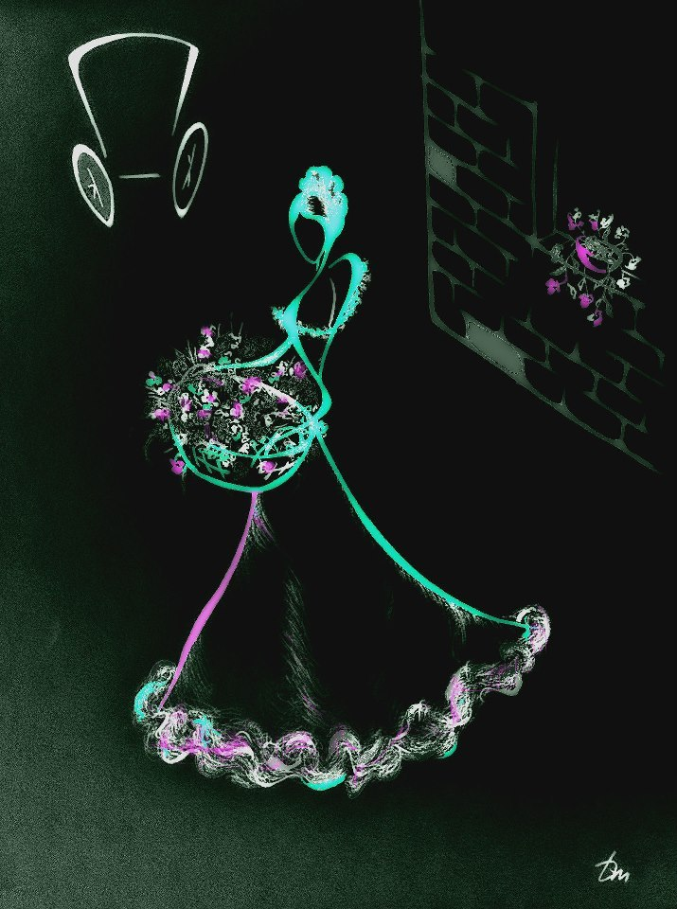
“The quickest way to double
your money
is to fold it over and
put it back
in your pocket.”
– Will Rogers

Slide 17
“We plant seeds that will flower as results in our lives, so best to remove the weeds of anger, avarice, envy and doubt...” Dorothy Day

Slide 18
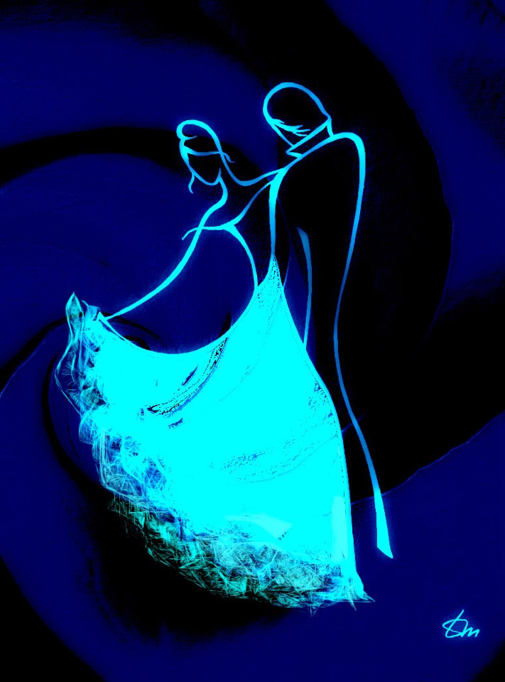
“Though no one can go back and make a brand new start, anyone can start from now and make a brand new ending.”
– Carl Bard

Slide 19
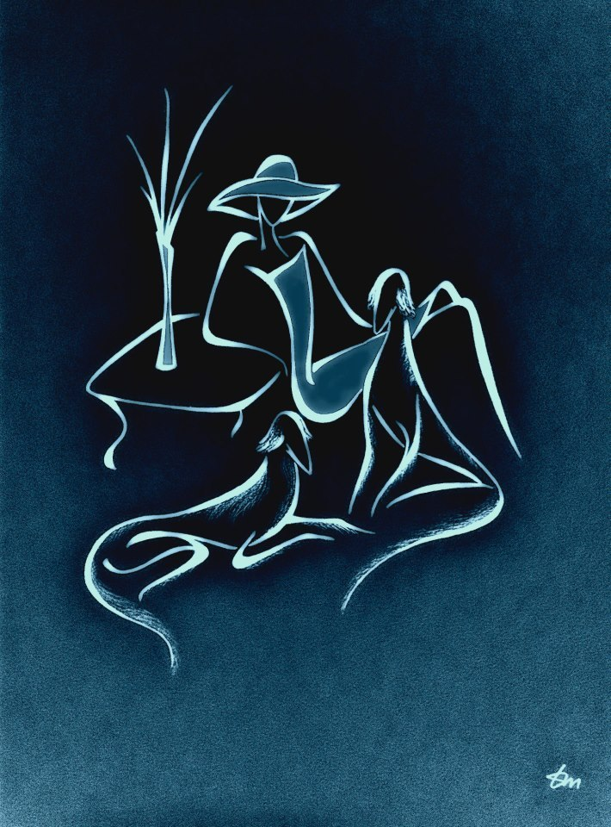
“The journey of a thousand miles begins
with one step.”
– Lao Tzu

Slide 20
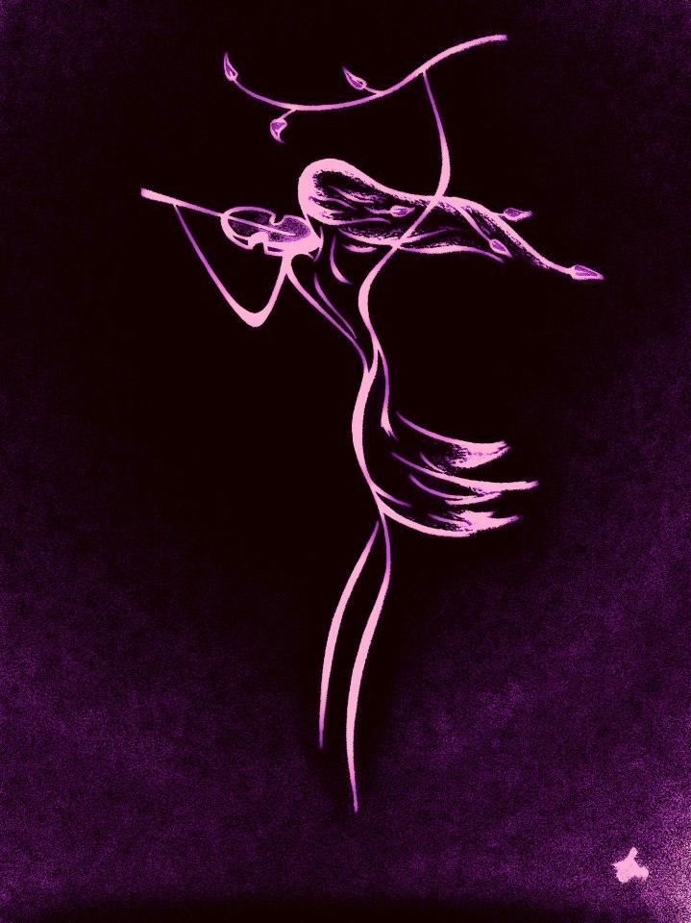
“The difference between a successful person and others is not lack of strength not a lack of knowledge but rather a lack of will.”
– Vince Lombardi

Slide 21
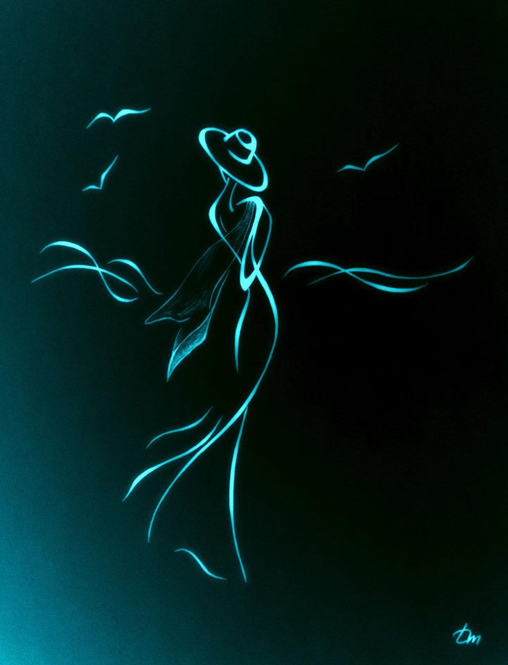
“Love and kindness are never wasted. They always make a difference. They bless the one who receives them, and they bless you, the giver.” Barbara De Angelis

Slide 22
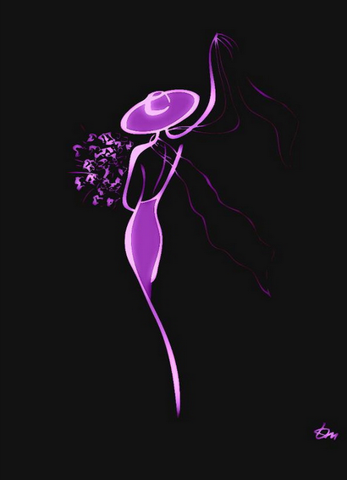
Cry. Forgive. Learn. Move on. Let your tears water the seeds of your future happiness.
– Steve Maraboli

Slide 23
Thank You
for Visiting the Gallery

Slide 24
Sources
http://ecx.images-amazon.com/images/I/51vVtKQNIWL._SX258_BO1,204,203,200_.jpg
https://s-media-cache-ak0.pinimg.com/564x/1d/7e/21/1d7e21755f74df7e6ea9f288289e6e30.jpg
https://elkedaginspiratie.files.wordpress.com/2012/03/smile.jpg
http://imageproxy.jxs.cz/~nd06/jxs/cz~/090/235/b7751fcc33_101593342_o2.jpg
http://imageproxy.jxs.cz/~nd06/jxs/cz~/809/293/889d699288_101593351_o2.jpg
http://imageproxy.jxs.cz/~nd06/jxs/cz~/659/243/44ff658082_101558295_o2.jpg
http://motivatequotes.com/wp-content/uploads/2013/12/1472071_10151889757309652_2092874037_n.jpg
https://s-media-cache-ak0.pinimg.com/736x/43/fa/88/43fa8843e7e3005bf4e7eac92231eb7e.jpg
http://www.coolnsmart.com/positive_quotes/page/6/
http://www.tuttartpitturasculturapoesiamusica.com/2013/03/Tatyana-Markovtsev.html

