Slide 1
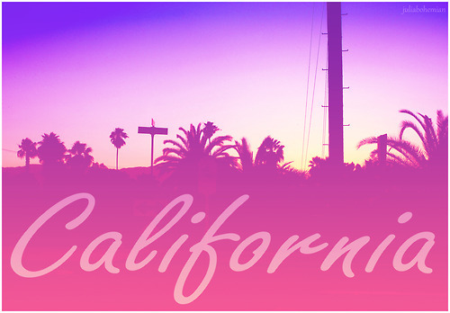
California
the Golden State
Interactive Poem Book
for 3-4 Formers
Автор:
Ольга Михайловна Степанова
учитель английского языка
МБОУ «Цивильская СОШ №1
имени Героя Советского Союза М.В. Силантьева»
города Цивильск Чувашской Республики
2016

Slide 2
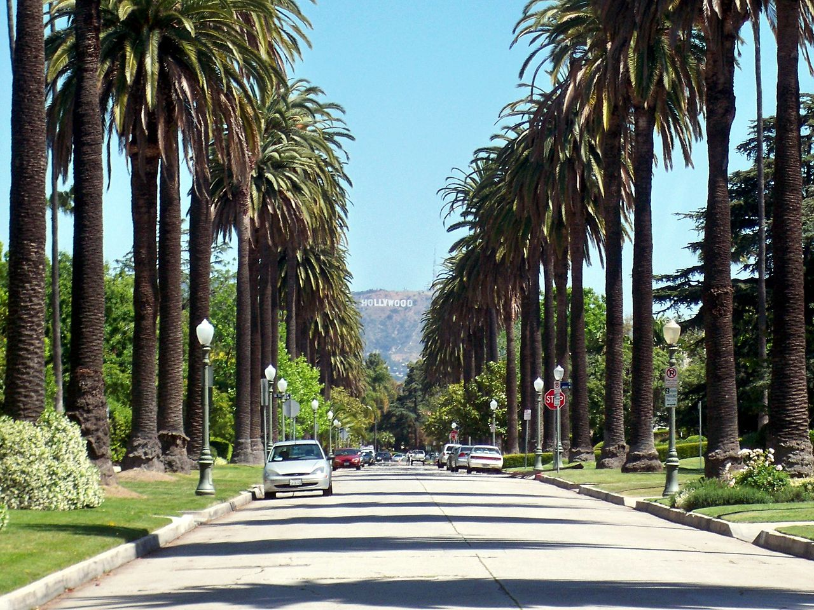
It is California that welcomes you,
One of the brightest states.
It really has a fantastic view!
It’s sometimes visited by Bill Gates…

Slide 3
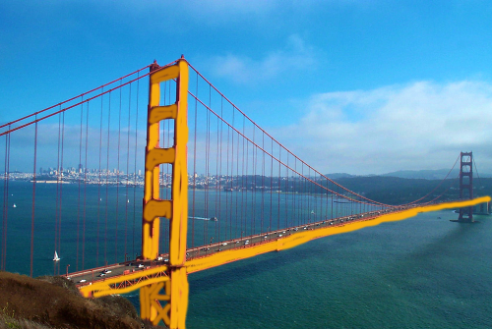
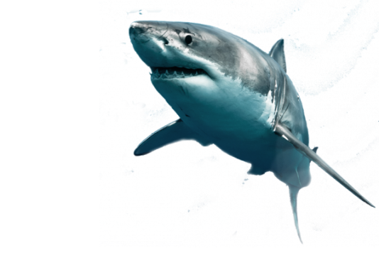
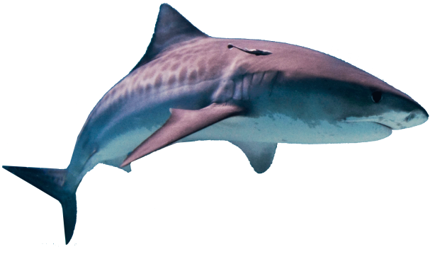
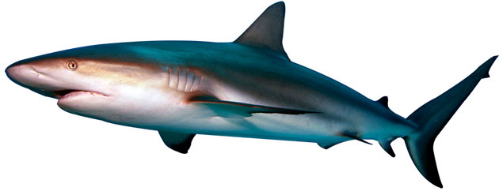
The state does offer a diverse landscape
including amusing national parks.
You’ll see its attractive Golden Gate!
But the beaches are here full of sharks!

Slide 4
You can enjoy the Yosemite Park
Where giant sequoias grow.
Then Hollywood! The USA’s landmark
Will greet you with its magnificent “Hallo”!

Slide 5
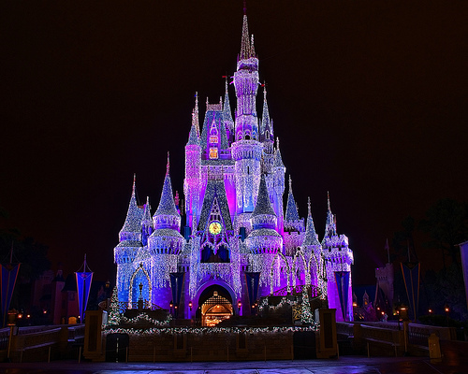
The USA are not the USA
Without its splendid Disneyland!
You’ll entertain here the whole day
Be sure it’s everyone’s dreamland!

Slide 6
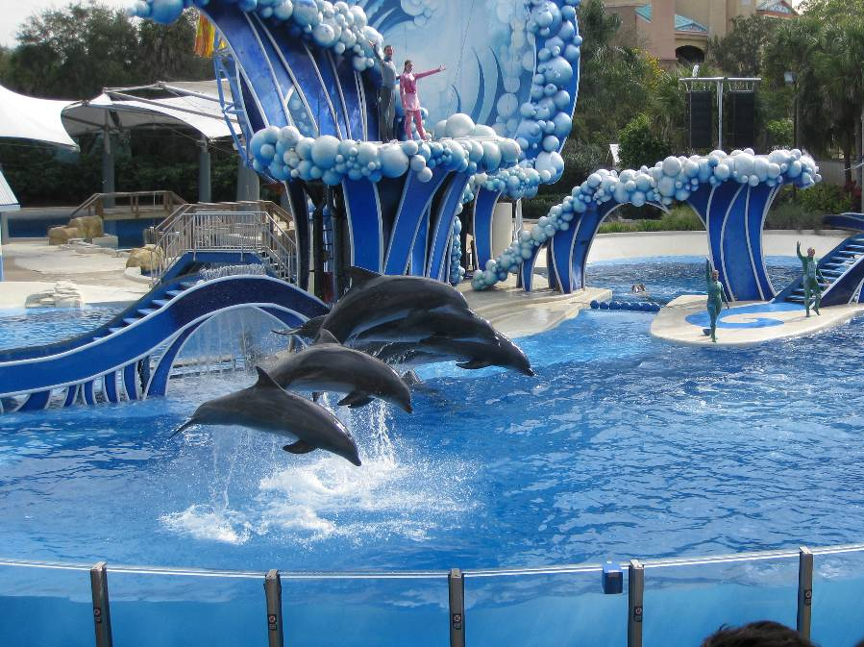
Angels Walk in Sacramento ,
The wonder of Sea World of San Diego,
Museums, Theatres and Venice beach…
Oh how is California rich!

Slide 7
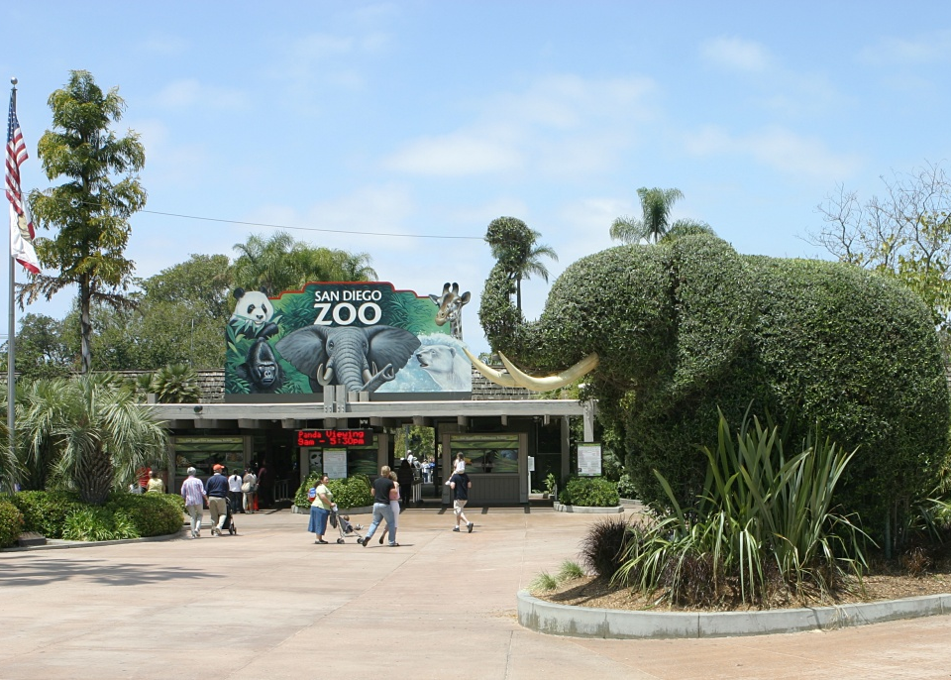
Find all the must-see California sights.
San Diego, for example, always invites
its guests to taste its unique see food.
By the way, it’s delicious and very good!

Slide 8
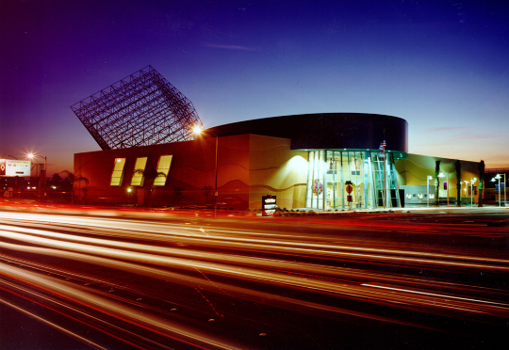
Experience here lots of adventure,
Do see Discovery Science Center .
It’s time to visit the Golden state.
California is extremely great!

Slide 9
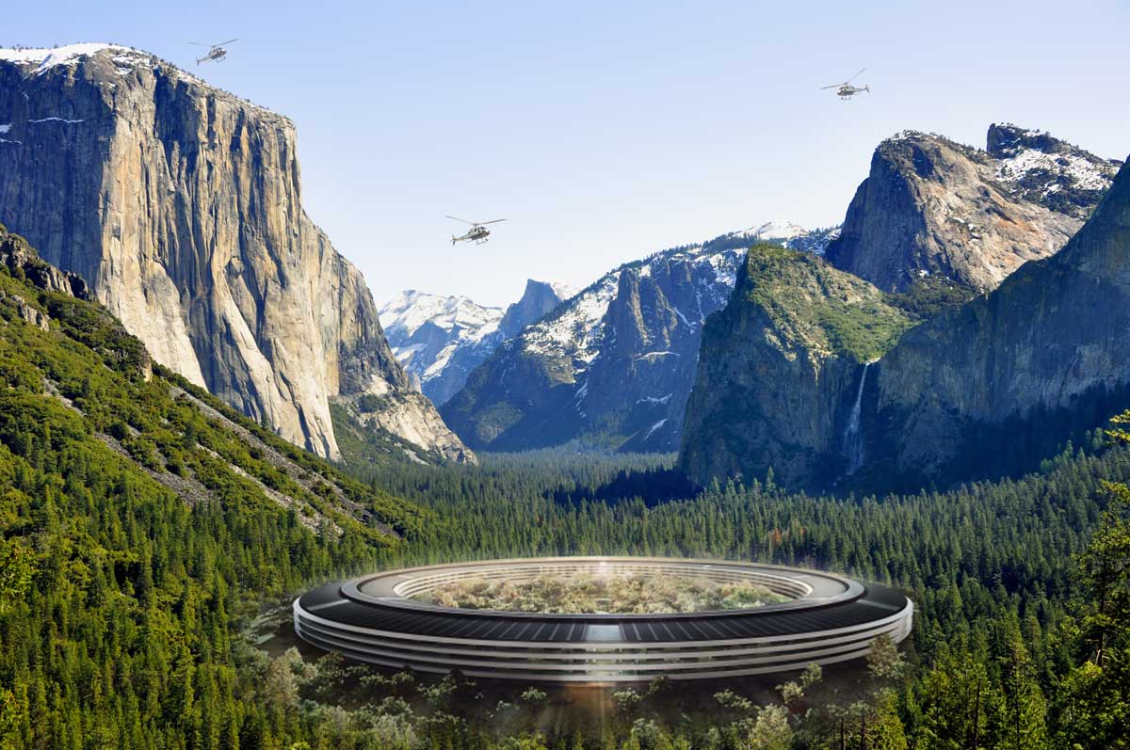
How did you like the Poem?
It’s really great,
isn’t it?
Yosemite Park

Slide 10
http://www.missionmission.org/wp-content/uploads/2012/04/GGB_Gold.jpg
https://fellowshipofminds.files.wordpress.com/2015/06/welcome-to-california-welfare-state.jpg
http://www.attractiontix.co.uk/images/photosGSD/disneyland-resort-california/disneyland-resort-california.jpg
http://www.taketours.com/images/destination/Sea-World-475416-1360356196-8.JPG
https://upload.wikimedia.org/wikipedia/commons/2/2e/San_Diego_Zoo_entrance_elephant.jpg
http://stopsharkfinningnow.com/images/reefshark.png
http://www.supremesharks.com/img/2.png
http://arquitectonica.com/wp-content/blogs.dir/1/files_mf/1.9516.5.1pil.jpg
http://www.planet-earth.ru/wp-content/uploads/disneyland_orlando17.jpg
http://scoopertino.com/wp-content/uploads/2014/07/yosemite_hotel.jpg

