Slide 1
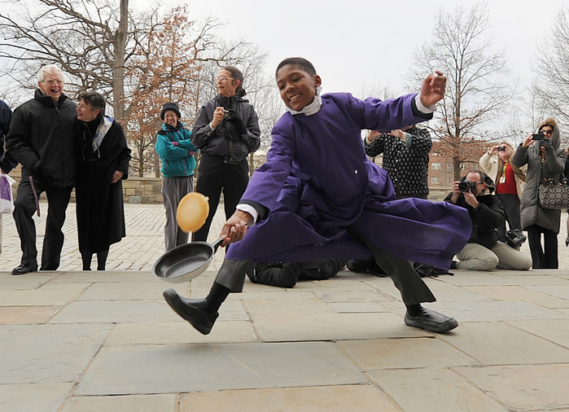
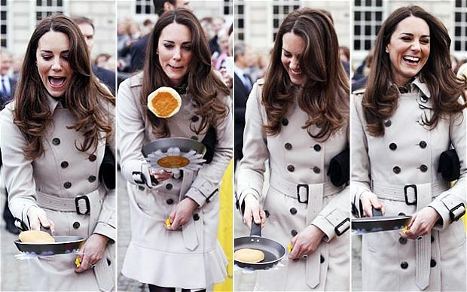
Pancake Day
in Great Britain and the USA
Шайдурова Валентина Федоровна
Учитель английского языка
ГБОУ «Школа №106»
Санкт-Петербург
2016

Slide 2
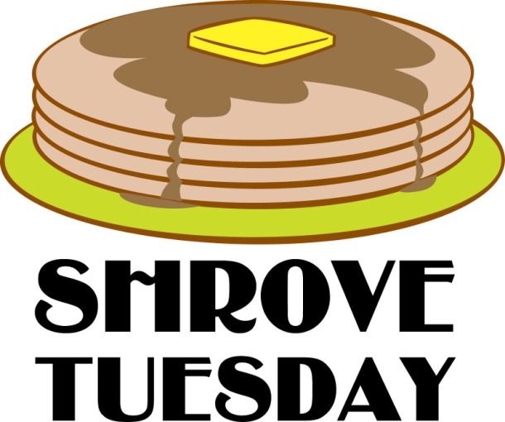
One fun occasion is Pancake Day in Great Britain, which takes place on Shrove Tuesday.
Shrove Tuesday is the day before the start of Lent.
The word “Shrove” comes from “shriving”, which means confessing your sins.
Originally, people went to church on this day to confess their sins before Lent.
The church bell would ring as a call for people to go shriving.

Slide 3
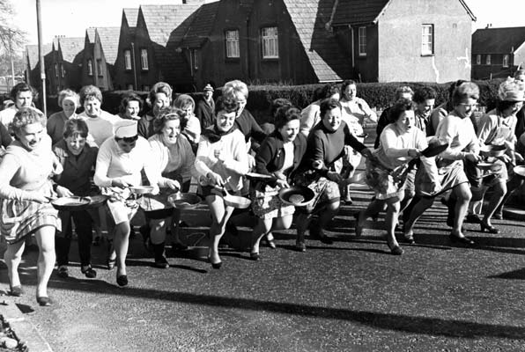
The idea of Pancake Day came next, its purpose was to use up the milk and eggs in the house before Lent, during which time they weren’t supposed to be eaten.

Slide 4
In one town in Britain called Olney, Pancake Races began.

Slide 5
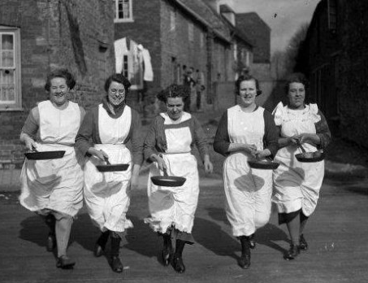
The legend is that these races started back in 1445.
A woman was making pancakes and she heard the bell to go to church to shrive.
She was in such a rush that she forgot to put down her frying pan.
She ran all the way to church with it!

Slide 6
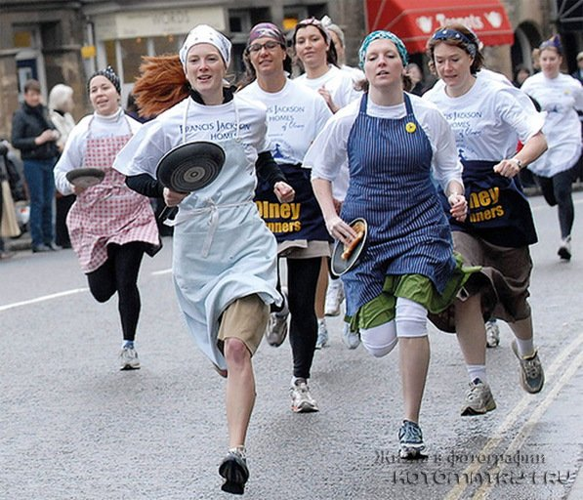
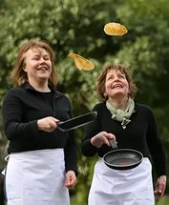
Now women of Olney follow the tradition that began way back then, and they race with a frying pan with a pancake in it.
One rule is that they have to flip the pancake at least three times during the race.

Slide 7
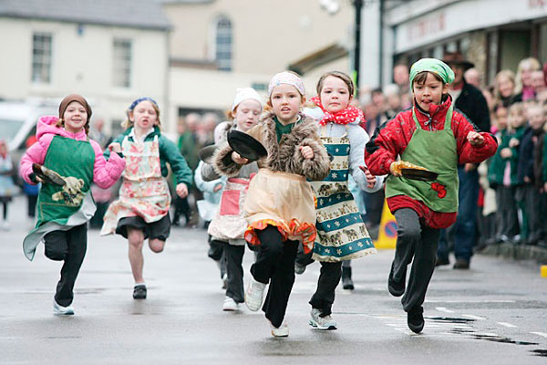
Today in some communities the church bells ring on Shrove Tuesday, not to remind the people to go to church to confess, rather, to remind them to make pancakes!

Slide 8
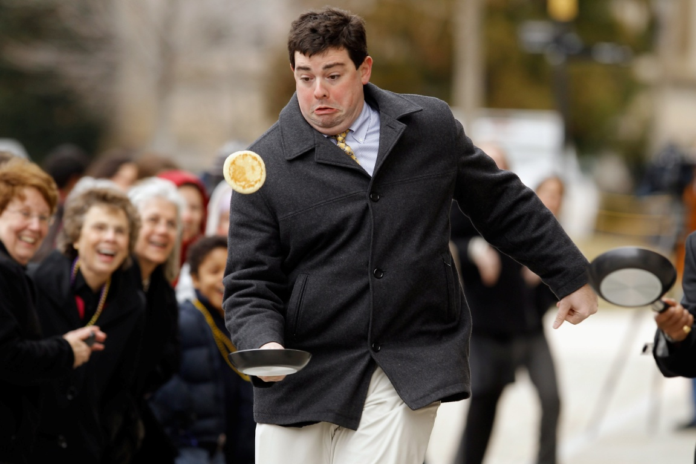
Pancake Day is also celebrated in the US, in the town of Liberal, Kansas.
Liberal was always known for being “flat as a pancake”.

Slide 9
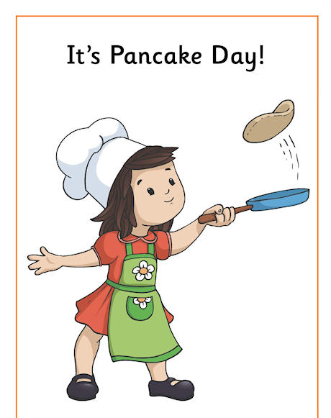
These days, the festivities have grown to a three day “Pancake Festival” in Liberal, including pancake eating and flipping competitions and many other activities.
(Liberal sounds like a fun place to live. It also hosts the annual “Oz Fest” on October 14 -15, as a tribute to Dorothy and her longing to return to Kansas in The Wizard of Oz.)

Slide 10
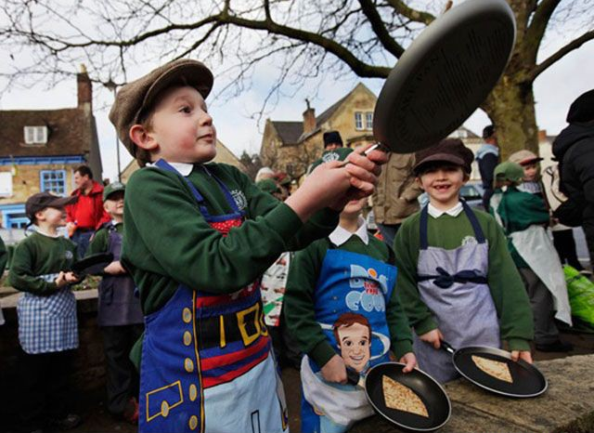
Happy Pancake Day!

Slide 11
Sources
http://www.mamalisa.com/blog/pancake-day-some-songs-rhymes-and-proverbs/
http://en.paperblog.com/two-tasty-pancake-recipes-for-pancake-day-get-flipping-816940
http://eatingappalachia.com/2009/02/24/international-pancake-day-aloha-cakes/
https://starttobehealthynow.wordpress.com/2013/02/12/international-pancake-day/

