Slide 1
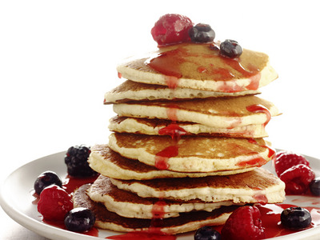
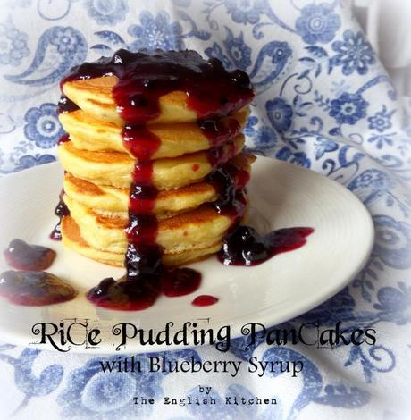
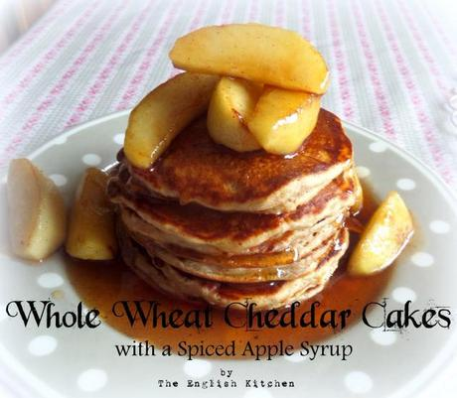
Nursery rhymes,
songs
proverbs
for Pancake Day
Шайдурова Валентина Федоровна
Учитель английского языка
ГБОУ «Школа №106»
Санкт-Петербург
2016

Slide 2
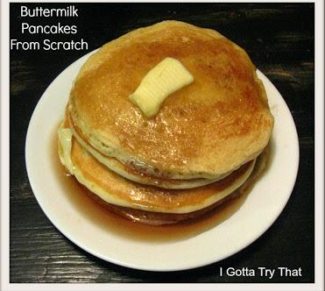
International Pancake Day

Slide 3
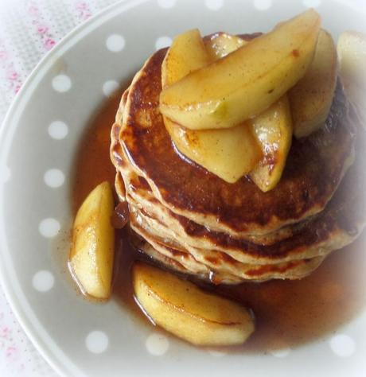
Here are some songs for Pancake Day…
Pancake Day is a very happy day, If we don’t have a holiday we’ll all run away, Where shall we run, up High Lane, And here comes the teacher with a great big cane!

Slide 4
But hark, I hear the pancake bell, And fritters make a gallant smell.
The cooks are baking, frying, boiling, Stewing, mincing, cutting, broiling, Carving, gourmandizing, roasting, Carbonading, cracking, slashing, toasting.

Slide 5
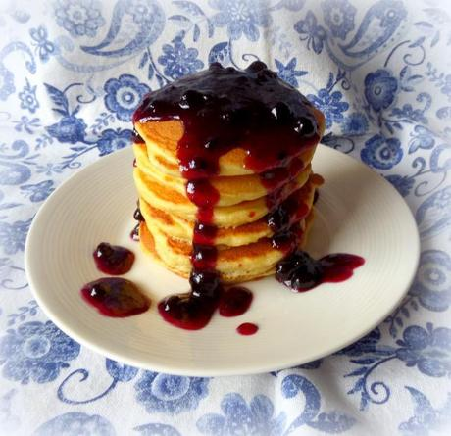
Here are some nursery rhymes
for Pancake Day…
Toss the pancakes, toss the pancakes, Turn the pancakes over! *** Pancake Day, Pancake Day, Don’t let the pancakes frizzle away!

Slide 6
Watch us put them quickly in the pan now, Toss them up and catch it if you can now.
*** Tippety, tippety tin, Give me a pancake and I will come in. Tippety, tippety toe, Give me a pancake and I will go.

Slide 7
Nicky, nicky, nan, Give me a pancake and then I’ll be gone. But if you give me none, I’ll throw a great stone And down your door shall come.

Slide 8
Here are some proverbs for Shrovetide
(the week of merriment before Lent)
and Shrove Tuesday…
Fit as a pancake for Shrove Tuesday. *** If it thunder upon Shrove Tuesday It fortelleth winde, store of fruit, and plenty.

Slide 9
Rejoice Shrovetide today, For tomorrow you’ll be ashes.
(This one is an echo of what the priest says on Ash Wednesday, the first day of Lent, while he makes a cross on the persons forehead in ashes,
“Remember man, for dust thou art, and to dust thou shall return.”) *** So much as the sun shineth on Pancake Tuesday, The like will shine every day in Lent. ***

Slide 10
Here’s another song about pancakes.
This one’s by Christina Rossetti
(1830 -1894)
Pancake Song Mix a pancake, Stir a pancake, Pop it in the pan; Fry the pancake, Toss the pancake, Catch it if you can

Slide 11
Happy Pancake Day!

Slide 12
Sources
http://www.mamalisa.com/blog/pancake-day-some-songs-rhymes-and-proverbs/
http://en.paperblog.com/two-tasty-pancake-recipes-for-pancake-day-get-flipping-816940
http://eatingappalachia.com/2009/02/24/international-pancake-day-aloha-cakes/
https://starttobehealthynow.wordpress.com/2013/02/12/international-pancake-day/

