Slide 1
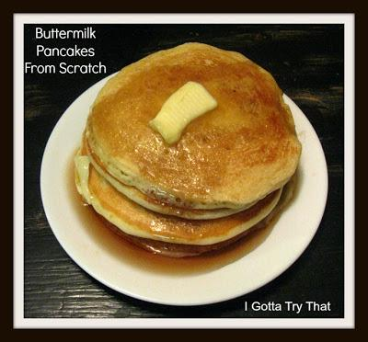
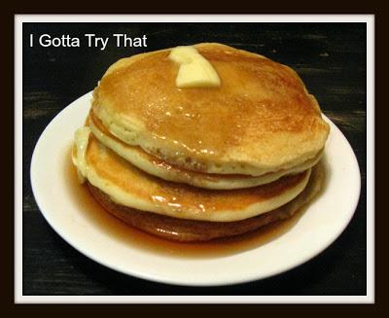
Yummy buttermilk pancakes
for Pancake Day
Шайдурова Валентина Федоровна
Учитель английского языка
ГБОУ «Школа №106»
Санкт-Петербург
2016

Slide 2
That's right, it's International Pancake Day.
Will you be hitting IHOP or making your own? Here is a yummy buttermilk
(with coconut oil) recipe to try.

Slide 3
Ingredients
2 cups flour
2 tablespoons sugar
2 teaspoons baking powder
1 teaspoon baking soda
1/2 teaspoon salt
2 cups buttermilk
2 large eggs
1/4 cup vegetable oil
1 TBS coconut oil softened (optional)
2 tsp pure vanilla extract

Slide 4
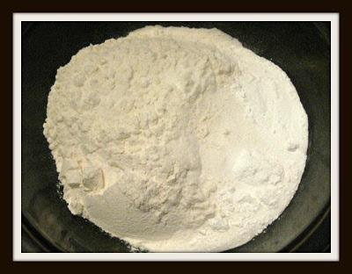
Mix dry ingredients together in bowl.

Slide 5
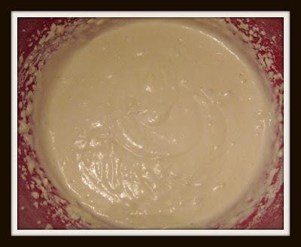
Add wet ingredients to a separate bowl and stir just until blended. Add the wet and dry ingredients together. Do not over mix, batter will be slightly lumpy

Slide 6
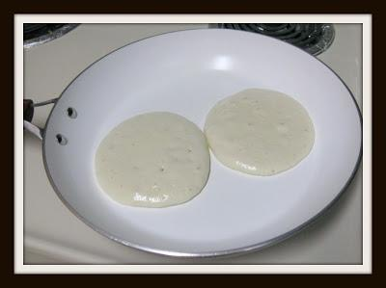
Heat frying pan or skillet to medium low.
Spray pan with Pam if it is not a nonstick pan.
Drop 1/4 cup of batter onto heated skillet.
Cook on first side until bubbles begin to form and underside is golden, about 2 minutes.
Flip.

Slide 7
Add your favorite syrup or jam and enjoy!

Slide 8
Sources
http://www.mamalisa.com/blog/pancake-day-some-songs-rhymes-and-proverbs/
http://en.paperblog.com/two-tasty-pancake-recipes-for-pancake-day-get-flipping-816940
http://eatingappalachia.com/2009/02/24/international-pancake-day-aloha-cakes/
https://starttobehealthynow.wordpress.com/2013/02/12/international-pancake-day/

