Slide 1
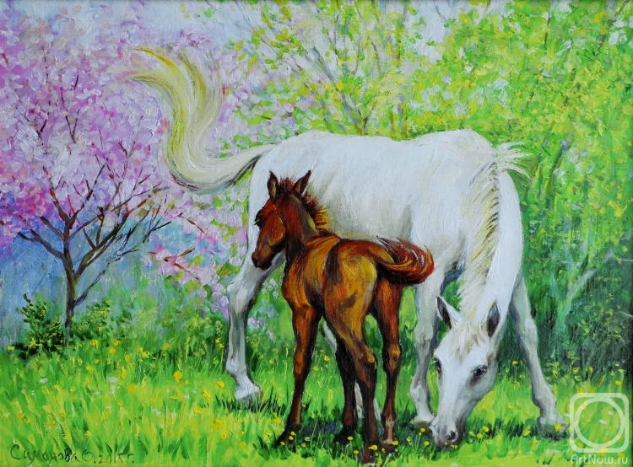
Touching
the Tenderness
Picture Gallery
by
Olga Simonova
for
8 - 11 Formers
Автор:
Ольга Михайловна Степанова
учитель английского языка
МБОУ «Цивильская СОШ №1
имени Героя Советского Союза
М.В. Силантьева»
города Цивильск Чувашской Республики
2016

Slide 2
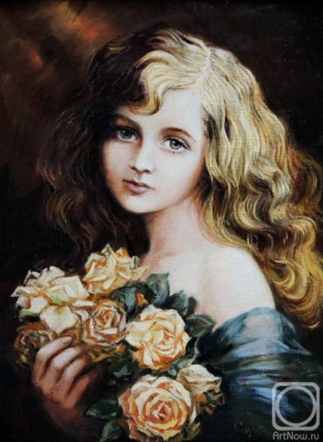
Picture in retro style. It is executed according to the old photo, perhaps the beginnings of the 20th eyelid. The girl holds tea roses in hand. Beautiful gold hair, pure thoughtful look. The picture is issued in a beautiful baguette. Can become a good gift, will decorate any interior.

Slide 3
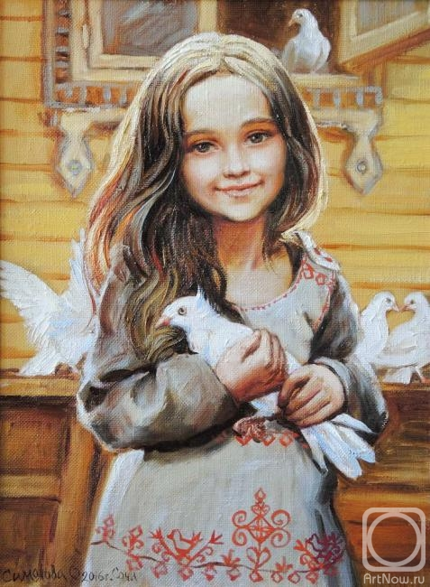
The lovely girl on a dovecot. Holds in hand thoroughbred white to a pigeon. Warm, solar, kind picture. Will become a good gift, will decorate the nursery, will teach good and love of your children. It is issued in a wooden frame.

Slide 4
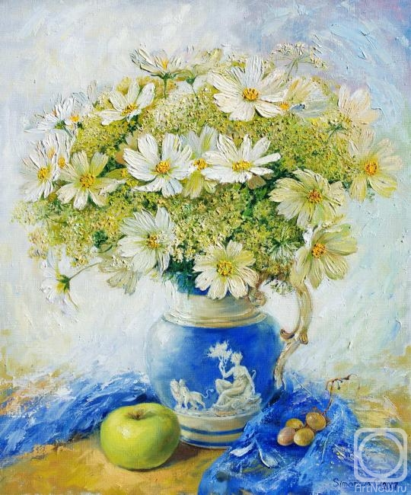
The still life with white cosmics in a blue jug with
a green apple
nearby.

Slide 5
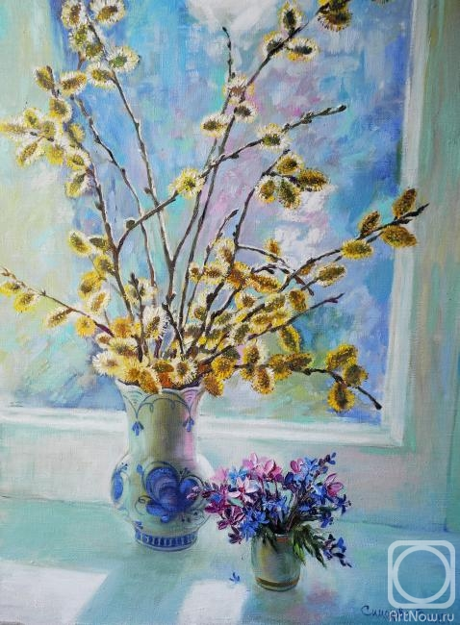
Gentle spring still life. A willow at a window in a modest Gzhel vase. A bouquet of forest florets is nearby. The picture can become a fine gift to a woman or a girl. Will create mood in an interior.

Slide 6
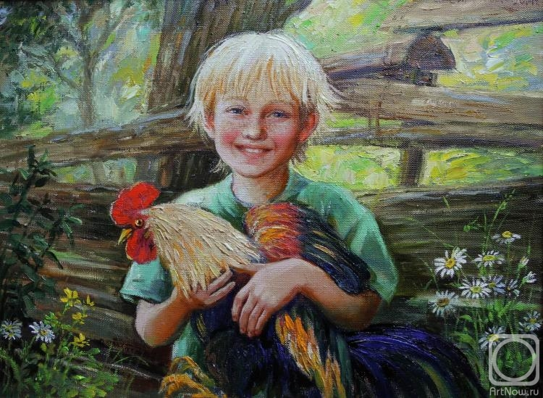
The boy holds a big rooster in his hands. Summer, village, happy children's smile. The picture will present good mood, will remind of summer, of giving, of the carefree childhood. It is issued in a wooden frame. Can become a good gift, will decorate any interior.

Slide 7
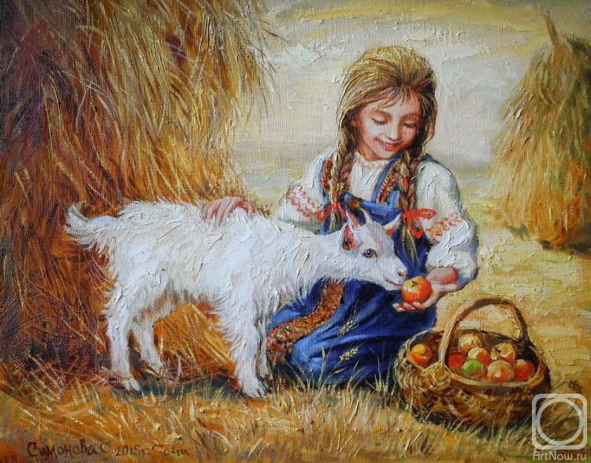
Early autumn… Already cleaned wheat fields. The girl feeds apples a little white nanny-goat. Warm touching picture.
Can
become
a sincere
gift,
will
decorate
any inferior.
interior.

Slide 8
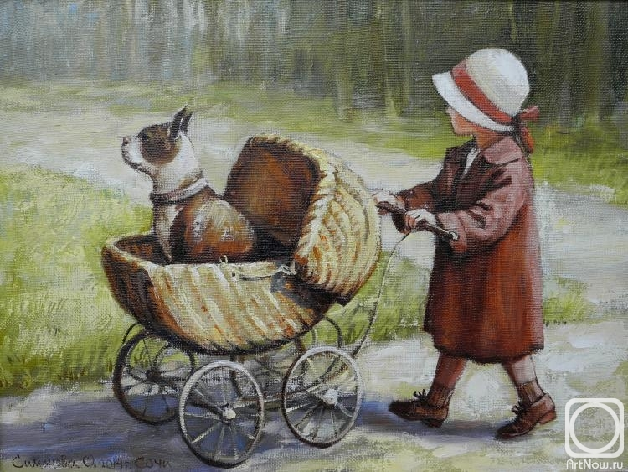
The little girl pushing a carriage of a bulldog. The picture is executed on a photo of 1940. Can become a good gift, decorate a nursery. It is issued in a wooden frame.

Slide 9
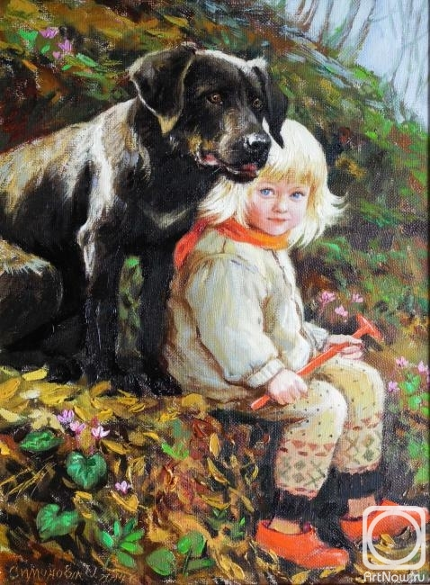
Portrait of the daughter. The little girl with a big black dog sitting on a prigorochka in the wood. The early spring. Leaves on trees didn't appear yet. But among the fallen-down foliage forest cyclamens already blossomed.

Slide 10
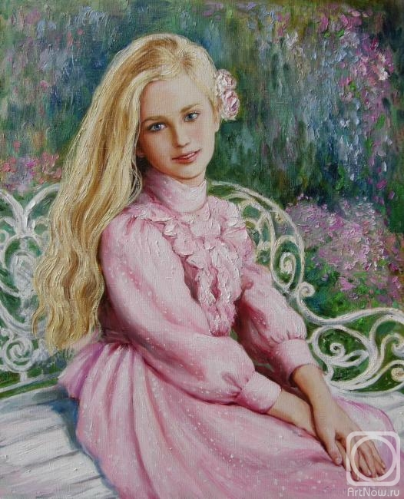
The girl the blonde in
a pink dress
sitting in a garden on a bench

Slide 11
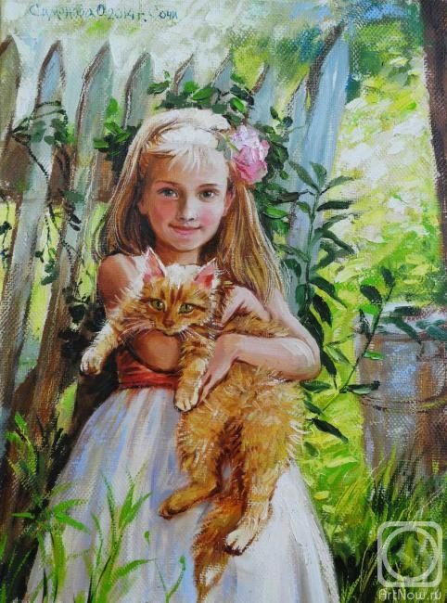
The girl holds a fluffy red cat in her hands. Summer, sun… The picture will create good mood, will decorate a nursery, becomes a good gift. It is issued in a wooden frame

Slide 12
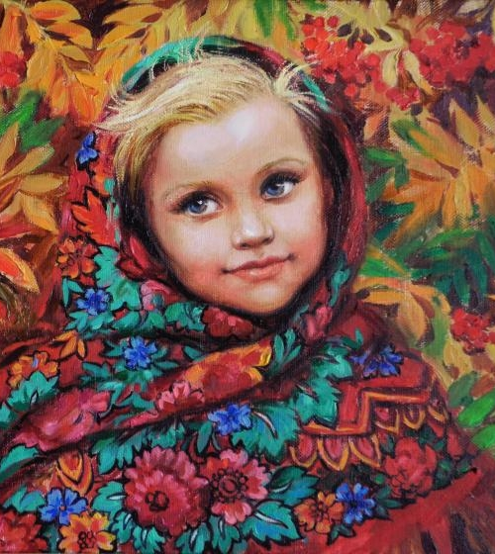
The Russian girl in the Pavlovo-posadsky scarf against a ripe mountain ash.
The picture in the Russian style, is issued in a wooden frame with beautiful texture. Can become a fine
gift, will decorate an interior in
rural style.

Slide 13
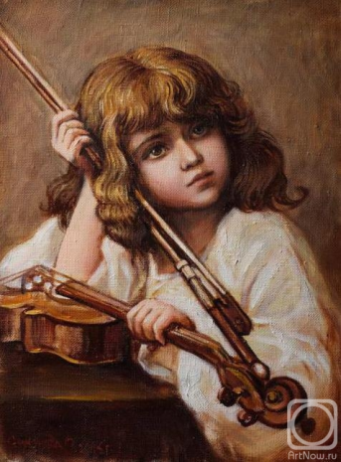
The picture "Violinist" is executed according to the old photo, perhaps the beginnings of the 20th eyelid. A girl, looks somewhere afar, dreaming of something special or being under impression of music… Spiritual features, clean, deep eyes… The picture can become a good gift, will decorate any interior. It is issued in a beautiful baguette.

Slide 14
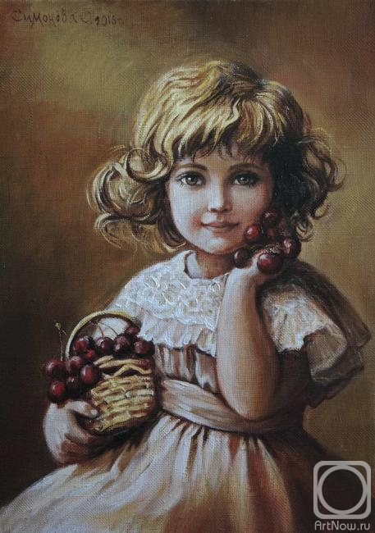
The picture is painted
from the ancient photo, perhaps the beginnings of the last century. The pretty girl holds in hand a small basket with ripe cherries. Presses her cheek with the other hand. Curly hair, a lacy dress, reserved, brown color of a picture, a beautiful modelled baguette in tone. Can become a sincere gift to fans of pictures in retro style, will decorate any interior. It is perfectly combined with a picture "Violinist".

Slide 15
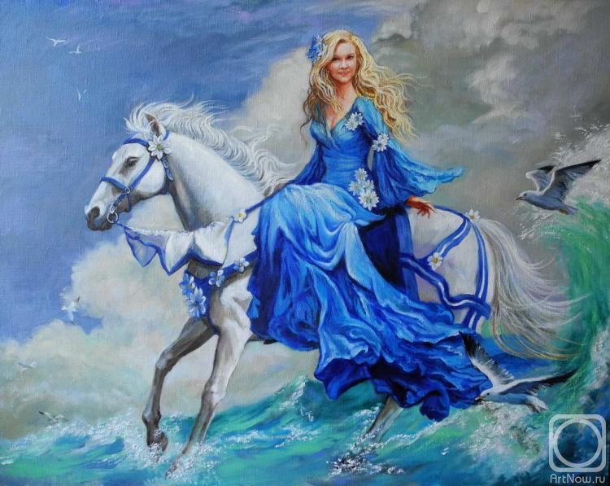
Custom-made portrait. The girl in a long blue
dress is
happily
sitting
on the
magnificent
white horse skipping
on waves. Clouds, seagulls and waves emphasize romantic nature of the heroine.

Slide 16
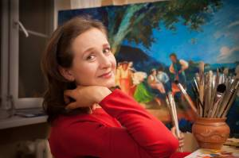
Olga Simonova,
the author of the paintings, was born in 1967.
She has participated in exhibitions since 1988.
Her paintings are in private collections in the USA, Japan, Sweden, Turkey, Poland.
Favorite genres - Portrait , Still life.
Country: Russia City: Sochi

Slide 17
Source
http://artnow.ru/en/gallery/3/31182/picture/0/717155.html

