Slide 1
Traveling
into the Stars
Zodiac Signs Review
for 8 - 11 Formers
Автор:
Ольга Михайловна Степанова
учитель английского языка
МБОУ «Цивильская СОШ №1
имени Героя Советского Союза М.В. Силантьева»
города Цивильск Чувашской Республики
2016

Slide 2
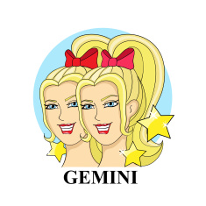
Connectedness
Sharing
Understanding
Psychic
Telepathic Bonds
Affinity
Geminis are the butterflies of the Zodiac. They have a beautiful light personality. You never know what side of Gemini you are going to see in a Day. These people will always keep you guessing.

Slide 3
Trust
Emotion
Protection
Loyalty
Open
Responsivity
Cancers are reserved at first because of their sensitive souls, but once you get to know these people
it is a real treat.

Slide 4
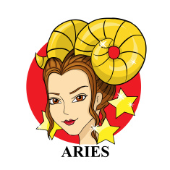
Impatience
Force
Energy
Adventure
Protection
Impulsiveness
Courage
Aries are the first fire sign in the Zodiac. They are head strong, somewhat selfish, but always very giving. They definitely have a fiery personality!

Slide 5
Knowledge
Progress
Dreams
Mind
Communication
Beauty
Aquarius is the unconventional sign of the Zodiac. They love doing things their own way, they are definitely not sheep. They are random and yet totally brilliant, and they love to shock people.

Slide 6
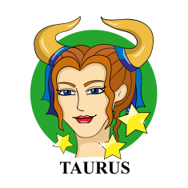
Stability
Strength
Provision
Confidence
Fertility
Helpfulness
Determination
Taurus' patience always impresses you. They have calm and mellow souls that take action
when the time is just right.

Slide 7
Control
Passion
Treachery
Protection
Defensiveness
Alone
Scorpios are the detectives of the Zodiac. You can't hide much from their penetrating eyes. They love to know everything, but do not reveal secrets about themselves in fear of vulnerability. Knowledge is power.

Slide 8
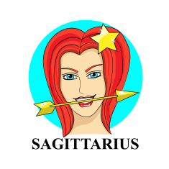
Independenсe
Optimism
Cheer
Freedom
Humor
Honesty
Intellect
Sagittarius are the travelers of the Zodiac. These free spirited and outspoken people are always ready for whatever is next.
They love a good time.

Slide 9
Fertility
Eternity
Creativity
Femininity
Good luck
Happiness
Knowledge
Pisces are the dreamers of the Zodiac. They are constantly going off into their own dream worlds away from reality. These people make some of the best entrepreneurs.

Slide 10
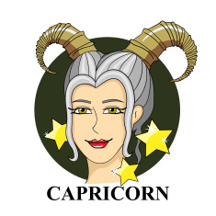
Peace&Respect
Dignity&Curiosity
Sacrifice
Exploration
Initiation
Intelligence
Independence
Capricorns are the climbers of the Zodiac. They are always pushing themselves to knew heights. They work hard to get where they want to be whether it be socially or career wise.

Slide 11
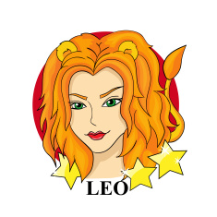
Wisdom
Power
Dignity
Courage
Justice
Ferocity
Authority
The royal Leo, Queen of the Zodiac is warm hearted and loved by all. Leos have a golden sparkling aura
that is hard to miss. You know
when a Leo walks into a room!

Slide 12
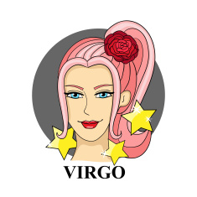
Power
Force
Drive
Energy
Virility
Protection
Fearlessness
Kind hearted Virgoans are always making sure everything is perfect. When they let loose its a real surprise, but you can always count on these people to stay in line.

Slide 13
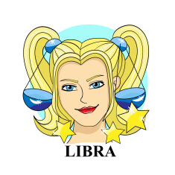
Harmony
Beauty
Balance
Justice
Equanimity
Stability
Libras are some of the most beautiful people in the Zodiac. They are a perfect balance between hard and soft. That is why this quote is so perfect; she's an absolute lady but watch out for her bite.

Slide 14
The End

Slide 15
Source
http://www.simplysunsigns.com/2013/11/quotes-for-your-sun-sign.html
http://www.whats-your-sign.com/zodiac-symbols-for-aquarius.html

