Slide 1
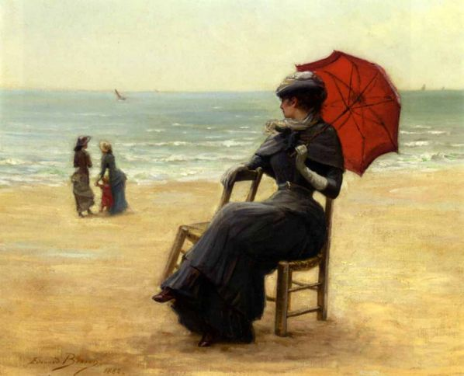
Beauty
that
inspires…
Picture Gallery for 9-11 Formers
Автор:
Ольга Михайловна Степанова
учитель английского языка
МБОУ «Цивильская СОШ №1
имени Героя Советского Союза
М.В. Силантьева»
города Цивильск Чувашской Республики
2016

Slide 2
Welcome to
Edouard Bisson’s
Picture Gallery
1856 – 1939
France

Slide 3
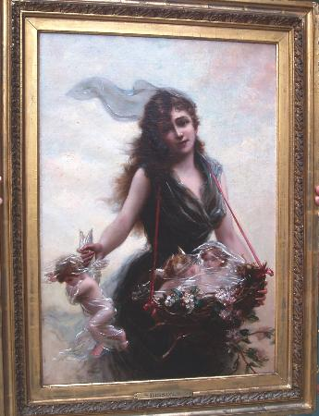
Born in Paris in 1856, Bisson studied art under one of the most successful of French artists, Jean Leon Gerome.

Slide 4
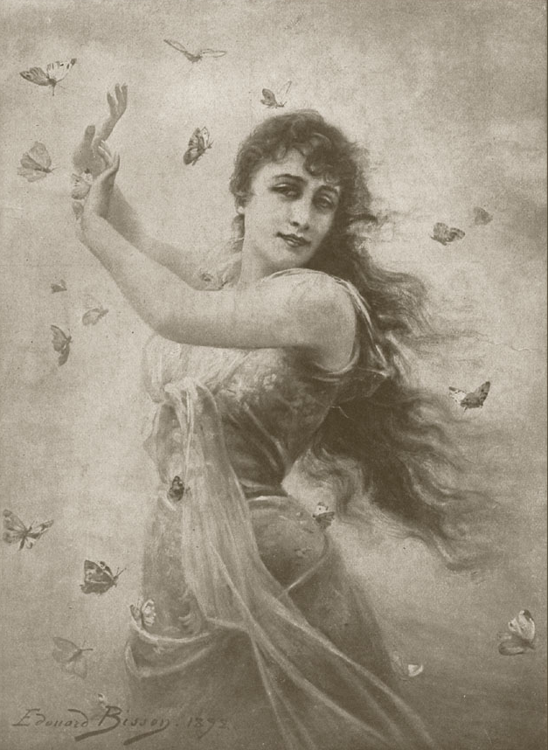
He
exhibited regularly at the Salon of French Artists of which
he
was
a member.

Slide 5
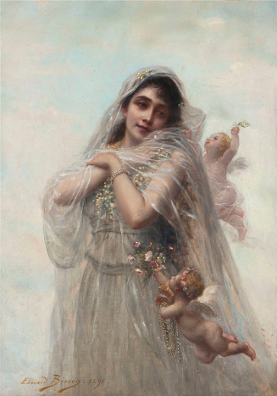
He was awarded Honorable Mentions in 1881 and 1889, a Third Class Medal in 1897, and a Bronze Medal at the Universal Exposition in Paris in 1900.

Slide 6
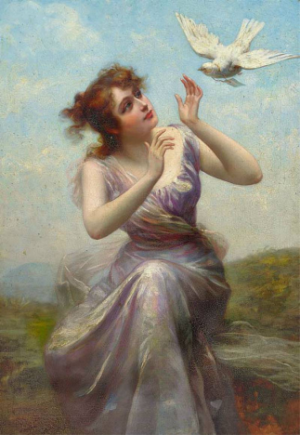
In 1908
he
was
made
a Knight
of the Legion of Honor.

Slide 7
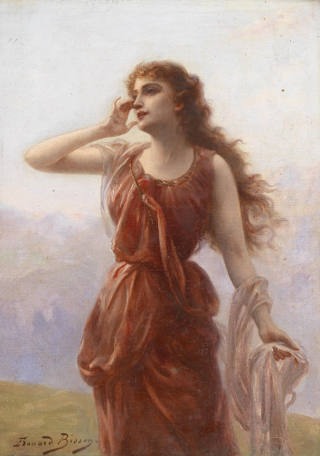
Fanciful ideas and flowing line characterize Bisson's studies of graceful feminine types.

Slide 8
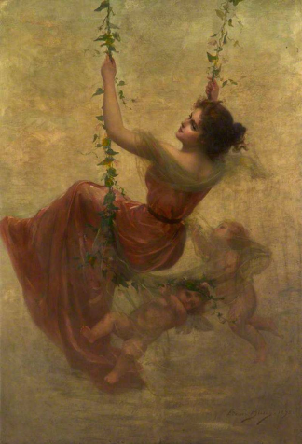
Distinguished by a certain charm, they agree with Delacroix that "the first quality in a picture is to be a delight for the eyes."

Slide 9
Pictures
Full of
Lady’s Beauty,
Tenderness,
Purity…

Slide 10
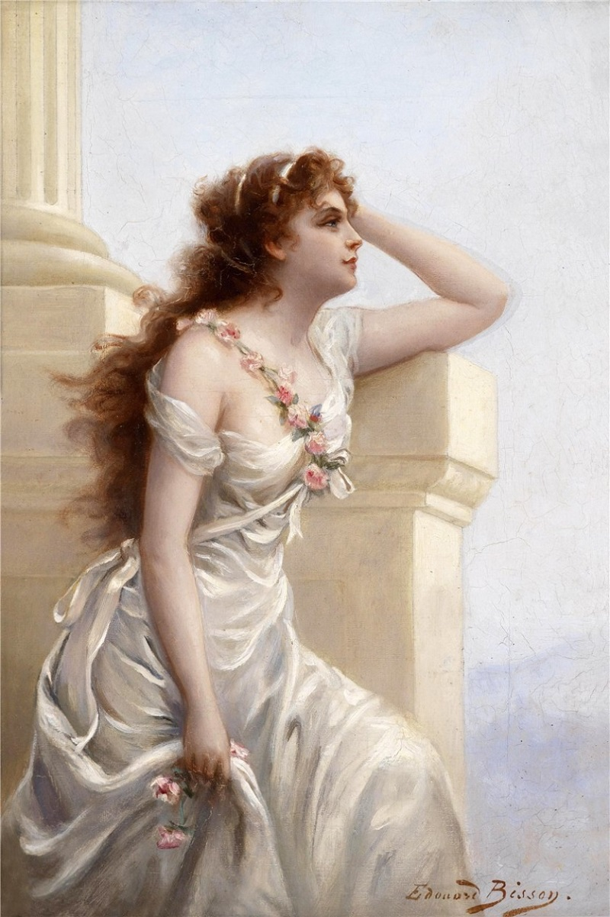
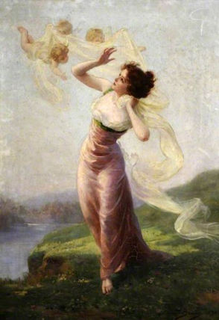

Slide 11
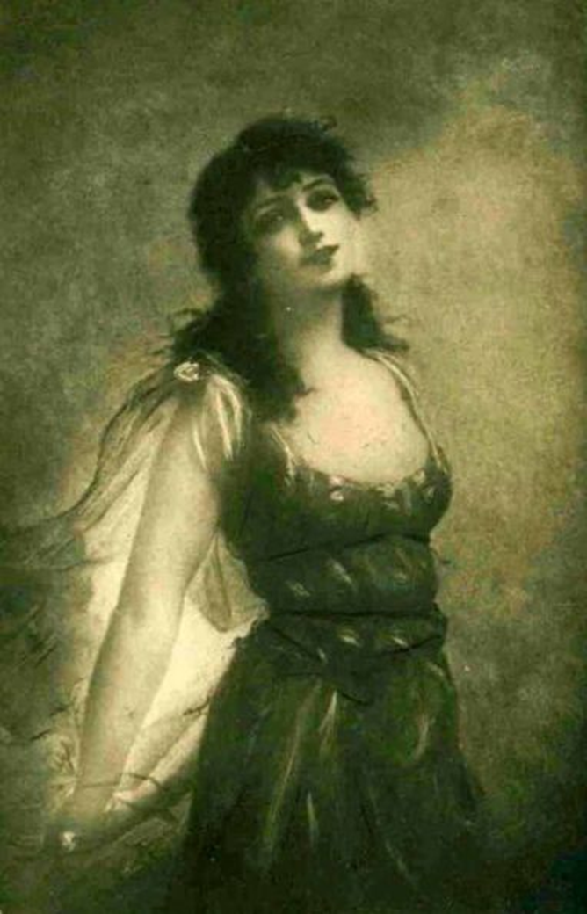
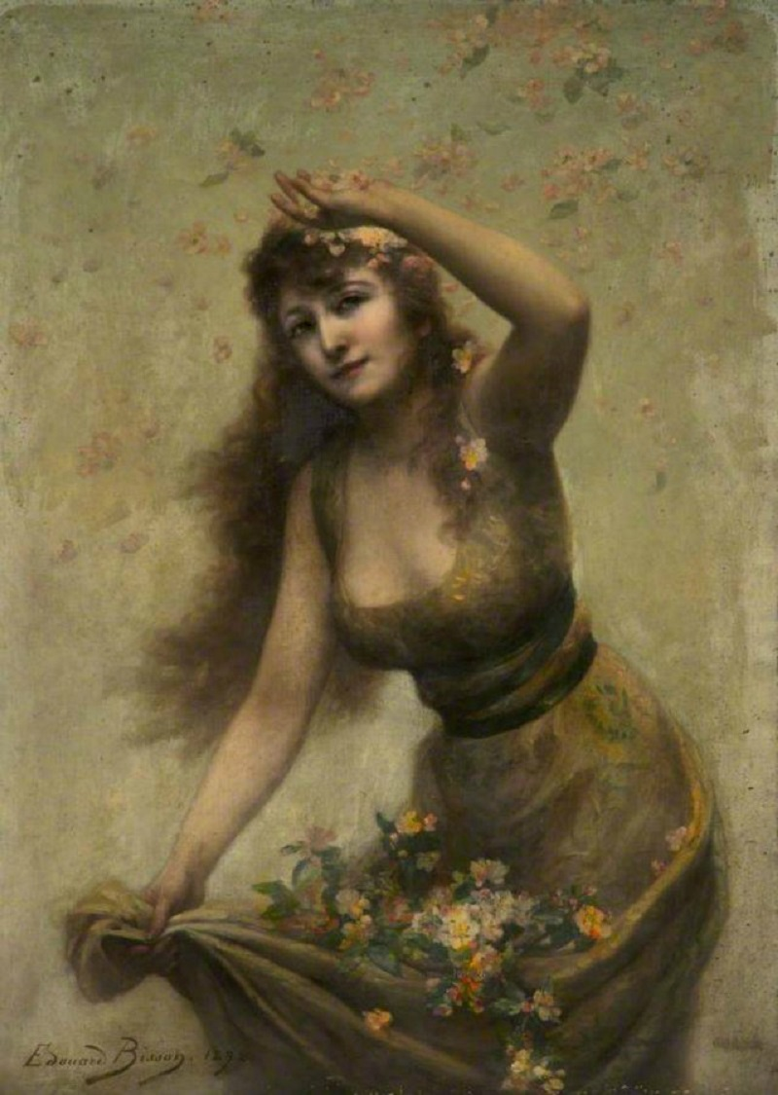

Slide 12
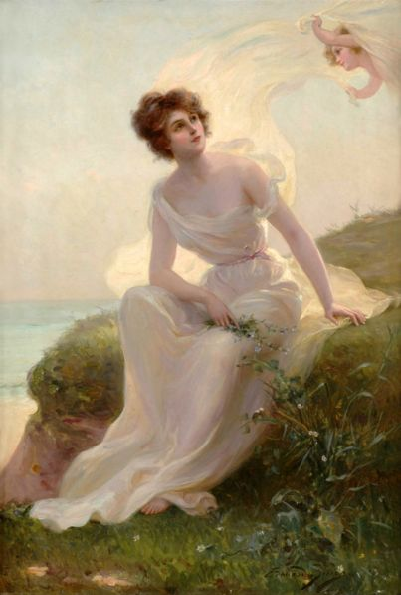
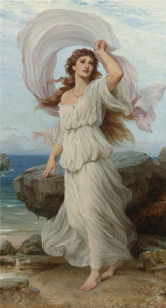

Slide 13
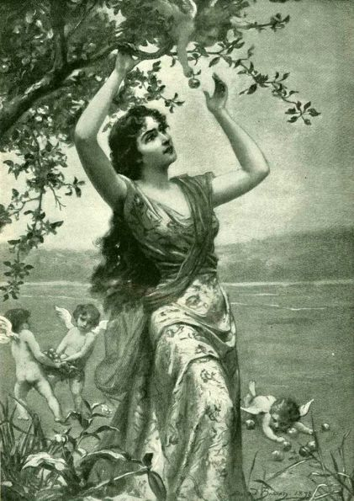
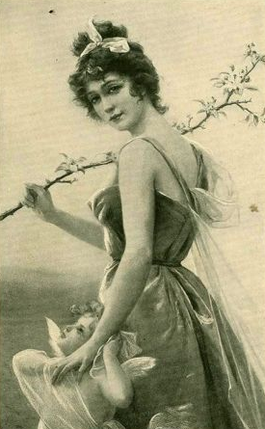

Slide 14
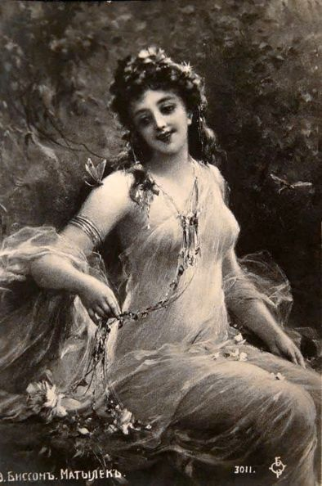

Slide 15
Edouard Bisson
1856 – 1939
France

Slide 16
http://www.iment.com/maida/family/mother/vicars/edouardbisson.htm
http://maherartgallery.blogspot.se/2012/10/bisson-edouard.html

